Slide 2


DARPT: Defense Against Remote Physical Attack Based on TDC in Multi-tenant Scenario
Fan Zhang^{1,2}, Zhiyong Wang^{1,2,3}, Haoting Shen^{1,}*, Bolin Yang^{1,2}, Qianmei Wu¹ and Kui Ren¹
¹ School of Cyber Science and Technology, College of Computer Science and Technology, Zhejiang University
² Alibaba-Zhejiang University Joint Research Institute of Frontier Technologies
³ Key Laboratory of Blockchain and Cyberspace Governance of Zhejiang Province
* Corresponding authors: Haoting Shen (Email: htshen@zju.edu.cn)
This work is partly supported by Alibaba-Zhejiang University Joint Institute of Frontier Technologies.

Slide 3

Fan (Terry) Zhang
Professor
School of Cyberscience and Technology
College of Computer Science and Technology
Zhejiang University, China
Research:
Hardware Security
AI Security
Network Security
https://person.zju.edu.cn/en/fanzhang

Slide 4

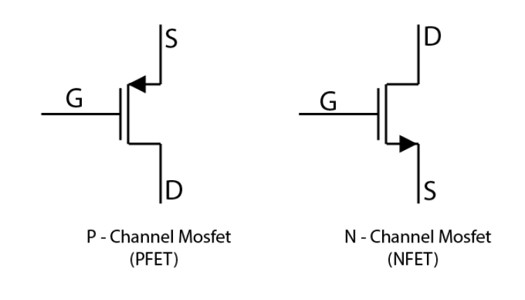

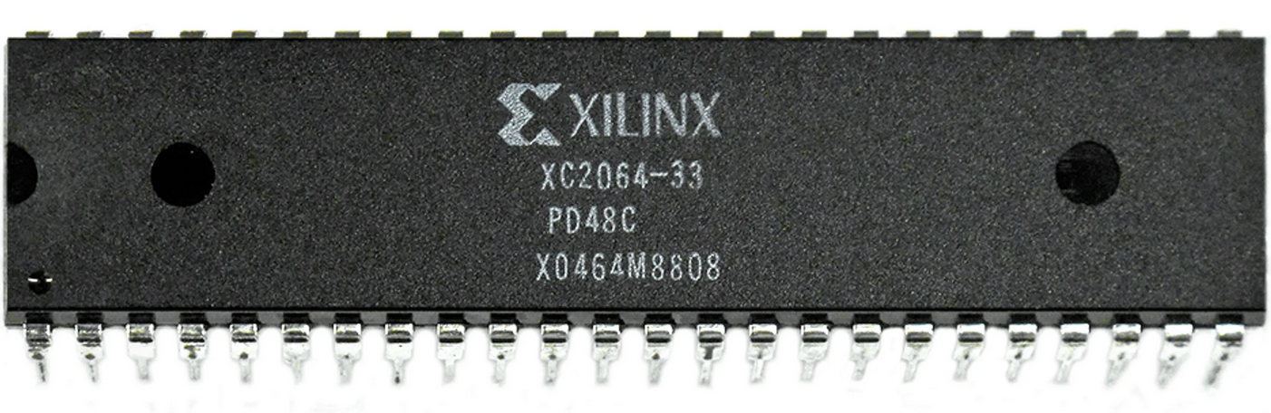
Background
Introduction
FPGA users are no longer just implementing logic; they need to make FPGA designs conform to system standards. FPGA becomes a system.
MOSFETs (metal–oxide–semiconductor field-effect transistor) are one of the most basic elements in an FPGA.
1960-First MOSFET
2000s-More Companies
Timeline
1985-First Commercial FPGA
2010s-Cloud FPGA Service
Using 2μm process, including 64 logic modules and 85000 transistors, the number of gates does not exceed 1000
More Services are provided, FPGA-as-a-Service(FaaS), Accelerator-as-a-service(AaaS) and Machine Learning-as-a-service(MLaaS)

Slide 5

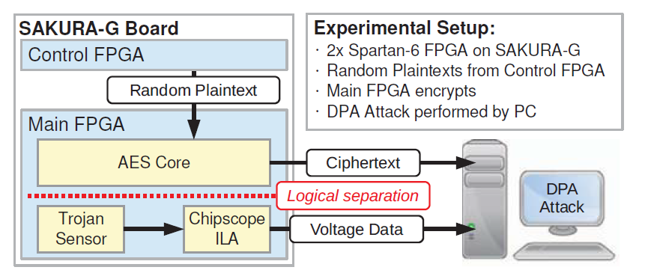
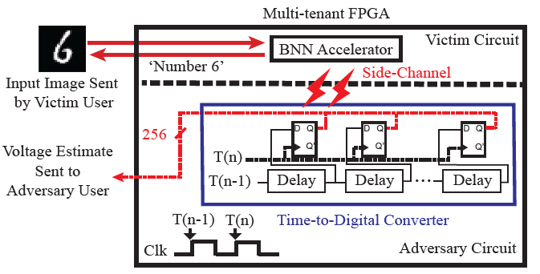
Security Problems in Cloud FPGAs (remote SCA)
Introduction
Schellenberg et al. launched remote SCA based on the on-board sensor, and the key is recovered less than 20k traces. [1]
Moini et al. use TDC as a remote sensor to perform remote SCA and the input of the BNN accelerator is recovered successfully. [2]
[1] Schellenberg et al. 2018. An inside job: Remote power analysis attacks on FPGAs. In 2018 Design, Automation & Test in Europe Conference & Exhibition (DATE). [2] Moini et al. 2021. Remote power side-channel attacks on BNN accelerators in FPGAs. In Design, Automation & Test in Europe (DATE).

Slide 6
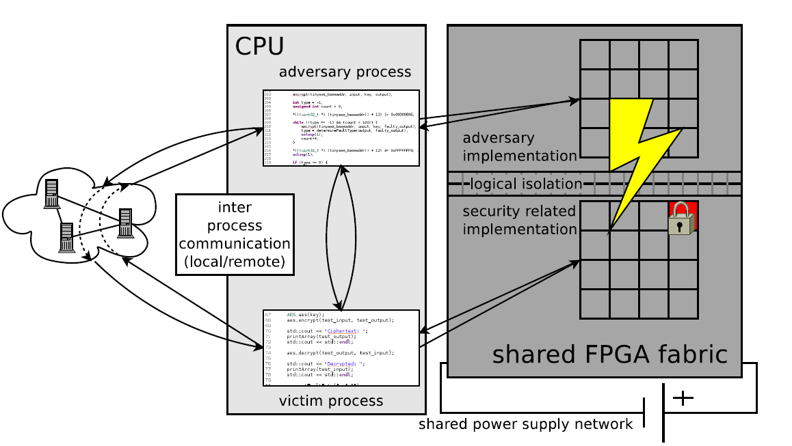
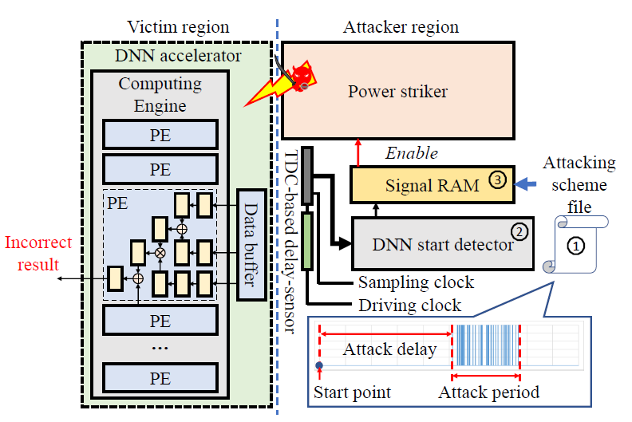
Security Problems in Cloud FPGAs (remote FA)
Introduction
In the condition of multi-tenant, the attacker is enable to injection precise failure to perform Differential Fault Analysis (DFA). [3]
Luo et al. utilize the RO-PUF structure to launch remote fault attacks against the running DNN accelerator. [4]
[3] Krautter et al. 2018. FPGAhammer: Remote voltage fault attacks on shared FPGAs, suitable for DFA on AES. IACR TCHES (2018).
[4] Luo et al. 2021. DeepStrike: Remotely-Guided Fault Injection Attacks on DNN Accelerator in Cloud-FPGA. arXiv preprint arXiv:2105.09453 (2021).

Slide 7
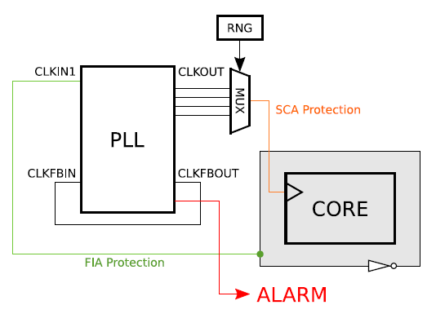
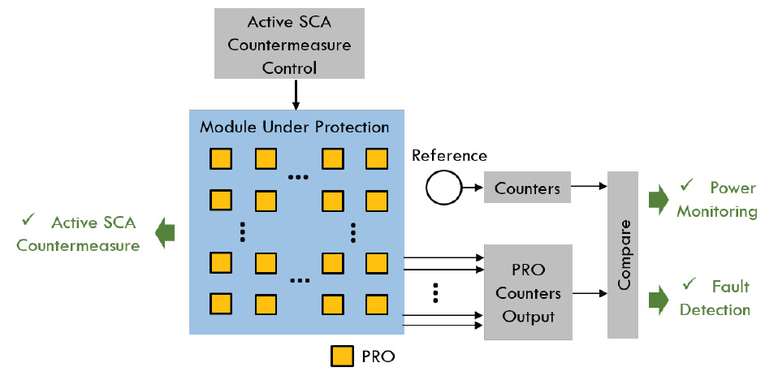
The State of Art Hardware Solutions
Introduction
PLL-based Protection
RO-based Protection
Ravi et al. [5]
Yuan Yao et al. [6]
[5] Ravi et al. 2018. Ppap and ippap: PLL-based protection against physical attacks. In 2018 IEEE Computer Society Annual Symposium on VLSI (ISVLSI). IEEE, 620–625.
[6] Yao et al. 2021. Programmable RO (PRO): A Multipurpose Countermeasure against Side-channel and Fault Injection Attack. arXiv preprint arXiv:2106.13784 (2021).

Slide 8

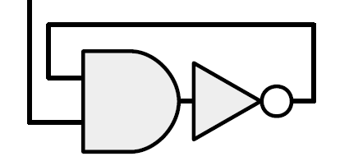
Some Unsolved Problems in Hardware Defense
Introduction
Loop structure (like RO) is forbidden in AWS EC2 Instance[7]
RO structure is forbidden in the Cloud conditions.
The structure of [5,6] cost extra resources. Low overhead solution is expected.
[7] AWS. 2021. Amazon Web Services. Retrieved 2021-10-30 from https://github.com/aws/aws-fpga/blob/master/ERRATA.md

Slide 9
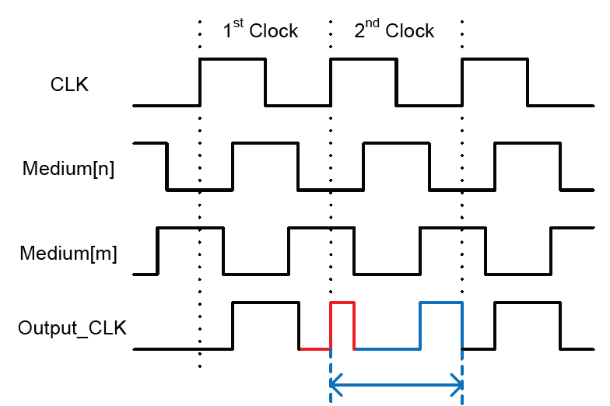
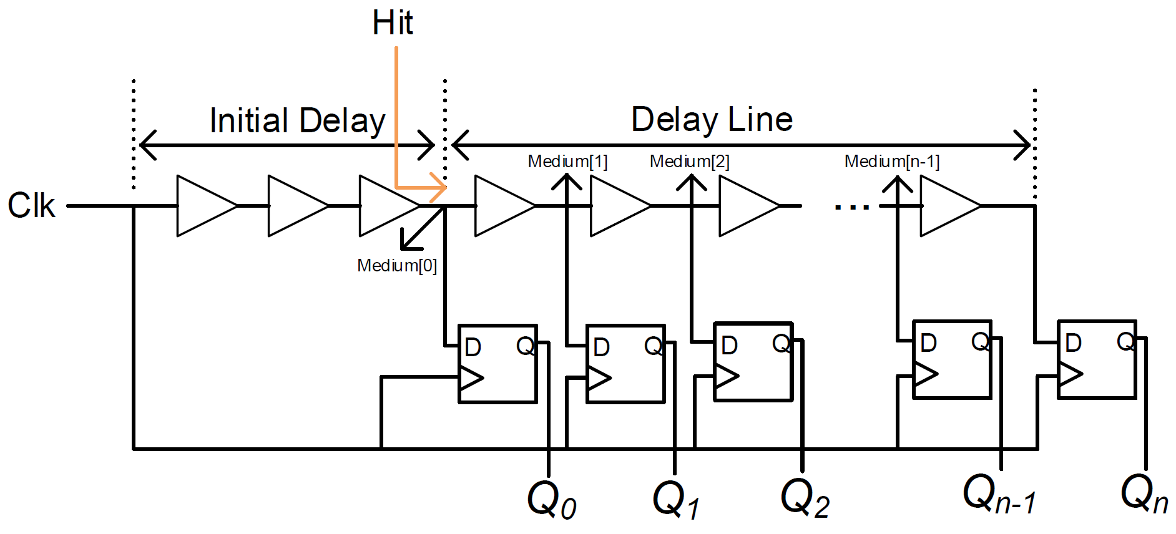
Our Solution: TDC-based solution
Design
Based on the time-to-digital converter (TDC)
Different medium nodes has different phase, which may be utilized for random delay defense.
Through switching the proper outputs of the medium node, the output clock shows partial double frequency.

Slide 10
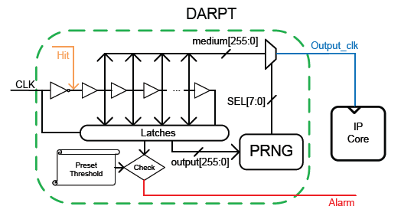
Our Solution: DARPT
Design
SCA defense part:
Combined with the PRNG, MUX and the delay line structure.
For each clock cycle, the PRNG will produce one random value, and the MUX would choose one medium output as the Output_clk.
The Output_clk works as the system clock.

Slide 11
Our Solution: DARPT
Design
FA detection part:
Combined with the TDC structure and a Preset-Threshold part.
The TDC should be pre-calibrated.
The Alarm signal is activated when the sample value beyond the preset boundaries.

Slide 12
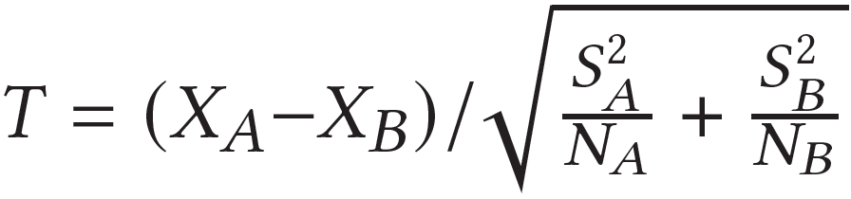
Evaluation
Evaluation Metrics
Test Vector Leakage Assessment
Testers utilize Welsh T-tests to detect any possible leakage. The result of this assessment is 𝑇 value, which is computed as follows.
Where $X_{A}, S_{A}$, and$N_{A}$ are the mean, standard deviation, and cardinality of group A, respectively. Group A is a set of stationary plaintexts, while group B is a set of varying plaintexts.
The test fails if the 𝑇 value crosses the threshold of[-4.5, 4.5] which shows the algorithm\system is possibly vulnerable to SCA.

Slide 13
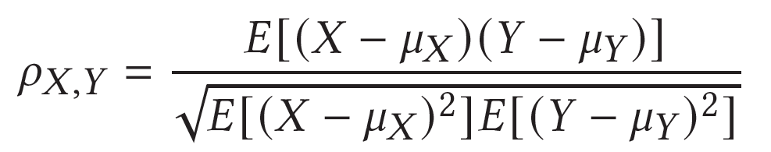
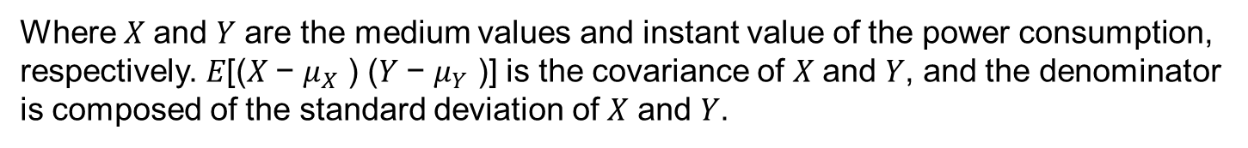
Evaluation
Evaluation Metrics
SCA with Correlation Power Analysis (CPA)
It is necessary to establish a correlation model between the medium values and the instantaneous power consumption. The Pearson’s Correlation Coefficient is considered an effective way for measuring the relevance.
Where 𝑋 and 𝑌 are the medium values and instant value of the power consumption, respectively. 𝐸[(𝑋 − $μ_{X}$ ) (𝑌 − $μ_{Y}$ )] is the covariance of 𝑋 and 𝑌, and the denominator is composed of the standard deviation of 𝑋 and 𝑌.

Slide 14
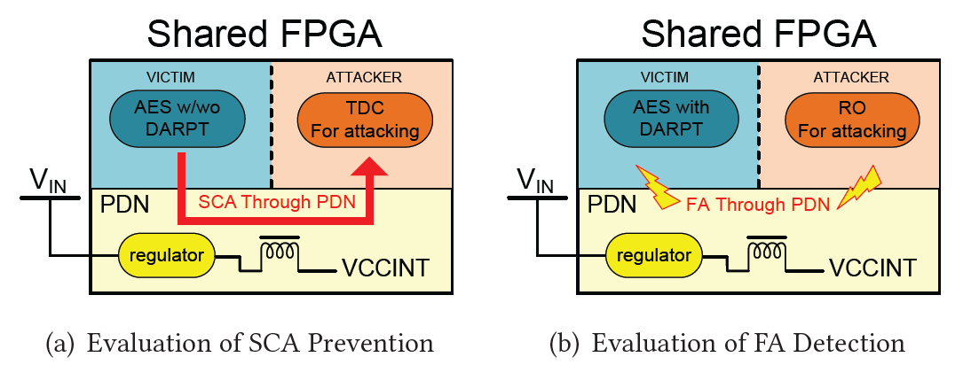
Evaluation
The Experiment Setup
In Fig (a), another TDC is used for performing the SCA.
In Fig (b), several RO fractions (each contains 512 ROs) are utilized to inject the fault.
The PYNQ-Z2 is chosen as the test platform.

Slide 15
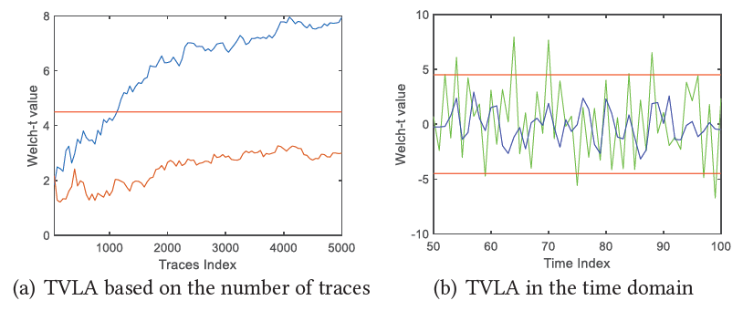
Evaluation
The SCA Evaluation with TVLA
In the graph with time and trace as abscissas respectively
The AES core without our defense has obvious information leaks! (the absolute value of T exceeds 4.5)
And there is no obvious information leakage on the core with DARPT.

Slide 16
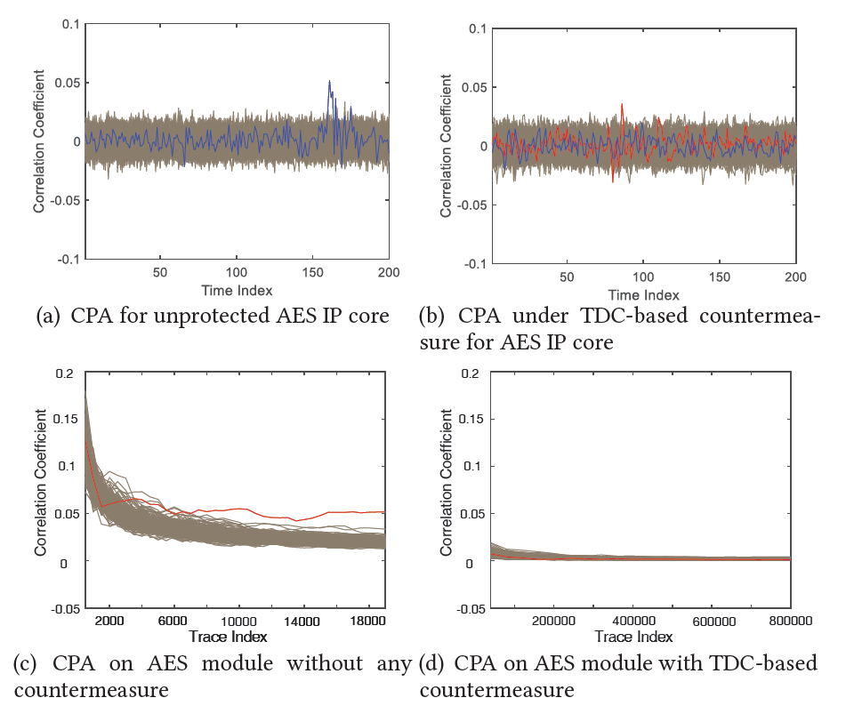
Evaluation
The SCA Evaluation with SCA
With 10k traces, the key of the AES core without our defense can be easily recovered.
8k traces are enough for a successful CPA on AES core without DARPT.
Measure security with Minimum Traces for Key recovery (MTK) as an indicator, the AES core with the DARPT increased by 100 times (800k) compared with the core without any countermeasures (8k).

Slide 17
Evaluation
The FA Evaluation
Relationship of RO fractions and Fluctuation of TDC sampling values
Number of enabled RO fractions | Detect value change ratio (compared with normal value)(%)
1 | 51.82
2 | 75.30
4 | 119.03
8 | 225.91
16 | 459.92
The relationship between the number of activated RO fractions and the detected value change ratio is linear.

Slide 18
Evaluation
The Overhead Evaluation
The Overhead Comparisons
Defense | LUT | FF | BUFG | PLL | BRAM
DARPT | 321 | 258 | 0 | 0 | 0
[5] | 204 | 266 | 11 | 2 | 0
[6] | 46648 | 93296 | 0 | 0 | 0
[8] | 1197 | 140 | 0 | 0 | 16
Compared with the overhead of [5,8], our design only require the primitives in FPGA.
Compared with the structure of [6,8], the whole resources for the design are less. (the sum of LUT and FF)
[5] Ravi et al. 2018. Ppap and ippap: PLL-based protection against physical attacks. In 2018 IEEE Computer Society Annual Symposium on VLSI (ISVLSI). IEEE, 620–625.
[6] Yao et al. 2021. Programmable RO (PRO): A Multipurpose Countermeasure against Side-channel and Fault Injection Attack. arXiv preprint arXiv:2106.13784 (2021).
[8] Ruben Lumbiarres-Lopez, Mariano Lopez-Garcia, and Enrique Canto-Navarro. 2016. Hardware architecture implemented on FPGA for protecting cryptographic keys against side-channel attacks. IEEE Transactions on Dependable and Secure Computing 15, 5 (2016), 898–905.

Slide 19
Conclusion
The Contributions of Our Work
We propose a new hardware-based countermeasure to defend against both SCA and FA.
Our design can be implemented on FPGA with low overhead.
We show that the proposed DARPT against SCA and FA is highly secure.

Slide 20
Questions?

