Slide 1
Study of Models for Image Classification
Fan Gao (fg2432)
Seung Hwan Lee (sl3966)
Sneha Nagaraj Bangalore (sb3889)

Slide 2
Project Objectives
We are all interested in image classification
We each studied an architecture and implemented an enhancement
It’s a broad exploration rather than a deep dive
Notes:
Our approach is a bit different from other teams.

Slide 3
Models
1
Wide ResNet + DenseNet ⇒ Wide DenseNet (WDN)
2
ResNet + Inception ⇒ ResNet-Inception
3
Convolution + RNN ⇒ ReLeNet
Notes:
We’ll each talk about our own model.

Slide 4

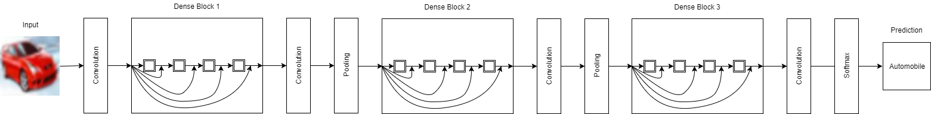
DenseNet
class DenseNetLayer(nn.Module):
def forward(self, input):
out = self.conv(self.relu(self.bn(input)))
return torch.cat([input, out], 1)

Slide 5
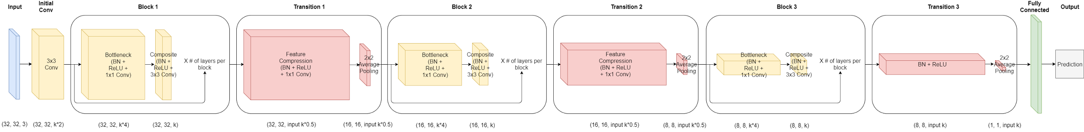
DenseNet
Alleviate the vanishing-gradient problem
Strengthen feature propagation
Encourage feature reuse / avoid information loss
Substantially reduce the number of layers and parameters

Slide 6
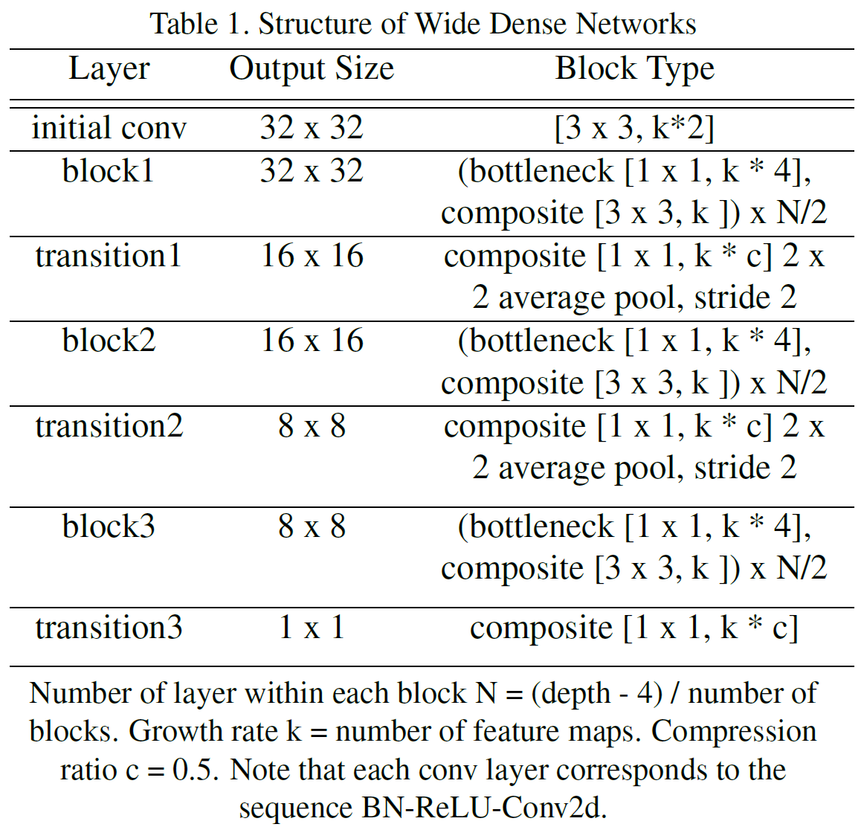
Why Go Wide?
01 | More computationally effective
02 | Considerable reduction in training time and inference time
03 | Train with more parameters
04 | Better scalability
Notes:
It is more computationally effective to widen the model because GPU is much more efficient in parallel computations.
We also see a considerable reduction in training time and inference time. Reduction in training time helps speeding up development cycles, allowing people to quickly verify their ideas. E.g., 1 month, error, demoralizing. And reduction in inference time benefits end-to-end models by improving their responsiveness. E.g. self-driving car, reduce latency, safety, comfortable ride.
Given the same amount of time, wide networks can learn with more parameters than thin ones, which would require considerably more layers, sometimes making them unfeasibly expensive to train.
Wide networks have better scalability given more computing power, which is critical in training large scale networks. E.g., simply by adding more GPUs.

Slide 7
Optimal Depth/Width Ratio
A network cannot be completely flattened
Performance degrades when network depth falls below a certain level
For CIFAR-10, it appears that 1:1 ratio is a sweet spot
Notes:
The optimal ratio is determined by many factors, i.e., the dimension of underlying image, the size of the mini batch, the architecture of the model, and the computing power of the GPU.

Slide 8
Results
 |  |  |  |  |  | 1 GPU |  | 2 GPUs
Dataset | Model | Depth | Growth Rate (K) | # Parameters | Error | Training Time (sec/epoch) | Inference Time (sec/epoch) | Training Time (sec/epoch) | Inference Time (sec/epoch)
C10+ | DenseNet-BC | 100 | 12 | 0.8M | 4.74% | 75.07 | 4.08 | 50.83 | 3.30
C10+ | DenseNet-BC | 19 | 48 | 0.7M | 5.99% | 21.11 | 1.41 | 14.86 | 1.10
C10+ | DenseNet-BC | 40 | 48 | 2.7M | 4.14% | 78.20 | 4.71 | 46.92 | 2.98
C10+ | DenseNet-BC | 19 | 96 | 2.7M | 5.03% | 50.83 | 3.30 | 31.28 | 1.96
C10+ | DenseNet-BC | 22 | 96 | 4.4M | 4.38% | 81.33 | 5.10 | 53.96 | 2.98
C10+ | DenseNet-BC | 40 | 96 | 10.9M | 3.91% | 197.06 | 12.25 | 114.17 | 6.75
01
03
02
Notes:
Standard data augmentation: color normalization, horizontal flip, random crop.

Slide 9
Models
2
ResNet + Inception ⇒ ResNet-Inception

Slide 10
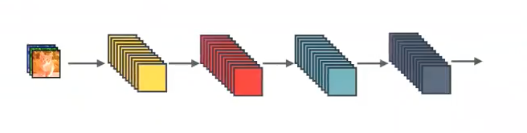
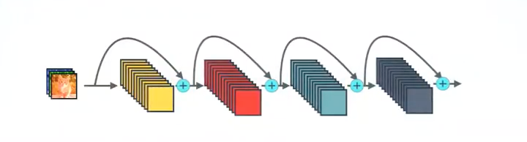
Standard Connectivity
ResNet Connectivity

Slide 11
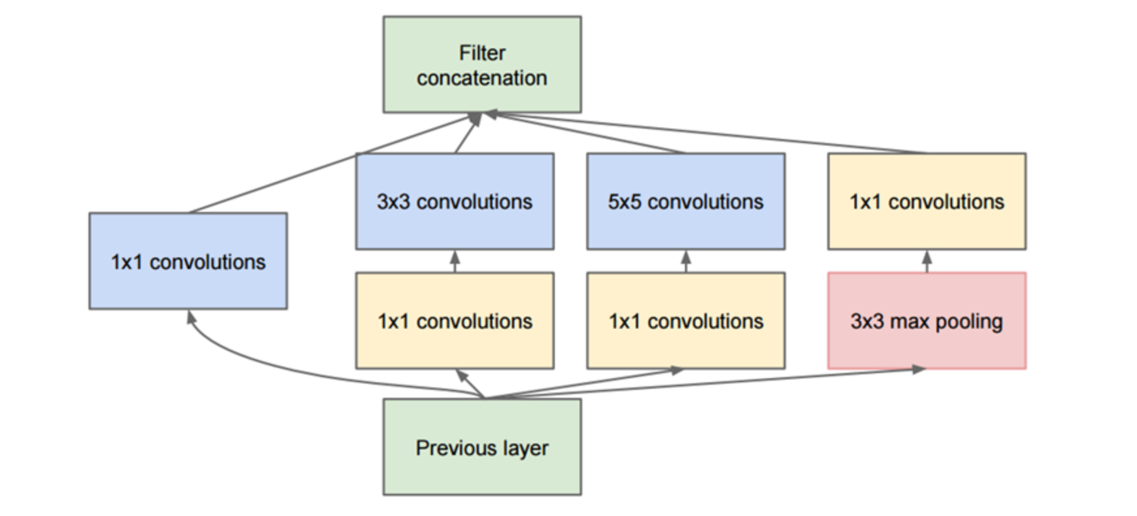
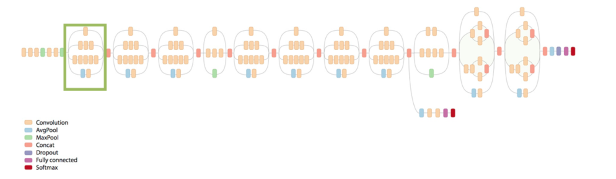
Inception

Slide 12
ResNet- Inception

Slide 13
Different models tried
Results obtained
Attribute | Model 1 | Model 2 | Model 3 | Model 4
Group 0 block count | 6 | 6 | 6 | 24
Group 0 filter size | 32 | 64 | 32 | 32
Group 1 block count | 12 | 12 | 12 | 16
Group 1 filter size | 32 | 64 | 64 | 32
Group 2 block count | 24 | 24 | 24 | 12
Group 2 filter size | 32 | 64 | 64 | 32
Group 3 block count | 16 | 16 | 16 | 6
Group 4 filter size | 32 | 64 | 128 | 32
Attribute | Model 1 | Model 2
Train Accuracy | 95% | 96%
Test Accuracy | 82% | 80%
Number of epochs | 300 | 100
Inference time (sec / epoch) | 27.78 | 44.47
Number of parameters (10^6) | 1.1 | 4.37

Slide 14
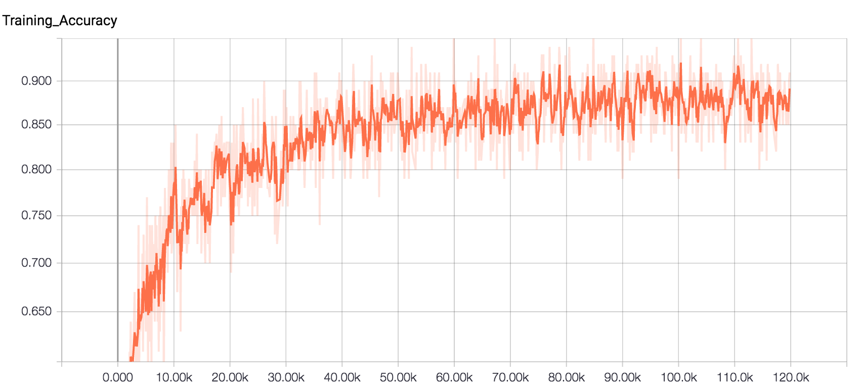
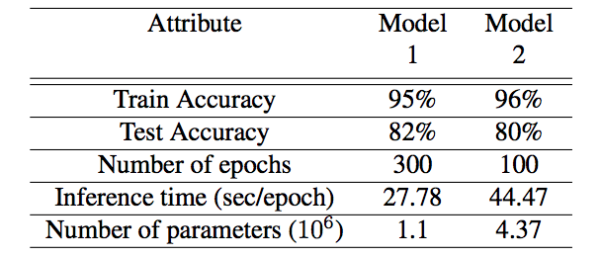
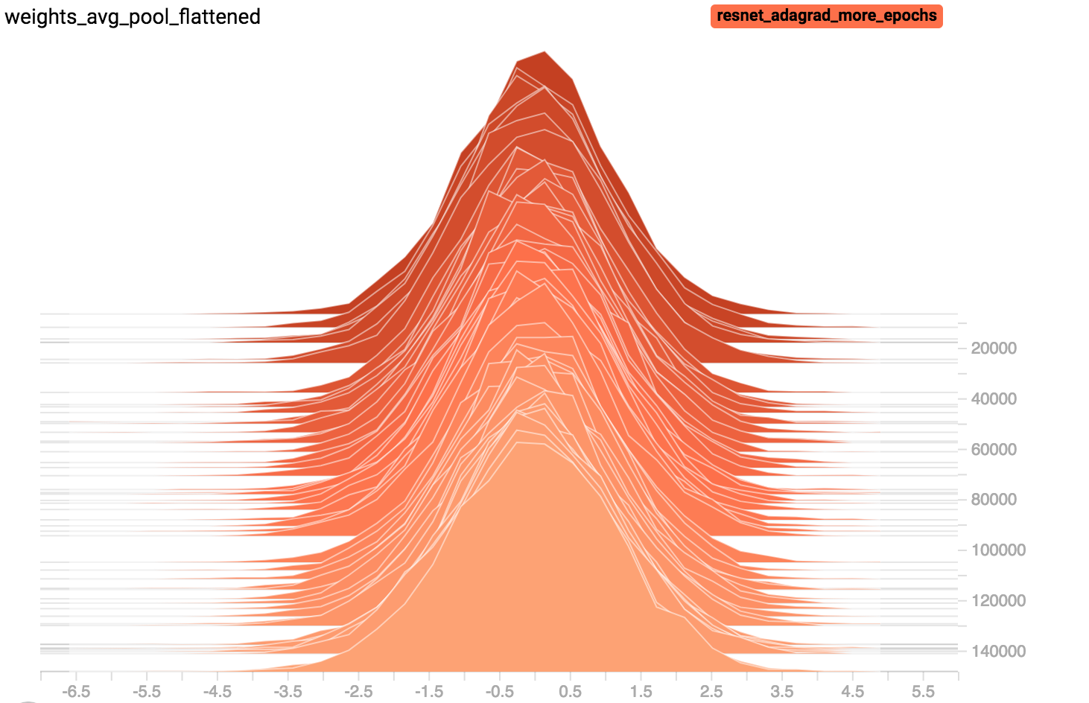
Accuracy
Weights

Slide 15
Models
3
Convolution + RNN

Slide 16
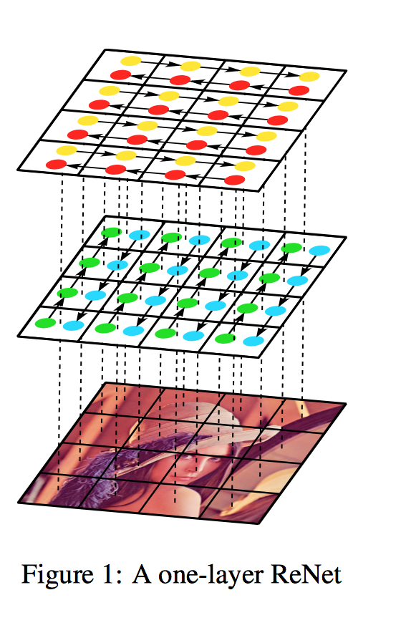
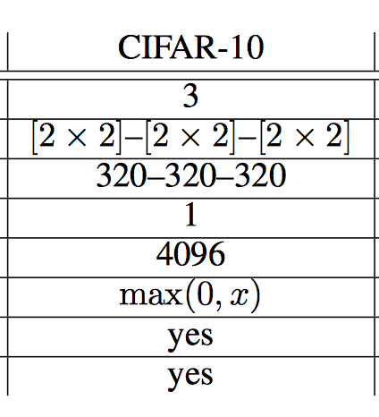
ReNet (RNN for Image Classification)
https://arxiv.org/pdf/1505.00393.pdf

Slide 17
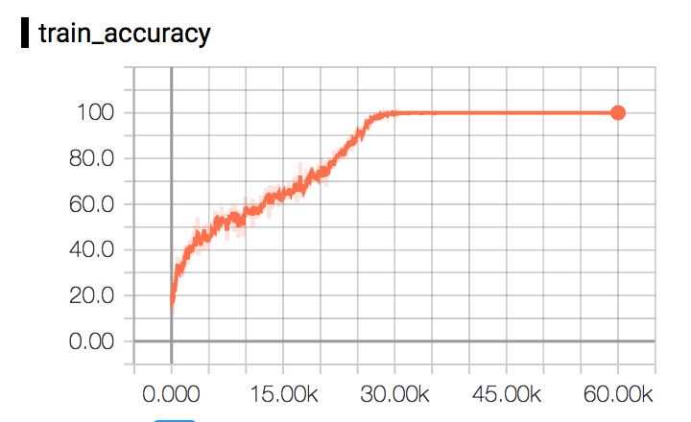
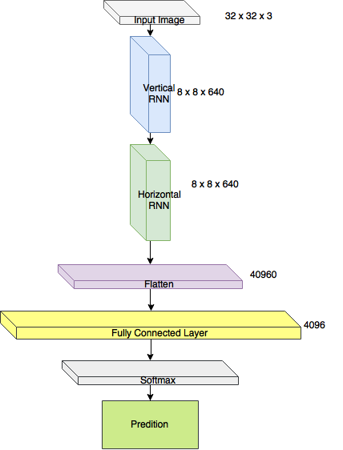
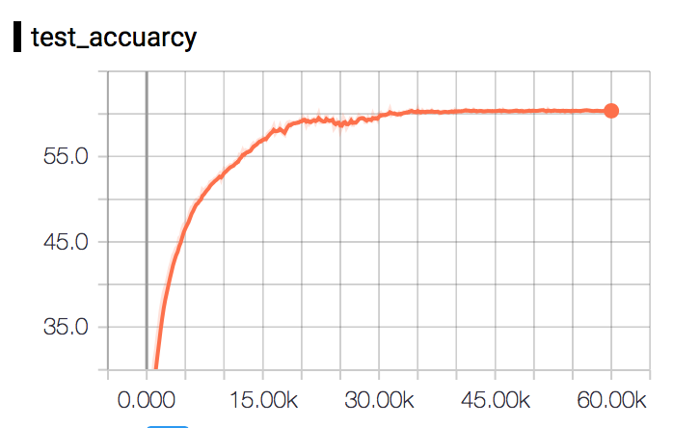
Our Base Model ReNet
One Layer
320 Hidden Units
4 x 4 receptive filter size

Slide 18
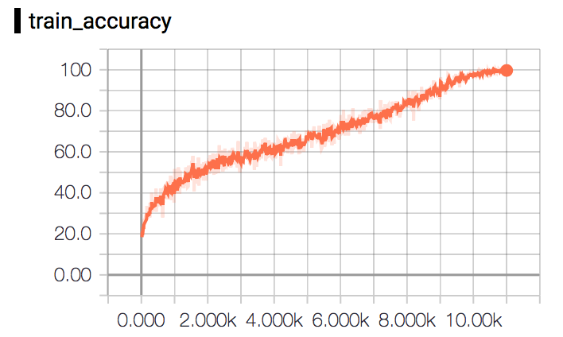
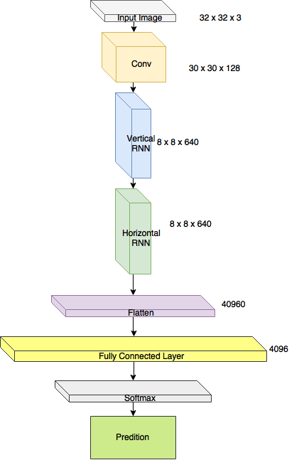
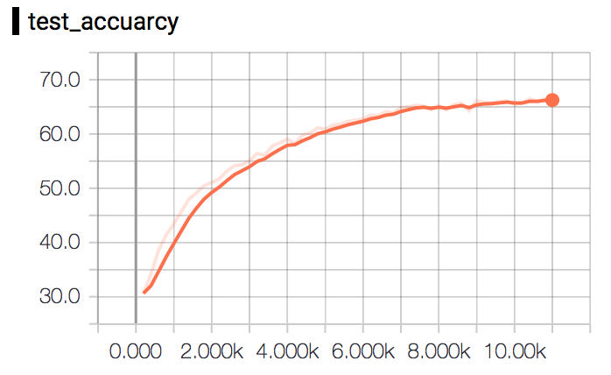
Adding Convolution on the Image

Slide 19
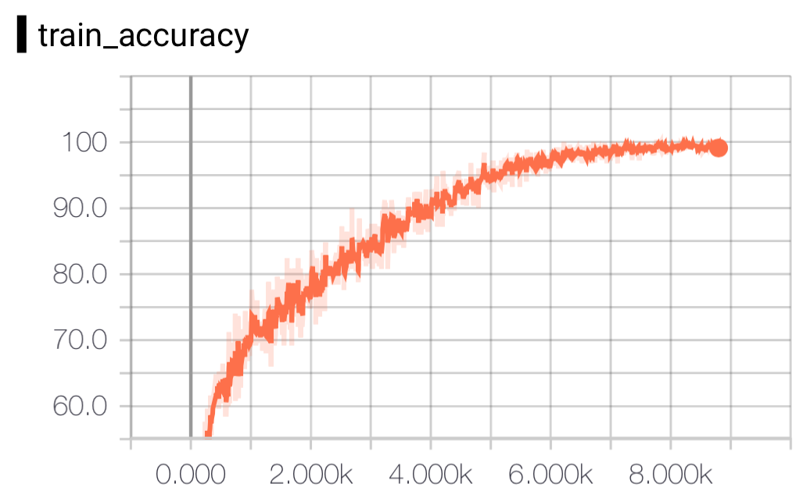
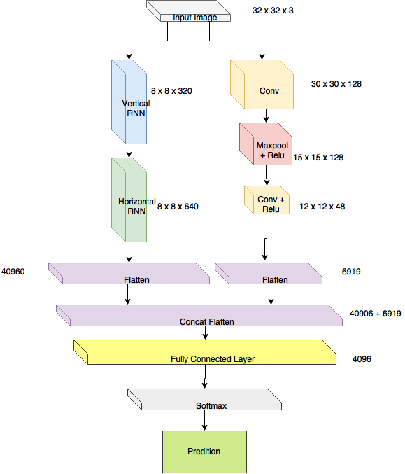
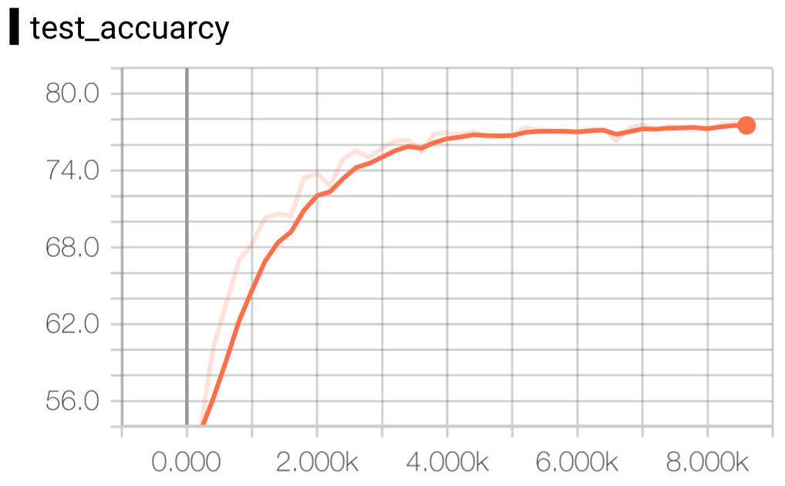
Concatenating CNN + ReNet Features

Slide 20
Thank you.

