Slide 1
Overview of Project Task
The main objective is to analyze Netflix movies and TV Shows dataset in other to gain valuable insight that will enable data driven decision and overall business performance optimization

Slide 2
Dataset Overview
8810 total records in the datasets
The key fields used are;
Movie type (i.e TV shows or Movies)
Date_add (Date content was added)
Release_year (The year the content was released)
Rating (Viewer maturing ratings)
Duration(The viewing duration of the content)
Listed_in(The category of the content)
date_add, release_year, rating, duration and listed_in.

Slide 3
Dataset Major Challenges
Each data point has one or more categories/genre in listed_in field.
Some rating code in the dataset span across multiple viewer rating categories.
Inconsistent data value in duration fields and some values were missing as well.
Irregular data value found in rating field.

Slide 4
Data Preprocessing steps.
Created a new field from rating field.
Handle the missing values and irregular data in duration and rating fields respectively.
Created a new duration field from existing field to make the values consistent, and another integer field to identify the new duration field by content type.
Created a new genre column from the list_in field.

Slide 5
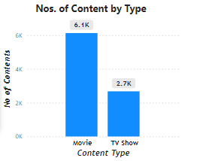
Observations
Overall, 6131 total numbers of movie contents were released.
And, 2677 total numbers of TV Shows contents.

Slide 6
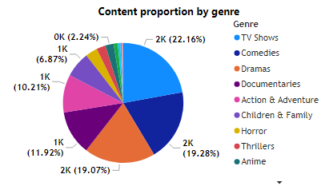
Observations cont.
Overall, TV Show genre has the largest proportion of the content with 1952 total numbers of contents.
Music genre has the smallest proportion of 0.2% with a value of 18 total numbers of contents.

Slide 7
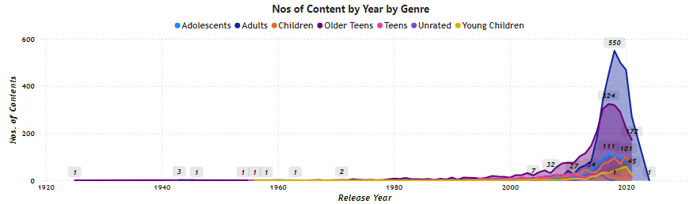
Observations cont.
The variety of contents increases by year from 1920 till 2020
There is spike in number of content between 2017 and 2019 among all genre of contents.
Adults genre content hit the highest content of 550 in 2018 and fall in 2019 to 500.
No content was released between 2022 and 2023
Only one adult content was release in 2024.

Slide 8
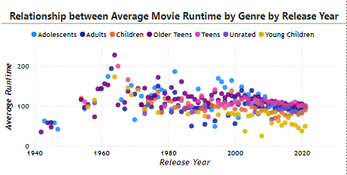
Observations cont.
The average runtime of movies among all genre increases consistently from 1940 till 1965.
Then, from 1966, the average runtime of all genre of movies decreases by release year.

Slide 9
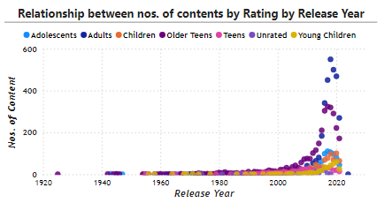
Observations cont.
No of contents increases as the release year increase
There is a +ve relationship between release year and the number of contents released in the year.

Slide 10
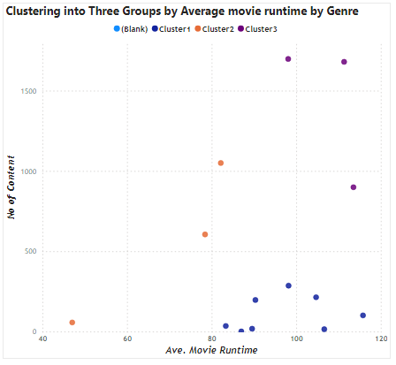
Observations cont.
Majority of the movies content has average runtime between 80mins and 120mins but fewer number of contents (cluster 1)
Minimal average runtime means more no of contents for the second group of contents (cluster 2).

Slide 11
Data Limitation
No data is available for popularity score to analyze correlation with genre

Slide 12
Assumptions
The first genre in the available lists of genre in the list_in field was assumed as the genre of each content
The following rating gotten from NetFlix website was used to reclassify the rating of each content.
All (Young Children) (TV-Y, TV-G) (G)
7+ (Children) (TV-Y7, TV-G) (soft PG)
10+ (Adolescents) (TV-Y7-FV, soft TV-PG) (hard PG)
13+ (Teens) (hard TV-PG, soft TV-14) (soft PG-13)
16+ (Older Teens) (hard TV-14, TV-MA) (hard PG-13, R)
18+ (Adults) (TV-MA) (NC-17, unrated)

Slide 13
Actionable Recommendation
To improve efficiency, the runtime for TV Movies should be reduced, to increase the numbers of content release

