Slide 1
iMaterialist Fashion Challenge at FGVC5
Multilabel image classification

Slide 2
Image Classification Problem
Automatic product detection
Must accurately assign attribute labels to fashion images
Difficulty with the variety of lighting, angles, backgrounds, and occlusion
Discerning between some fine-grained categories (e.g. turquoise vs. light blue)
228 different labels
1 million images in training set
40,000 image in testing set
10,000 images in validation set

Slide 3
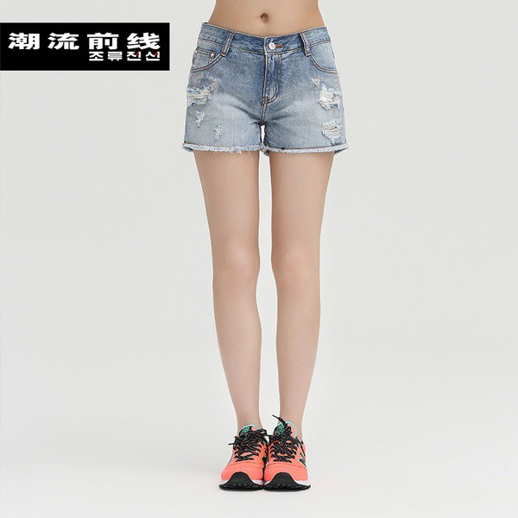
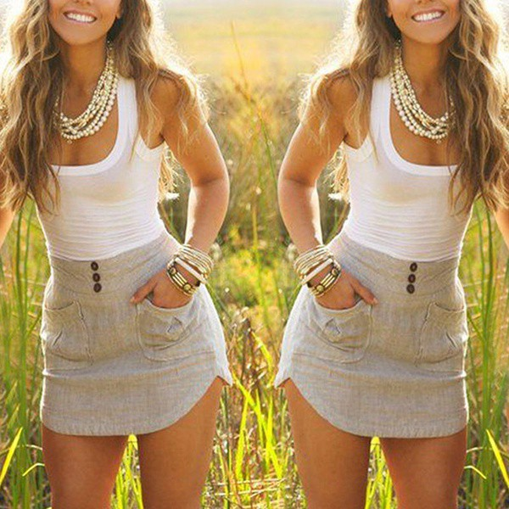
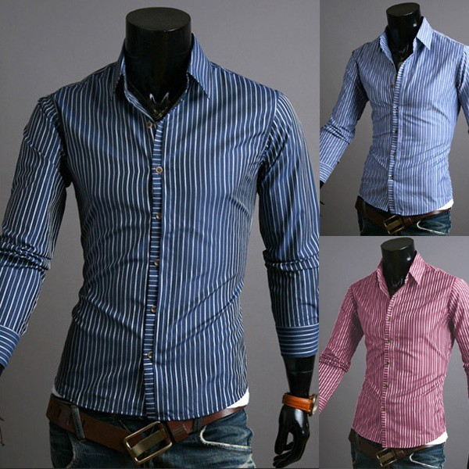
Image Examples

Slide 4
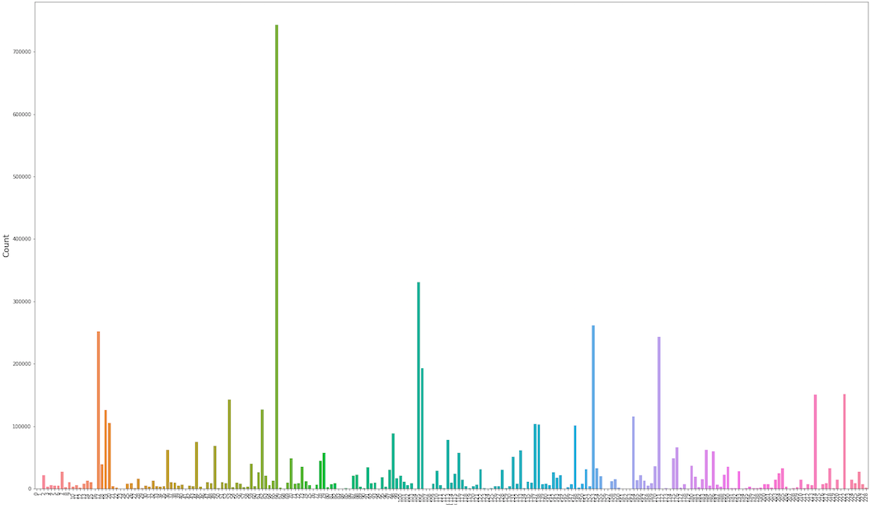
Distribution of Labels

Slide 5
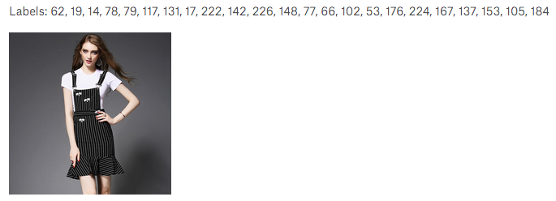
Maximum Number of Labels

Slide 6
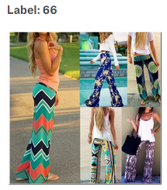
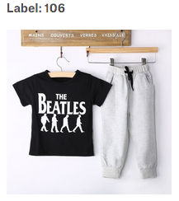
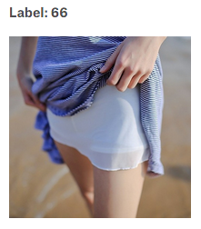
Single Label

Slide 7
Approach
Not much preprocessing is required, maybe some automatic bounding or cropping
Must download images and load them into a dataframe with appropriate labels
Utilize Tensorflow Object Detection as a starting point
Could also use pretrained model like VGG16, InceptionV3 or ResNet
Compare results from various models

