Slide 1
iMaterialist Fashion Challenge at FGVC5
Team Members: Matt Emmons
Sankeerthana
Sai Praveen

Slide 2
Problem Statement
Handling multi-label image classification.
Main objective is to train a model that can automate the process of classifying the fashion images based on labels.
Some images has single labels and few has multi labels.

Slide 3
Dataset Description
Training set consists of 1014544 images.
Attribute 1: image url
Attribute 2: image id
Attribute 3: label id
Labels : 228
Testing set: 40,000 images
Validation set: 10,000 images

Slide 4
Challenges
Data collection and storage of images.
Images contain a variable number of multiple labels.
Divergence in the levels of saturation and occlusion.
Pictures taken at different lightings and saturations.
Few blank images
Missing images

Slide 5
Data Collection and Storage
Google Colab
It’s a free cloud service (your Google drive) in which we can fetch the images using the url’s from the dataset and store.
Setting up free GPU.
Can import the .py files and can also install the libraries.
Can also clone them to git repositories.

Slide 6
Missing images were ignored when downloaded to hard drive
If using Google Colab (which fetches the image and loads it into RAM in batches), missing images were set as an np.array of ones, which becomes a black image

Slide 7
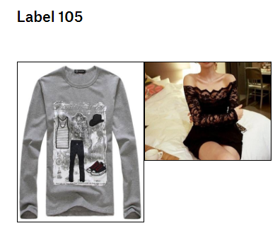
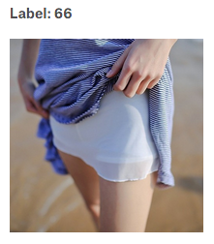
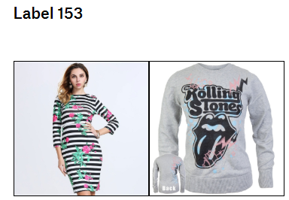
Exploratory Analysis:
No missing data in the training, testing and validation dataset.
66 is most frequent label with count 743250
105 is 2nd most frequent label with count 330864
153 is 3rd most frequent label with count 261844

Slide 8
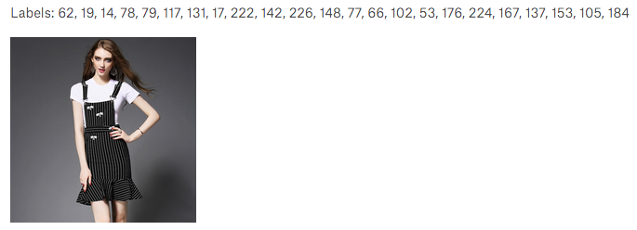
Images with multiple labels
Maximum number of labels:

Slide 9
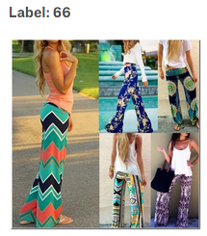
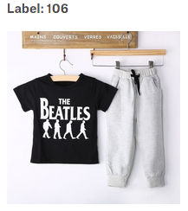
Images with Single label
Minimum number of labels:

Slide 10
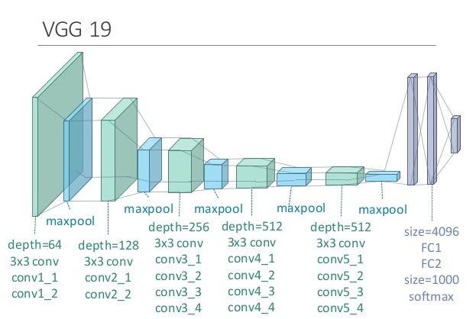
Pretrained Model
Best success with VGG19
Weights pretrained on ImageNet
The first 5 layers were frozen to prevent training of the most broad features of each image
Output from VGG19 fed into:
Dense layer of size 1024 with ReLU activation
Aggressive Dropout layer (0.4)
Dense layer of size 1024 with ReLU activation
Finally, a Dense later of size 228 (the total number of classes) with softmax

Slide 11
Pretrained Model
Trained our dataset on using batches of size 16 for 10 epochs
Utilized a custom generator class to instantiate the image batches into and out of memory
Able to reduce the training time per epoch from 8 hours to 1.5 hours via optimizations and reducing the data stored in memory
Also used a Learning Rate Scheduler to implement learning rate annealing from epoch to epoch

Slide 12
Results Obtained
Best score was 0.58183, which is placed within the top 40 of the competition (the top 5 received scores around 0.7)
Interestingly, during training the traditional metrics (accuracy, training loss and validation loss) we’re not reflective of the accuracy of our model.
This is likely due to the unique issues in multi-label classification and the softmax activation on the last layer
For each test image, probabilities were calculated for each potential label using predict_generator and a modified image generator class.
From there, we select the labels with a probability higher than 30%

Slide 13
Questions?

