Slide 1

Room reservation project
Anton Tsymbal

Slide 2
Task formulation
Web application, which allows:
Registration
Registered users can make an order
Immediate booking and cancelation
Admin can add or remove certain room
Admin knows information about rooms, reservations and guests

Slide 3
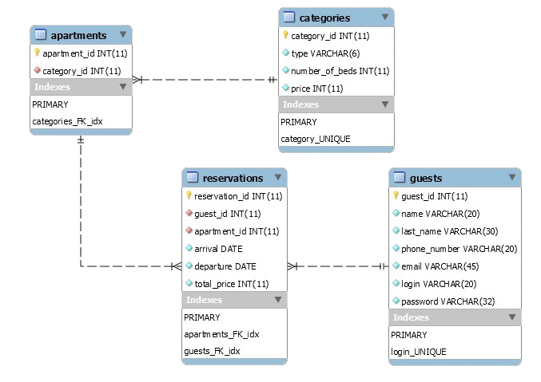

Slide 4






Used technologies

