Slide 1
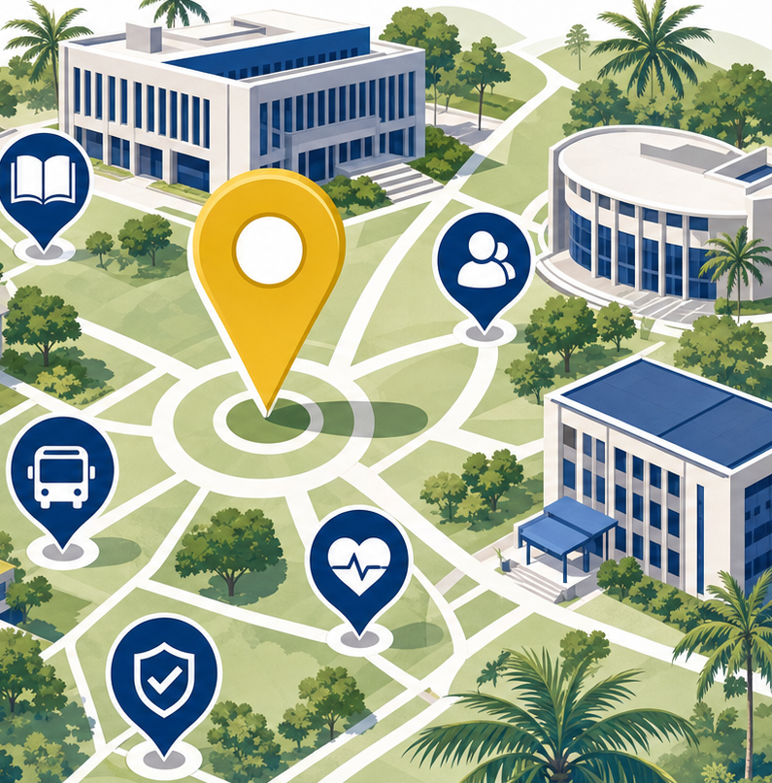
UCC CAMPUS CONNECT
AI Group Project Presentation
MSc Information Technology • University of Cape Coast • 2026

Slide 2
PROJECT TEAM
A four-member MSc team developed the project
01
Ebenezer Nana Annan
MS/ITE/25/0041
02
Okyere-Darko Addai
MS/ITE/25/0044
03
Frank Akrasi Antwi
MS/ITE/25/0051
04
Michael Essel
MS/ITE/25/0053
Programme: MSc Information Technology • Project: UCC Campus Connect
02

Slide 3
PRESENTATION OUTLINE
The presentation follows the project from need to evidence
01
Context and purpose
04–07
02
Design approach
08–10
Problem, aim, objectives and stakeholders
Proposed solution, methodology and architecture
03
System implementation
11–12
04
Campus AI
13–15
Features, technologies and data design
Capabilities, models, grounding and feedback
05
Assurance and evaluation
16–17
06
Outlook
18–19
Security, verification and evaluation evidence
Limitations, future work and conclusion
03

Slide 4
PROBLEM STATEMENT
Campus information is available, but it is fragmented
Students and visitors often need several disconnected channels to complete one campus journey.
DISCOVER
PLAN
ACT
Where is it?
When and how?
Who can help?
Facilities, halls, services and landmarks are difficult to discover from one trusted interface.
Timetables, campus updates, shuttle guidance and route context are not coordinated.
Safety contacts, incident reporting and service feedback are scattered across channels.
The consequence is avoidable delay, uncertainty and a poorer campus experience.
04

Slide 5
AIM & OBJECTIVES
The project creates one dependable campus companion
AIM
Design and implement an integrated smart-campus platform that improves access to location, academic, transport, safety and support information at UCC.
01
Centralise campus information
02
Support personal planning
Create a single responsive access point for places, updates and services.
Persist profiles, preferences and timetable entries securely.
03
Improve navigation and safety
04
Build an extensible platform
Provide route guidance, accessibility options and incident reporting.
Use Laravel APIs and MariaDB structures that can grow with campus needs.
05

Slide 6
METHODOLOGY
A design-and-build method translated campus needs into software
1
2
3
4
5
Needs analysis
Requirements
Iterative design
Implementation
Verification
Map common campus tasks and information gaps.
Define functional, usability, security and data needs.
Develop responsive interactions and refine task flows.
Build React UI, Laravel services and MariaDB persistence.
Check routes, validation rules, migrations and responsive layouts.
Outcome: a working full-stack prototype whose implementation choices remain traceable to identified campus needs.
06

Slide 7
SCOPE & STAKEHOLDERS
The system serves four user groups through one interface
01
STUDENTS
Personal timetable, saved places, updates, routes and issue reporting
02
STAFF
Campus discovery, service information, events and feedback
03
VISITORS
Orientation, landmarks, safety contacts and accessible navigation
04
ADMINISTRATORS
Structured records that can support moderation and service improvement
Current prototype boundary
Campus information and self-service support; not a replacement for official emergency response or institutional records.
07

Slide 8
PROPOSED SOLUTION
Three capabilities turn fragmented information into action
01
02
03
DISCOVER
PLAN
RESPOND
Search facilities, halls and services; inspect map context and campus updates.
Maintain a personal timetable, travel preferences and saved destinations.
Access emergency guidance, report issues with evidence and rate AI answers.
One account carries context across all three capabilities.
08

Slide 9
SYSTEM ARCHITECTURE
Laravel separates presentation, application logic and data
APPLICATION
CLIENT
Laravel 13
PERSISTENCE
React + Vite
MariaDB
Session authentication, validation, REST-style endpoints, storage and Eloquent models.
Responsive interface, maps, forms and personal dashboards.
Relational storage for users, profiles, preferences, timetables, reports and feedback.
EXTERNAL SERVICES
Weather • routing • official UCC updates
Clear boundaries make the platform easier to test, secure and extend.
09

Slide 10
DATABASE DESIGN
The data model keeps personal and operational records distinct
IDENTITY
PLANNING
OPERATIONS
users
profiles
timetable_entries
user_preferences
issue_reports
ai_feedback
Login credentials and academic profile
Courses, saved places, travel mode and visit history
Service incidents, evidence paths and answer-quality feedback
Design choices
UUID primary keys • indexed user email • JSON preference fields • timestamps • bounded validation
10

Slide 11
FUNCTIONAL CAPABILITIES
Implemented features cover the complete campus task cycle
01
Campus directory
02
Route guidance
03
Personal timetable
Search and browse campus places
Walking route previews and steps
Add, import and remove entries
04
Campus updates
05
Weather context
06
Issue reporting
Present relevant official notices
Surface current Cape Coast conditions
Submit category, location and photo
07
Safety support
08
Preferences
09
AI assistance
Show contacts and safe-location guidance
Store accessibility and travel choices
Answer context-aware campus questions
11

Slide 12
IMPLEMENTATION
The technology stack prioritises maintainability and deployment choice
FRONTEND
React 19
BUILD
Vite
Component-based, responsive user experience
Fast development and optimised production assets
BACKEND
Laravel 13
DATABASE
MariaDB
Routing, validation, sessions, storage and APIs
Reliable relational persistence and indexing
DATA ACCESS
Eloquent ORM
FILES
Laravel public disk
Readable models, UUIDs, casts and queries
Managed incident-photo storage
12

Slide 13
AI FEATURES
Campus AI converts campus context into practical guidance
CONVERSATIONAL SEARCH
CONTEXTUAL GUIDANCE
Understands place names, aliases, common misspellings and campus-service questions.
Combines profile, timetable, saved places, recent questions, weather and location.
ROUTE INTELLIGENCE
PROACTIVE SUPPORT
Finds destinations, calculates walking routes and identifies nearby landmarks.
Suggests departure times, weather precautions and timetable actions.
MULTILINGUAL ACCESS
ACTIONABLE CHAT
Supports English, Fante, Twi, Ga and Ewe interface copy with browser speech services.
Starts issue reports, surfaces official updates and links answers to map actions.
The assistant is designed around campus tasks, not unrestricted general conversation.
13

Slide 14
AI MODELS USED
The current assistant uses transparent deterministic models
01
Intent classification
02
Entity resolution
Regular-expression and keyword rules identify directions, shuttle, discovery, safety, updates and reporting intents.
Aliases, direct name matching and Levenshtein edit distance resolve campus destinations; acceptance threshold is 0.42.
03
Proximity ranking
04
Context model
Haversine distance ranks nearby services, with an accessibility penalty when accessible travel is preferred.
Rules combine timetable, weather, profile, location, saved places and recent interactions to generate suggestions.
MODEL BOUNDARY
No GPT, foundation model or trained neural model is called in the current implementation; responses remain inspectable and reproducible.
14

Slide 15
AI PIPELINE & RESPONSIBLE USE
Grounding and feedback keep AI answers tied to campus evidence
1
2
3
4
5
INPUT
INTERPRET
GROUND
PERSONALISE
ACT
Text or browser speech
Intent + destination match
Campus data + live services
Profile + timetable + preferences
Answer, route, report or update
QUALITY CONTROL
FUTURE INTEGRATION
Human feedback loop
Retrieval-grounded language model
Helpful, not-helpful and incorrect ratings are stored with the question, answer and correction for review.
A future LLM should sit behind Laravel, retrieve approved UCC content, cite sources and fall back safely when evidence is missing.
Principle: assist decisions while preserving source visibility, user control and clear uncertainty.
15

Slide 16
SECURITY & PRIVACY
Security controls are built into every write path
Authentication
Authorisation
Laravel sessions, password hashing and session regeneration
Protected write routes and user-scoped timetable deletion
Validation
CSRF protection
Allow-lists, length limits, time formats and numeric constraints
Token attached to same-origin browser requests
Upload safety
Data minimisation
Image-only files, 5 MB limit and managed storage paths
Only task-relevant identity, preference and feedback fields
Security is a system property, not a single feature.
16

Slide 17
VALIDATION & EVALUATION
Verification confirms the backend structure is deployable
19
6
0
ROUTES LOADED
CAMPUS TABLES
PHP SYNTAX ERRORS
Authentication, pages, APIs, storage and health endpoints
Profiles, timetables, preferences, reports and feedback
Controllers, models, routes and migrations validated
Database verification
NEXT EVALUATION STEP
A clean migration run created the complete schema successfully. Route inspection confirmed the expected application surface.
Task-based usability study with students, staff and first-time visitors.
17

Slide 18
LIMITATIONS & FUTURE WORK
The prototype establishes a base for institutional-scale deployment
CURRENT LIMITATION
FUTURE WORK
Static campus place catalogue
Administrative place and content management
CURRENT LIMITATION
FUTURE WORK
External routing and weather availability
Caching, monitoring and graceful offline behaviour
CURRENT LIMITATION
FUTURE WORK
No completed user study yet
Measure task success, time, satisfaction and accessibility
CURRENT LIMITATION
FUTURE WORK
Single-institution deployment model
Role-based administration and institutional integrations
18

Slide 19
CONCLUSION
UCC Campus Connect demonstrates an integrated smart-campus model
The project delivers
CORE CONTRIBUTION
One interface for discovery, planning and response
Campus information becomes more useful when it is connected to the user’s immediate task and context.
A maintainable Laravel application architecture
A MariaDB model for personal and operational data
A practical foundation for measured campus-service improvement
Questions & Discussion
19

