Slide 1
Chapter 14
Fluid Mechanics

Slide 2
States of Matter
Solid
  Has a definite volume and shape
Liquid
  Has a definite volume but not a definite shape
Gas – unconfined
  Has neither a definite volume nor shape

Slide 3
States of Matter, cont
All of the previous definitions are somewhat artificial
More generally, the time it takes a particular substance to change its shape in response to an external force determines whether the substance is treated as a solid, liquid or gas

Slide 4
Fluids
A fluid is a collection of molecules that are randomly arranged and held together by weak cohesive forces and by forces exerted by the walls of a container
Both liquids and gases are fluids

Slide 5
Statics and Dynamics with Fluids
Fluid Statics
  Describes fluids at rest
Fluid Dynamics
  Describes fluids in motion
The same physical principles that have applied to statics and dynamics up to this point will also apply to fluids

Slide 6
Forces in Fluids
Fluids do not sustain shearing stresses or tensile stresses
The only stress that can be exerted on an object submerged in a static fluid is one that tends to compress the object from all sides
The force exerted by a static fluid on an object is always perpendicular to the surfaces of the object

Slide 7
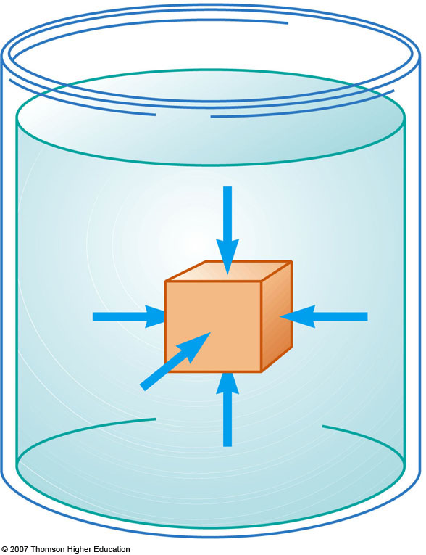
Pressure
The pressure P of the fluid at the level to which the device has been submerged is the ratio of the force to the area

Slide 8
Pressure, cont
Pressure is a scalar quantity
  Because it is proportional to the magnitude of the force
If the pressure varies over an area, evaluate dF on a surface of area dA as dF = P dA
Unit of pressure is pascal (Pa)

Slide 9
Pressure vs. Force
Pressure is a scalar and force is a vector
The direction of the force producing a pressure is perpendicular to the area of interest

Slide 10
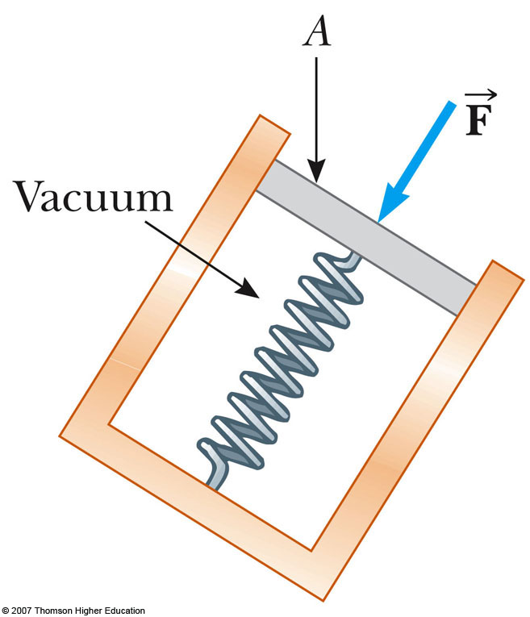
Measuring Pressure
The spring is calibrated by a known force
The force due to the fluid presses on the top of the piston and compresses the spring
The force the fluid exerts on the piston is then measured

Slide 11
Density Notes
Density is defined as the mass per unit volume of the substance
The values of density for a substance vary slightly with temperature since volume is temperature dependent
The various densities indicate the average molecular spacing in a gas is much greater than that in a solid or liquid

Slide 12
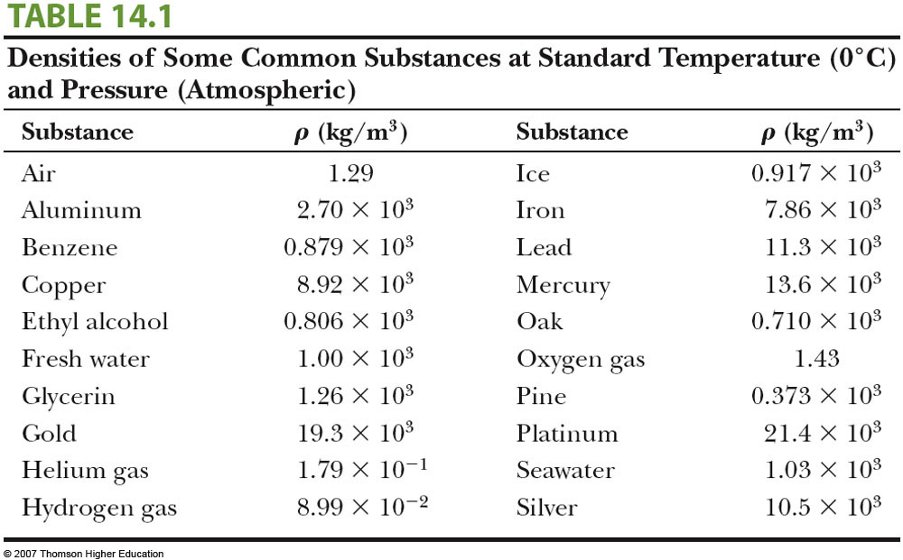
Density Table

Slide 13
Variation of Pressure with Depth
Fluids have pressure that varies with depth
If a fluid is at rest in a container, all portions of the fluid must be in static equilibrium
All points at the same depth must be at the same pressure
  Otherwise, the fluid would not be in equilibrium

Slide 14
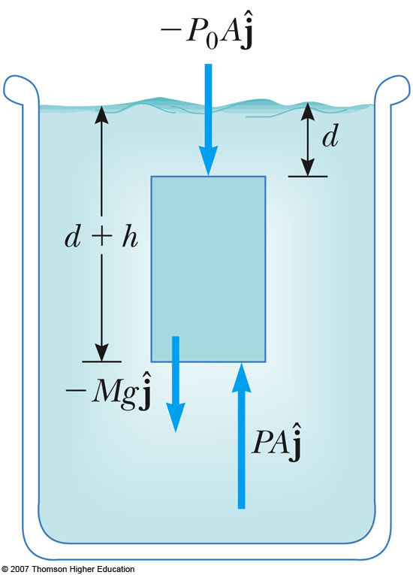
Pressure and Depth
Examine the darker region, a sample of liquid within a cylinder
  It has a cross-sectional area A
  Extends from depth d to d + h below the surface
Three external forces act on the region

Slide 15
Pressure and Depth, cont
The liquid has a density of ρ
  Assume the density is the same throughout the fluid
  This means it is an incompressible liquid
The three forces are:
  Downward force on the top, P₀A
  Upward on the bottom, PA
  Gravity acting downward, Mg
    The mass can be found from the density:

Slide 16
Pressure and Depth, final
Since the net force must be zero:
  This chooses upward as positive
Solving for the pressure gives
  P = P₀ + ρgh
The pressure P at a depth h below a point in the liquid at which the pressure is P₀ is greater by an amount ρgh

Slide 17
Atmospheric Pressure
If the liquid is open to the atmosphere, and P₀ is the pressure at the surface of the liquid, then P₀ is atmospheric pressure
P₀ = 1.00 atm = 1.013 x 10⁵ Pa

Slide 18
Pascal’s Law
The pressure in a fluid depends on depth and on the value of P₀
An increase in pressure at the surface must be transmitted to every other point in the fluid
This is the basis of Pascal’s law

Slide 19
Pascal’s Law, cont
Named for French scientist Blaise Pascal
A change in the pressure applied to a fluid is transmitted undiminished to every point of the fluid and to the walls of the container

Slide 20
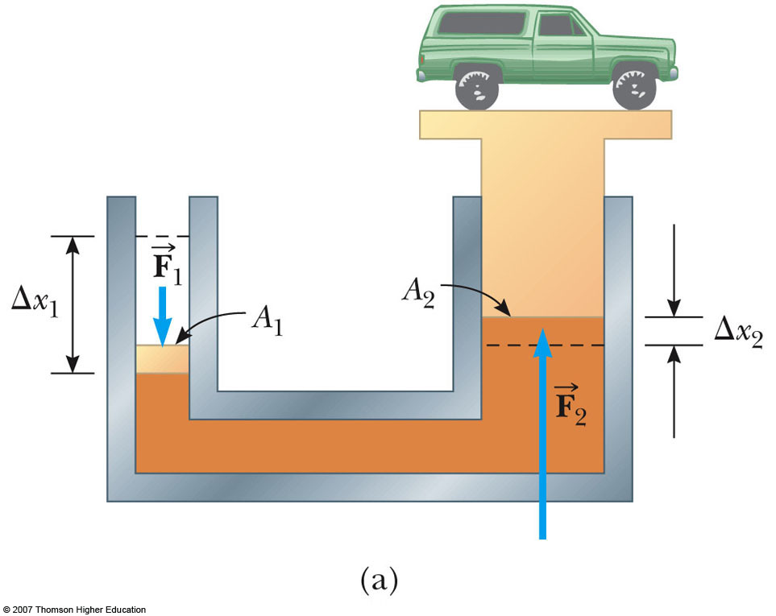
Pascal’s Law, Example
Diagram of a hydraulic press (right)
A large output force can be applied by means of a small input force
The volume of liquid pushed down on the left must equal the volume pushed up on the right

Slide 21
Pascal’s Law, Example cont.
Since the volumes are equal,
Combining the equations,
  which means Work₁ = Work₂
  This is a consequence of Conservation of Energy

Slide 22
Pascal’s Law, Other Applications
Hydraulic brakes
Car lifts
Hydraulic jacks
Forklifts

Slide 23
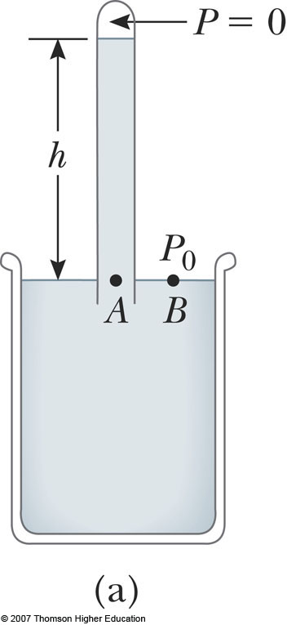
Pressure Measurements: Barometer
Invented by Torricelli
A long closed tube is filled with mercury and inverted in a dish of mercury
  The closed end is nearly a vacuum
Measures atmospheric pressure as P_{o} = ρ_{Hg}gh
One 1 atm = 0.760 m (of Hg)

Slide 24
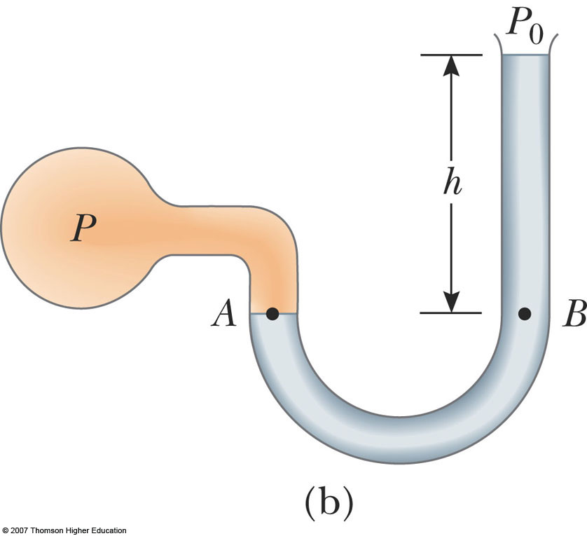
Pressure Measurements:
Manometer
A device for measuring the pressure of a gas contained in a vessel
One end of the U-shaped tube is open to the atmosphere
The other end is connected to the pressure to be measured
Pressure at B is P = P₀+ρgh

Slide 25
Absolute vs. Gauge Pressure
P = P₀ + ρgh
P is the absolute pressure
The gauge pressure is P – P₀
  This is also ρgh
  This is what you measure in your tires

Slide 26
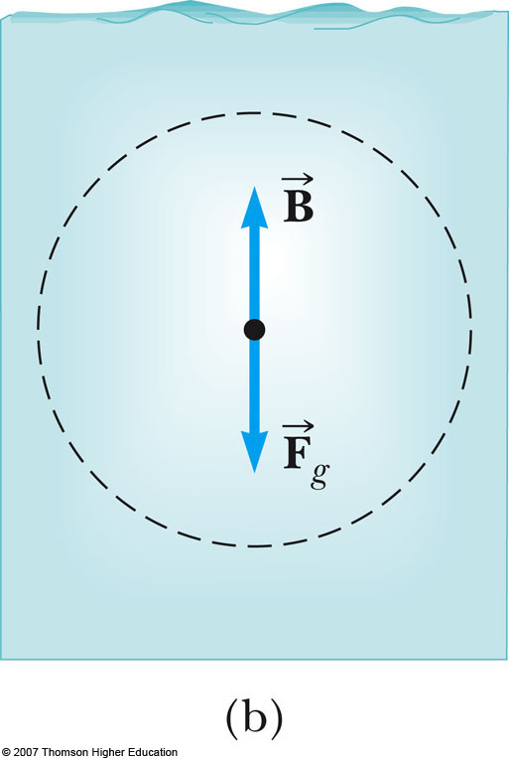
Buoyant Force
The buoyant force is the upward force exerted by a fluid on any immersed object
The parcel is in equilibrium
There must be an upward force to balance the downward gravitational force

Slide 27
Buoyant Force, cont
The magnitude of the upward (buoyant) force must equal (in magnitude) the downward gravitational force
The buoyant force is the resultant force due to all forces applied by the fluid surrounding the parcel

Slide 28
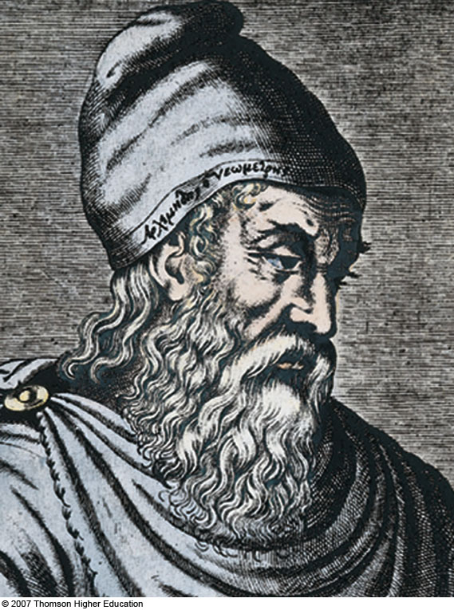
Archimedes
C. 287 – 212 BC
Greek mathematician, physicist and engineer
Computed ratio of circle’s circumference to diameter
Calculated volumes of various shapes
Discovered nature of buoyant force
Inventor
  Catapults, levers, screws, etc.

Slide 29
Archimedes’s Principle
The magnitude of the buoyant force always equals the weight of the fluid displaced by the object
  This is called Archimedes’s Principle
Archimedes’s Principle does not refer to the makeup of the object experiencing the buoyant force
  The object’s composition is not a factor since the buoyant force is exerted by the fluid

Slide 30
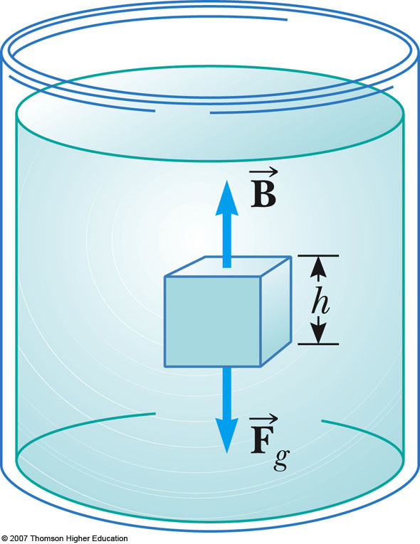
Archimedes’s Principle, cont
The pressure at the top of the cube causes a downward force of P_{top} A
The pressure at the bottom of the cube causes an upward force of P_{bot} A
B = (P_{bot} – P_{top}) A
= ρ_{fluid} g V = Mg

Slide 31
Archimedes's Principle: Totally Submerged Object
An object is totally submerged in a fluid of density ρ_{fluid}
The upward buoyant force is
B = ρ_{fluid} g V = ρ_{fluid} g V_{object}
The downward gravitational force is
F_{g} = Mg = = ρ_{obj} g V_{obj}
The net force is B - F_{g} = (ρ_{fluid} – ρ_{obj}) g V_{obj}

Slide 32
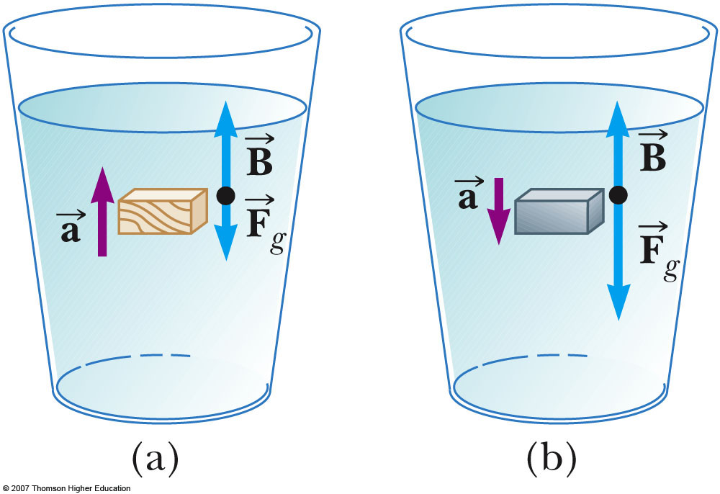
Archimedes’s Principle: Totally Submerged Object, cont
If the density of the object is less than the density of the fluid, the unsupported object accelerates upward
If the density of the object is more than the density of the fluid, the unsupported object sinks
The direction of the motion of an object in a fluid is determined only by the densities of the fluid and the object

Slide 33
Archimedes’s Principle:
Floating Object
The object is in static equilibrium
The upward buoyant force is balanced by the downward force of gravity
Volume of the fluid displaced corresponds to the volume of the object beneath the fluid level

Slide 34
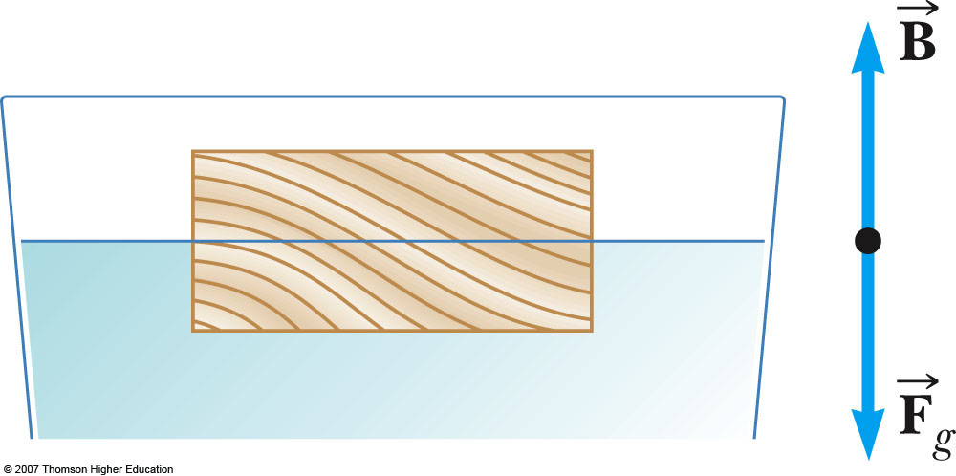
Archimedes’s Principle:
Floating Object, cont
The fraction of the volume of a floating object that is below the fluid surface is equal to the ratio of the density of the object to that of the fluid
  Use the active figure to vary the densities

Slide 35
Archimedes’s Principle, Crown Example
Archimedes was (supposedly) asked, “Is the crown made of pure gold?”
Crown’s weight in air = 7.84 N
Weight in water (submerged) = 6.84 N
Buoyant force will equal the apparent weight loss
  Difference in scale readings will be the buoyant force

Slide 36
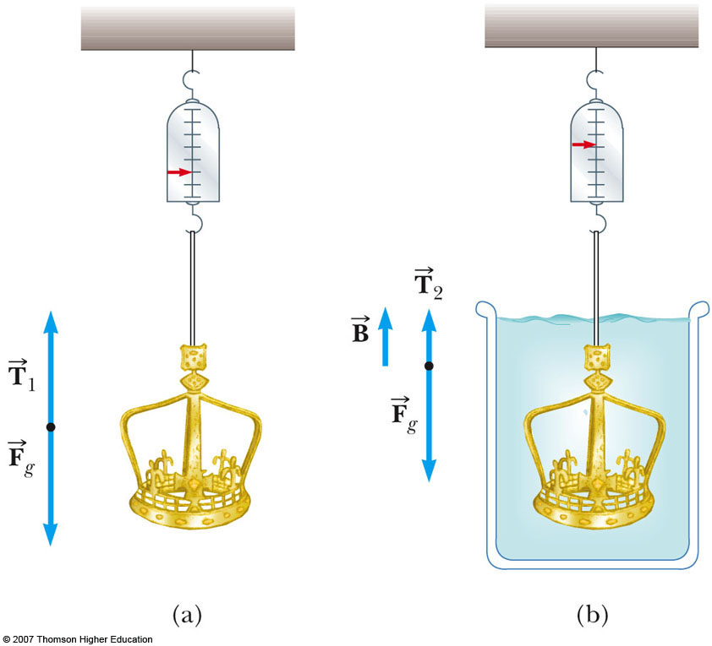
Archimedes’s Principle, Crown Example, cont.
ΣF = B + T₂ – F_{g} = 0
B = F_{g} – T₂
(Weight in air – “weight” in water)
Archimedes’s principle says B = ρgV
  Find V
Then to find the material of the crown, ρ_{crown} = m_{crown in air} / V

Slide 37
Archimedes’s Principle, Iceberg Example
What fraction of the iceberg is below water?
The iceberg is only partially submerged and so V_{seawater} / V_{ice} = ρ_{ice} / ρ_{seawater} applies
The fraction below the water will be the ratio of the volumes (V_{seawater} / V_{ice})

Slide 38
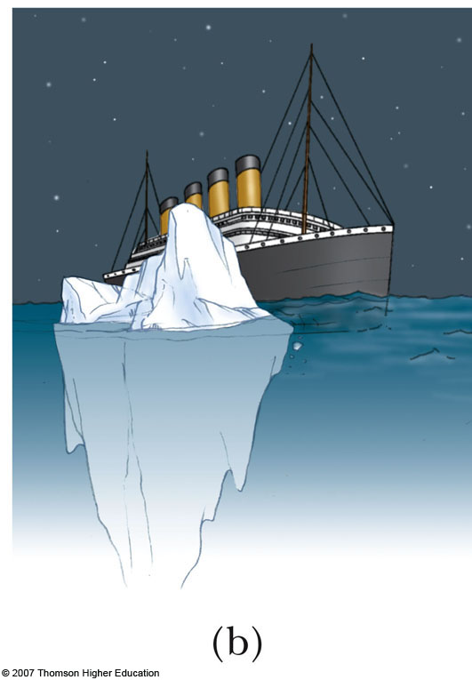
Archimedes’s Principle, Iceberg Example, cont
V_{ice} is the total volume of the iceberg
V_{water} is the volume of the water displaced
  This will be equal to the volume of the iceberg submerged
About 89% of the ice is below the water’s surface

Slide 39
Types of Fluid Flow – Laminar
Laminar flow
  Steady flow
  Each particle of the fluid follows a smooth path
  The paths of the different particles never cross each other
  Every given fluid particle arriving at a given point has the same velocity
  The path taken by the particles is called a streamline

Slide 40
Types of Fluid Flow – Turbulent
An irregular flow characterized by small whirlpool-like regions
Turbulent flow occurs when the particles go above some critical speed

Slide 41
Viscosity
Characterizes the degree of internal friction in the fluid
This internal friction, viscous force, is associated with the resistance that two adjacent layers of fluid have to moving relative to each other
It causes part of the kinetic energy of a fluid to be converted to internal energy

Slide 42
Ideal Fluid Flow
There are four simplifying assumptions made to the complex flow of fluids to make the analysis easier
(1) The fluid is nonviscous – internal friction is neglected
(2) The flow is steady – the velocity of each point remains constant

Slide 43
Ideal Fluid Flow, cont
(3) The fluid is incompressible – the density remains constant
(4) The flow is irrotational – the fluid has no angular momentum about any point

Slide 44
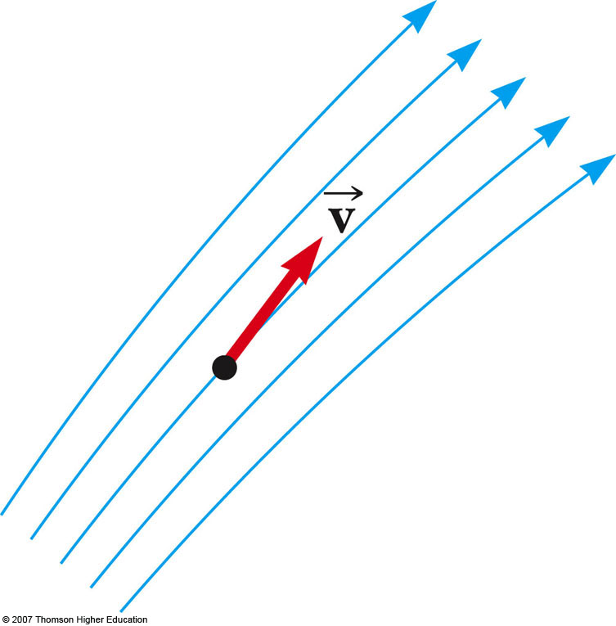
Streamlines
The path the particle takes in steady flow is a streamline
The velocity of the particle is tangent to the streamline
A set of streamlines is called a tube of flow

Slide 45
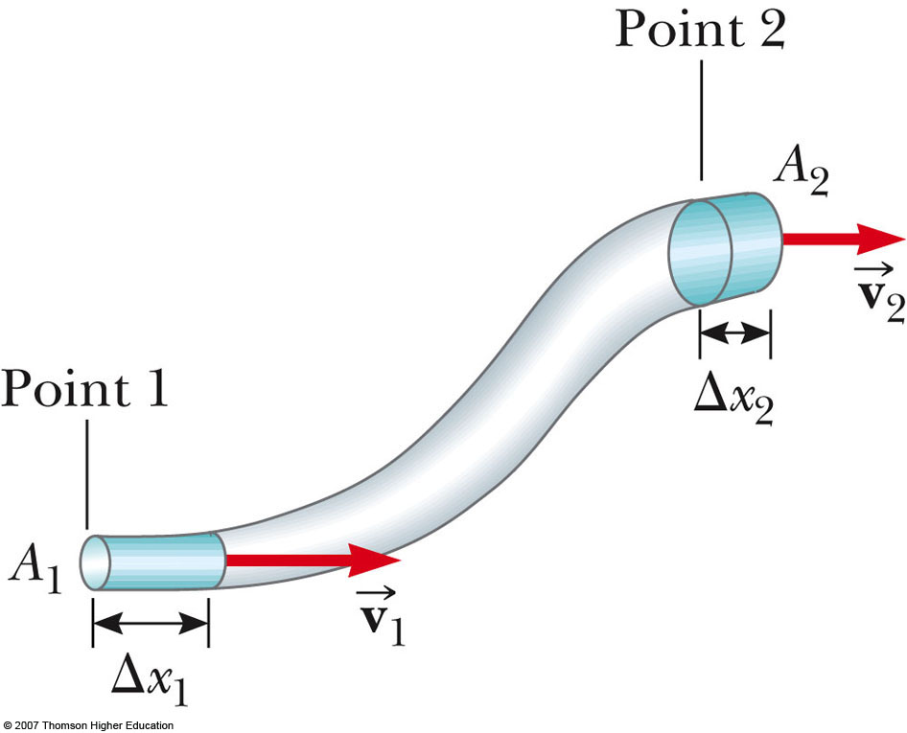
Equation of Continuity
Consider a fluid moving through a pipe of nonuniform size (diameter)
The particles move along streamlines in steady flow
The mass that crosses A₁ in some time interval is the same as the mass that crosses A₂ in that same time interval

Slide 46
Equation of Continuity, cont
m₁ = m₂ or ρA₁v₁ = ρA₂v₂
Since the fluid is incompressible, ρ is a constant
A₁v₁ = A₂v₂
  This is called the equation of continuity for fluids
  The product of the area and the fluid speed at all points along a pipe is constant for an incompressible fluid

Slide 47
Equation of Continuity, Implications
The speed is high where the tube is constricted (small A)
The speed is low where the tube is wide (large A)
The product, Av, is called the volume flux or the flow rate
Av = constant is equivalent to saying the volume that enters one end of the tube in a given time interval equals the volume leaving the other end in the same time
  If no leaks are present

Slide 48
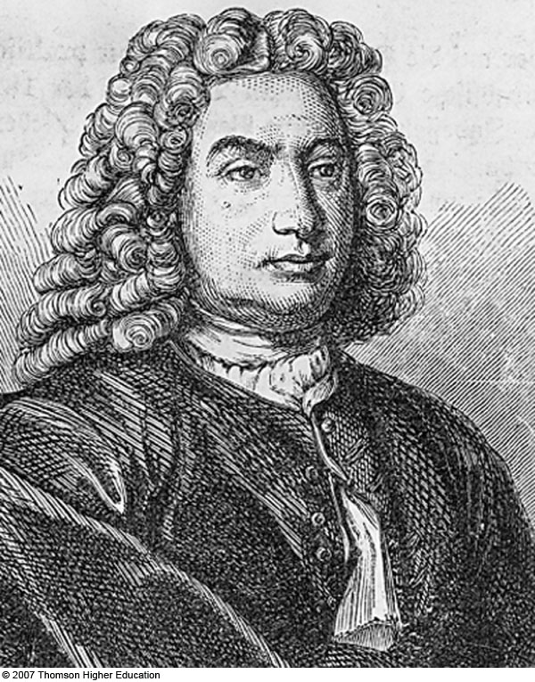
Daniel Bernoulli
1700 – 1782
Swiss physicist
Published Hydrodynamica
  Dealt with equilibrium, pressure and speeds in fluids
  Also a beginning of the study of gasses with changing pressure and temperature

Slide 49
Bernoulli’s Equation
As a fluid moves through a region where its speed and/or elevation above the Earth’s surface changes, the pressure in the fluid varies with these changes
The relationship between fluid speed, pressure and elevation was first derived by Daniel Bernoulli

Slide 50
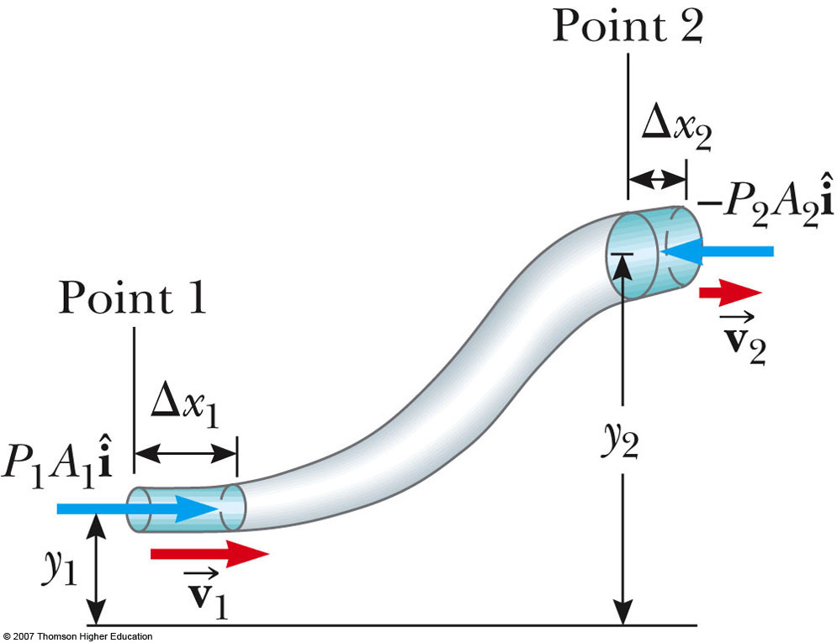
Bernoulli’s Equation, 2
Consider the two shaded segments
The volumes of both segments are equal
The net work done on the segment is W =(P₁ – P₂) V
Part of the work goes into changing the kinetic energy and some to changing the gravitational potential energy

Slide 51
Bernoulli’s Equation, 3
The change in kinetic energy:
  ΔK = ½ mv₂² - ½ mv₁²
  There is no change in the kinetic energy of the unshaded portion since we are assuming streamline flow
  The masses are the same since the volumes are the same

Slide 52
Bernoulli’s Equation, 4
The change in gravitational potential energy:
  ΔU = mgy₂ – mgy₁
The work also equals the change in energy
Combining:
  (P₁ – P₂)V =½ mv₂² - ½ mv₁² + mgy₂ – mgy₁

Slide 53
Bernoulli’s Equation, 5
Rearranging and expressing in terms of density:
P₁ + ½ ρv₁² + mgy₁ = P₂ + ½ ρv₂² + mgy₂
This is Bernoulli’s Equation and is often expressed as
P + ½ ρv² + ρgy = constant
When the fluid is at rest, this becomes P₁ – P₂ = ρgh which is consistent with the pressure variation with depth we found earlier

Slide 54
Bernoulli’s Equation, Final
The general behavior of pressure with speed is true even for gases
  As the speed increases, the pressure decreases

Slide 55
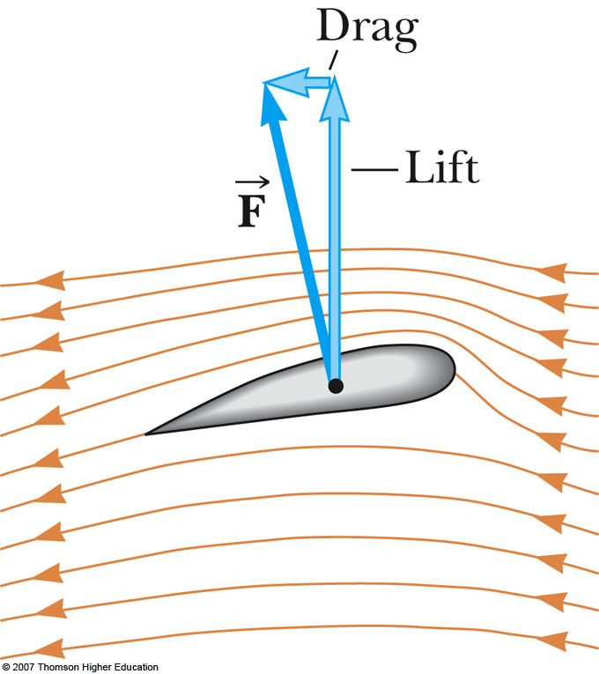
Applications of Fluid Dynamics
Streamline flow around a moving airplane wing
Lift is the upward force on the wing from the air
Drag is the resistance
The lift depends on the speed of the airplane, the area of the wing, its curvature, and the angle between the wing and the horizontal

Slide 56
Lift – General
In general, an object moving through a fluid experiences lift as a result of any effect that causes the fluid to change its direction as it flows past the object
Some factors that influence lift are:
  The shape of the object
  The object’s orientation with respect to the fluid flow
  Any spinning of the object
  The texture of the object’s surface

Slide 57
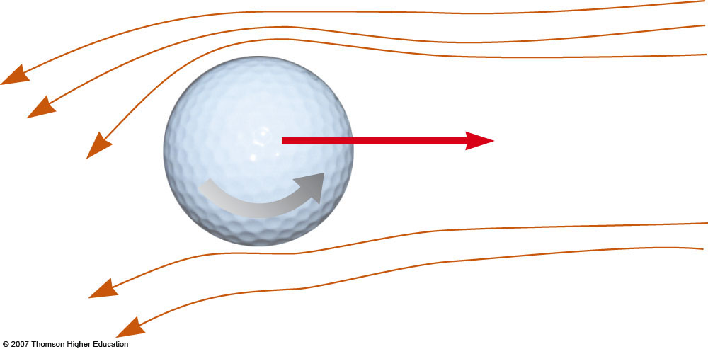
Golf Ball
The ball is given a rapid backspin
The dimples increase friction
  Increases lift
It travels farther than if it was not spinning

Slide 58
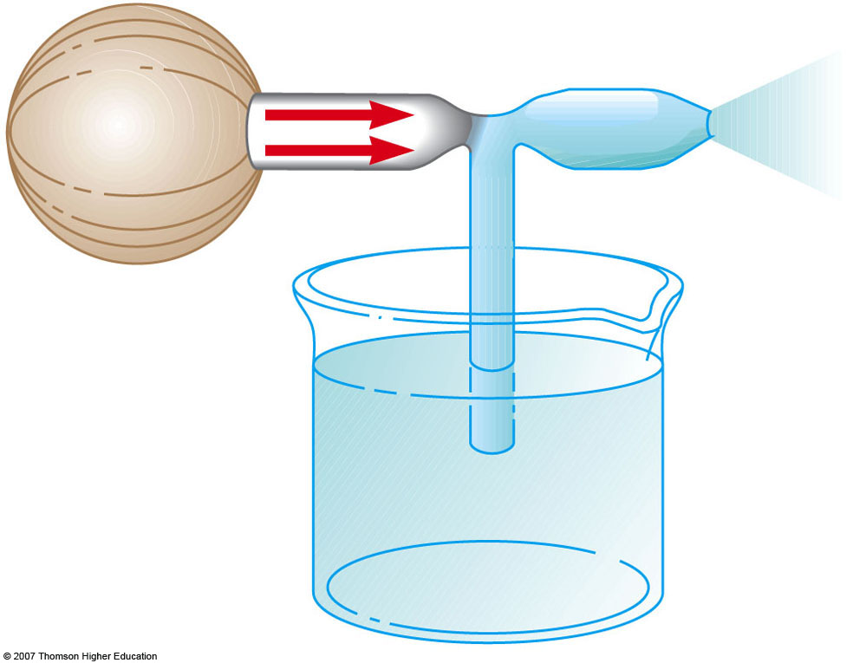
Atomizer
A stream of air passes over one end of an open tube
The other end is immersed in a liquid
The moving air reduces the pressure above the tube
The fluid rises into the air stream
The liquid is dispersed into a fine spray of droplets

