Slide 1
Non deterministic path analysis on cFlow
WEN FAN
2021.9

Slide 2
Content
Problem
Reason
Solution
Result
Next step

Slide 3
Content
Problem
Reason
Solution
Result
Next step

Slide 4


Problem
Run cFlow on hadoop_common 3.3.0 several times,
And I get two different outputs.
a.txt: 28738 lines
b.txt: 28746 lines

Slide 5
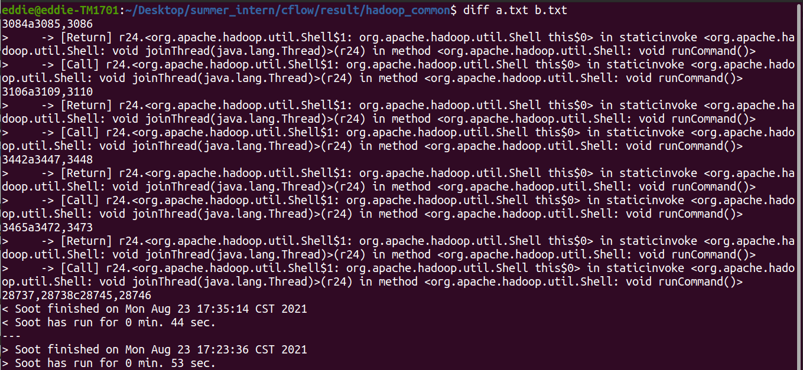
Problem
b.txt has more taints about call and return on method joinThread().
单击此处添加文本

Slide 6
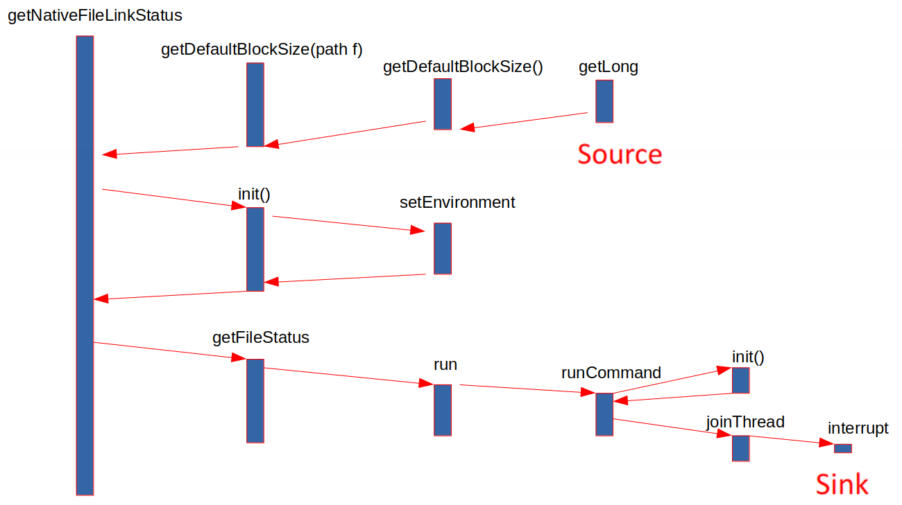
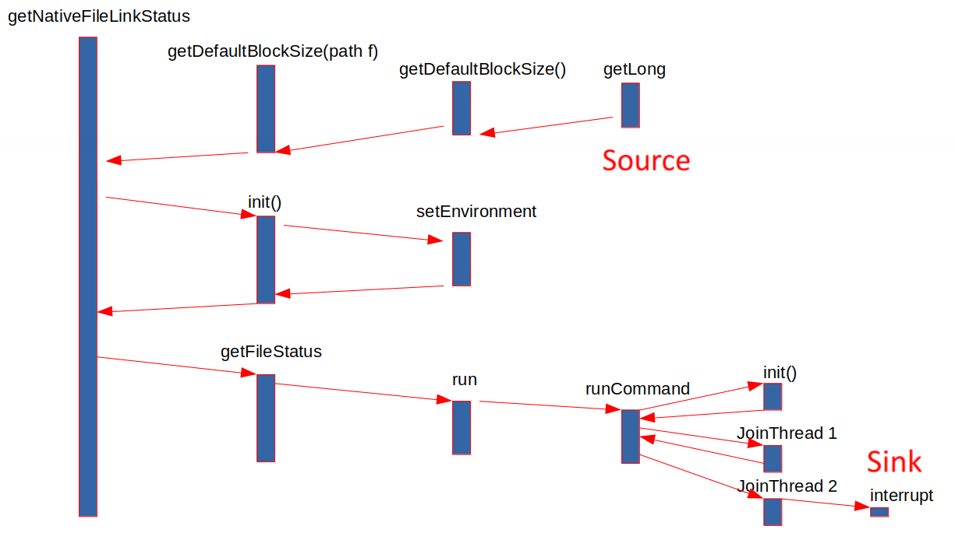
Problem
I trace the taint propagation path(at line 3084) that contains the difference above.
a.txt
b.txt

Slide 7
Content
Problem
Reason
Solution
Result
Next step

Slide 8
Reason
For simplicity, I adjust cFlow by
Printing all taint propagation paths between each pair of source and sink.
Only detecting method getLong() as source and method interrupt() as sink.
Only Considering the taint propagation path after method runCommand().
Also, I analyze the control flow graph of method runCommand() and joinThread().

Slide 9
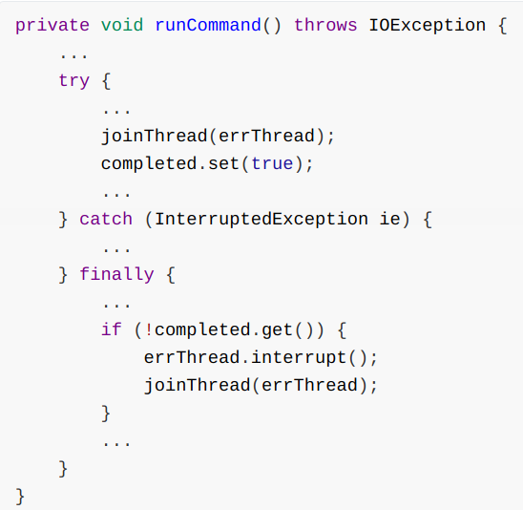
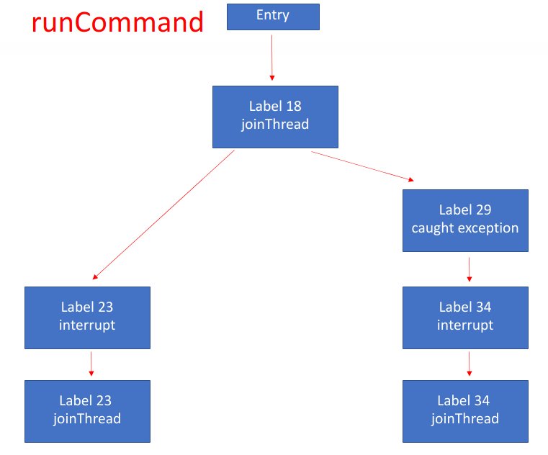
Reason
Here is the logic structure of method runCommand().
Source code
CFG

Slide 10
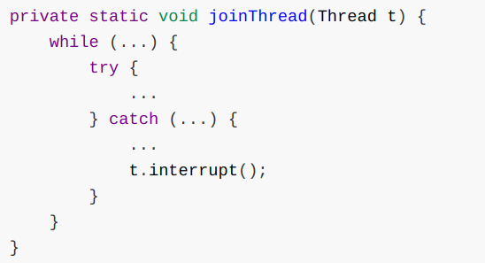
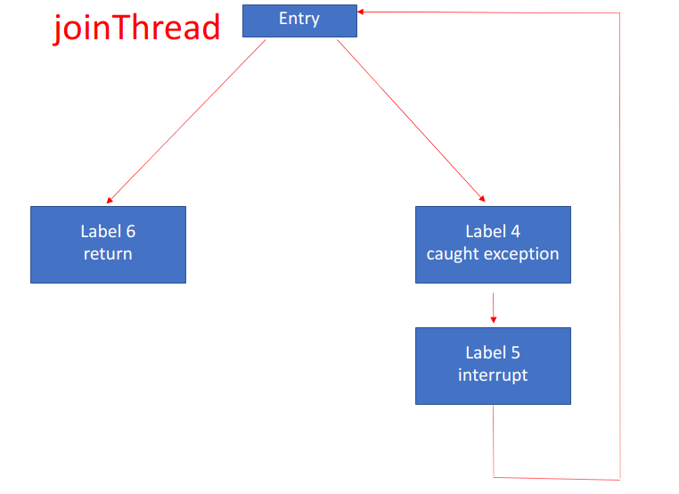
Reason
Here is the logic structure of method joinThread().
Source code
CFG

Slide 11
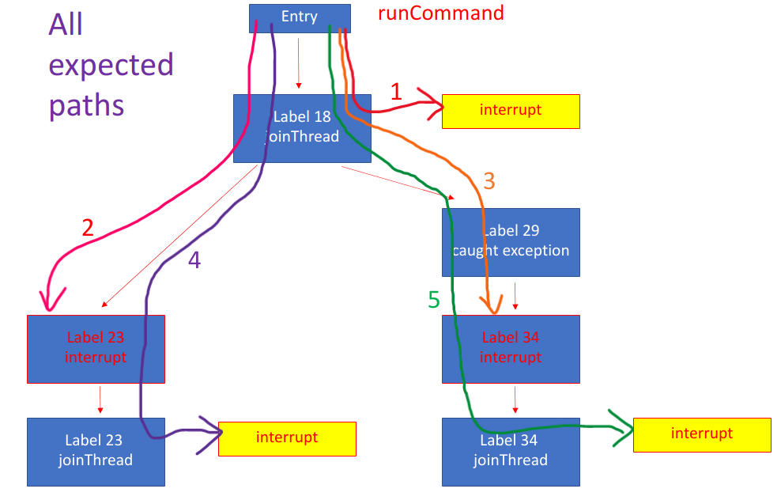
Reason
Theoratically, there are five propagation paths to interrupt().

Slide 12
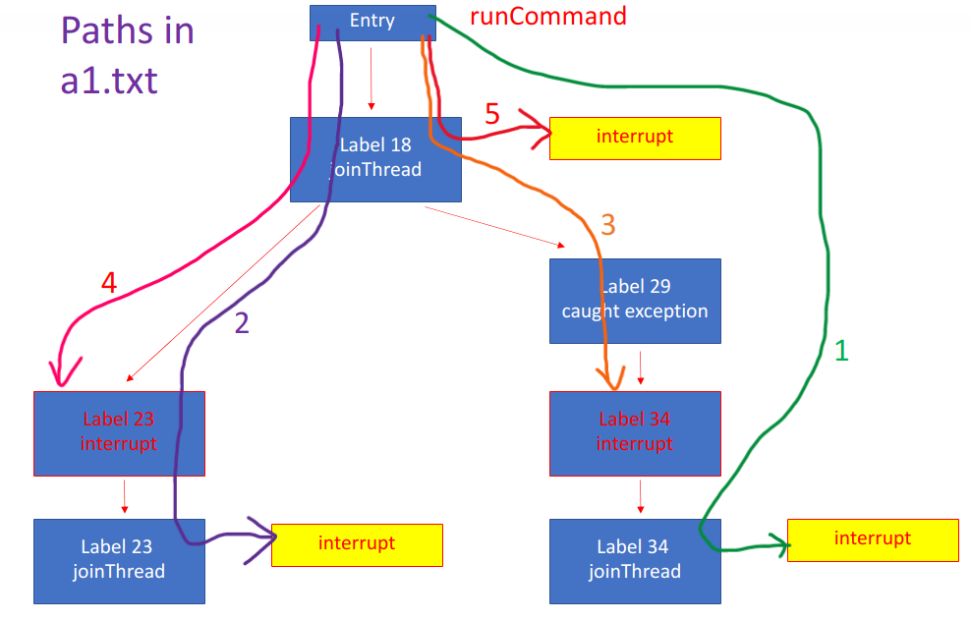
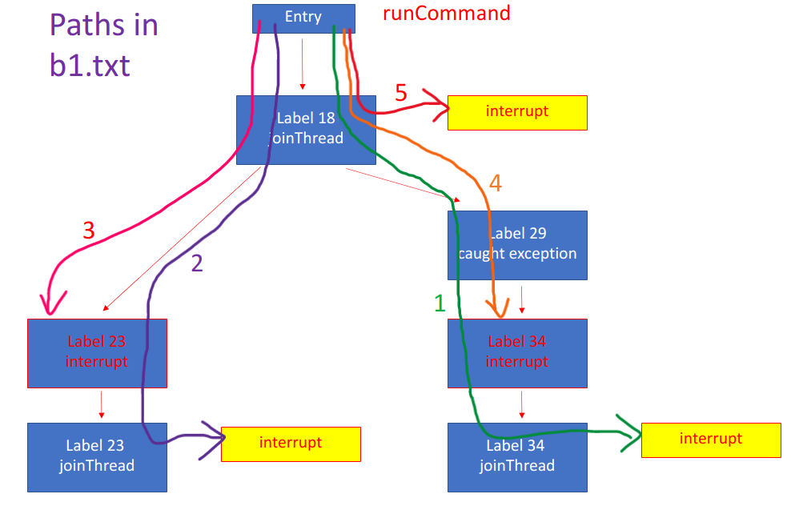
Reason
However, I get two different outputs after this adjustment.
a1.txt
b1.txt

Slide 13
Reason
From a1.txt and b1.txt, we can find that
paths in b1.txt are the same as the expected paths.
only path 1 in a1.txt and path1 in b1.txt are different.
a1.txt
b1.txt
expected

Slide 14
Reason
I use IntelliJ IDEA to trace the path reconstruction step.
Before the trace, I record the identityHashCode of each invoke statement of method joinThread() and interrupt().
I have found a difference when current taint is

Slide 15
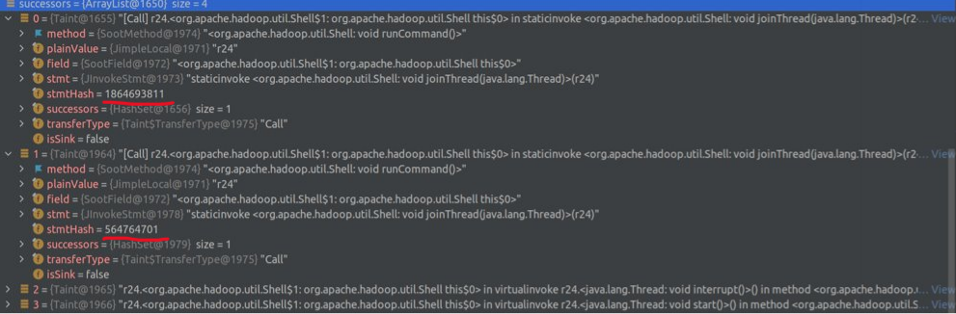
Reason
In one case, the sorted list successors is
{
Invoke joinThread 1864693811
Invoke joinThread 564764701
Invoke
interrupt
Invoke
start
}

Slide 16
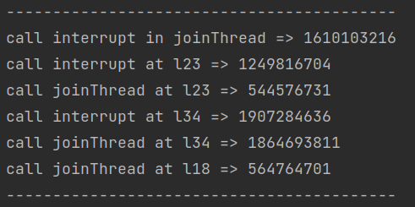
Reason
Since the Map from IdentityHashCode to Statement is
So successors is
{
Invoke joinThread
at Label 34
Invoke joinThread
at Label 18
Invoke
interrupt
Invoke
start
}

Slide 17
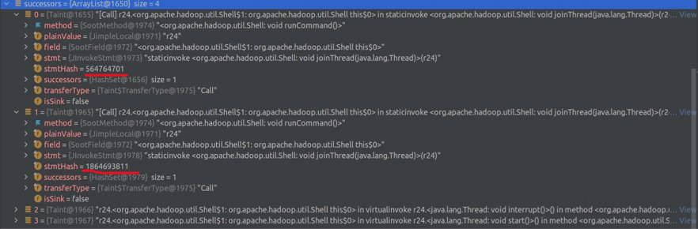
Reason
In another case, the sorted list successors is
{
Invoke joinThread 564764701
Invoke joinThread 1864693811
Invoke
interrupt
Invoke
start
}

Slide 18
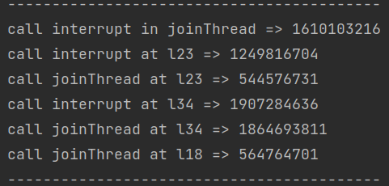
Reason
Since the Map from IdentityHashCode to Statement is
So successors is
{
Invoke joinThread
at Label 18
Invoke joinThread
at Label 34
Invoke
interrupt
Invoke
start
}

Slide 19
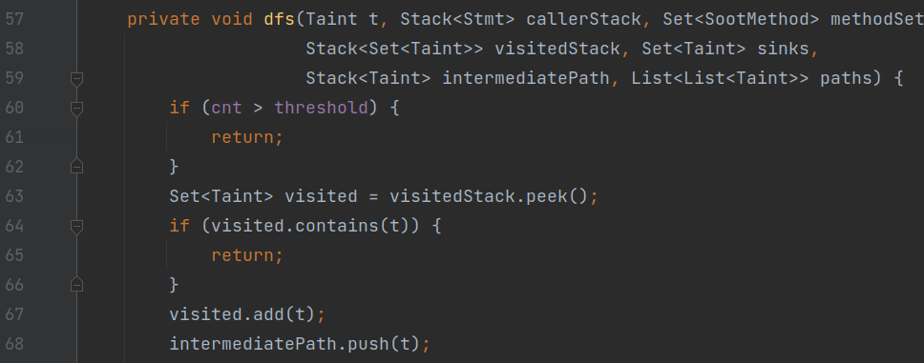
Reason
Different sequence in successors(as an open list) can cause different sequence of DFS searching, which contributes to different paths due to visitedStack.
VisitedStack can avoid repetitious visit to one taint in the same procedure.

Slide 20
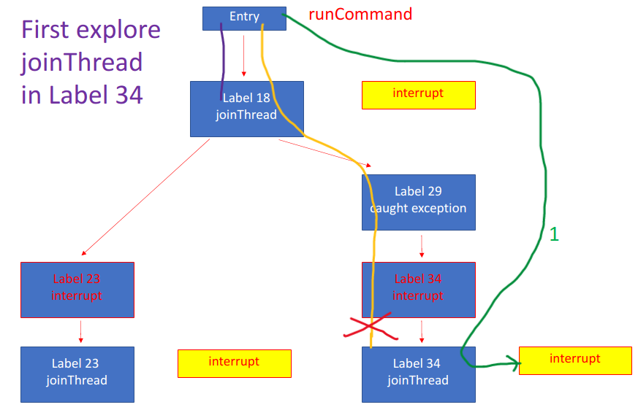
Reason
The first case causes the result of a1.txt.
Searching case 1
a1.txt

Slide 21
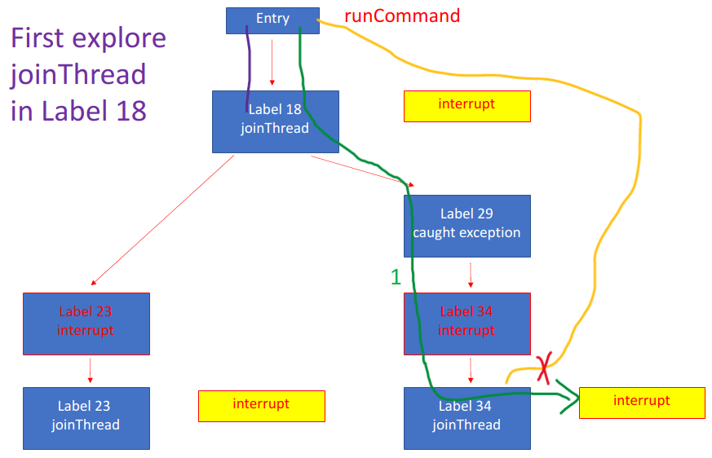
Reason
Another case causes the result of b1.txt.
Searching case 2
b1.txt

Slide 22
Reason
Why successors is not deterministically sorted after the sort?
Originally, the sequence of taints appended into successors is not deterministic(Soot???)
The sort is stable and it is based on the comparison on the string representation of taint. However, Two taints on invoke statement of joinThread() has the same string representation

Slide 23
Content
Problem
Reason
Solution
Result
Next step

Slide 24
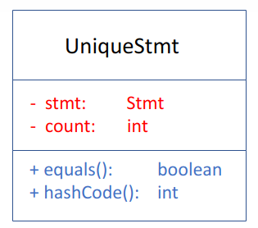
Solution
Since it is not easy to change the feature of Soot , I try to add more information to each statement for comparison.
Here, I encapsulate each statement with its sequence number(count) as UniqueStmt, so those statements are distinct in comparison.

Slide 25
Solution
I get UniqueStmt for each statement in method flowThrough()
To save memory, I use some HashMaps to maintain a cache for UniqueStmts that have been created. And It requires some time for caching.

Slide 26
Solution
Then I only need to add the info of statement count for comparison. That is, I change the comparison from
to

Slide 27
Content
Problem
Reason
Solution
Result
Next step

Slide 28
Result
I test the revised cFlow on hadoop_common 3.3.0 for 10 times and check the outputs.
All output files contain 28746 lines and they only differ in execution time.
Both versions have 29 iterations to build taint propagation graph. However, the original one requires 50s, but the revised one requires 3min 20s.
deterministic
Sacrifices performance

Slide 29
Content
Problem
Reason
Solution
Result
Next step

Slide 30
Next step
Test cFlow on more applications
Consider implicit taint propagation
Consider Alias Analysis

