Slide 1
Role of Science and technology in China’s Health Sector
Piyush Ahuja 2008MT50454
Shitij Chohan 2008TT10705
Seema Chauhan 2009CH70191

Slide 2
Outline
Overview of Chinese Health Sector
Historical Perspective and Challenges
Reform and role of Science and Technology
e-Healthcare
Pharmaceutical Sector
Medical Equipments
Distribution Systems
Future Challenges
References

Slide 3
Overview of Chinese Health Sector
1949-1979
Socialist government
Free health care
Urban: Work units
Rural: 3 tier system
1990-2005
Public to Private health care service
High out of the pocket expenses
1980-1990
Market pressures
Healthcare funding and Insurance coverage decreased
2005-present
Universal health care coverage
Use of ICT in Health

Slide 4
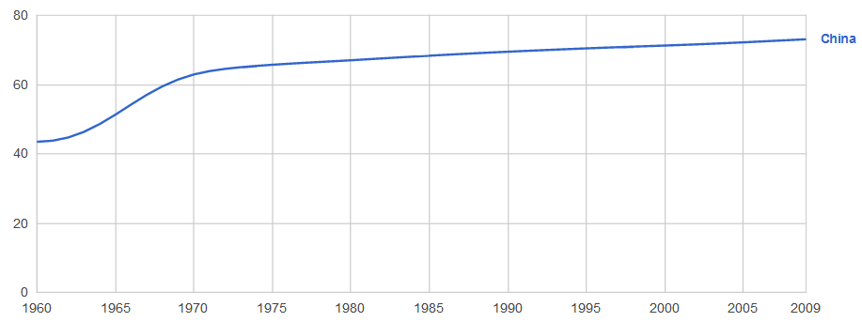
Historical Perspective and Challenges
Beginning in 1949 – state owned
Enormous improvements in health despite slow economic growth
Life expectancy almost doubled (from 35 to 68)
dramatic drop in infant mortality(falling from 200 to 34 per 1,000 live births)
Investments in public health through a highly centralized government agency
Cost-effective approach to improving health

Slide 5
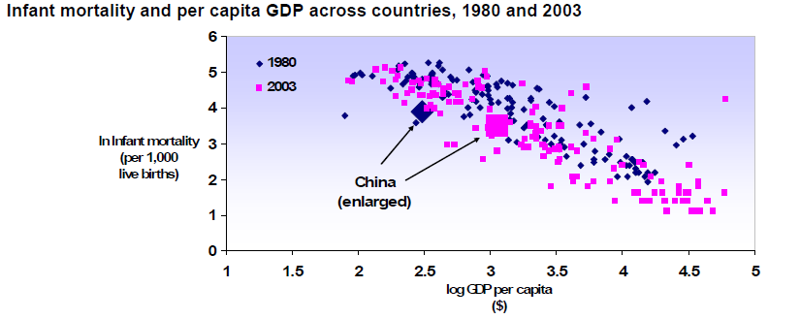
Historical Perspective and Challenges
Launched market-oriented reforms in 1979
Indicators at the end of 70s compared well with countries at a similar per capita income level
Source: WHO

Slide 6
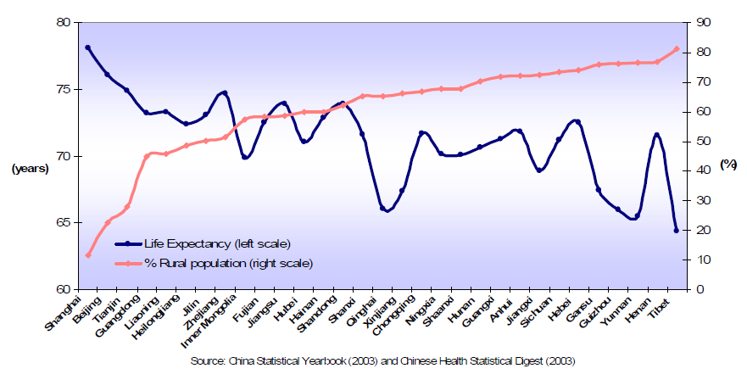
Historical Perspective and Challenges
Source: WHO
Collapse of the CMS system in rural areas
Inequality and disparities in health outcomes – a critical challenge
Problems like black market, overprovision of profitable high-tech services, overuse of prescription drugs

Slide 7
Reforms and the role of Science and Technology
Government has acknowledged the need for reform
Plans to achieve equal access to public healthcare by 2020
Extend basic medical insurance coverage
Government sponsored training
Promote price-competitive generic medicines
Consolidate pharmaceutical distribution channels
Construction of Community hospitals and clinics
Extensive focus on using science and technology in the reformation process, especially in the following areas:
E-Healthcare
Pharmaceutical Sector
Medical Equipments

Slide 8
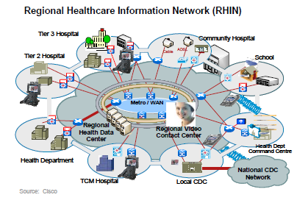
e-Healthcare
Use of information technology and modern networked communication
infrastructure to manage health care related processes
Finance/Administration related functions
Hospital Management information
Hospital clinical information
Geographic management Information
Information Systems
Clinical/Diagnostic functions
Information sharing functions
Provincial Govt : RHIN and HIT in public hospital
National Govt : IT infrastructure development and standardization of EMR and EHR
Private Hospital: HMIS and HCIS
Electronic Medical Record (EMR)
Electronic Health Record (EHR)
Regional Health Information Network (RHIN )
Health Information Technology( HIT)
Source: KPMG

Slide 9
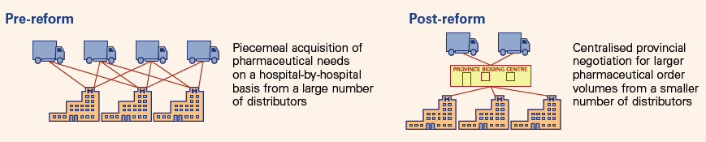
e-Healthcare
It is a very fast growing area in China with Compound annual growth for 2007-2012 is estimated at 21.2%.
Policy and Infrastructure
Increasing number of health care facilities
Establishment of universal health care insurance
Technological and Process Improvement
Improved infectious disease surveillance ( Chinese CDC)
Remote clinical and diagnostic facilities
Central procurement and distribution of drugs
RHIN to manage information between Departments, Hospitals, Medical insurance and Health administration
ERP and inventory software to improve procurement process
Source: KPMG

Slide 10
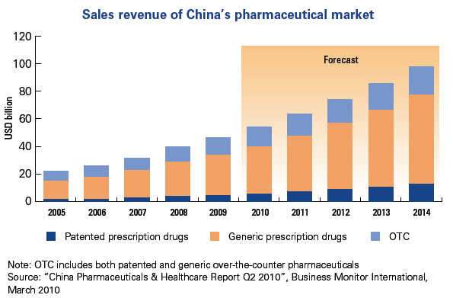
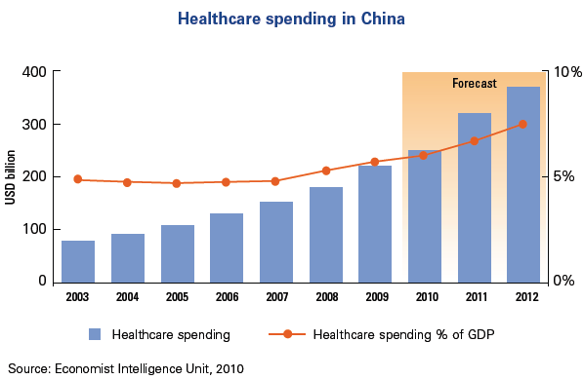
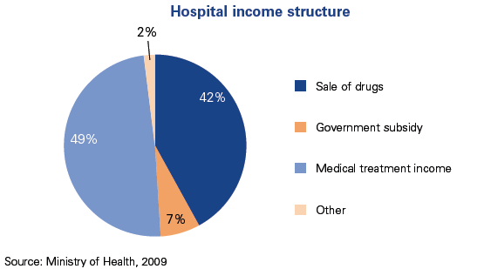
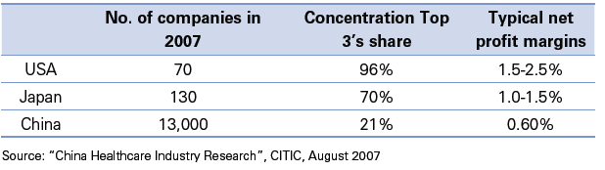
Effect of Policy and IT on Healthcare
Consolidation in drug manufacturers
Differentiation between Public and Private hospitals
Growth of medical equipment, HIT and infrastructure
Increase in OTC drugs
Source: KPMG

Slide 11
ICT
RFID
Training and Simulation
Patient Data storage and transfer
Digital Imaging
Websites and Podcast
Financial and Managerial Software
ERP
Management
Remote Diagnosis

Slide 12
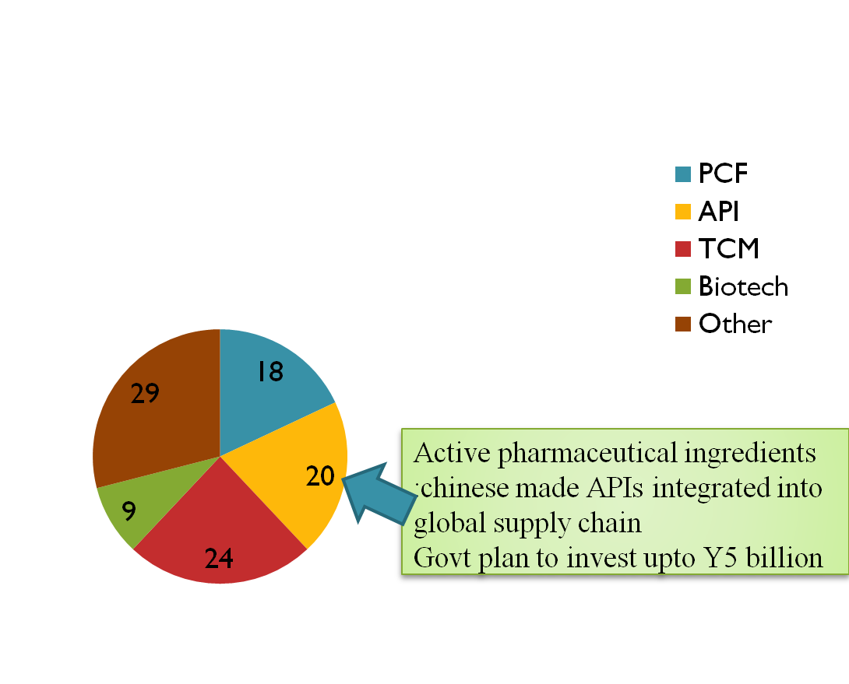
Current Composition of China’s Pharmaceutical Market
Pharmaceutical Chemical Formulation
23 % of total sales
Market size: US $24 billion
90% of China’s US $9.8 billion biotech market is focused on biogeneric products
Traditional Chinese Medicine: US $ 22.5 billion
I/4 th of china’s drug companies produce TCM

Slide 13
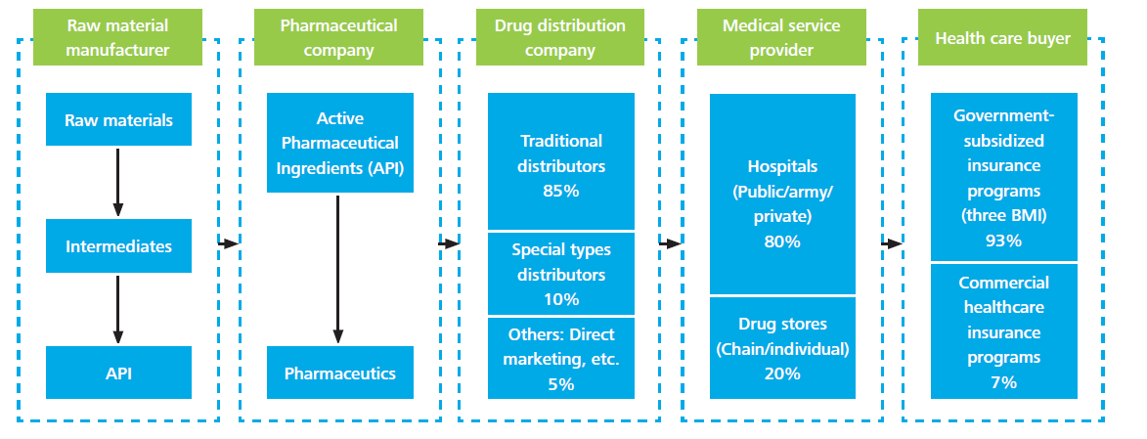
Chinese Pharmaceutical Industry Value Chain
Dominated by domestic generic pharmaceuticals
Vertically integrated distribution channels for pharmacy products
Less indigenous patents
Growing at an average annual rate of 16.72% over the last few decades.
Drug administration departments are established at both central and regional governmental level

Slide 14
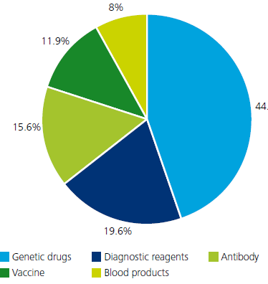
Biotech Sector
account for 10 % of total pharmaceuticals
market in China
Investment of RMB10 billion to support drug
innovation
recent annual growth rate of 32.2 percent
strong domestic pharmaceutical
capacity
20 biotech zones nationwide
Biologics and biosimilars in china, market shares by sales,2010

Slide 15
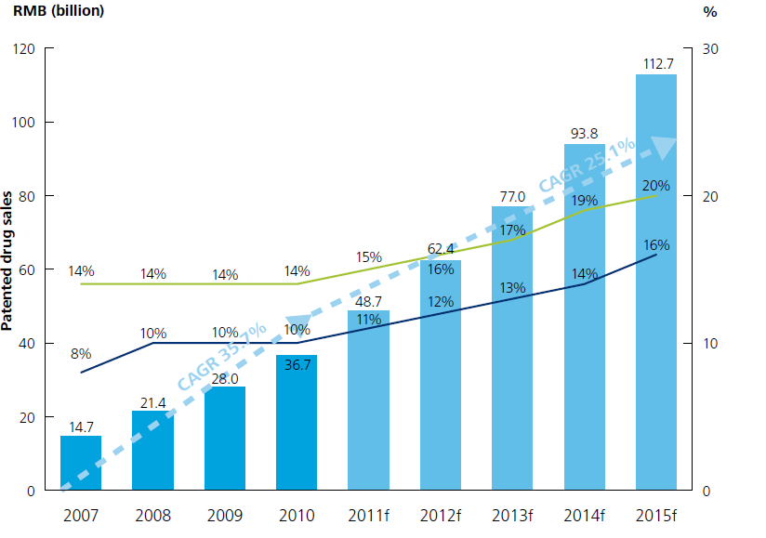

Patented drug sales in China, 2007–2015

Slide 16
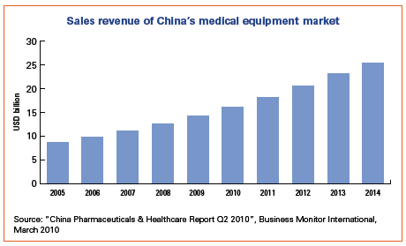
Medical Equipments
Investment in rural hospitals and clinics driving demand for low and mid range medical equipment
Government pushing “indigenous innovation” (favouring local firms in tendering, procurement and so on…)
Frugal innovation” + leapfrogging to the latest technologies (miniaturization, mobile communications and advanced materials)
Reformed public procurement process with a renewed emphasis on enforcing existing regulation triggering consolidation amongst equipment manufacturers
Domestic equipment manufacturer moving quickly up the value chain
Source: KPMG

Slide 17
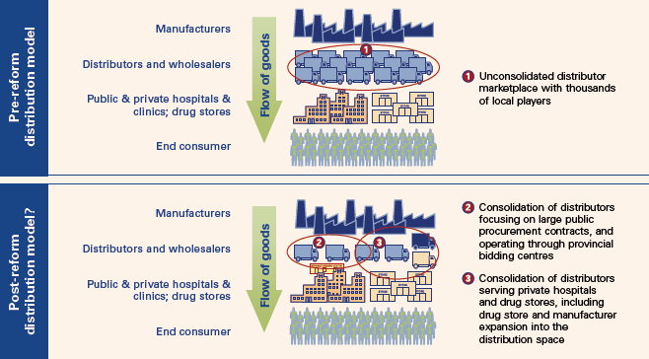
Distribution of Equipments and Pharmaceuticals
Source: KPMG

Slide 18
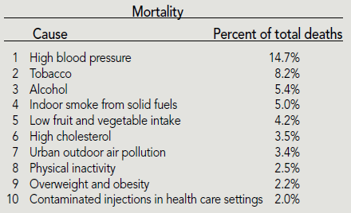
Future Challenges
The burden of disease in China is now dominated by premature adult mortality from chronic diseases such as cancers, cardiovascular disease and chronic obstructive lung disease
Changing demography – graying population

Slide 19
References
China Healthcare ICT: Reinventing China’s national healthcare system through electronic medical records, telecom networks and advanced IT servicesby Ken Zita, 2009
China HIT Case Study by Grace Yu, 2005
Changing face of Healthcare in China: changing public policy and resulting opportunity by KPMG
Life science and Healthcare in China: opportunities, challenges and implications by Deloitte
A comparison of health Systems in China and India by Sai Ma, Neeraj Sood, Centre for Asia Pacific Policy, Rand Occasional Paper,2007
The challenges of public health education with a particular reference to China by S.M. Grifﬁths,, L.M. Li, J.L. Tang ,X.Ma , Y.H. Hu , Q.Y. Meng
, H.Fu, Jouranal of Pubic Health, 2009

