Slide 1
Content
Introduction
Engagement Objective
Engagement Structure, Deliverables and Status
Engagement Details
Engagement Outcome
Lessons Learnt
Question & Answers

Slide 2


Introduction
 | Information About You
 | 4th Year Student, Department of Mathematics Academic Interests : Algorithmic Game Theory, Stochastic Modelling Based on the internship, have been extended a job offer which will be confirmed only next year.
Piyush Ahuja

Slide 3

Summer internship program
Final Presentation as part of Colloquim
Date: November 8, 2011
Presented by :
Piyush Ahuja

Slide 4
Engagement Objective
Build a Decision Support System from the raw data of Communication Excellence Program, aimed at improving the efficiency and effectiveness of the program by providing vital strategic information.
The system will support faster and better decision-making, incorporating various computing techniques in identifying, extracting and analyzing Business Data.

Slide 5
Engagement Structure, Deliverables and Status
Team Structure
Jignesh Barai
Nikita Dhameja
Anushree Ringne
Piyush Ahuja
Savin Goyal
Akshaya Nim
Deliverable Details
# | Deliverable Name | Del. Date | %age Completion | Status | Remarks
1 | Theoretical Data Model | Jun 15, 2011 | 100% | Done | -
2 | Technical Specifications of Tables | Jun 17, 2011 | 100% | Done | -
3 | Unit Test Document | Jun 27, 2011 | 100% | Done | -
4 | Combined ETL Code | Jul 6, 2011 | 100% | Done | -
5 | Final Code | Jul 19, 2011 | 100% | Done | -

Slide 6
Engagement Details - Overview
CE Database (Operational System) – day to day operations – doesn’t provide strategic information.
Two observations :
(1) Program has lots of data – Monthly CE Alert Sheet with data for all employees
(2) Requirement of technology resources and systems effective at turning all that data into useful strategic information.
Strategic information in the form of readily accessible, user-friendly and instantaneous reports of aggregated data .

Slide 7
Engagement Details - Objectives
Database for analytical tasks – Provide an integrated and total view of the CE data
Storage of both current and historical data.
Data flow design for periodic and stable update of content.
Interface permitting direct interaction with the system by the users without IT assistance.
Ability for users to run queries, initiate reports and get results online and on the fly.
Make decision-support transactions possible without hindering operational systems

Slide 8
Engagement Details – My Approach
Employed Data Warehousing.
Maintains its functions in three layers - staging, integration, and access
Dimensional approach : Transaction data partitioned into either "facts", generally numeric transaction data, or "dimensions", the reference information that gives context to the facts
Relational OLAP.
History Preservation through SCD 2.

Slide 9
Engagement Details - Approach
Steps followed –
Requirement Gathering
Physical Environment Setup – Getting the servers and softwares running
Data Modeling – Conceptual Model -> Logical Model -> Physical Model
ETL – Data Mapping
Report Development
Performance Tuning – Query Optimization
Quality Assurance – Rigorous Test Plan

Slide 10
How did I achieve the objectives
Database Tables - MySQL5.0 queries
Dimension Tables(SCD2) - SAP Business Objects Data Services Designer
Testing - Manually and MYSQL5.0 queries
Universe(interface & cardinality) - SAP Business Objects Enterprise Designer
Report Generation - Web Intelligence Rich Client
Creation of users with access rights - Central Management Console

Slide 11
Activities I Accomplished
Single click jobs for
Data dumping into the database staging area, from excel sheets
Data flow from the staging area into the dimension tables, ensuring SCD2
Data flow from the dimension tables into the fact table
Data updates and refreshing in the universe
Reporting via web intelligence rich client

Slide 12
Resources
Tools
MYSQL 5.0
SAP Business Objects Data Services Designer
SAP Business Objects Universe Designer
SAP Business Objects Web Rich Client
Info View
Reference Material
Data Warehousing Fundamentals by P.Ponniah
OCA Oracle Database 11g: SQL Fundamentals 1 by J.Watson

Slide 13
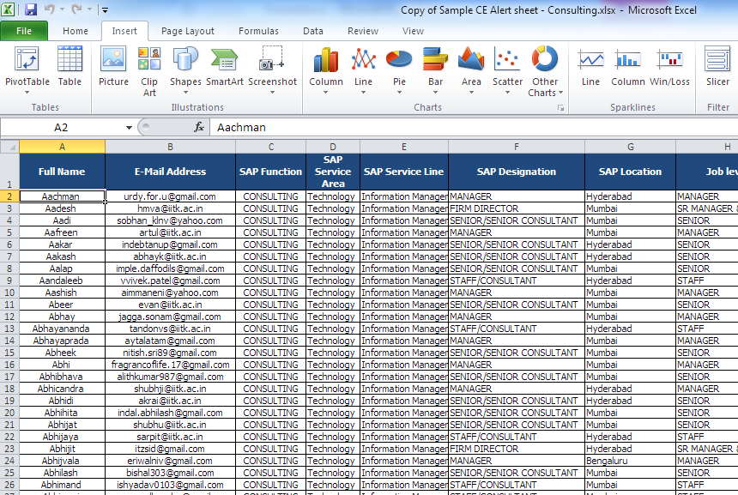
Engagement Outcome
Data Source – Excel Sheet

Slide 14
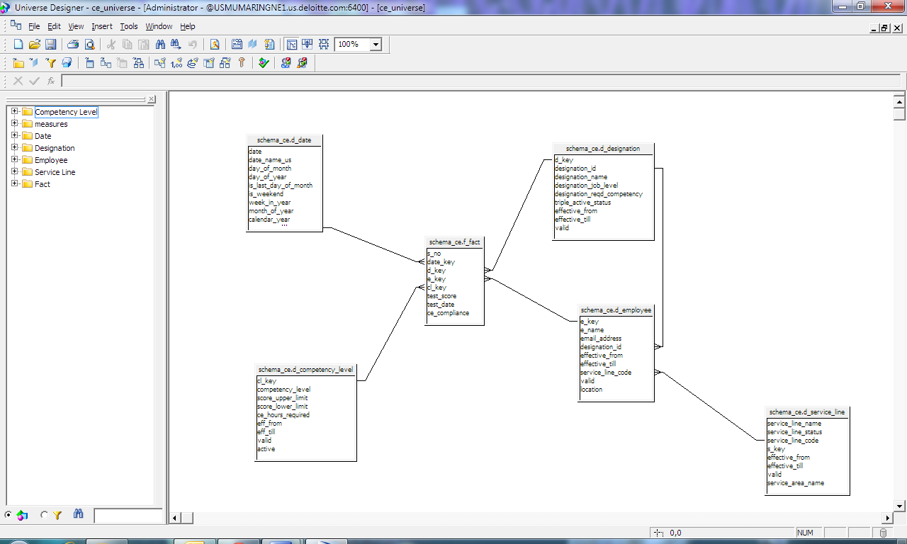
Engagement Outcome – Contd.
Implemented Data Model

Slide 15
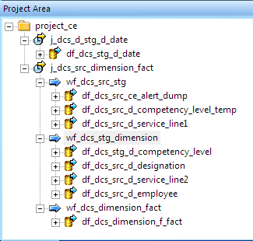
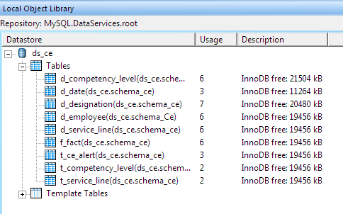
Engagement Outcome – Contd.
Tables and Data Flow using Business Objects Data Services

Slide 16
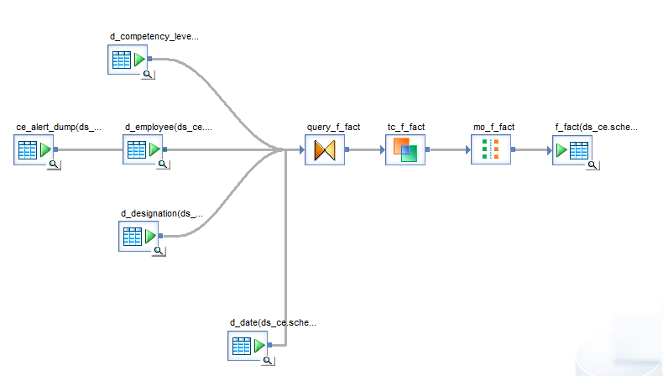
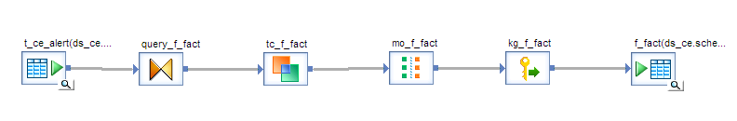
Engagement Outcome – Contd.
ETL using Business Objects Data Services

Slide 17
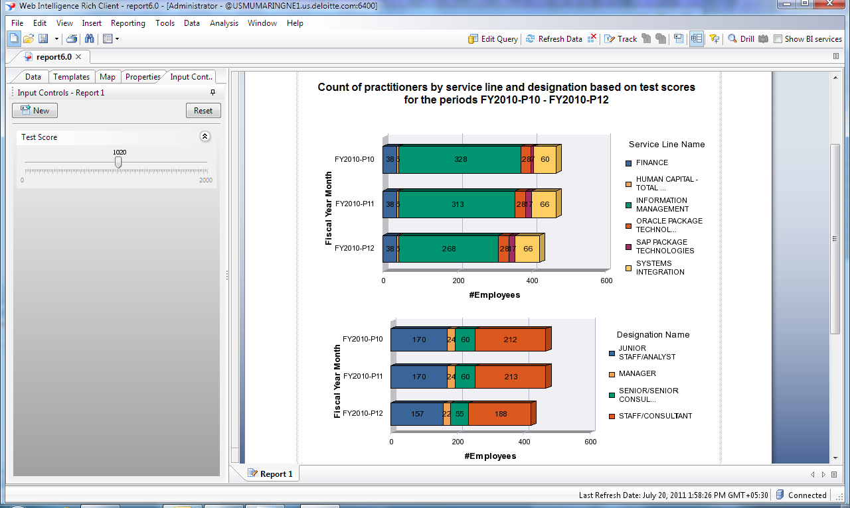
Engagement Outcome – Contd.
Reporting through Business Objects Enterprise

Slide 18
The Lessons I Learnt
Learnt the essentials of planning for a data warehouse and distinguishing between data warehouse projects and OLTP system projects.
Understand Data Warehouse architecture and how the framework supports flow of data.
Examine the data extraction function, its challenges, its techniques, and learn how to evaluate and apply the techniques
Learnt how to adapt the life cycle approach for a data warehouse project.
Discussed project team organization, roles, and responsibilities.

Slide 19

Q&A
Copyright © 2010 Deloitte Development LLC. All rights reserved.

