Slide 1
Market Equilibria
Piyush Ahuja
Pradeep George Mathias

Slide 2
Contents
Market Equilibria
Models: Walras vs Fisher
Mathematical Model
Non-convex program and implications
Convex Program(s)
Towards Combinatorial Algorithms

Slide 3
Market Equillibria
Walras Model
Initial Endowment of divisible goods
Utility Function for Consuming goods
Every person sells the initial endowment and then buys an optimal bundle of goods with the entire revenue i.e., the market clears
Walras asked whether a price can be assigned to every good so that this is possible.
Arrow –Debreu Theorem
Fisher Model – Two kinds of People , Producers and Consumers
Consumers have money and utility function for goods
Producers have initial endowment of goods and want to earn money
Special Case of Walras‘ Model

Slide 4
Models: Walras vs Fisher
Walras model - money has no intrinsic value - a scale to measure the value of goods
Fisher model assumes the value of the money.
This feedback feature of the Walras model

Slide 5
Mathematical Model
N people in the system,with initial endowment of divisible goods
Without loss of generality
Each person has a single good
Quantity of each good is 1
Further,
Each good has atleast someone interested in it
Each person is interested in atleast one good
With a little loss of generality
Each subset of persons has atleast one person outside the set who is interested in a good possessed by a person in the subset.

Slide 6
Non-zero liking graph
Arrow-Debreu allows for 0-priced goods
Consider the non-zero liking graph
If there exists set of goods in whom others are not interested, then it will not be a single SCC
Solve the problem for each SCC
In the acyclic components of the SCCs, scale the prices appropriately so that people will buy only goods from their own SCC
Prices can be set to 0 only for ‘initial’ SCCs.

Slide 7
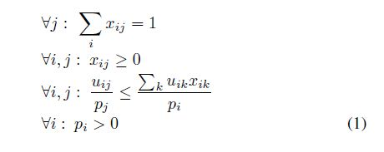
Characterization – a non-convex program
The feasible region of non-convex program 1 has all and only general market equilibria.

Slide 8
Implications
Prices are market-clearing
Money is spent optimally

Slide 9
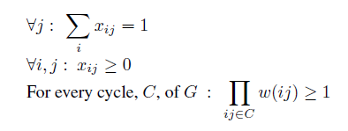

Convex Program 1
Non-Convex program feasible if and only of No Negative Cycle in the non-zero liking graph.

Slide 10
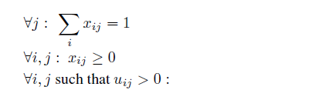

Convex Program 2
Non convex program 1 is equivalent to Convex program 2.
The set of equilibria prices, on a logarithmic scale, is convex.

Slide 11
Toward Combinatorial Algorithms
Combinatorial characterization - No Negative Cycle
Passive Characterization – doesn’t tell us how to fix it
Active characterization in Fisher’s model through Eisenberg-Gale’s LP

Slide 12
Possible directions
Can we discretize our search space?
Looking for an objective function whose optimal solutions are market equilibria
Can we move from price vector to optimal allocation vector and vice-versa easily?

Slide 13
References
K.Jain. A Polynomial Time Algorithm for Computing an Arrow-Debreu Market Equilibrium for Linear Utilities

