Slide 1
Design of a Combinatorial Algorithm for Computing A-D Market Equilibria
Piyush Ahuja
Pradeep George Mathias
Supervisor: Prof. Naveen Garg

Slide 2
Contents
Mathematical Model
Non-zero liking graph
Non convex program & implications
Equivalent convex program and combinatorial characterization
Removal of negative cycles
Open Questions

Slide 3
Mathematical Model
N people in the system, with initial endowment of divisible goods
Without loss of generality (in the linear utility case):
Each person has a single good
Quantity of each good is 1
Further,
Each good has atleast someone interested in it
Each person is interested in atleast one good
With a little loss of generality
Each subset of persons has atleast one person outside the set who is interested in a good possessed by a person in the subset.

Slide 4
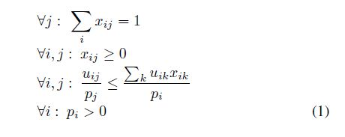
Characterization – a non-convex program

Slide 5
Non-zero liking graph
Directed graph having n nodes, each node representing a person/good
Directed edge from node i to node j iff uij > 0.
Our assumptions ensure that the Non-zero liking graph is a single SCC.
If there exists set of goods in whom others are not interested, then it will not be a single SCC
Solve the problem for each SCC
In the acyclic components of the SCCs, scale the prices appropriately so that people will buy only goods from their own SCC
Prices can be set to 0 only for ‘initial’ SCCs.

Slide 6

Implications
The feasible region of non-convex program has all and only general market equilibria.
Prices are market-clearing:
Money is spent optimally

Slide 7

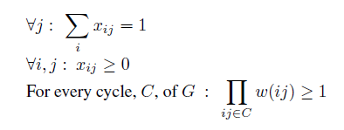
Convex Program
Modifying equation (3) gives :
Non-Convex program feasible if and only of No Negative Cycle in the non-zero liking graph (on logarithmic scale)

Slide 8
Toward Combinatorial Algorithms
Combinatorial characterization - No Negative Cycle
Passive Characterization – doesn’t tell us how to fix it
Active characterization in Fisher’s model through Eisenberg-Gale’s LP

Slide 9
Detection of Negative Cycles
Value of most negative cycle should be made >= 0. Iteratively increase the weight of this most negative cycle.
Control over only xij. Increase in xij results in increase of weights of all edges from node i.
If we have two negative cycles having different values, we can transfer some amount of good from one to the other so that the most negative cycle increases.

Slide 10
Floyd Warshall
Use Floyd-Warshall algorithm with edge weights to find most negative cycle containing a given vertex.
Gives value of the most negative cycle containing a vertex, not all the cycles that achieve this value.

Slide 11
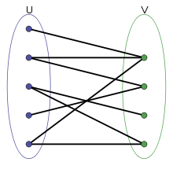
Allocation Graph
Bipartite graph (U, V): U are goods, V are users, edges demarcate allocation.
Useful in visualizing (re-)allocation of goods.

Slide 12
Open Questions
Can we reallocate goods within a cycle so as to ensure its weight increases?
Can we always find cycles with differing negativity? -Not necessarily. Eg. A single cycle graph.
FW cannot give us all cycles that achieve the maximum negativity. There can be exponential number of cycles. Need to correct all of them.
Cycles interleave at nodes. Hence trying to correct one cycle, affects all cycles that the node is part of.

Slide 13
References
K.Jain. A Polynomial Time Algorithm for Computing an Arrow-Debreu Market Equilibrium for Linear Utilities [2004]

Slide 14
Q/A ,Feedback?

