Slide 1
MAD 350
Project : Application of Measure Theory in Finance
Date: December 1, 2011
Piyush Ahuja
Undergraduate, Department of Mathematics
IIT Delhi
2008MT50454

Slide 2
Content
Capturing Information Flow in Financial Markets
Motivation and Definition of Conditional Expectation
Proof of Existence by Radon-Nikodym theorem
Alternative Construction for Finite Variance Random Variables
Generalization for Random Variables whose Lebesgue Integral exists
A Topological Approach (Hilbert Spaces)
Some Nice Properties

Slide 3
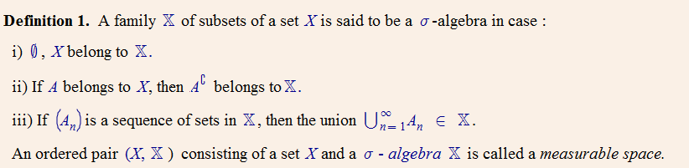
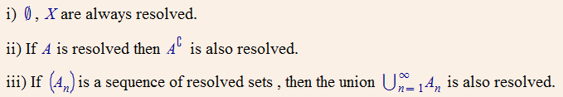
Capturing Information Flow in Financial Markets
Structure of a σ-algebra is specially suited to model information
Let the set of all outcomes of a random experiment be the set Ω, and let ω be a particular outcome
We have some information, which may or may not us in evaluating ω
If we know, for a set A , whether the eventual ω lies in it or not, then it is said to be resolved

Slide 4
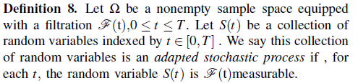
Capturing Information Flow in Financial Markets
When we get to time t, we will know for each set in F(t) whether the eventual ω lies in that set or not.
In mathematical finance, a filtration represents the information available up to and including each time t, and is more and more precise (the set of measurable events is staying the same or increasing) as more information from the evolution of the stock price becomes available.
Knowing the value of S(ω) , does give us some information
, Resolves every set of the form {ω : S(ω) belongs to B, where B of B(R)}.
Information provided by S is captured by σ(S). *
Introduce the notion of stochastic processes for asset prices, portfolio processes, and wealth process (value of a portfolio), and these are adapted to a filtration that we regard as a model of the flow of public information.

Slide 5
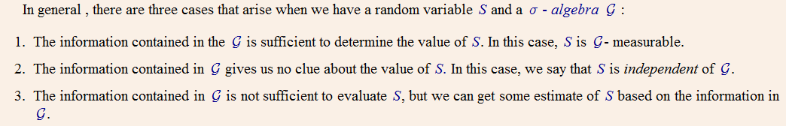
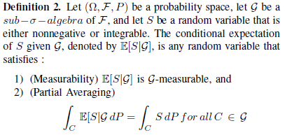
Towards Conditional Expectation
Three Cases Arise :
But does it exists ?
Proof by Radon – Nikodym Theorem
Can also prove other properties.

Slide 6
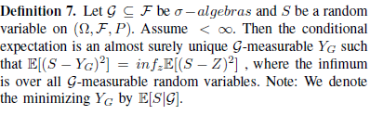




Alternative View
Closest approximation to a random variable S if we restrict ourselves to random variables belonging to some smaller σ-algebra . (sub- σ-algebra )
Claim 1 :
Claim 2 : If G = { φ, Ω } , then Y_{G} = E[S]
Claim 3 :
Claim 4 : If G is generated by a finite partition {A₁, A₂, ….A_{N}} , then :

Slide 7
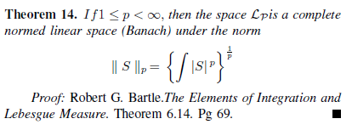

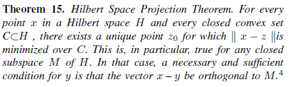
A Topological Approach (Hilbert Spaces)
Two ways of looking at the same general, more abstract concept of Conditional Expectation
Existence of Conditional Expectation arises as a direct consequences of the special structure of Hilbert Spaces

Slide 8
A Topological Approach (Hilbert Spaces)
Proof of Existence of Conditional Expectation by Hilbert Space Projection Theorem
Thus, the Conditional Expectation is :
the best approximation of S
the function in the sub-σ-algebra G closest to S, where the distance is given by the L₂ norm
the orthogonal projection of S onto G.
can extend to all non- negative random variables
can extend all integrable random variables
The special stucture of the L₂ Hilbert Space (one-to-one correspondence between closed subspaces and orthogonal projections) and σ-algebras allow us to model public information in such a way that we can estimate any random variable (like future Stock Price) , whose Lebesgue Integral exists.

Slide 9
Some Useful Properties
Linearity of Conditional Expectation: If X and Y are integrable random variables and c₁ and c₂ are constants, then :
E[(c₁X + c₂ Y)|G ] = c₁E[X|G] + c₂E[Y|G]
Taking out what is known : If X and Y are integrable random variables, XY is integrable, and X is G-measurable, then :
E[XY|G] = XE[X|G]
Iterated Conditioning : If H is a sub-σ-algebra of G, and X is an integrable random variable, then :
E[E[X|G]|H] = E[X|H]
Independence : If X is integrable and independent of G, then:
E[X|G] = E[X]

Slide 10
References
Robert G. Bartle.The Elements of Integration and Lebesgue Measure (Wiley Classics Library Edition 1995)
S.E Shreve. Stochastic Calculus for Finance - Volume I and II. (Springer, 2004)
Robert B. Ash and Catherine A.Doleans-Dade, Probability and Measure Theory.(Elsevier)
http://planetmath.org

Slide 11
Acknowledgements
I’d like to express my sincere gratitude to my supervisor Professor S. Kundu, who is responsible for my good foundations in Analysis, Linear Algebra, Measure Theory and Topology – all 4 courses which I’ve had the fortune of doing under him.
I’d like to thank my course co-ordinator Professor Sreenadh, who was very kind in accomodating me even though I missed the deadline for registering.

