Slide 1
From Pure Math to Data Science: My Perspective
Paul Raff
Principal Data Scientist, Analysis and Experimentation, Microsoft
October 1, 2015
My email: paraff@Microsoft.com
Microsoft CMU Recruiter: http://aka.ms/cmurecruiter

Slide 2

Caveats!
Pizza is complements of Microsoft, but contents of this presentation represent my thoughts, potentially not Microsoft’s!
Potentially explosive statements will be marked with, well,
This deck is generally unfiltered/unpolished.

Slide 3


Icebreaker
Notes:
<<NEXT>> Example 1

Slide 4
Example 1: MSN Home Page Columns
Notes:
<<NEXT>> Example 1

Slide 5

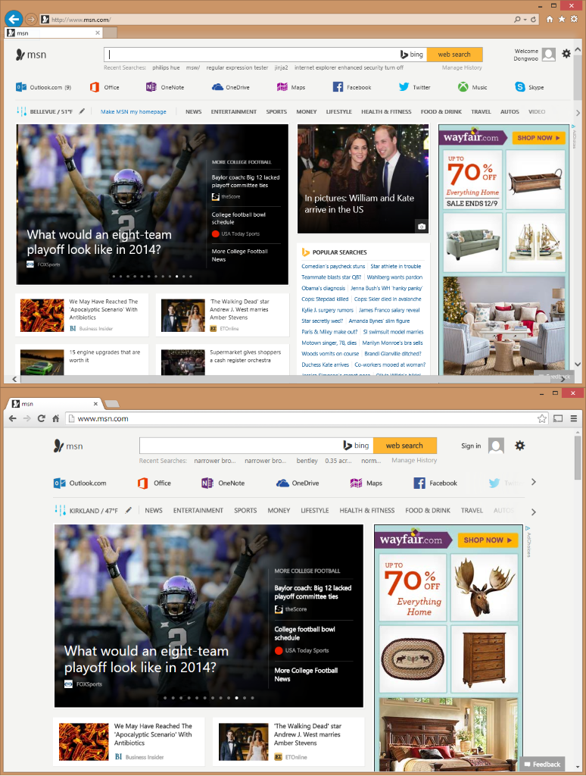
Home Page
A
Three Columns
B
Two Columns
Which variant has more clicks per user?
Raise your left hand if you think A Wins (left, with three columns)
Raise your right hand if you think B Wins (right, with two columns)
Don’t raise your hand if they are the about the same
Notes:
<<NEXT>> Example 1 Results

Slide 6
Home Page
A
Three Columns
WINNER IS
A
Which variant has more clicks per user?
If you have your left hand up, stay standing
If you have your right hand up, sit down
If you have your no hand up, sit down

Slide 7
Example 2: OneNote Welcome Email
Notes:
<<NEXT>> Example 2

Slide 8

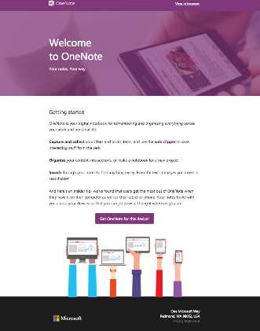
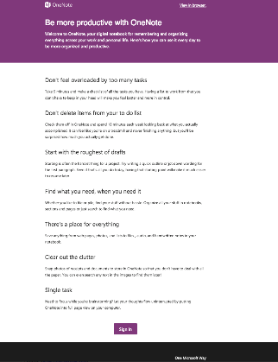
Welcome Email
A
Getting Started
B
Usage Tips
Which variant has more actions per user?
Raise your left hand if you think A Wins (left, “getting started”)
Raise your right hand if you think B Wins (right, “usage tips”)
Don’t raise your hand if they are the about the same
Notes:
<<NEXT>> Example 2 Results

Slide 9
Welcome Email
B
Usage Tips
WINNER IS
B
Which variant has more actions per user?
If you have your left hand up, sit down
If you have your right hand up, stay standing
If you have your no hand up, sit down
Notes:
Surprisingly, the Getting Started version did not show significant improvement over the Control.
The Usage Tips version, on the other hand, showed stat-sig lift of key metrics (e.g., actions and activity length) compared to the Control.
These were unexpected results!
The key takeaway is that controlled experimentation often uncovers insights that are not shown through other less rigorous approaches (e.g., before and after).
<<NEXT>> Example 3

Slide 10
Example 3: XBOX ONE – Killer Instinct Default Character
Notes:
<<NEXT>> Example 3

Slide 11


Xbox – Killer Instinct
Fighting video game that runs on the Xbox One console
Freemium Model: can play one character for free (Jago) but must pay to play others
Team hopes to increase revenue by getting players to purchase additional characters
Notes:
<<NEXT>> Example 3 Continued

Slide 12


Experiment: Change Free Character
Is revenue affected by which character is offered for free?
Guess the outcome:
Jago => more revenue
Glacius => more revenue
No significant difference
Jago
Glacius
Notes:
<<NEXT>> Example 3 Results

Slide 13
Glacius Wins! Or Does He?
Revenue increased for Glacius but engagement (time in game) decreased!
Mixed outcomes are common => teams must decide how to tradeoff between various metrics
Tradeoff should be determined a-priori and built into the OEC (Overall Evaluation Criterion)
Jago
Glacius
Notes:
<<NEXT>> Experimentation at Scale

Slide 14




About Me
 | 2004 – BS Math, BS Computer Science
 | 2009 – PhD Math
 | 2010 – Applied Researcher, Supply Chain Research
 | 2012 – Data Scientist, Analysis and Experimentation

Slide 15
If you only remember one thing:
Don’t ever

Slide 16
If you only remember one thing:
Don’t ever, ever

Slide 17
If you only remember one thing:
Don’t ever, ever, ever

Slide 18
If you only remember one thing:
Don’t ever, ever, ever, ever

Slide 19
If you only remember one thing:
Don’t ever, ever, ever, ever, ever

Slide 20
If you only remember one thing:
Don’t ever, ever, ever, ever, ever, ever

Slide 21
If you only remember one thing:
Don’t ever, ever, ever, ever, ever, ever, ever

Slide 22
If you only remember one thing:
Don’t ever, ever, ever, ever, ever, ever, ever, ever

Slide 23
If you only remember one thing:
Don’t ever, ever, ever, ever, ever, ever, ever, ever, ever

Slide 24
If you only remember one thing:
Don’t ever, ever, ever, ever, ever, ever, ever, ever, ever
forget your fundamentals

Slide 25
What is Data Science?
Answering two questions, over and over and over again:

Slide 26
What is Data Science?
Answering two questions, over and over and over again:
Why?

Slide 27
What is Data Science?
Answering two questions, over and over and over again:
Why?
What does it mean?

Slide 28
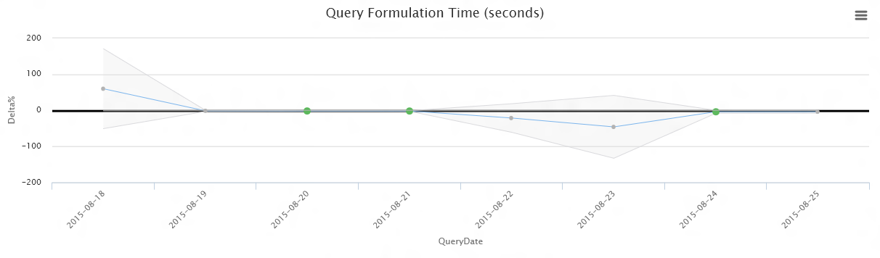
Example - Analytics
Why do we have such extreme deltas on certain days?
Why is the confidence interval super-wide some days and super-narrow others?

Slide 29
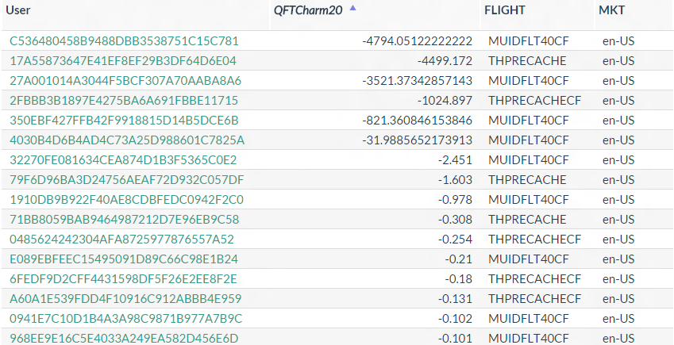
Example - Analytics
It’s because the data shows that there are some users with a very very negative value for a measurement that’s supposed to be between 0 and 20.
What does it mean for this to be the case?

Slide 30
Example - Analytics
Good data scientists are able to find this out quickly and effectively.
Great data scientists are able to take that data and fully quantify the effects of the peculiarities they are faced with.

Slide 31
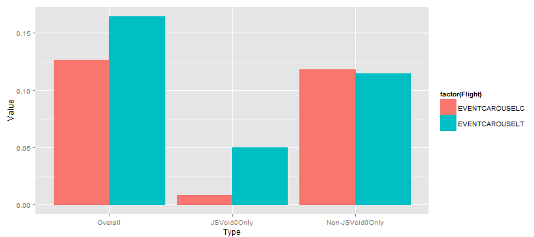
Example – Understanding Change
Suppose you observe this, which is a difference observed between two groups:

Slide 32
Example – Understanding Change
We want to be able to find something, so that conditioning on that something yields separation:
Omitting this something, there is no statistical difference between the two groups.
All difference can be attributed by this something

Slide 33

Don’t forget to fail, in a good way
There’s good fail, and there’s bad fail
Not doing your homework assignments -> bad fail
Demonstrating a proof that $\int{e^{x}dx}=\sin{x}+C$ -> bad fail
Thinking and telling people that $N$ fair coin flips will necessarily result in exactly $0.5N$ heads as $N$ gets large -> bad fail

Slide 34
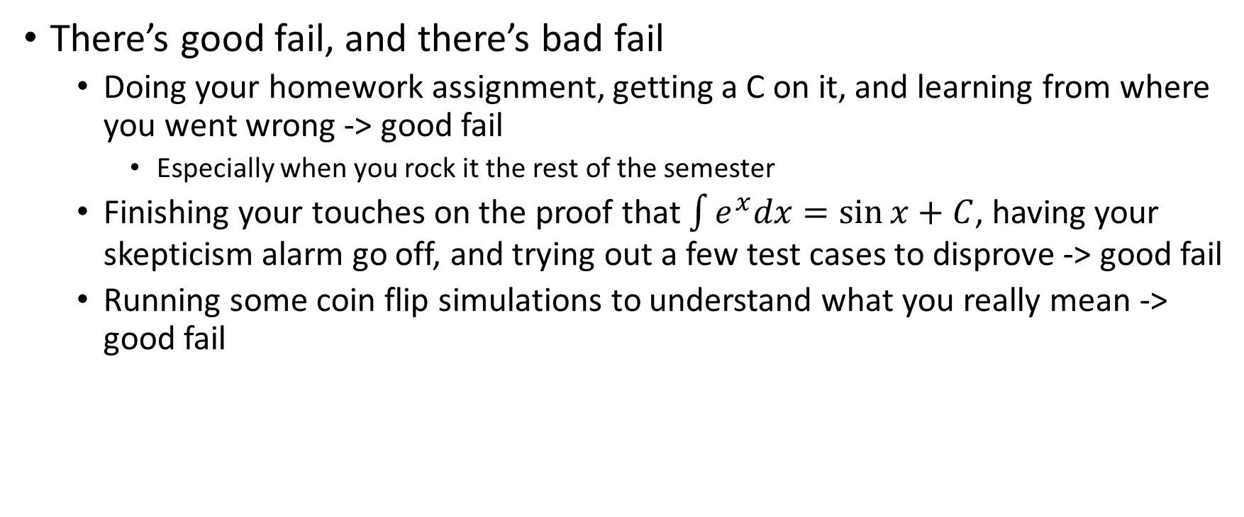
Don’t forget to fail, in a good way
There’s good fail, and there’s bad fail
Doing your homework assignment, getting a C on it, and learning from where you went wrong -> good fail
Especially when you rock it the rest of the semester
Finishing your touches on the proof that $\int{e^{x}dx}=\sin{x}+C$, having your skepticism alarm go off, and trying out a few test cases to disprove -> good fail
Running some coin flip simulations to understand what you really mean -> good fail

Slide 35
My Advice To You, Now
Take computer science classes
Get a CS minor/major
It’s easier for mathematicians to code than it is for coders to do mathematics
Find ways to experiment and tinker with what you do
Nothing beats a good example

Slide 36
My Advice To You, Later
Best said by Alon Halevy of Google (but I switched the order):
Never stop looking at data
Never stop writing code
It is not enough to simply produce data, real data scientists make sense of data and apply it appropriately
Nothing beats a good example

Slide 37
Appendix
Neat stuff I do

Slide 38
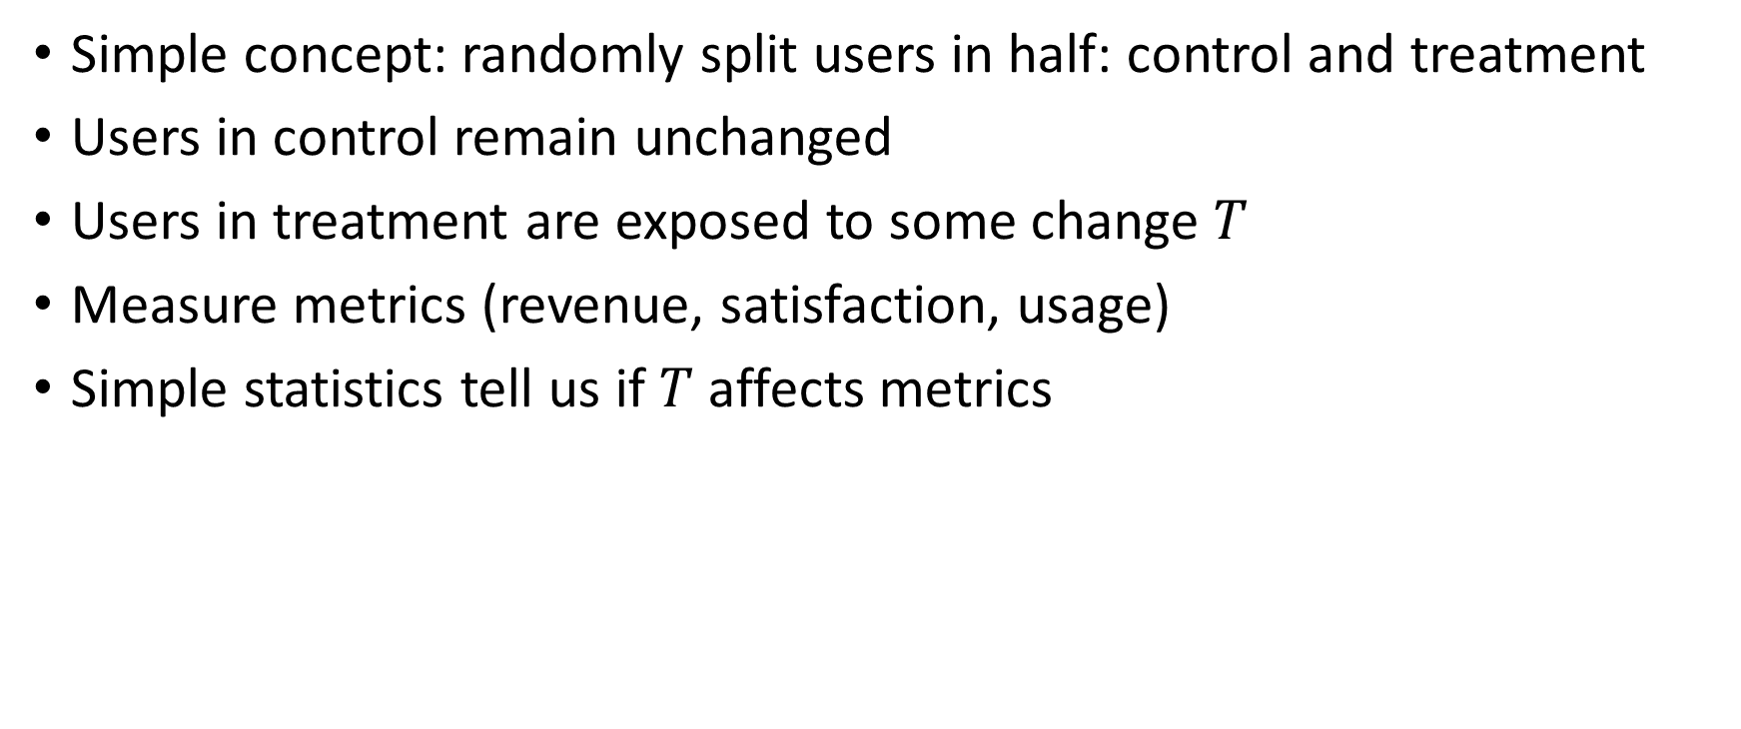
A/B Experimentation
Simple concept: randomly split users in half: control and treatment
Users in control remain unchanged
Users in treatment are exposed to some change $T$
Measure metrics (revenue, satisfaction, usage)
Simple statistics tell us if $T$ affects metrics

Slide 39
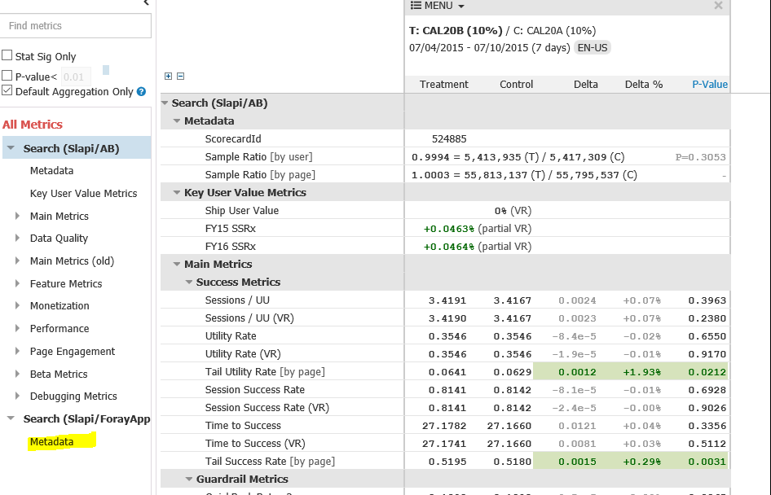
A/B Experimentation
For each experiment, we provide a so-called scorecard that lists various measurements and our assessment of validity of the movement measured.

Slide 40
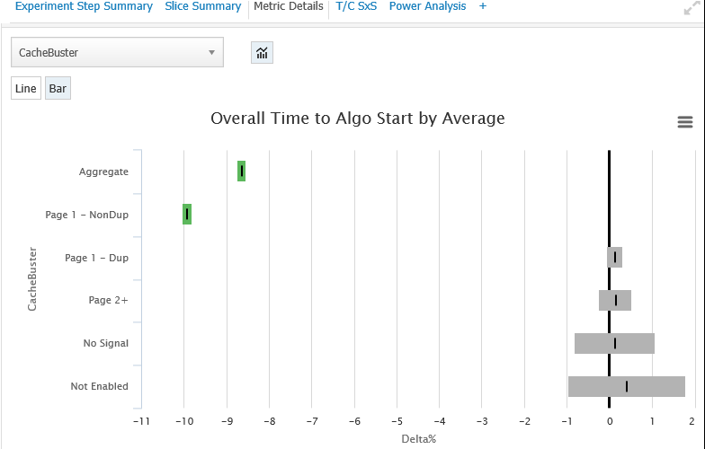
A/B Experimentation
Can go deep

Slide 41
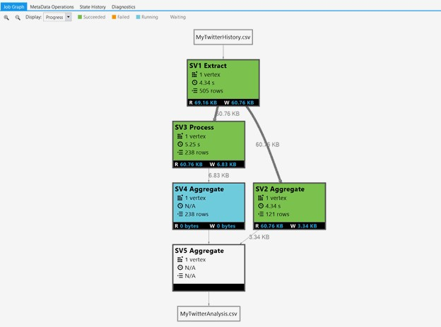
Big Data Analysis
Bing.com produces 200TB of data per day.
Can analyze in minutes

