Slide 1
Forecasting Retail Sales of 45 Stores Using Time Series Model
Yufan Zheng(yz6070), Xuechen Li (xl3002), Jih-Wei Yu (jwy290)

Slide 2
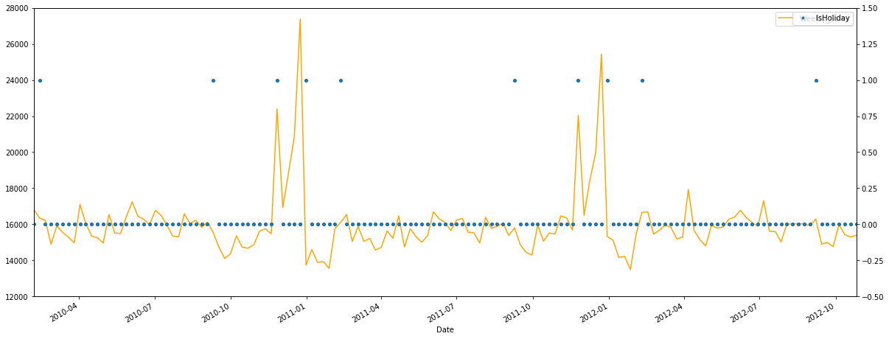
Data Visualization
We use dataset to plot average weekly sales by date, which is the foundation for forecasting in the next step. Besides, we add IsHoliday (dummy variable) scatter plot and find that the spikes of sales are probably due to those festivals, indicating that holiday is an important indicator for sales, so we put this variable in our forecast model.

Slide 3
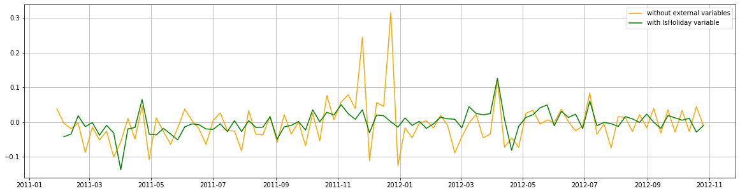
General Model
Firstly, by analyzing PACF of average sales time series, our AR model contains all lagged correlated terms, 1, 5, 39 etc. weeks. Our 2nd model adds variable 'IsHoliday’ for its correlation to current term. The results of two models indicate that stores may achieve a higher sales volume in holiday weeks while sales history of the stores has little influence on average sales volume for its dropped coefficients. Moreover, by comparing the goodness-of-fitness between 2 models, we can see that ‘IsHoiday’ greatly improves the degree of fitting and thus it is significantly positively correlated to mean sales.

Slide 4
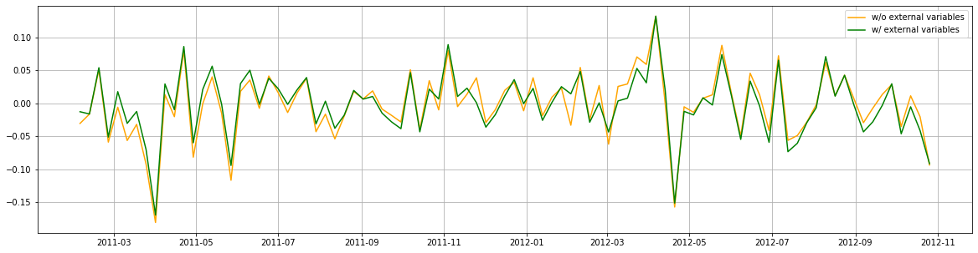
Specific Model for Store 19
As adding external variables does not bring much extra benefits to the prediction, we can infer that the model only containing lagged variables has predicted the model quite well. However, there is a little improvement after adding external variables reveals that current and future sales volume of one specific store is closely related to its past performance in sales.

Slide 5
Conclusion
General Model
Specific Model for Store 19
Summarizing models above, we can see that the lagged terms of week 1, 5, 39 ,51 or 52 are correlated to its current sales. Therefore, we can partly predict future average sales with sales volume history. At the same time, holidays will greatly stimulate consumption and increase the value of sales. Thus, the incoming holiday arrangements can also help us to forecast future sales in a macroscopic view.
Noticing that the sales values from last week and one year ago affect the predicted sales most significantly and markdowns seems not to be an effective method to raise sales.
We can also advise stores to increase inventory when CPI raises or holiday is coming. Similarly, faced with higher unemployment rate or temperature, stores are supposed to cut down on their stock to avoid slow sale and unnecessary loss.

