Slide 1

PRIVACY-PRESERVING USING HOMOMORPHIC ENCRYPTION ON FEDERATED LEARNING
Members:
21520011 - Võ Nguyên Chương
21520757 - Nguyễn Hữu Dương

Slide 2
TABLE OF CONTENTS
A
About our project
Propose for implementation
B
References
C

Slide 3
A
About our project
Overall
Scenarios.
Assets that need to be protected.
Related party.
Security goal.
2. Propose solution
Proposed system model.
Federated Learning.
Logistic Regression.

Slide 4
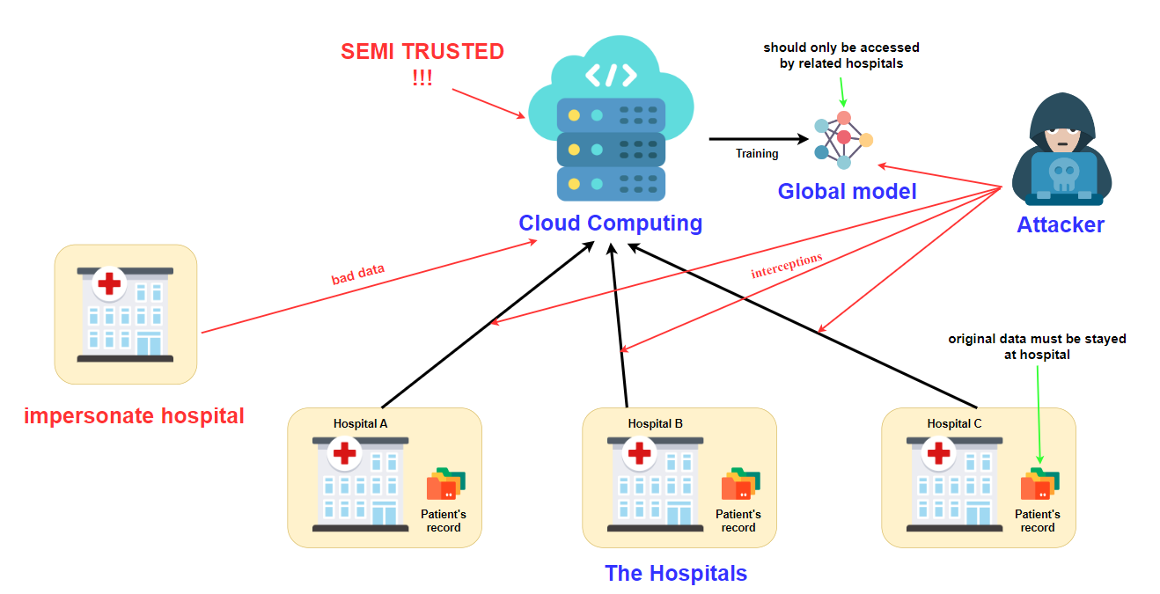
Scenario:
There are several different hospitals that want to collaborate to train a global machine learning model to do breast cancer classification...

Slide 5



Assets need to be protected:
Privacy of original medical data.
Personal information of patients and doctors.
Global machine learning models.

Slide 6



Related party:
Cloud computing service (semi-trusted).
Hospitals, which want to cooperate with each other.
The global model.

Slide 7


Security goals:
Protect the privacy-preserving of medical data from the orther hospitals, attacker, cloud server (semi-trusted)
=> Decentrialize datasets challenges on machine learning
Protect global model from any model steal attack (usually from the aggregator).
=> Prevent model-stealing from cloud aggregator

Slide 8
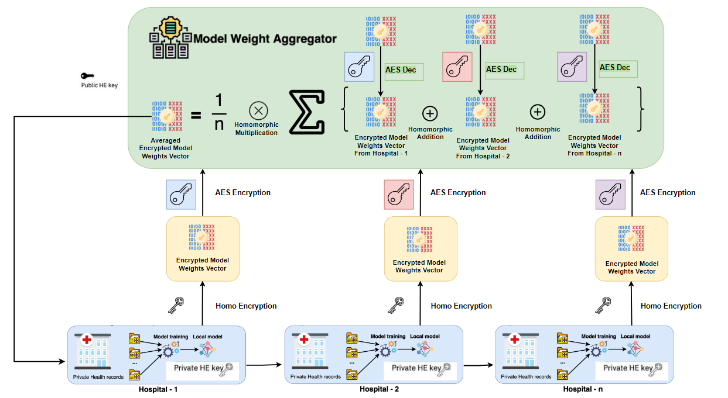
Proposed System model

Slide 9


There are some clear advantages with this approach:
The aggregator doesn’t get access to any of the model updates => preventing potential inference attacks.
Only hospitals get access to global models, preventing any model steal attack from the aggregator.
The hospitals operate over the plain-text model, so the type of model we can train is not restricted.
More efficient and accuracy.

Slide 10
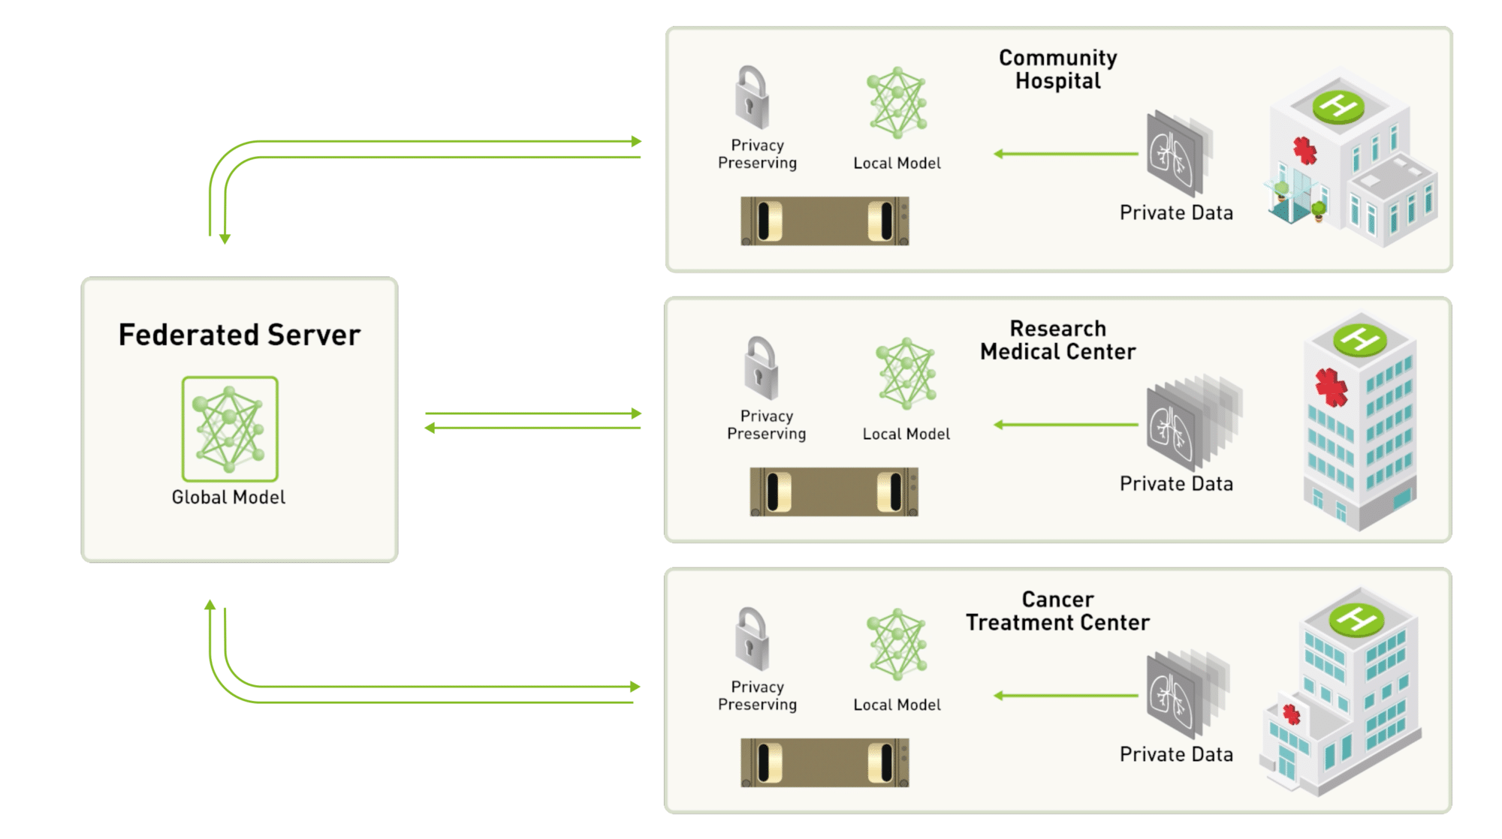
Federated Learning

Slide 11
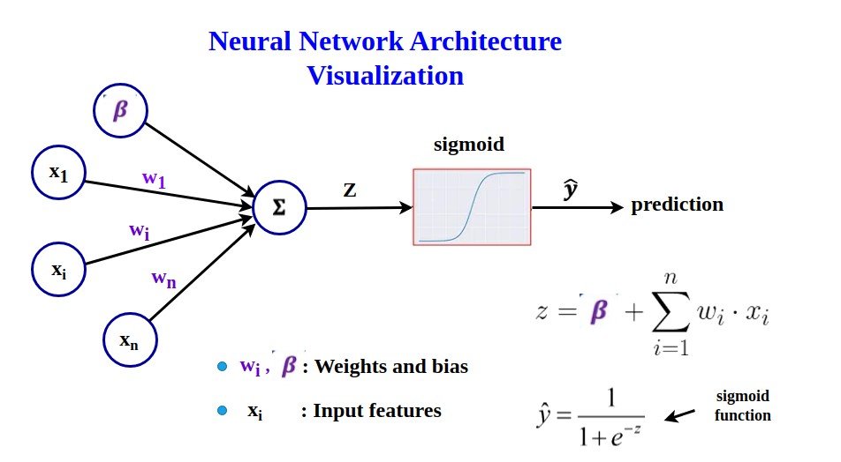
Logistics Regression

Slide 12
Homomorphic Encryption Schemes
Second-generation FHE:
The Brakerski-Gentry-Vaikuntanathan (BGV, 2011) scheme.
The Brakerski/Fan-Vercauteren (BFV, 2012) scheme.
Mainly used for computations involving integer values.
Fourth-generation FHE:
The Cheon, Kim, Kim and Song (CKKS, 2016) scheme.
Supports approximate computations with floating-point precision
High security level:
Based on the hardness of the LWE problem in these rings.

Slide 13




B
Propose for Implementation
Using the proposed system model for Breast Cancer detection training method.
Datasets: Breast Cancer datasets for study-case
https://www.kaggle.com/datasets/yasserh/breast-cancer-dataset
https://archive.ics.uci.edu/ml/datasets/Breast+Cancer+Wisconsin+(Diagnostic)
Python for Machine learning:
PyTorch: for machine learning processes.
Numpy, pandas: for data preprocesses.
Crypto library:
openFHE: Open-Source Fully Homomorphic Encryption Library, written by C++

Slide 14
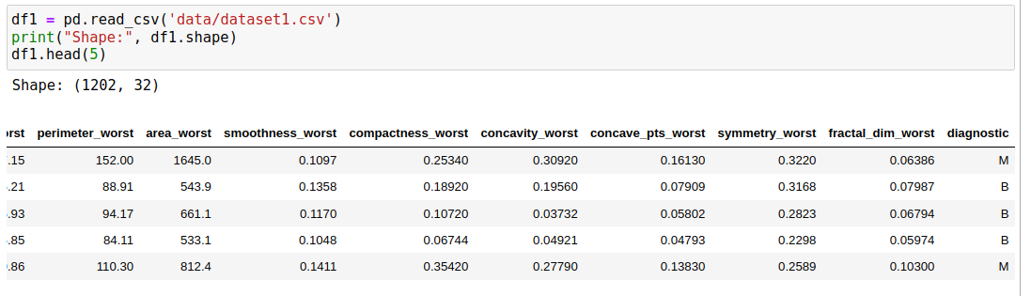
Raw datasets

Slide 15
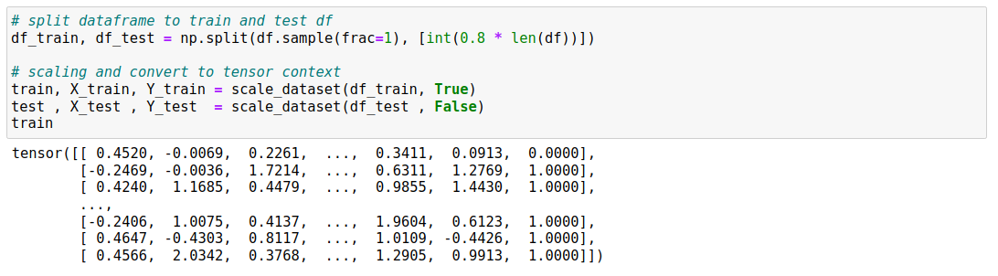
Data preprocessing

Slide 16
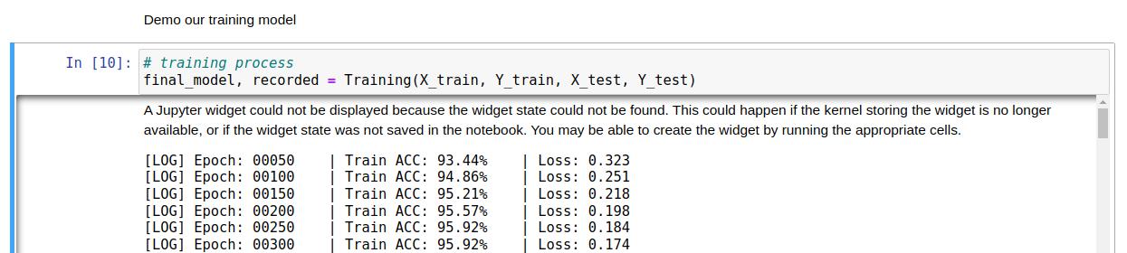
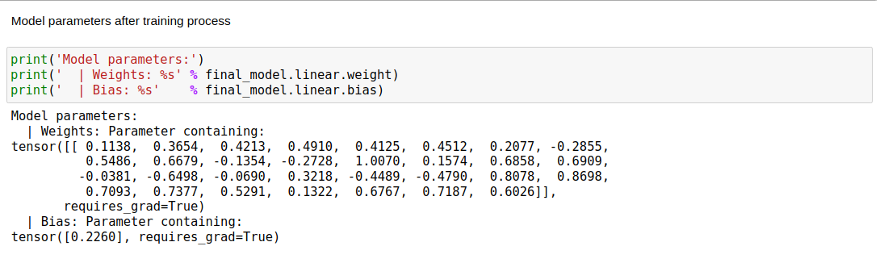
Local training

Slide 17
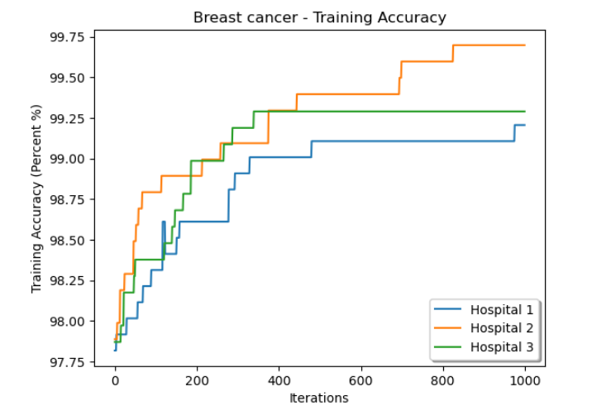
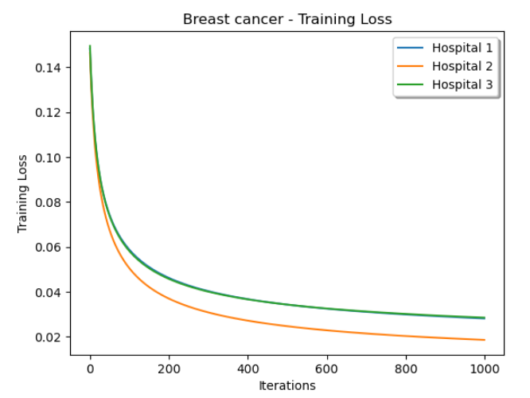
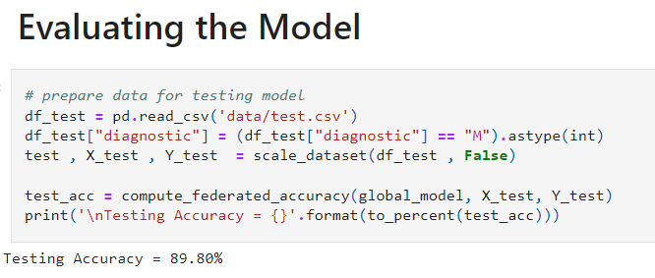
Federated learning result

Slide 18
Compare between different schemes
 | BFV scheme | BGV scheme | CKKS scheme
Training Time | ~ 12 mins | ~ 14 mins | ~ 20 mins
Accuracy | ~ 87.76% | ~ 89.81% | ~ 85.71%

Slide 19
More details? https://github.com/idk-wh0am1/Federated-Learning-meets-Homomorphic-Encryption

Slide 20
Work division
Võ Nguyên Chương
Nguyễn Hữu Dương
Federated Learning
Logistic Regression
Suggest papers and homomorphic scheme
Presentation
Build openFHE library
Programming technical for optimizing training proccess
Support slides

Slide 21
D
References
[1] Kim, A., Song, Y., Kim, M., Lee, K., & Cheon, J. H. (2018). Logistic regression model training based on the approximate homomorphic encryption. BMC medical genomics, 11(4), 23-31.
[2] Wibawa, F., Catak, F. O., Kuzlu, M., Sarp, S., & Cali, U. (2022, June). Homomorphic encryption and federated learning based privacy-preserving cnn training: Covid-19 detection use-case. In Proceedings of the 2022 European Interdisciplinary Cybersecurity Conference (pp. 85-90).

Slide 22
THANKS!
Any questions?

