Slide 1
Group 7
Ma Xu
Fan Jiajie
Wang Siyun
Sun Qirui

Slide 2
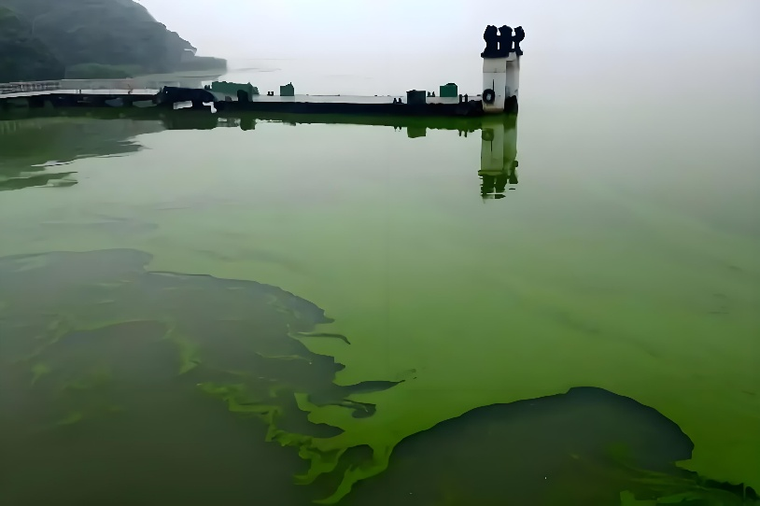
biological
One of the major types of Harmful Algal Bloom is cyanobacteria
Cyanobacterial bloom is a phenomenon in which cyanobacteria bloom in a water body under specific environmental conditions, forming a thick or thin layer of green, blue-green or other colors of floating foam, gelatinous material or algal mats on the water surface.
Competitive advantage of cyanobacteria:
Cyanobacteria have air sacs that regulate their buoyancy and occupy light dominant zones on the surface of the water.
Some cyanobacteria secrete toxins that inhibit competition from other algae or aquatic organisms.

Slide 3
biological
Causes of formation
Rich in nutrients:
Excessive content of nitrogen, phosphorus and other nutrients in water bodies is one of the main reasons for the formation of cyanobacterial blooms. For example, the discharge of industrial wastewater, domestic sewage and agricultural surface pollution can cause a large amount of nitrogen, phosphorus and other nutrients to enter the water body, providing sufficient nutrients for the growth of cyanobacteria.
Suitable environmental conditions:
Cyanobacteria are suitable for growth in high temperatures, strong light and still water. In summer, the environment of water body with high water temperature, long light time and slow water current is favorable for cyanobacterial bloom. In addition, the pH value of the water body, dissolved oxygen and other factors will also affect the growth and reproduction of cyanobacteria.

Slide 4
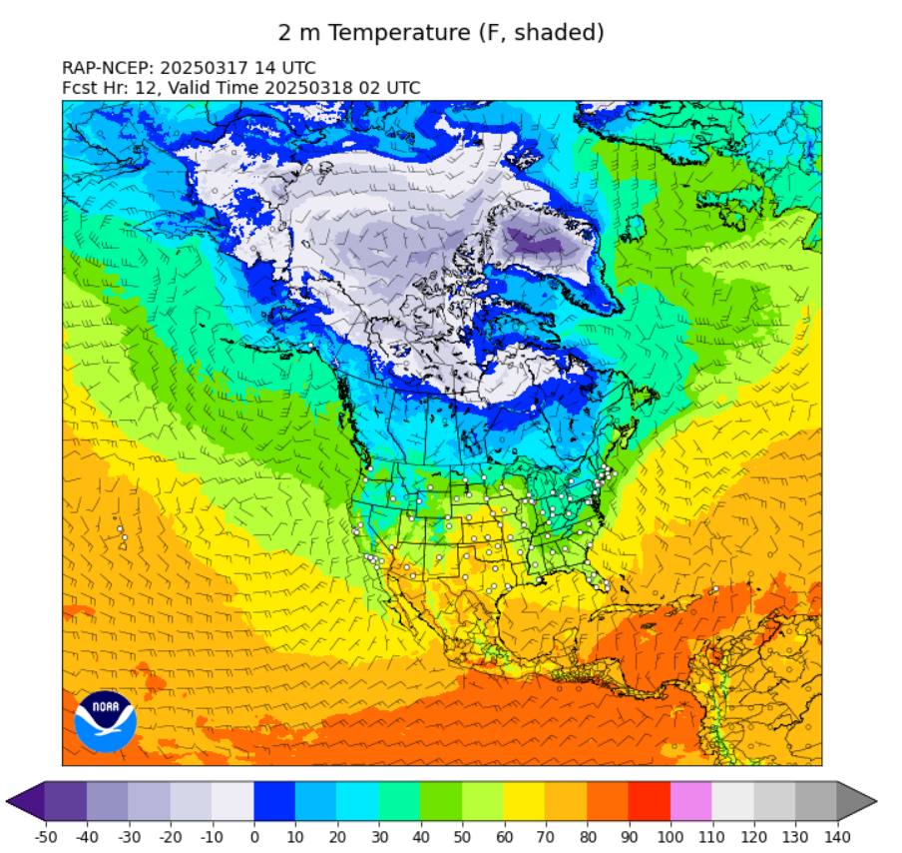
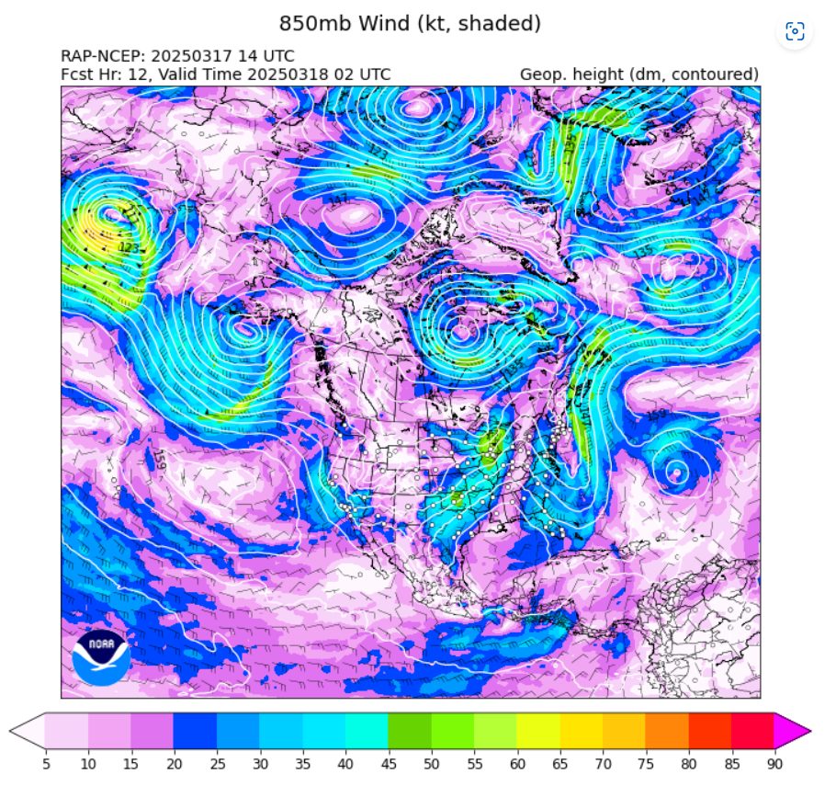
High-Resolution Rapid Refresh (HRRR)

Slide 5
High-Resolution Rapid Refresh (HRRR)
Provides short-term high-resolution weather forecasts, with particular attention to convective weather (e.g., thunderstorms, heavy precipitation), cold temperatures, fog, and wind shear.
Integration of real-time data from radar, satellites, ground observatories, and sounding balloons, combined with advanced physical parameterization schemes to enhance forecast accuracy.
The grid is spaced at 3-kilometer intervals and covers the continental U.S. and surrounding areas, providing fine-grained geographic information (e.g., topography, surface features) that is suitable for the prediction of localized weather phenomena.
For example, high temperatures and low wind speeds may promote algal growth. Precipitation may affect nutrient inputs. Climate data need to be aligned with sampling dates and locations, and time-series sliding-window statistics may be required, such as average temperatures over the past week.

Slide 6
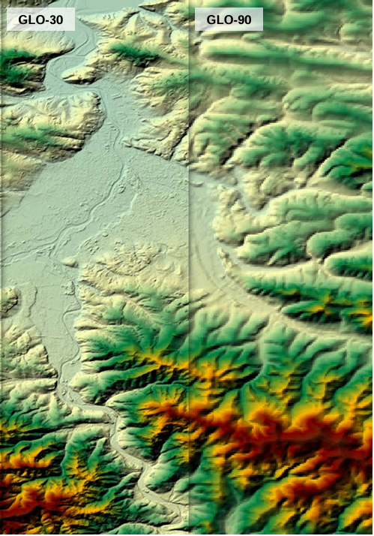
Elevation data
Copernicus DEM (30-meter resolution) is a global digital elevation model (Digital Elevation Model, DEM) under the Copernicus Programme of the European Union.
High resolution and global coverage
A resolution of 30 meters, covering the global land surface (including polar regions), for large-scale terrain analysis and identification of small-scale geographic features (e.g., valleys, rivers, urban terrain).
Elevation accuracies of ±4 meters (flat areas) to ±10 meters (mountainous areas) are better than many publicly available DEM data.
2. Multi-source data fusion
It is mainly based on Sentinel-1 and TerraSAR-X/TanDEM-X radar data, combined with optical satellite and ground-truthing data, and generated by interferometric techniques.

Slide 7
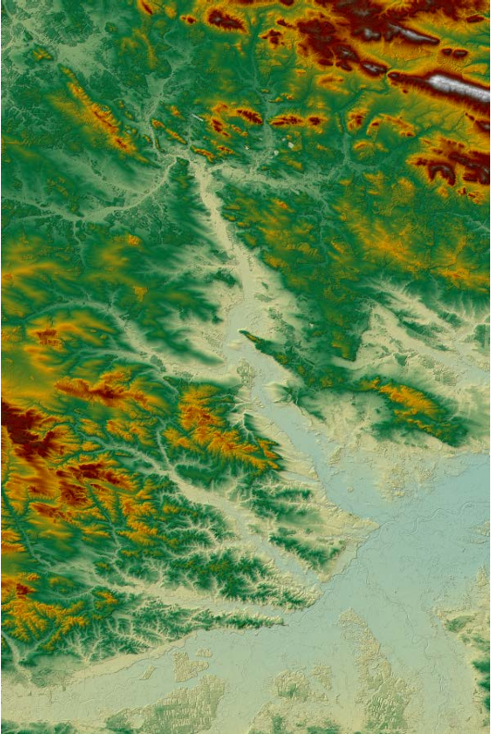
Elevation data
Elevation data (DEM) can be used for topographic analysis, such as calculating slope and slope direction, which may affect nutrient inflow and water movement. For example, steeper slopes may result in more runoff, bringing in more nutrients and promoting algal blooms.
Example:
Topographic complexity: calculate the slope (slopes) around a water body; steep slopes may increase runoff inputs.
Elevation effect: higher elevation areas have cooler water temperatures and inhibit algae growth.

Slide 8
RGB
Definition of RGB values and data sources 1. Basic concepts RGB values: Reflectance values in the Red, Green and Blue bands captured by the optical sensor. Physical Significance: Red light (620-750 nm): sensitive to chlorophyll absorption, red light reflectance decreases when algae are enriched. Green light (495-570 nm): high reflectance from vegetation (including algae) and elevated green light values in algal bloom areas. Blue light (450-495 nm): strong penetration, but easily scattered by suspended particles, low reflectivity of blue light in turbid water. 2. Data sources Satellite remote sensing: e.g. Landsat-8, Sentinel-2 provide multispectral data: Landsat-8 band: Band 4 (Red): 0.64–0.67 μm、Band 3 (Green): 0.53–0.59 μm、Band 2 (Blue): 0.45–0.51 μm Sentinel-2 band: Band 4 (Red): 0.665 nm、Band 3 (Green): 0.560 nm、Band 2 (Blue): 0.490 nm
Ground sensors: Multi-spectral water quality monitors directly measure the RGB reflectance of the water column.

Slide 9
Clouds are opaque in the visible band, but partially transparent in the short infrared or thermal infrared bands. In combination with multispectral data, specific bands can be used to penetrate thin clouds or to identify cloud boundaries and assist in the restoration of obscured areas.
A cloud mask is generated using a pre-trained cloud detection algorithm (e.g., s2cloudless from Sentinel Hub), which directly rejects pixels that are covered by clouds, retaining only clear areas for analysis. The remaining blank areas can be filled by interpolation with contextual information (e.g., surrounding pixels or historical data).

