Slide 1
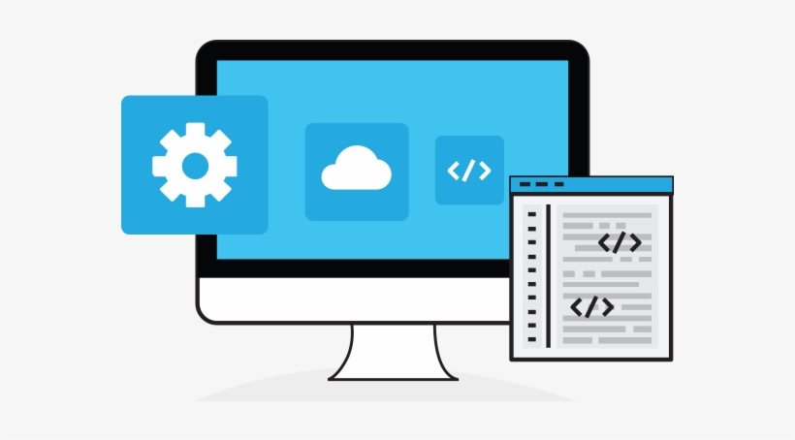

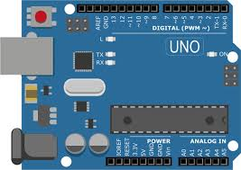
Backend
Frontend
Depth info
processing
Host
Lens Autofocus
Image Acquisition
Image post processing
UltraSonic Sensor Client
Data Storage
(Arduino)

Slide 2
