Slide 1
A7
Publish with GitHub Pages + Auto Activity Log
B11309044
https://github.com/fanyuzhenfu/activity-log-a7

Slide 2
Project overview
02
Repository
Assignment goal
https://github.com/fanyuzhenfu/activity-log-a7
Publish a simple site, update README automatically, and prevent invalid content from reaching the live page.
Public repository under fanyuzhenfu
Initial Pages source: main / root
README is the activity-log homepage
Final source: GitHub Actions with gated deployment
A7 | B11309044

Slide 3
GitHub Pages setup
03
Pages source: main / root
Build type: legacy
Status: built
Pages build evidence
https://github.com/fanyuzhenfu/activity-log-a7/actions/runs/41182258941
Live URL was checked with a real HTTPS request.
Initial branch deployment created the first public page.
The page uses Jekyll so include_relative can render README.md.
A7 | B11309044

Slide 4
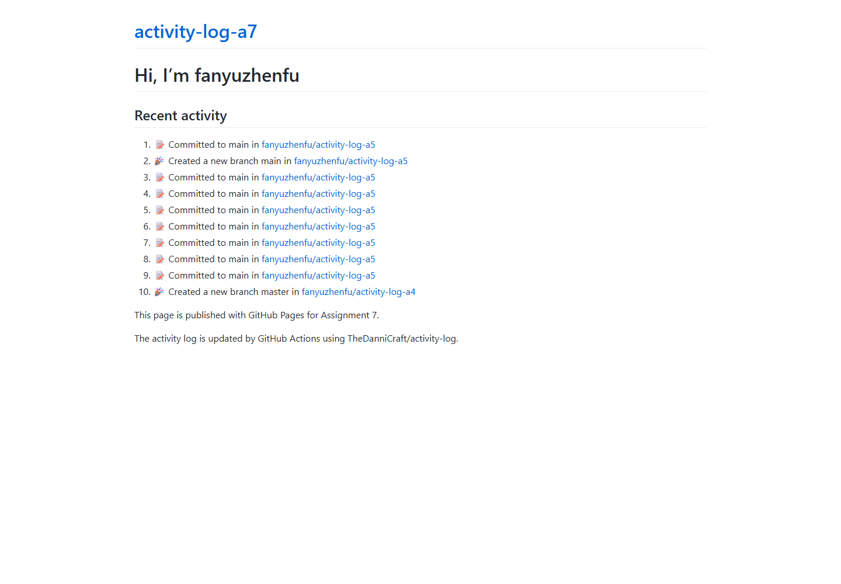
Published website
04
Live verification
HTTP 200 OK
Recent activity section is visible
README content is rendered through index.md
https://fanyuzhenfu.github.io/activity-log-a7/
A7 | B11309044

Slide 5
Automatic activity log
05
name: Update activity log
on:
schedule:
- cron: "0 */6 * * *"
workflow_dispatch:
with:
GITHUB_USERNAME: fanyuzhenfu
GITHUB_TOKEN: ${{ secrets.TOKEN }}
Secret safety
TOKEN exists as a repository secret.
The token value never appears in code or logs.
The schedule was enabled only after the secret was configured.
A7 | B11309044

Slide 6
Activity update to Pages
06
The verified E-Level chain
Activity Run
README commit
Pages build
Live page
Run 41183083659
Commit 38c4947
Build 1329285214
HTTP 200
A7 | B11309044

Slide 7
Gated deployment design
07
Build uses actions/jekyll-build-pages.
build
↓
validate
↓
deploy
Validate checks README markers and index.md.
Deploy needs validate, so failure stops publication.
The workflow does not modify README, avoiding loops.
A7 | B11309044

Slide 8
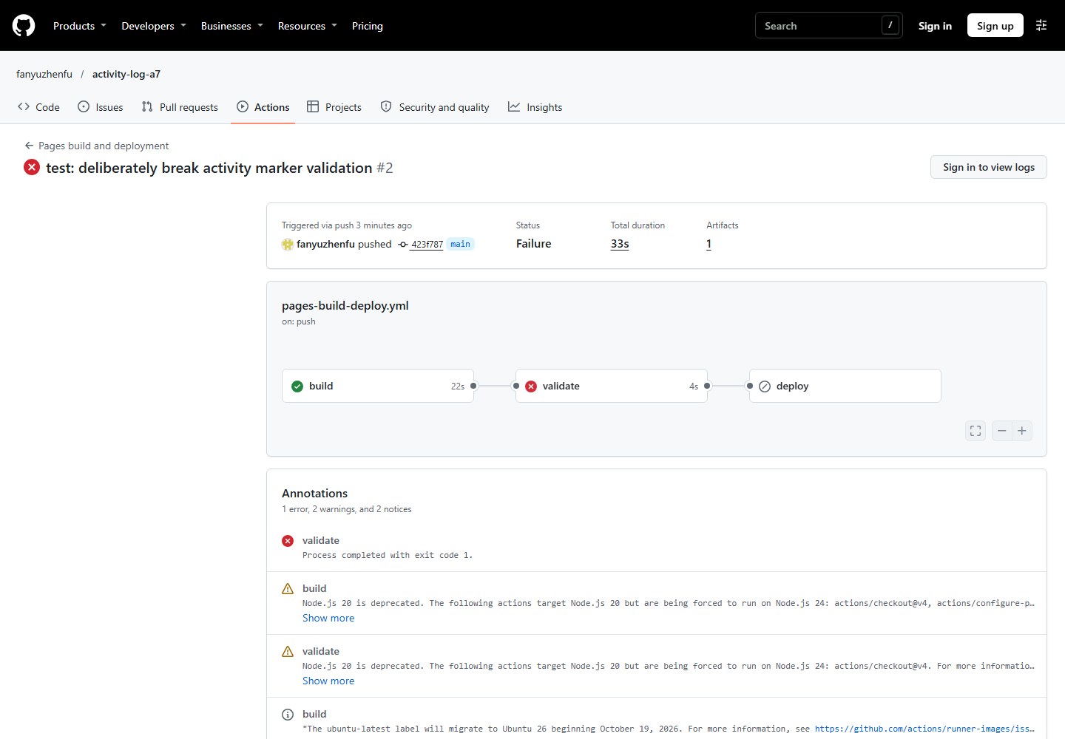
Deliberate failure test
08
Run 41183626360
Build succeeded.
Validate failed because the end activity marker was changed.
Deploy was skipped.
The old live site still returned HTTP 200.
Failure commit: 423f787
A7 | B11309044

Slide 9
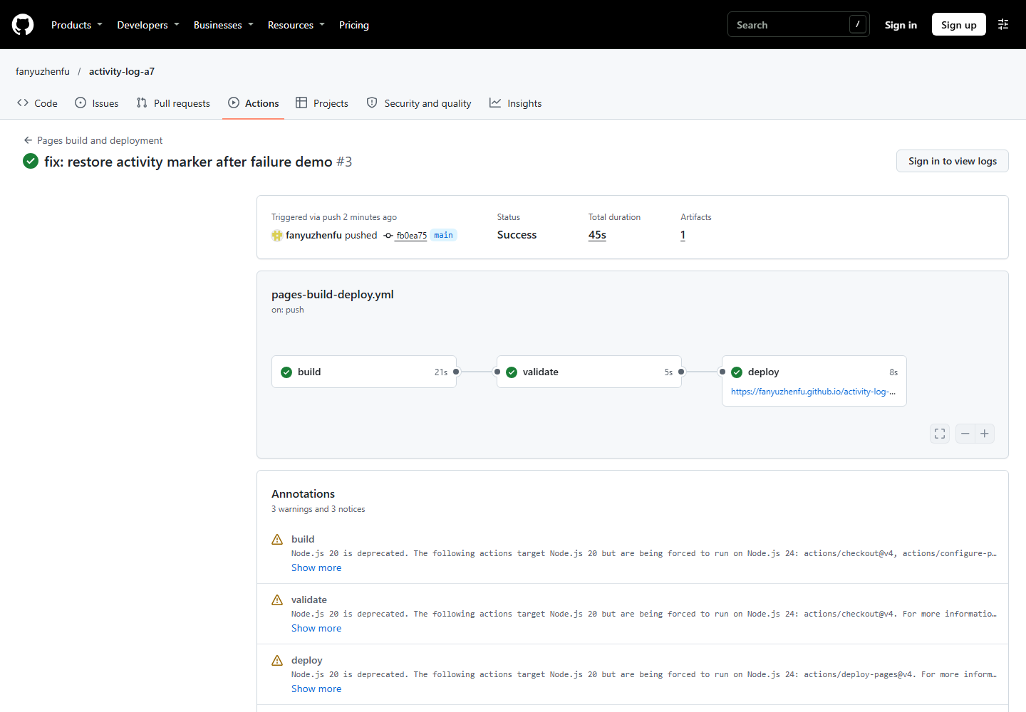
Recovery and release safety
09
Run 41183714027
The README marker was restored.
Build, Validate, and Deploy all passed.
The live site was deployed again.
This gate reduces the chance of publishing broken content.
Warnings about Node.js 20 and ubuntu-latest were recorded but did not block the run.
A7 | B11309044

Slide 10
Reflection
10
This was my first time using GitHub Pages, an activity log action, and an automated deployment workflow. At first, I thought publishing a simple page would be easy, but I needed to understand how README, Jekyll, and Pages work together.
I also had to solve a real problem when the site first returned 404. Checking the Pages build and waiting for the deployment helped me find that the build had to finish before the page was available. Later, I intentionally changed the activity marker and saw the Validate job fail while Deploy was skipped.
This helped me understand why a gated deployment is useful. I am still learning CI/CD, but I now know how to check workflow logs and verify the final website instead of assuming that a successful commit means the site is ready.
A7 | B11309044

