Slide 1
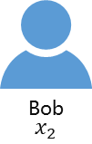
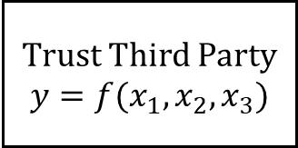
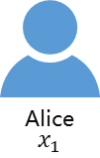
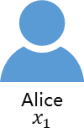

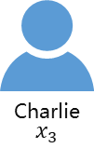
Alice
$$x_{1}$$
Bob
$$x_{2}$$
Alice
$$x_{1}$$
Bob
$$x_{2}$$
Trust Third Party
$$y=f(x_{1},x_{2},x_{3})$$
$$y=π(x_{1},x_{2},x_{3})$$
Charlie
$$x_{3}$$
Charlie
$$x_{3}$$

