Slide 1
PREDICTION MARKETS · UNSUPERVISED LEARNING
Potential anomaly analysis on the event “Which company has the best AI model at the end of June 2026?”
Zhongyang Fan
Notes:
This deck follows the extended “1 EDA” notebook. Numbers on the data slides come from outputs already in that notebook. The results slides are marked where the new cells still need to be run against the database.

Slide 2
Three tables, joined on the market
Table | Source | Used for | Joined on
Trades | Wallet trade files, one per day (remote parquet) | wallet, market, side, price, size, time | market
Resolutions | Resolution table (database) | which market resolved, when, and to which outcome | market_slug
Markets | Market table (database) | outcome names; outcome = “Yes” and “No” | slug
The join answers “which market was this trade in, and how did it resolve?”.

Slide 3
Data and cleaning
50,777
15
10,625
trades kept after deduplication and bot screen
Yes/No markets, one per company
wallets in the raw June pull
Step | What I did
Source | June 2026 wallet trades joined to the event’s 15 markets ( Which company best AI?)
Audit | No missing fields; 416 fully identical rows (0.67%) removed from 61,829
Remove likely bots | 3 wallets with 2,000 or more trades removed (10,636 rows), leaving 50,777
Kept | Same wallet, market and time with different size or price is real, so it stays

Slide 4
Cleaning step: remove likely bots (3 wallets, 41.7% of BUY dollars)
3
17.3%
41.7%
wallets with 2,000 or more trades; 8 have 1,000 or more
of all trade rows (10,636 of 61,413) come from those three
of BUY dollars, as in the data-processing screen
The busiest wallets trade in nearly all 15 markets, which looks like market making rather than one-off informed bets.
High trade count is a proxy, not proof of a bot. They are removed from every later step: 50,777 trade rows, 9,467 wallet profiles and 11,499 positions remain.

Slide 5
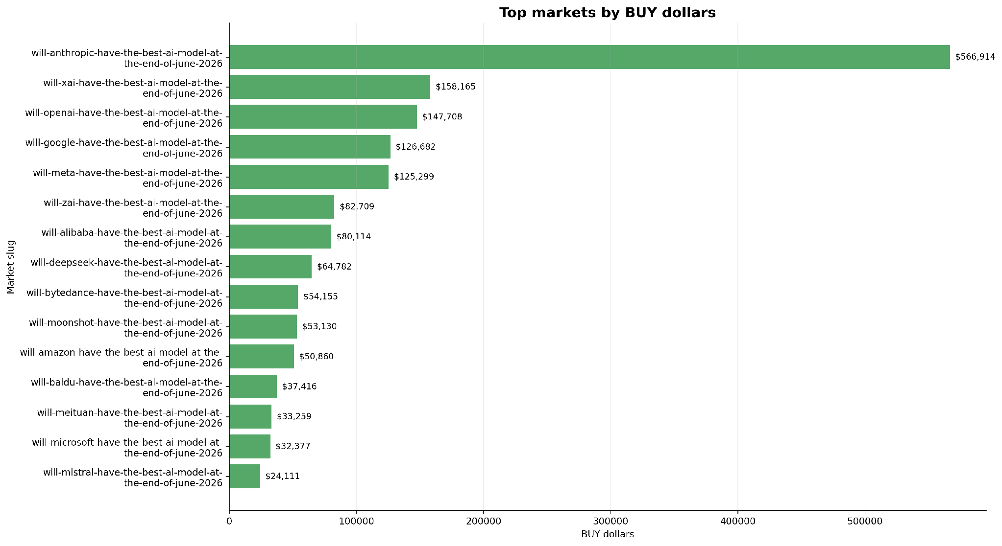
Money is spread unevenly across the 15 markets
Anthropic: $566,914 of BUY dollars, the largest market, and the only market that resolved YES.
xAI, OpenAI, Meta, Google: $125k to $158k each, far below Anthropic.

Slide 6
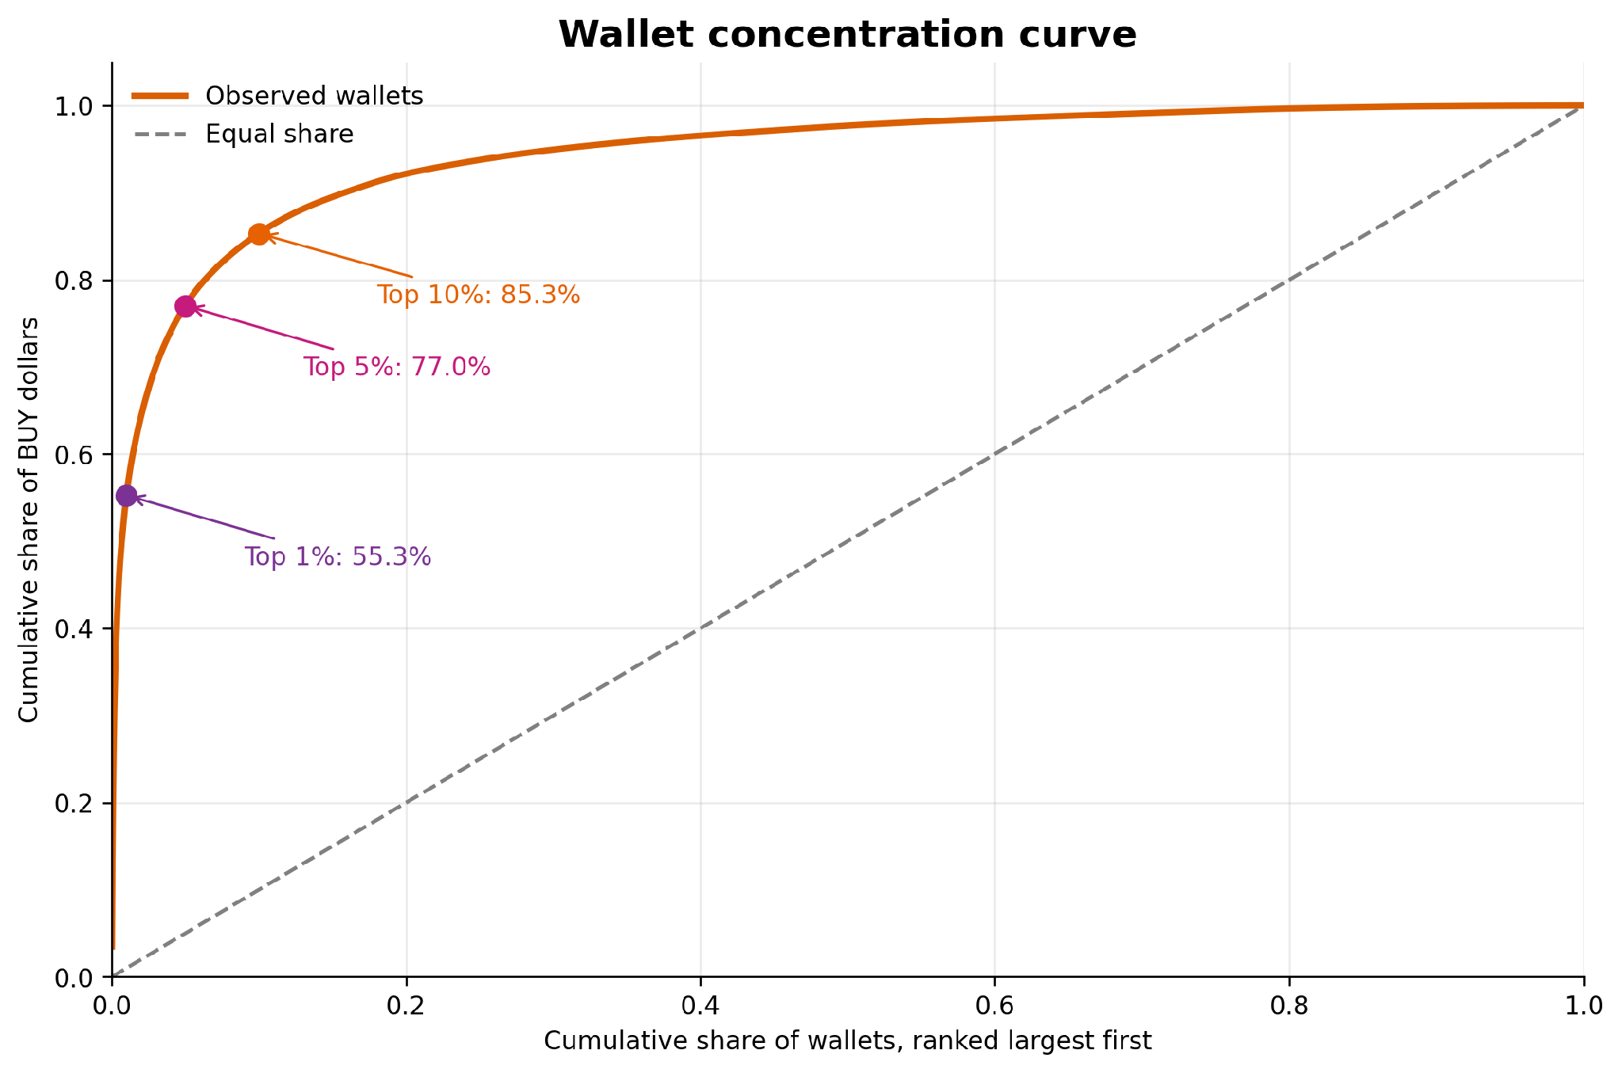
A few wallets hold most of the money
Top 1% of wallets: 55.3% of BUY dollars
Top 5%: 77.0%
Top 10%: 85.3%
Even without the three busiest wallets, any size-based detector will mostly flag whales. That is why we also use timing, price and market-share features.

Slide 7
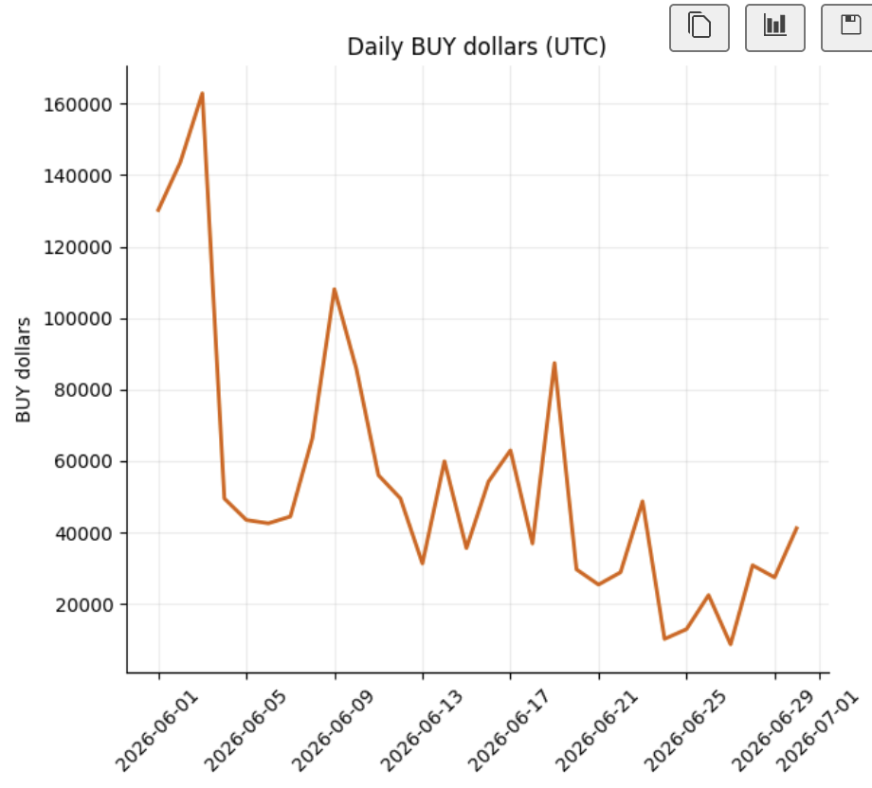
Market Participation Was Concentrated Early in the Event
This suggests that market participation and liquidity were concentrated early in the event.
Daily BUY volume peaked at approximately $160k in early June, followed by a second spike of around $110k. After these peaks, activity gradually declined and became more volatile, reaching its lowest levels in late June before a modest rebound.

Slide 8
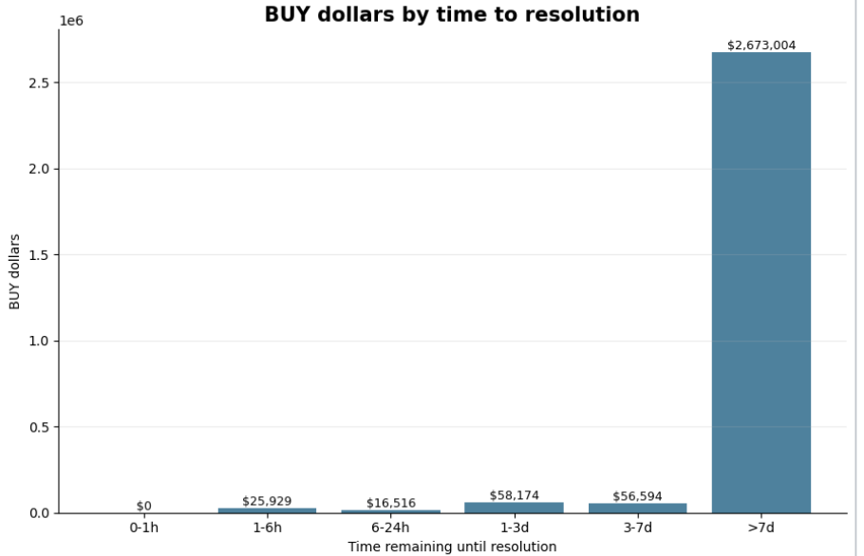
Most Trading Occurred More Than Seven Days Before Resolution
Most BUY volume occurred more than seven days before resolution ($2.67M), with very little activity in the final hours.
This suggests trading was concentrated well before settlement rather than immediately before the outcome was known.

Slide 9
Breakdown by time remaining and direction in Anthropic
Time remaining | Direction | BUY dollars | Trades | Wallets | Share
0–1h | YES | $109.44 | 9 | 9 | 100.0%
1–6h | YES | $1,389.73 | 71 | 67 | 100.0%
6–24h | NO | $24.71 | 6 | 2 | 0.1%
6–24h | YES | $23,401.62 | 1,345 | 1,263 | 99.9%
1–3d | NO | $17.00 | 11 | 8 | 0.0%
1–3d | YES | $34,236.07 | 1,370 | 1,101 | 100.0%
3–7d | NO | $1,029.79 | 98 | 50 | 1.6%
3–7d | YES | $61,494.02 | 463 | 380 | 98.4%

Slide 10
The Anthropic market is the odd one out
96%
23.1%
5,369
of its BUY dollars were on YES; other markets are 0.0% to 17.4%
held by its top-10 wallets, against 35.9% to 70.0% elsewhere
wallets, the most of any market, with $566,914 in BUY dollars
It was the one market that resolved YES, and the crowd leaned that way. Broad participation on the winning side is the opposite of a few informed wallets, so concentration alone does not point to insiders here.

Slide 11
Six behavioural features per wallet from demo idea
Feature | Idea
Position anomaly ratio | How large the wallet’s biggest trade was compared with its usual average spending per market.
Market notional ratio | The wallet’s trading amount as a share of the total trading amount in that market.
Average buy price | The average price the wallet paid when buying.
Concentration | How much the wallet focused its spending on one market.
Wallet age (days) | The number of days between the wallet’s first and last observed trades.
Unique markets | The number of different markets the wallet participated in.
Pipeline: remove likely bots (2,000 or more trades), log-transform the skewed features, StandardScaler, then Isolation Forest.

Slide 12
Unsupervised method and settings
Method | Setting | Score used for ranking
Isolation Forest | 300 trees, contamination 0.05, seeds start at 42 | Higher means easier to isolate
Input: 9,467 wallets with the six features, log-transformed where skewed and standardised. We use the score as a ranking; the top 5% by score (474 wallets) are flagged as abnormal, so the contamination setting does not decide who is abnormal.

Slide 13
How’s abnormal wallets in money spend area
474
95
49.2%
flagged abnormal: the top 5% of 9,467 wallets
flagged in the top 1%
of BUY dollars held by the 474 flagged wallets

Slide 14
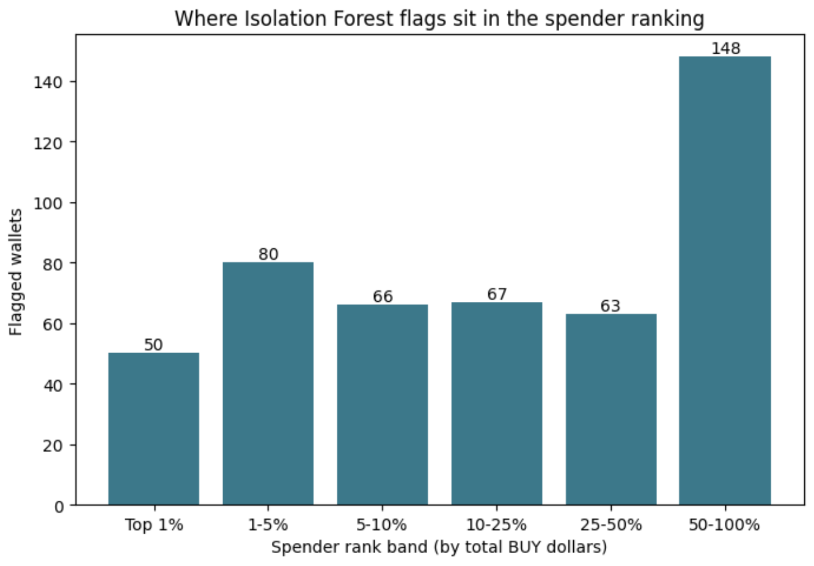
About 70% of the abnormal wallets are in the top half of spenders, and they account for nearly all of the flagged money. The 50 flagged wallets in the top 1% alone hold 86% of the flagged BUY dollars.

Slide 15
The Isolation Forest list is stable across seeds
0.88
0.27
0.38
mean abnormal labels overlap across 10 random seeds (0.86 to 0.91)
top-5% overlap with the biggest-spenders list
top-1% overlap with the biggest-spenders list
Biggest spenders” is a simple comparison baseline that uses no model.
Ranking wallets by total BUY dollars and take the top 5% (474 wallets) and the top 1% (95 wallets).

Slide 16
Conclusion
1
Flagged 474 wallets are stable across seeds
After removing 3 likely bots, the top 5% by anomaly score are marked abnormal. The list is stable across seeds (0.88).
2
Flags sit mostly on big spenders
About 69% of flagged wallets are in the top half of spenders; the 50 in the top 1% hold 86% of the flagged BUY dollars.
3
No evidence of insiders in this event
This is one event, so the result is exploratory.

Slide 17
Limits and next steps
Limits
Next
Only find potential abnormal wallets
No confirmed insider labels in this event
Wallet age covers June only
Try some other features
Try more unsupervised learning method
Test across more events in different area
Longer time span

