Slide 1
Knowledge Representation Issues

Slide 2
Introduction
The fundamental goal of knowledge representation is to facilitate inference (conclusions) from knowledge.
The issues that arise while using KR techniques are many. Some of these are: important attributed, relationships among attributes, choosing the granularity of relationships, representing sets of objects, and finding the right structures.

Slide 3
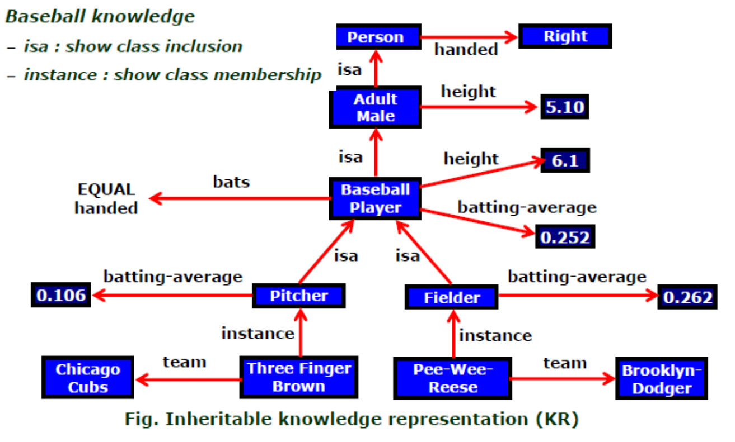

Slide 4
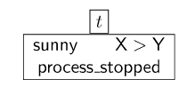
Important Attributed
Any attribute of objects so basic that they occur in almost every problem domain?
There are two attributed “instance” and “isa”, that are general significance.
They are important because they support property inheritance.

Slide 5
Relationship among attributes
Any important relationship that exists among objects attributed?
The attributes describing objects are entities which are represented.
The relationship between the attributes of an object, independent of the specific knowledge they encode.

Slide 6
The relationship holds properties such as:
Inverse – this is about consistency check, while a value is added to one attribute
Existence in an “isa” hierarchy – this is about generalization – specification, like, classes of objects and specialized subsets of those classes, there are attributes and specialization of attributes.
For example, the attribute height is a specialization of general attribute physical size.
These generalization-specialization relationships are important for attributes because they support inheritance.

Slide 7
Technique for reasoning about values – this is about reasoning values of attributes not given explicitly. The values are often specified when a knowledge base is created.
Single valued attributes – this is about a specific attribute that is guaranteed to take a unique value.
For example, a baseball player can at times have only a single height and be a member of only one team. KR systems take different approaches to provide support for single-valued attributes.
Notes:
Several kinds of information are used in reasoning, like height: must be in a unit of length, Age: of a person cannot be greater than the age of person’s parents.

Slide 8
Choosing the Granularity of Representation
At what level of detail should the knowledge be represented?
It is necessary to know:
At what level should the knowledge be represented and what are the primitives?
Should there be a small number or should there be a large number of low-level primitives or High-level facts.
High-level facts may not be adequate for inference while low-level primitives may require a lot of storage.

Slide 9
Example of Granularity:
Suppose we are interested in the following facts:
John spotted Sue.
This could be represented as
Spotted(agent(John), object(Sue))

Slide 10
Such a representation would make it easy to answer questions such are:
Who spotted Sue?
Suppose we want to know:
Did John see Sue?
Given only one fact, we cannot discover that answer
We can add other fact, such as
Spotted(x,y) -> saw(x,y)
We can now infer the answer to the question.

Slide 11
Representing Sets of objects
How should sets of objects be represented?
There are certain properties of objects that are members of a set, but not as individual.
Example: consider the assertion made in the sentences:
“There are more sheep than people in Australia”, and
“English speakers can be found all over the world.”

Slide 12
To describe these facts, is to attach assertion to the sets representing people, sheep, and English.
The reason is if a property is true for all or most elements of a set, then it is more efficient to associate it once with the set rather than to associate it explicitly with every element of the set.
This is done,
in logical representation: using universal quantifier, and
in a hierarchical structure where a node represents sets and inheritance propagates set-level assertion down to the individual.

Slide 13
Finding the Right Structure
Given a large amount of knowledge stored in a database, how can relevant parts be accessed when they are needed?
This is about the right structure for describing a particular situation.
It requires selecting an initial structure and then revising the choice.

Slide 14
While doing so, it is necessary to solve following problems:
How to perform an initial selection of the most appropriate structure.
How to fill in appropriate details from the current situations.
How to find a better structure if the one chosen initially turns out not to be appropriate.
What to do if none of the available structure is appropriate.
When to create and remember a new structure.

Slide 15
There is no good, general-purpose method for solving all these problems.
Some knowledge representation techniques solve some of these issues.

