Slide 1
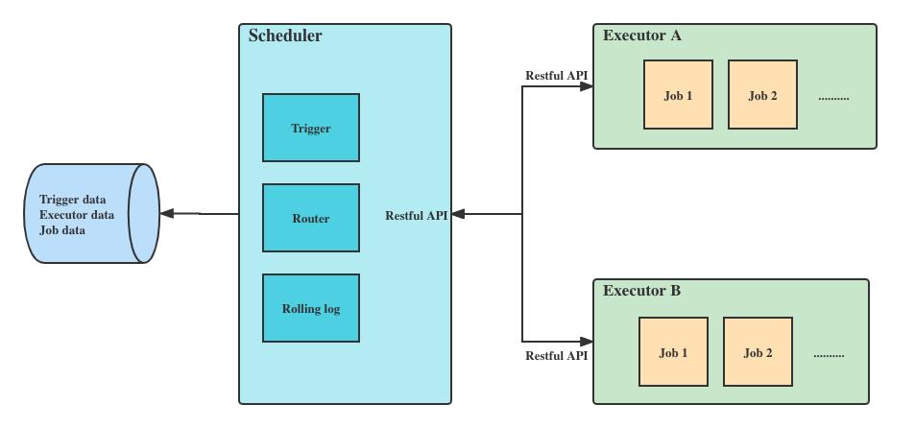
myjob solution diagram

Slide 2
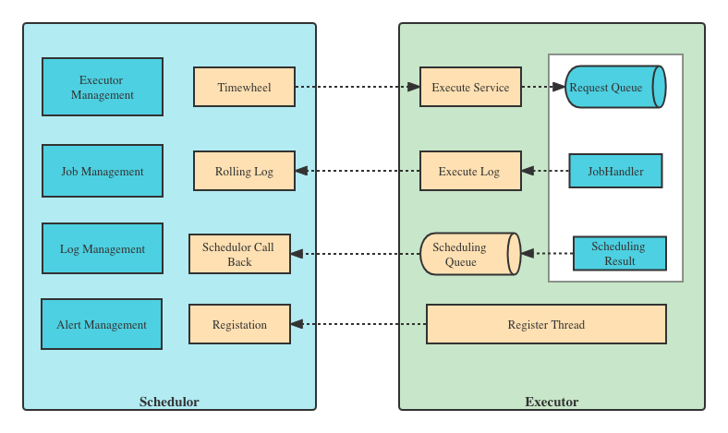
myjob architect diagram

