Slide 1

UNIVERSITY OF HERTFORDSHIRE School of Physics, Engineering and Computer Science
MSc Data science and analytics
7PAM2002-0509-2024 - Data Science Project
16/07/2025
Concrete Structural crack detection using Efficientnet model.
Name: Student ID: Supervisor:

Slide 2
Table of Content
1. Introduction
2. Literature review
3. Methodology
4. Dataset
5. EDA of the dataset
6. Data management and ethics

Slide 3


Introduction
(a)
Aim of the project
This project aims to create an automated method for identifying structural faults in masonry structures via deep learning techniques. The system seeks to maximize accuracy and minimize subjectivity in defect identification by integrating modern image preprocessing methods CLAHE for local contrast enhancement and Hessian-based filtering for emphasizing crack-like structures with the EfficientNet convolutional neural network. The objective is to develop a scalable and dependable approach for expedited condition evaluation of structures, facilitating improved maintenance decisions and conservation strategies.
Research questions
What is the efficacy of the EfficientNet model in precisely identifying structural fractures from photos in comparison to conventional visual inspection techniques?
Can modern image preprocessing approaches, such as CLAHE and Hessian-based filtering, enhance the performance of crack detection models regarding precision, recall, and computing efficiency?
(b)
Figure: Images of Structures, With crack(a) and without cracks(b)

Slide 4
Literature review
Loverdos and Cirrhosis (2022)
Employed U-Net, DeepLabV3+, LinkNet, and FPN for brick segmentation and fracture detection on 107 annotated pictures of masonry walls. DeepLabV3+ attained an accuracy of 96.27%, surpassing conventional image processing techniques.
Ca et al. (2023)
Engineered a Convolutional Neural Network for crack identification and amalgamated it with Random Forest and XGBoost for predicting crack depth. Validated on actual RC slab photos, with an accuracy of 96–97% with dependable depth estimate.
Zhong Qu and colleagues (2020)
Utilized a combined LeNet-5 for classification and a modified VGG16 integrated with Inception modules for detection, employing the CCD1500, Cracktree200, and DeepCrack datasets. Attained F1 scores of up to 0.901, markedly above baseline models.
Golding et al. (2022)
Utilised a VGG16-based CNN trained on 40,000 pictures, including grayscale conversion, thresholding, and edge detection for preprocessing. The Grayscale and RGB models had superior performance with F1 values above 96.5%, demonstrating resilience to color fluctuations.

Slide 5
Novelty of the project
Gaps in literature
Current research employs only rudimentary preprocessing techniques (e.g., grayscale conversion, edge recognition), which inadequately improves the visibility of subtle or noisy fissures in intricate brick textures.
Many studies depend on resource-intensive CNNs such as VGG16, U-Net, and DeepLabV3+, which complicates real-time or mobile implementation due to substantial processing requirements.
The dataset's variety is restricted, mostly concentrating on pavements or homogeneous brick walls, leading to inadequate generalization to diverse masonry buildings such as aged facades or conservation sites.
Novelty & How Gaps Are Addressed
The project's innovation is in integrating CLAHE and Hessian-based filtering with EfficientNet, therefore augmenting fracture visibility and boosting input quality for detection.
EfficientNet is a lightweight and scalable architecture that delivers excellent accuracy with a reduced number of parameters and minimal computational expense, making it suitable for mobile or real-time applications.
Mitigates current deficiencies by the use of sophisticated preprocessing, substitution of cumbersome models, utilization of varied datasets, and assessment of accuracy, recall, and inference duration for practical application.

Slide 6
Methodology
Data preprocessing
Dataset
EDA of the dataset
Apply CLAHE
Apply Hessian-based filtering
Model development
Evaluation of model
Hyperparameter tuning
Model development

Slide 7
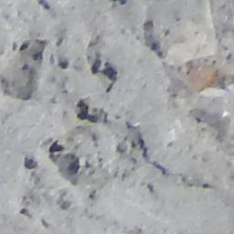
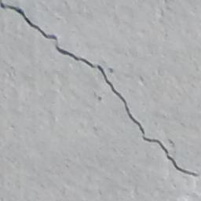
Dataset: SDNET2018
SDNET2018 is a publicly accessible, annotated picture dataset designed for the training, validation, and evaluation of AI-driven concrete crack detection algorithms.
The dataset comprises more than 56,000 sub-pictures (256×256 px), categorized as ‘Cracked’ (C) or ‘Non-cracked’ (U), derived from 230 high-resolution source photos.
Images were obtained using a 16MP Nikon camera and depict three structural categories:
Walls – (Russell/Wanlass Performance Hall, USU campus)
Pavements – (roads and sidewalks on USU campus)
Bridge Decks – (SMASH Lab, Utah State University)
Cracks vary in width from 0.06 mm to 25 mm and encompass impediments such as shadows, roughness, debris, scaling, edges, and holes, rendering it suitable for training resilient deep learning models under real-world settings.
What is the rationale behind SDNET2018?
Encloses walls, pavements, and bridge decks for structural variety.
Captures real-world conditions like shadows, debris, and varied crack widths (0.06 mm to 25 mm).
Renowned benchmark dataset in structural health monitoring studies. Optimal for training and assessing resilient, generalizable deep learning models.
Link to download:
https://digitalcommons.usu.edu/all_datasets/48/
https://www.kaggle.com/datasets/aniruddhsharma/structural-defects-network-concrete-crack-images

Slide 8
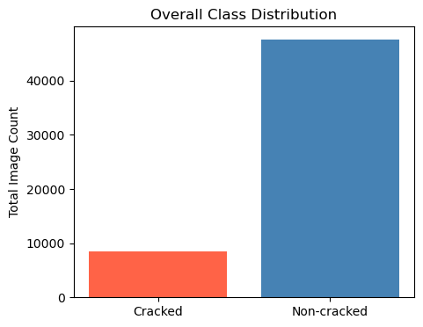
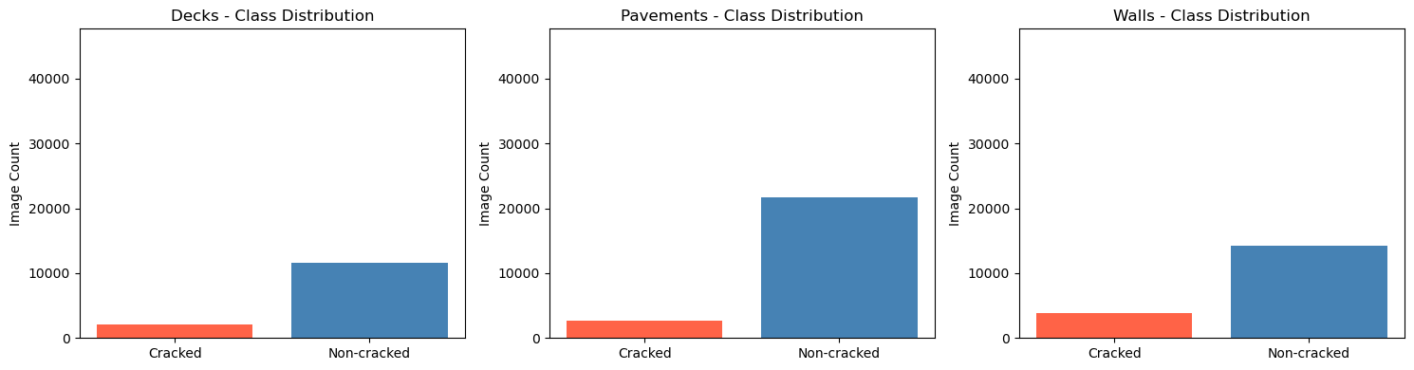
EDA of the Dataset
1. Class Distribution
Significant Class Disparity:
The dataset is significantly biased towards Non-cracked photos across all three categories (Decks, Pavements, Walls).
Pavements and walls exhibit over four times the number of non-cracked pictures in comparison to cracked images.
Category Analysis:
Decks: Extremely few fractured samples; imbalance may impede model efficacy about minor surface deterioration.
Pavements: Predominantly imbalanced; fracture identification in this category may be more challenging without augmentation.
Walls: More equitable than decks, however, still exhibits considerable discrepancy.
Comprehensive Assessment:
Cracked photos constitute a minor
portion of the sample (~15%), perhaps
resulting in a bias towards the predominant
class during training.

Slide 9
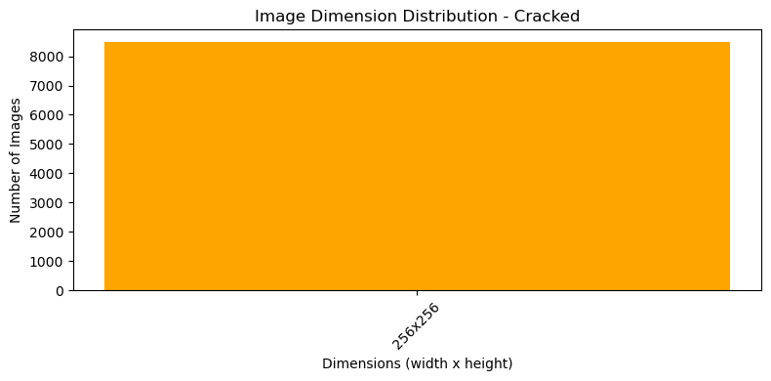
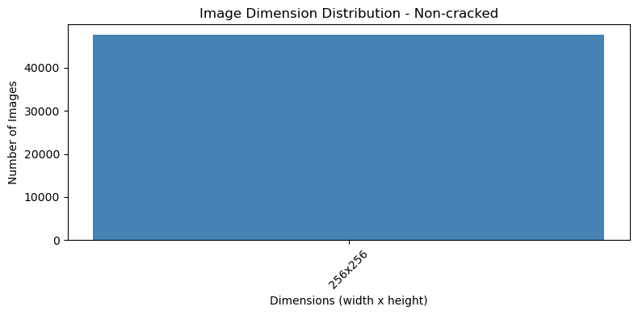
EDA of the Dataset
Image Dimensions
Consistent Image Dimensions: All cracked and non-cracked photos are uniformly sized at 256×256 pixels.
Preprocessing Efficiency: This consistency eliminates the need for scaling or reshaping prior to model input, hence streamlining preprocessing.
Model Compatibility: Fixed dimensions are optimal for CNN-based architectures such as EfficientNet and VGG19, guaranteeing consistent performance.
Scalability: A standardized size enhances batch processing efficiency, facilitating uniform training across all categories.

Slide 10
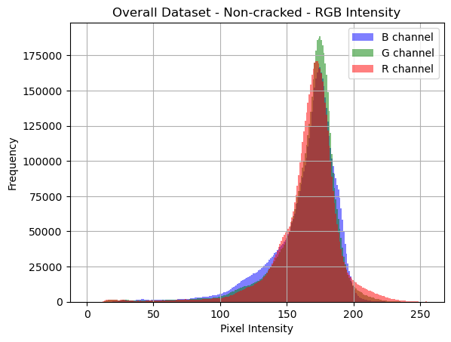
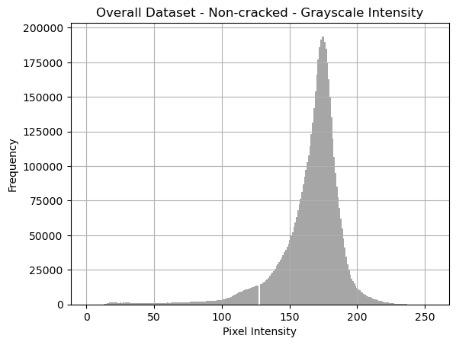
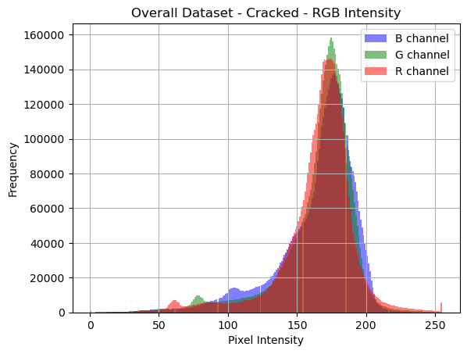
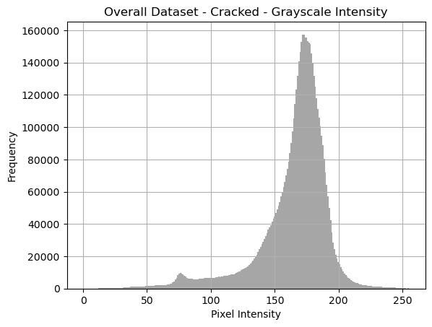
EDA of the Dataset
Pixel Intensity of images
Clearly Defined Intensity Peaks: Both cracked and non-cracked photos have intensity peaks ranging from 150 to 200, indicating uniform lighting conditions throughout the dataset.
Cracked surfaces have a broader distribution, characterized by a greater range in pixel intensity values. This illustrates the intricate surface patterns and shadows produced by fissures.
The RGB channels are well-aligned: In RGB histograms, the Red, Green, and Blue channels exhibit comparable patterns for both classes, indicating no substantial colour imbalance.
Crucial for Preprocessing: These distributions validate the application of CLAHE and Hessian filtering, which can improve local contrast and reveal intricate structural patterns that are not readily discernible in the raw intensity spectrum.

Slide 11
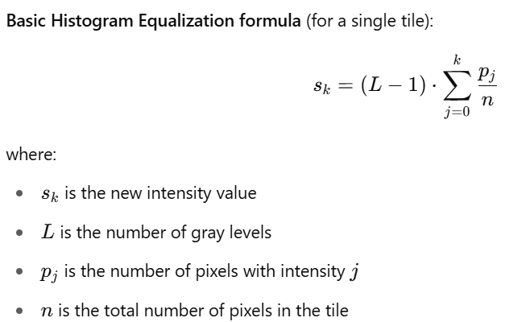
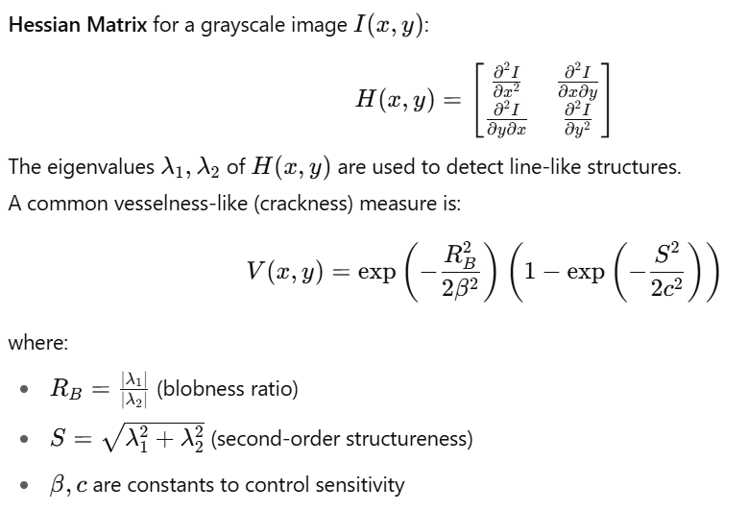
Data preprocessing
CLAHE
CLAHE (Contrast Limited Adaptive Histogram Equalization) improves local contrast by equalizing tiny picture segments (tiles), hence rendering subtle details such as cracks more discernible.
It prevents excessive enhancement and noise amplification, maintaining texture and clarity in intricate stone surfaces.
Chosen for this initiative to augment crack visibility in inconsistent lighting conditions, hence improving detection precision in aged or textured stone edifices.
Hessian-based filtering
Hessian-based filtering improves elongated, fissure-like features by examining second-order intensity variations in pictures. It emphasizes linear characteristics, such as slender fissures, by calculating the eigenvalues of the Hessian matrix.
Particularly proficient at identifying subtle, low-contrast fissures that are hard to see with standard filters.
Utilized in this project to highlight structural fissures prior to inputting photos into the detection model—enhancing precision and uniformity.
Benefits of Combining CLAHE + Hessian Filtering
The integration of CLAHE with Hessian-based filtering constitutes an effective preprocessing method for detecting cracks in concrete surfaces. CLAHE improves local contrast, rendering small fractures more discernible even in difficult settings such as uneven illumination or textured backdrops. Conversely, Hessian-based filtering accentuates slender, elongated formations such as hairline fractures through the examination of second-order intensity variations. When combined, CLAHE enhances the visibility of intricate details, while Hessian filtering accentuates linear characteristics, yielding crisper, more crack-centric pictures. This synergy promotes feature extraction and markedly improves the performance of deep learning models in detecting complicated or subtle fractures.
Figure: Formula for CLAHE
Figure: Formula for Hessian-based filtering

Slide 12
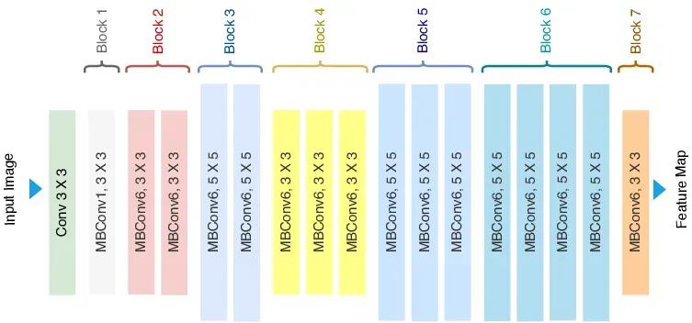
Model development
EfficientNet is a series of convolutional neural networks that harmonizes accuracy and efficiency using a compound scaling approach to improve depth, breadth, and resolution.
This study employs EfficientNet (pretrained on ImageNet) utilizing transfer learning for a binary classification problem aimed at detecting the presence of cracks in concrete images.
Transfer learning facilitates the utilisation of pretrained weights to decrease training duration and enhance accuracy with constrained data.
The model will undergo fine-tuning via hyperparameter optimization, which encompasses:
Freezing and unfreezing layers to regulate the depth of feature learning
Testing several optimizers (e.g., Adam, SGD) to determine the optimal convergence characteristics
The objective is to develop an economical, high-performing model that generalizes effectively for real-world structural fault identification.
Figure: Architecture of EfficientNet

Slide 13
Evaluation of the model
The model will be assessed utilizing essential categorisation metrics:
Utilisation of Accuracy, Precision, Recall, and F1-Score for performance assessment
The suggested technique will be evaluated against VGG19, which will serve as the baseline model for comparison.
Four combinations will undergo testing:
VGG19 only – baseline devoid of any preprocessing
VGG19 with preprocessing utilizing CLAHE and Hessian-based filtering
EfficientNet only — devoid of preprocessing
EfficientNet with Advanced Preprocessing (Proposed Method) — comprehensive pipeline with sophisticated preprocessing and an efficient architecture
This comparison analysis underscores the influence of preprocessing and the efficiency improvements offered by EfficientNet compared to conventional models such as VGG19.

Slide 14
Data Management & Ethics
Ethics:
The dataset is distributed under the Creative Commons acknowledgment 4.0 License (CC BY 4.0), permitting usage for academic and research purposes with appropriate acknowledgment.
The collection comprises just photos of concrete structures, including walls, pavements, and decks, without any personal or sensitive information.
The GDPR is inapplicable, as no human or identifiable personal data is collected or utilised.
Ethical approval from UH is unnecessary, as:
no human participants are engaged.
No social media or personal information has been gathered.
No surveys or fieldwork are performed.
The data is sourced from a credible institution (Utah State University), accompanied by appropriate documentation about its collection methodology. The dataset is associated with peer-reviewed papers, verifying its ethical collection for research purposes.
Data and Code Management:
All model development code will be made available on GitHub to provide version control, transparency, and repeatability.
Weekly backups are conducted to guarantee the security of data and code.
Project files are safely saved with organized version control to prevent loss or unintentional overwriting in google drive and OneDrive.
Link of GitHub:

Slide 15
Any questions?
Thank You

Slide 16
Literature review
Loverdos, D. and Sarhosis, V. (2022). Automatic image-based brick segmentation and crack detection of masonry walls using machine learning. Automation in Construction, 140, p.104389. Available at: https://doi.org/10.1016/j.autcon.2022.104389 [Accessed 12 Jul. 2025].
Ca, L.K., Tabassum, N., Ai, L., Cole, C. and Ziehl, P. (2023). Automated crack detection and crack depth prediction for reinforced concrete structures using deep learning. Construction and Building Materials, 370, p.130709. Available at: https://doi.org/10.1016/j.conbuildmat.2023.130709 [Accessed 12 Jul. 2025].
Qu, Z., Mei, J., Liu, L. and Zhou, D.Y. (2020). Crack Detection of Concrete Pavement With Cross-Entropy Loss Function and Improved VGG16 Network Model. IEEE Access, 8, pp.54564–54574. Available at: https://doi.org/10.1109/ACCESS.2020.2981561 [Accessed 12 Jul. 2025].
Golding, V.P., Gharineiat, Z., Munawar, H.S. and Ullah, F. (2022). Crack Detection in Concrete Structures Using Deep Learning. Sustainability, 14(13), p.8117. Available at: https://doi.org/10.3390/su14138117 [Accessed 12 Jul. 2025].

