Slide 1
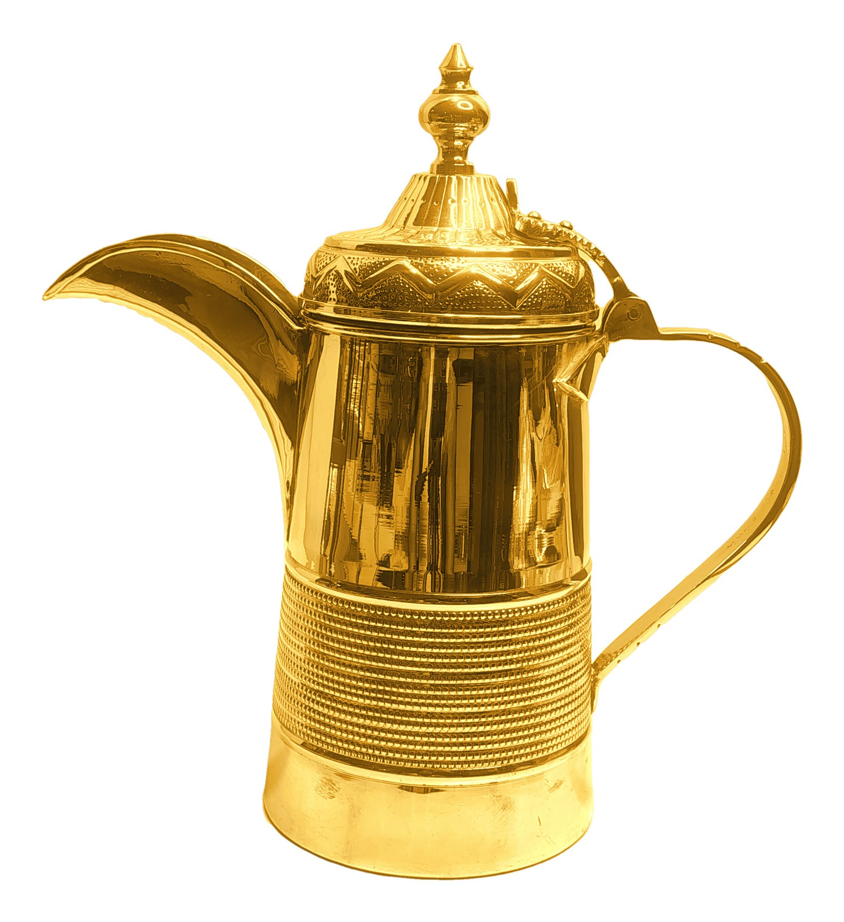
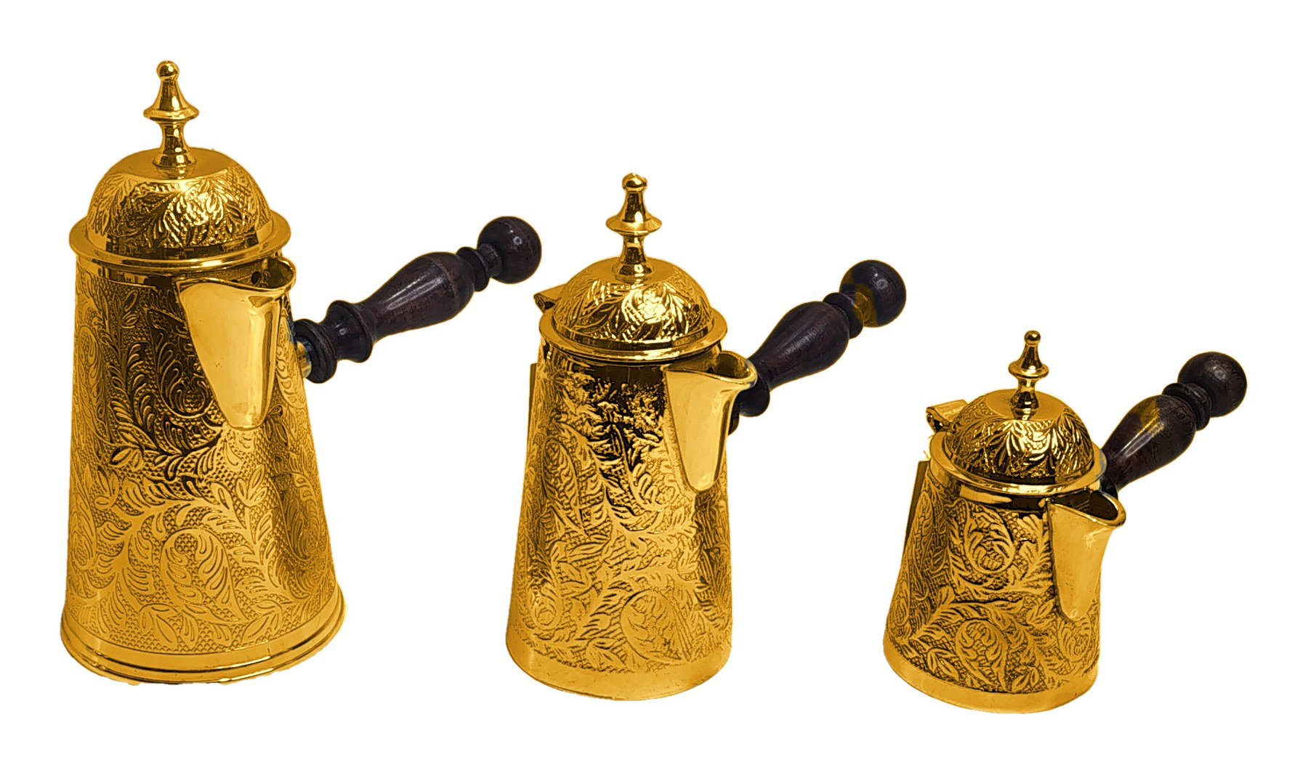

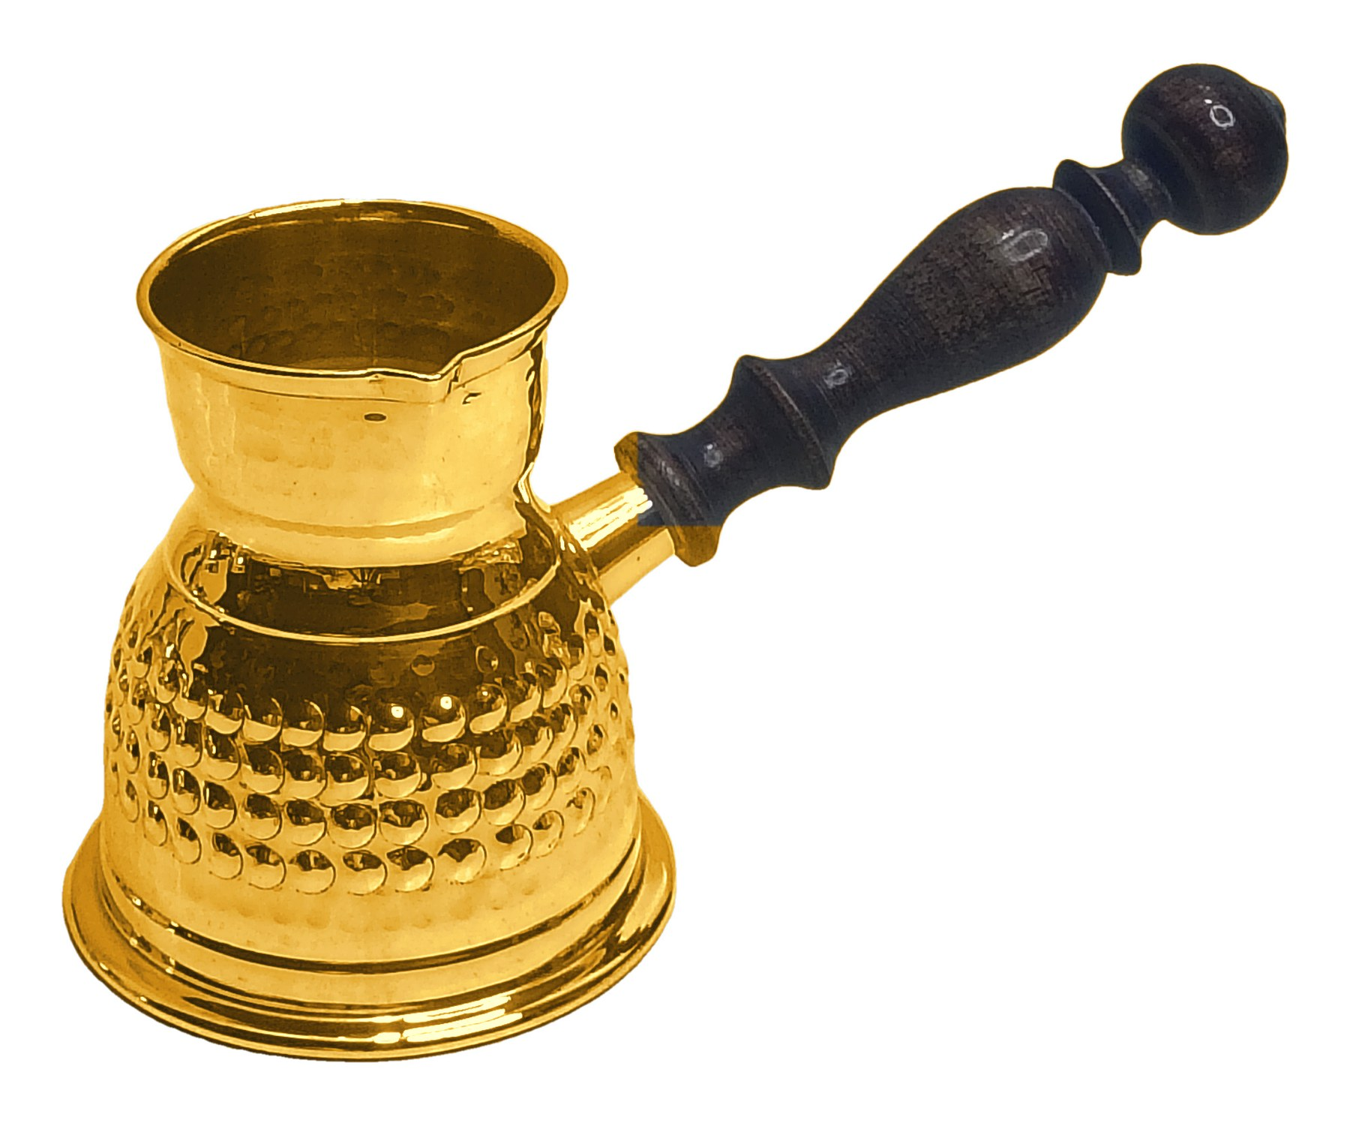
Gold Finish Collection
Brass coffee pots, dallahs and teapots in a shiny gold-plated finish. 30 products.
Notes:
Cover. Each following slide shows one product with fields for item number, size, quantity per carton and price in USD.

Slide 2
Product 01
PRODUCT 01 OF 30
Notes:
Source photo: IMG_20260924_164642914_HDR.jpg

Slide 3
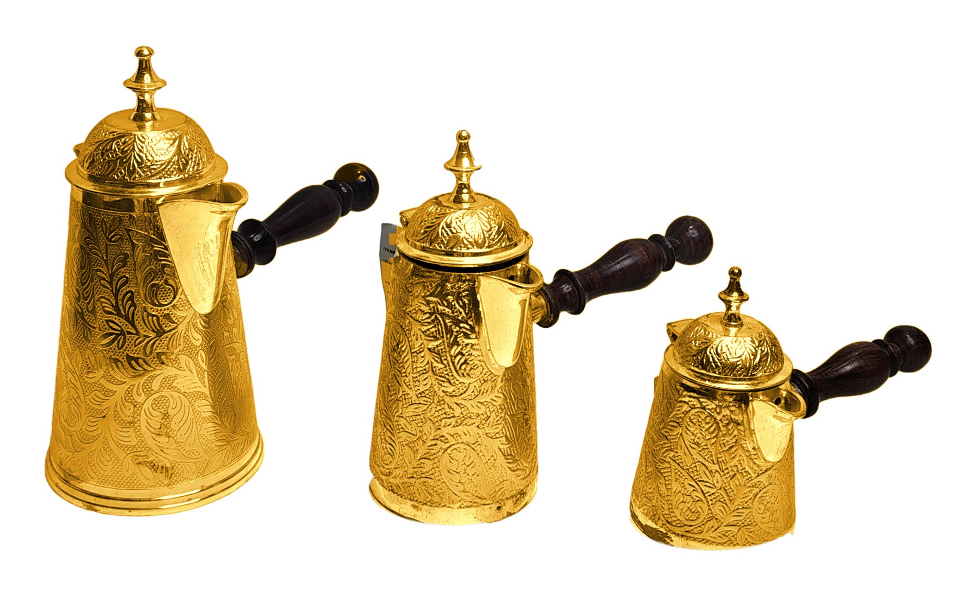
Product 02
PRODUCT 02 OF 30
Notes:
Source photo: IMG_20260927_124413419_HDR.jpg

Slide 4
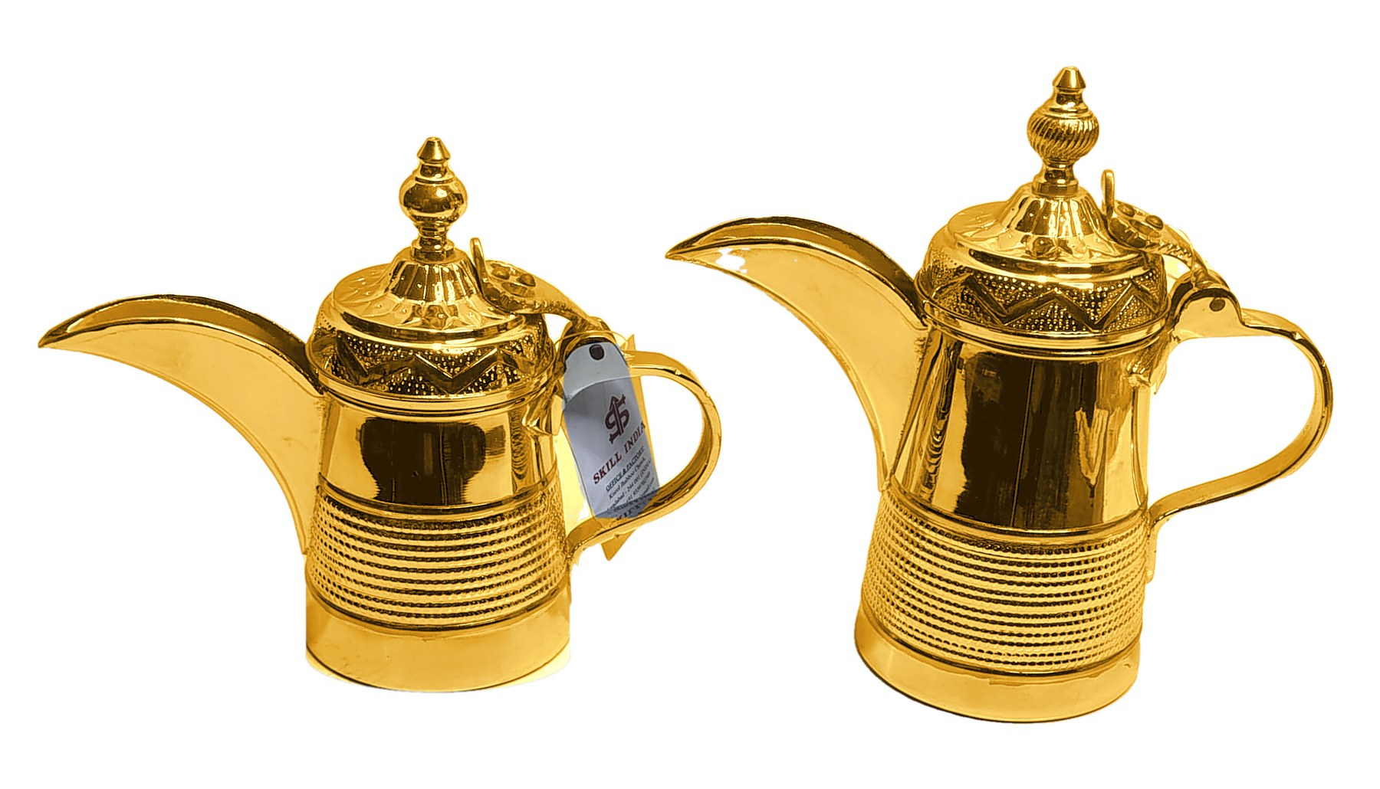
Product 03
PRODUCT 03 OF 30
Notes:
Source photo: IMG_20260927_125159740_HDR.jpg

Slide 5
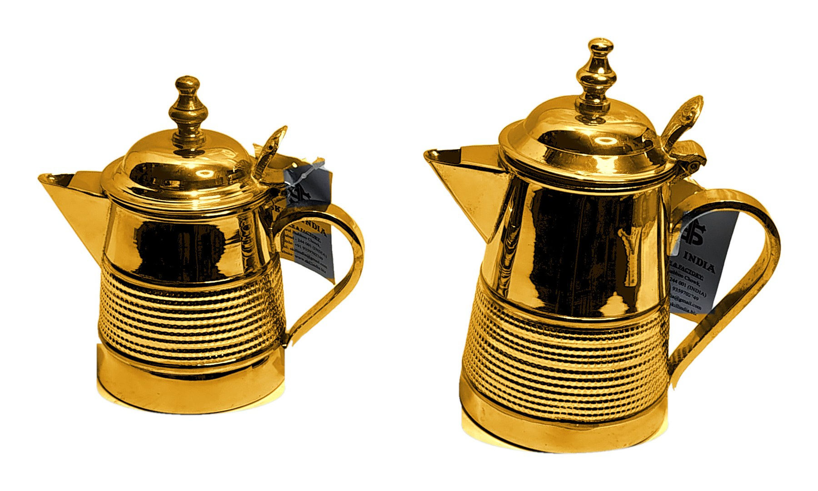
Product 04
PRODUCT 04 OF 30
Notes:
Source photo: IMG_20260927_125227154_HDR.jpg

Slide 6
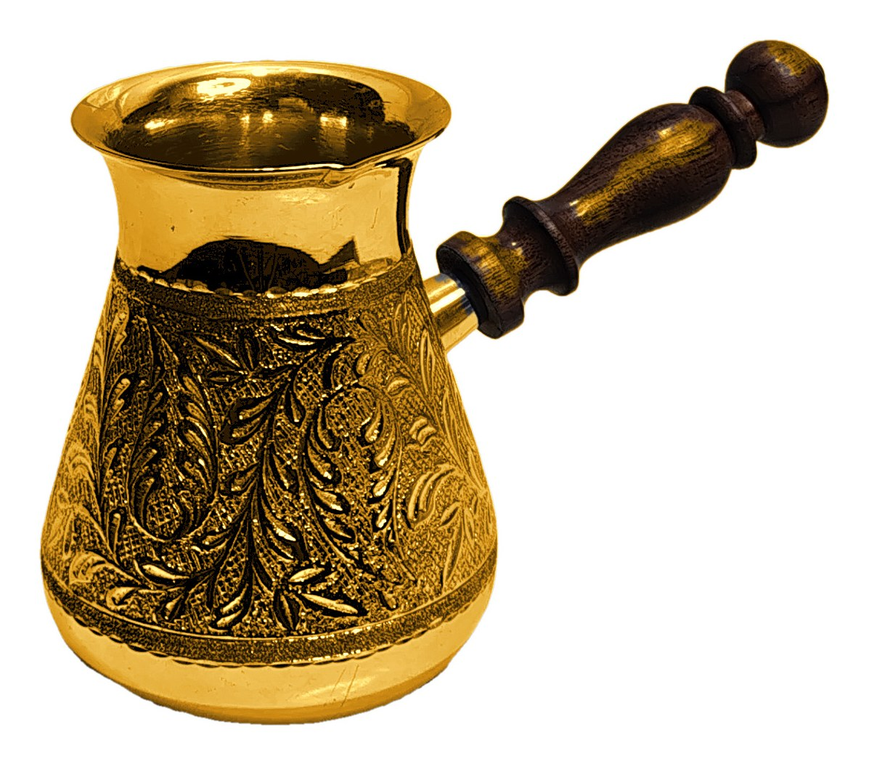
Product 05
PRODUCT 05 OF 30
Notes:
Source photo: IMG_20260927_134124919_HDR.jpg

Slide 7
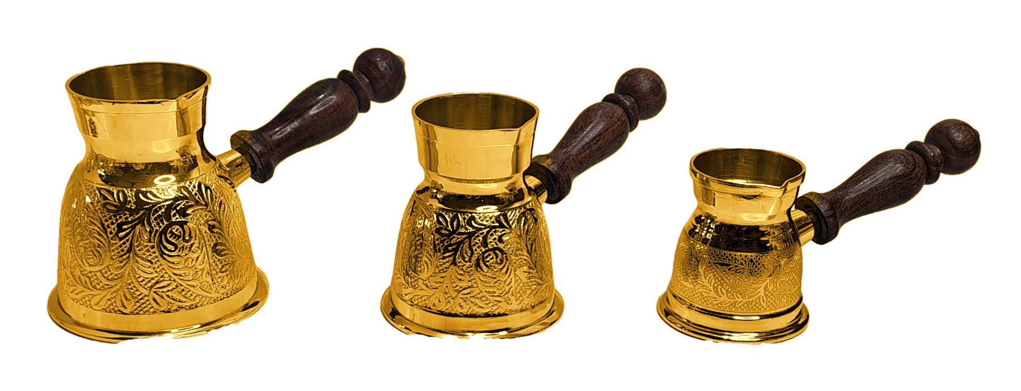
Product 06
PRODUCT 06 OF 30
Notes:
Source photo: IMG_20261001_124952182_HDR.jpg

Slide 8
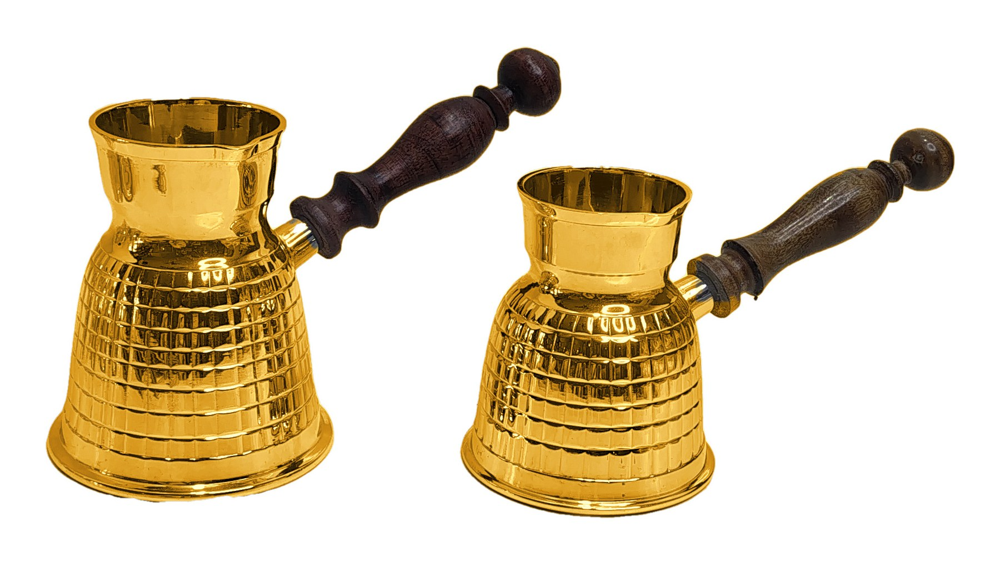
Product 07
PRODUCT 07 OF 30
Notes:
Source photo: IMG_20261001_125717020_HDR.jpg

Slide 9
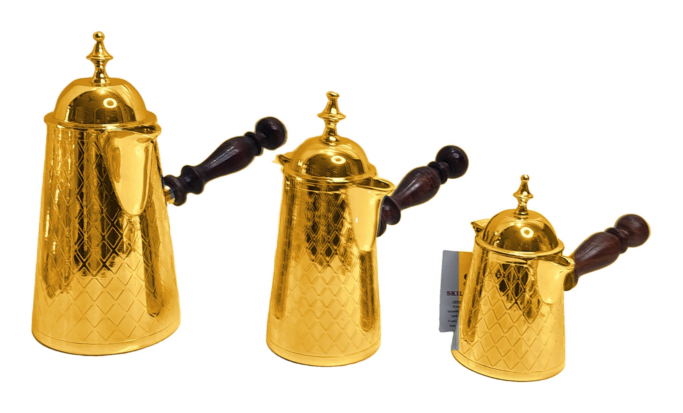
Product 08
PRODUCT 08 OF 30
Notes:
Source photo: IMG_20261001_133325817_HDR.jpg

Slide 10
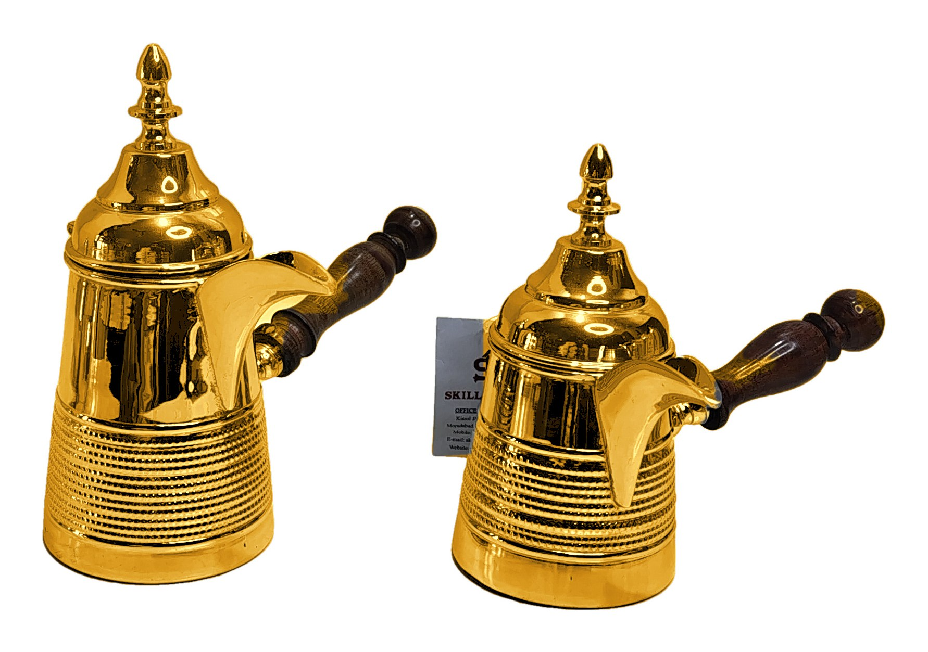
Product 09
PRODUCT 09 OF 30
Notes:
Source photo: IMG_20261001_133620315_HDR.jpg

Slide 11
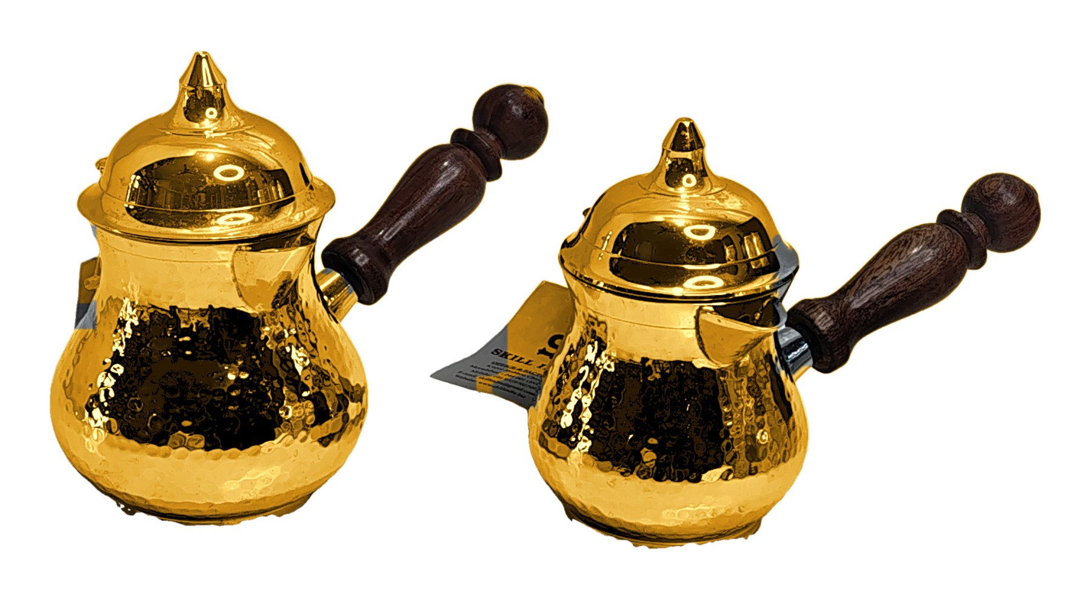
Product 10
PRODUCT 10 OF 30
Notes:
Source photo: IMG_20261001_134020300_HDR.jpg

Slide 12
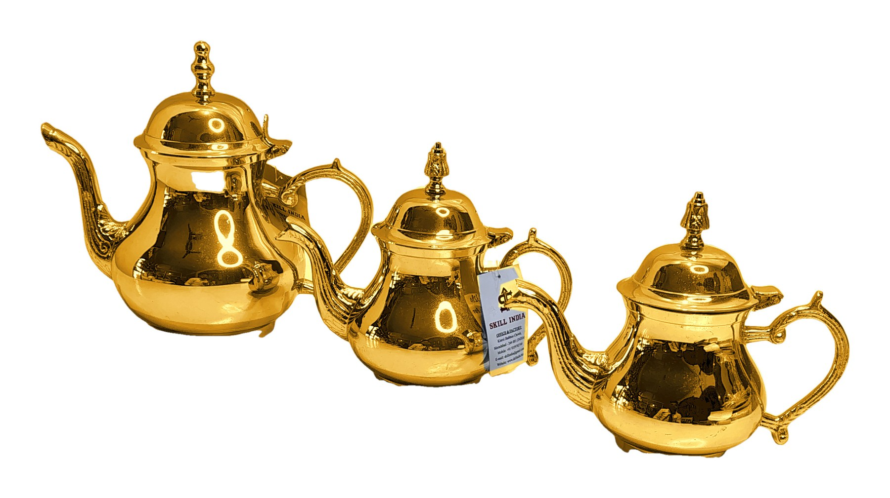
Product 11
PRODUCT 11 OF 30
Notes:
Source photo: IMG_20261001_134637743_HDR.jpg

Slide 13
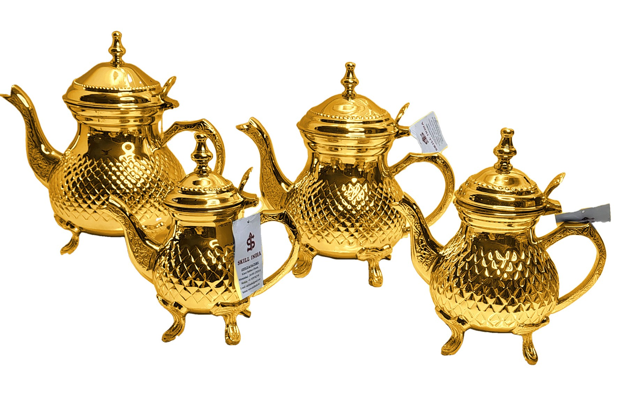
Product 12
PRODUCT 12 OF 30
Notes:
Source photo: IMG_20261001_140306591_HDR.jpg

Slide 14
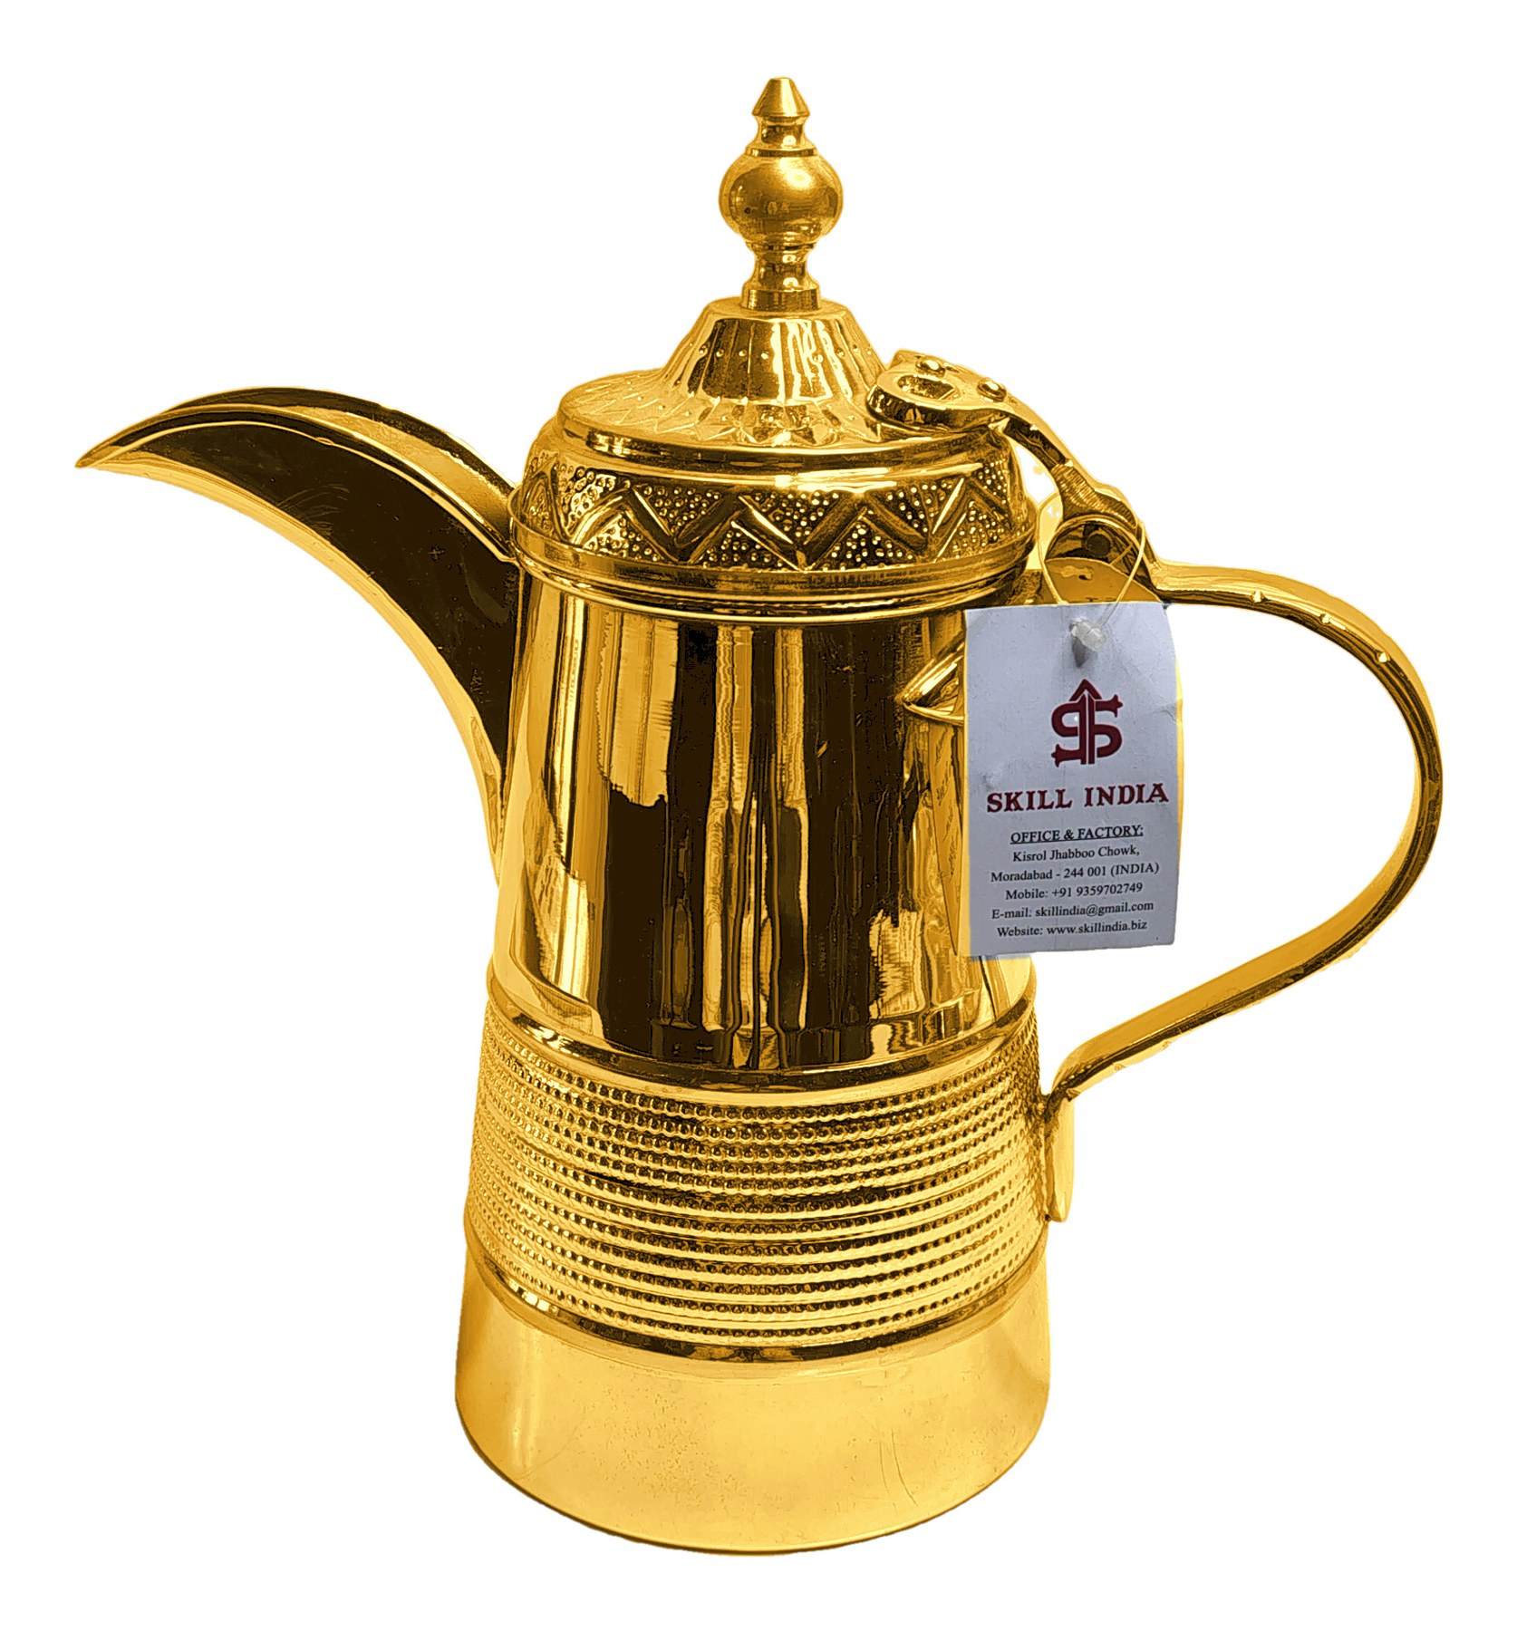
Product 13
PRODUCT 13 OF 30
Notes:
Source photo: IMG_20261001_142651268_HDR.jpg

Slide 15
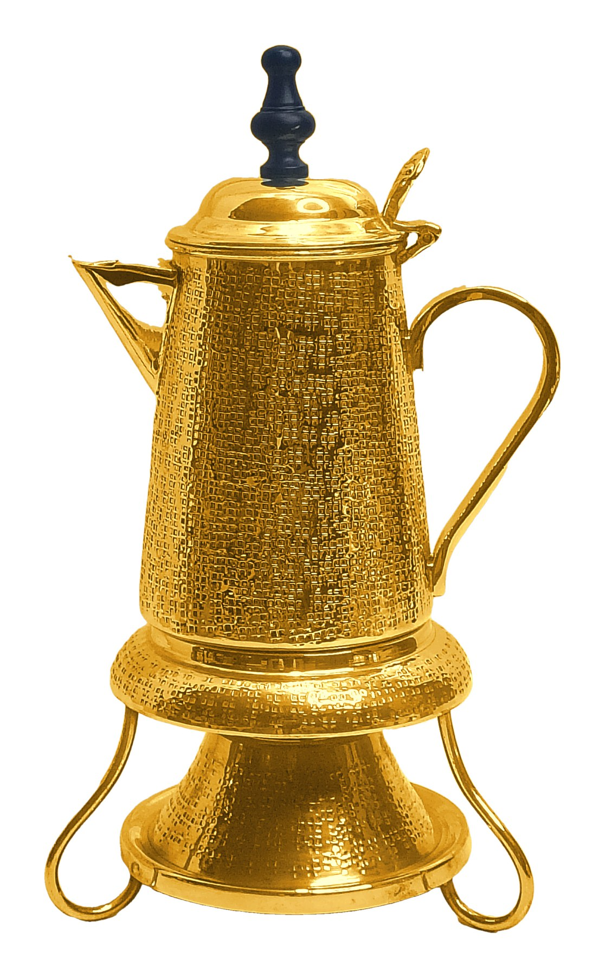
Product 14
PRODUCT 14 OF 30
Notes:
Source photo: IMG_20261003_172218233_HDR.jpg

Slide 16
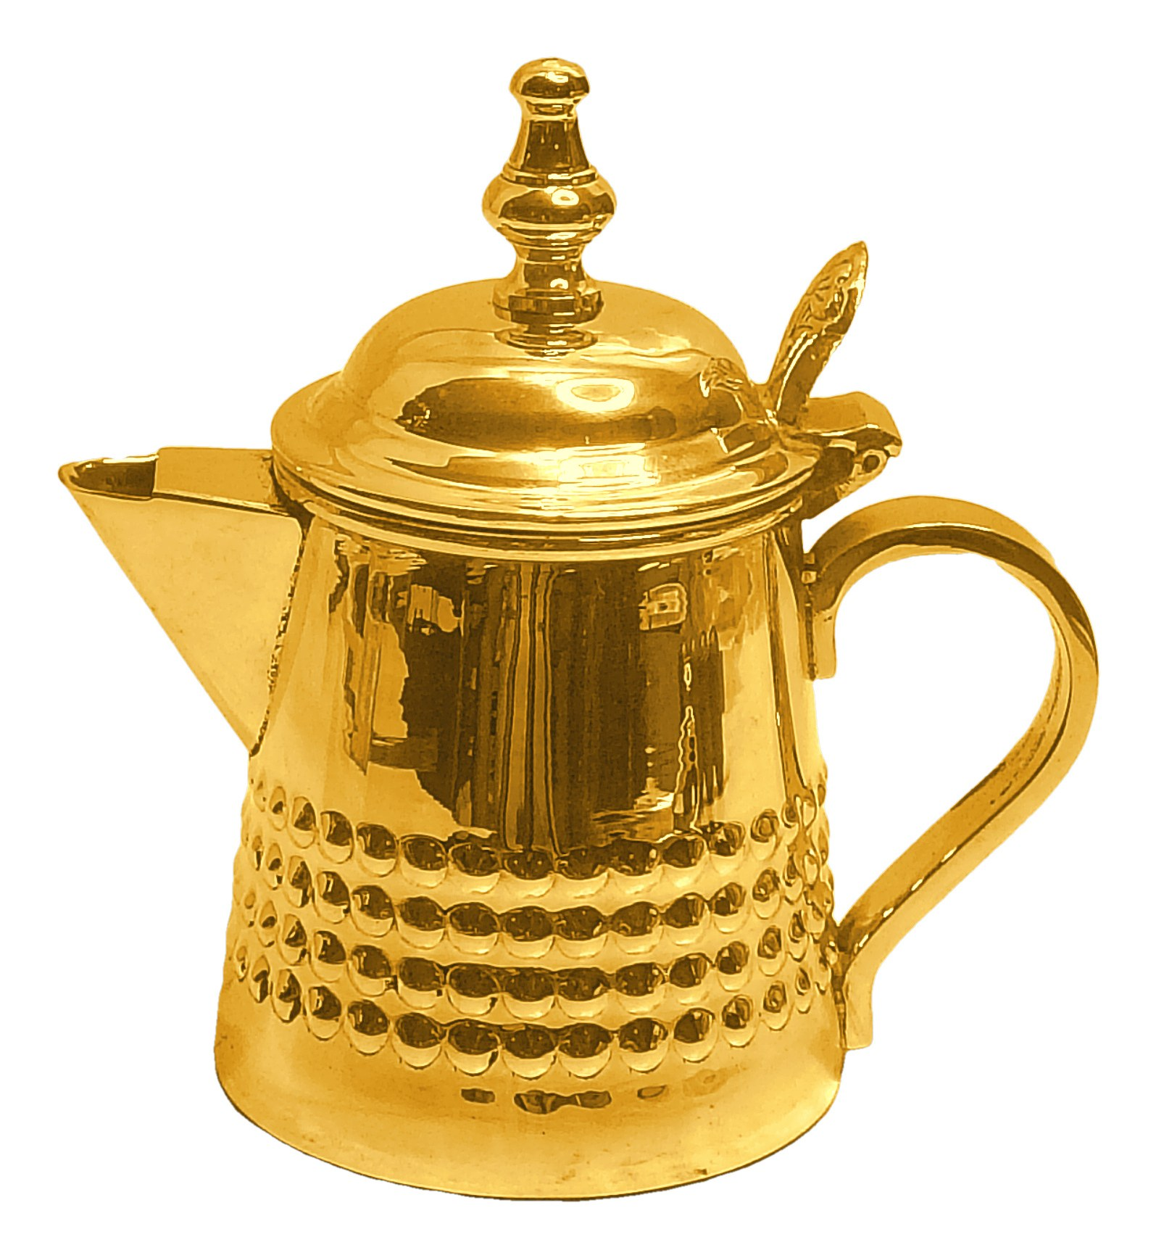
Product 15
PRODUCT 15 OF 30
Notes:
Source photo: IMG_20261003_172243164_HDR.jpg

Slide 17
Product 16
PRODUCT 16 OF 30
Notes:
Source photo: IMG_20261003_172444369_HDR.jpg

Slide 18
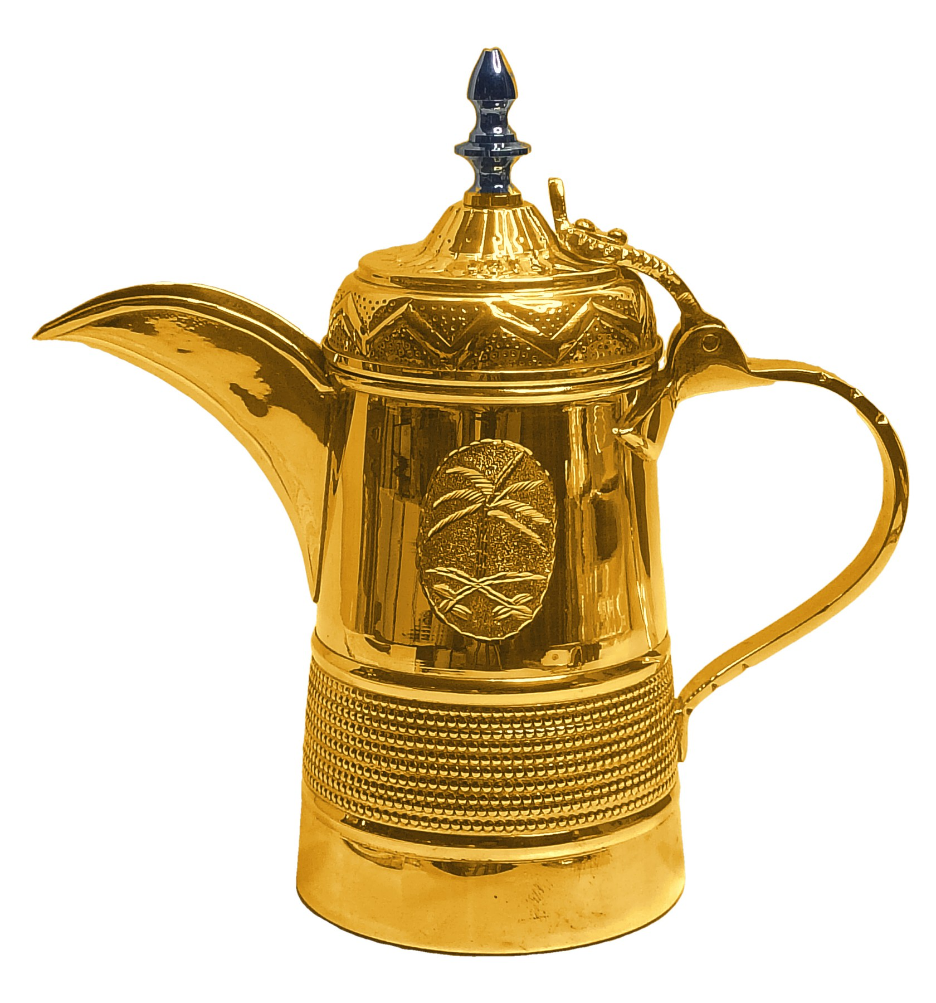
Product 17
PRODUCT 17 OF 30
Notes:
Source photo: IMG_20261003_172604045_HDR.jpg

Slide 19
Product 18
PRODUCT 18 OF 30
Notes:
Source photo: IMG_20261003_174228868_HDR.jpg

Slide 20

Product 19
PRODUCT 19 OF 30
Notes:
Source photo: IMG_20261003_175655651_HDR.jpg

Slide 21

Product 20
PRODUCT 20 OF 30
Notes:
Source photo: IMG_20261003_175847795_HDR.jpg

Slide 22

Product 21
PRODUCT 21 OF 30
Notes:
Source photo: IMG_20261003_175953185_HDR.jpg

Slide 23
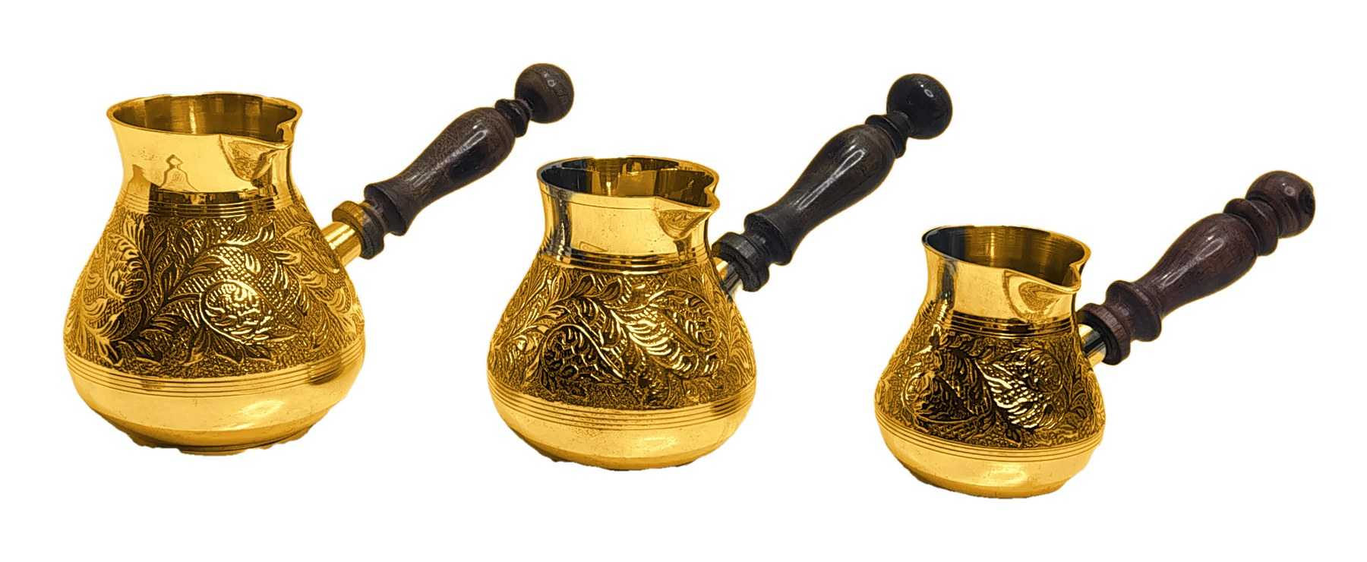
Product 22
PRODUCT 22 OF 30
Notes:
Source photo: IMG_20261003_183226848_HDR.jpg

Slide 24
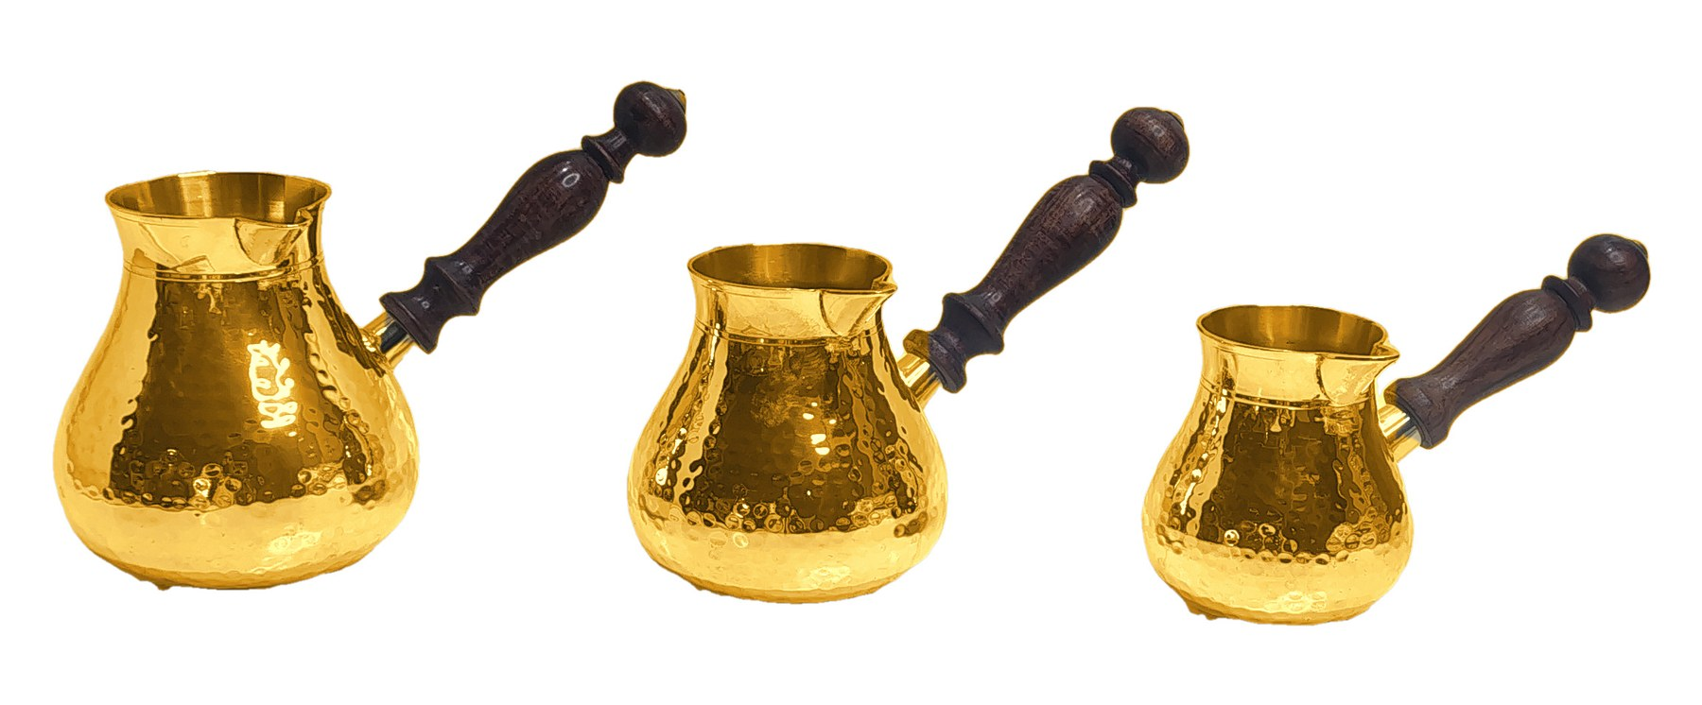
Product 23
PRODUCT 23 OF 30
Notes:
Source photo: IMG_20261003_183736093_HDR.jpg

Slide 25
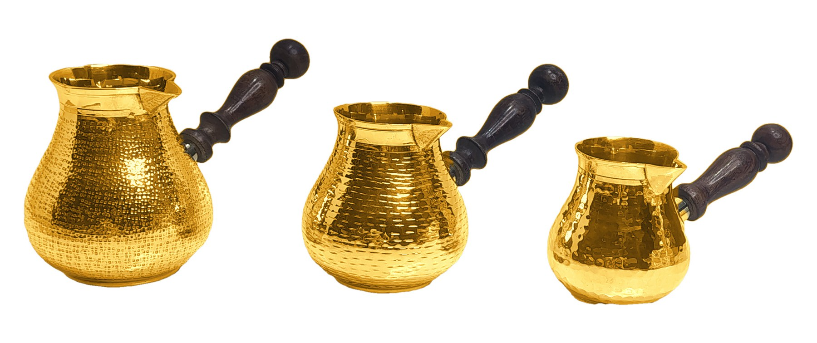
Product 24
PRODUCT 24 OF 30
Notes:
Source photo: IMG_20261003_184112432_HDR.jpg

Slide 26
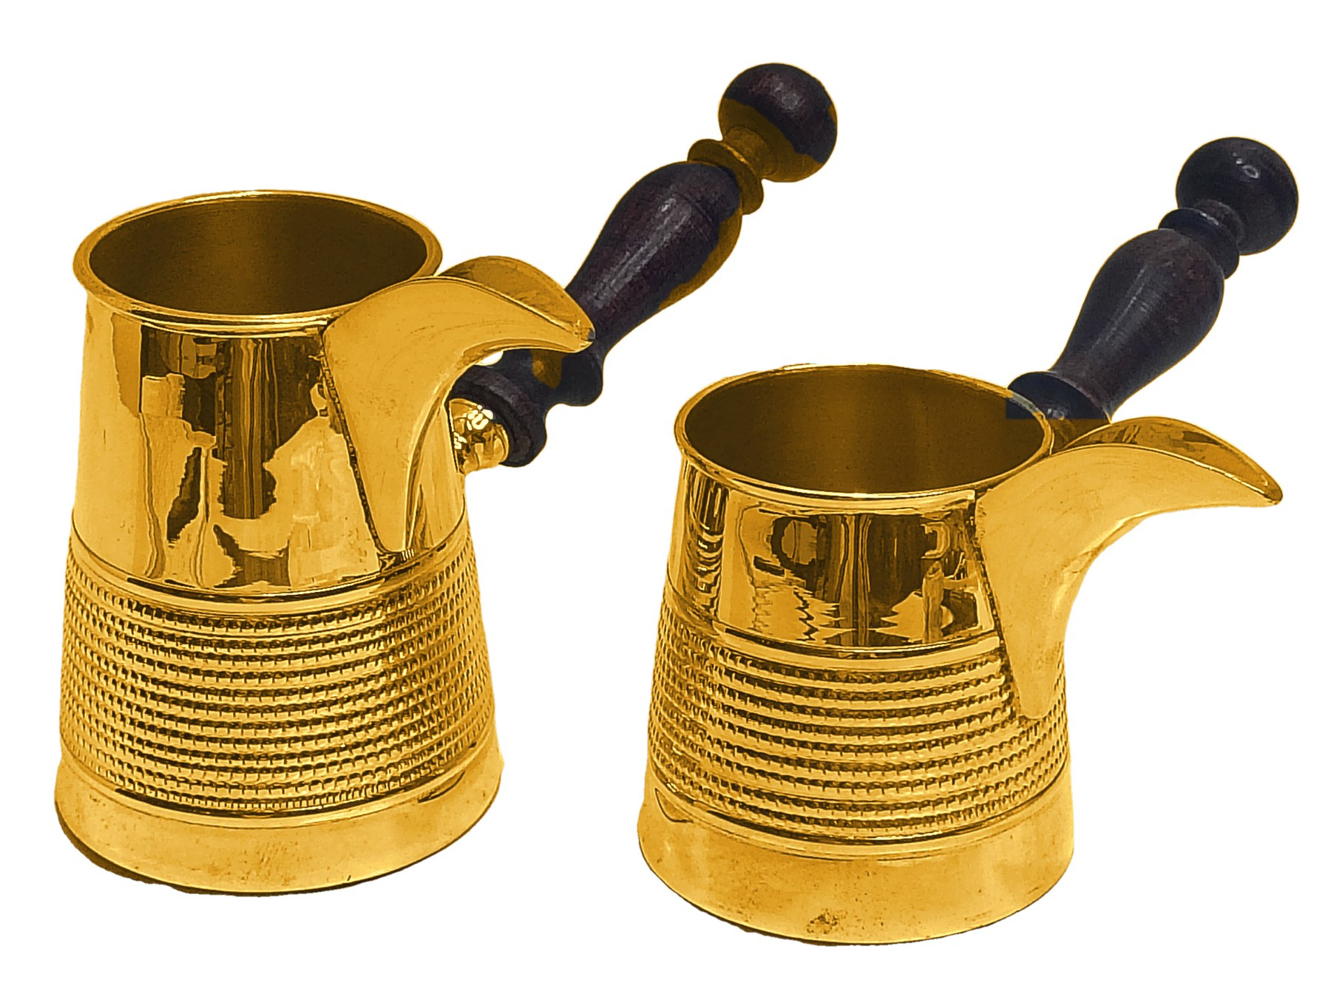
Product 25
PRODUCT 25 OF 30
Notes:
Source photo: IMG_20261003_184754631_HDR.jpg

Slide 27
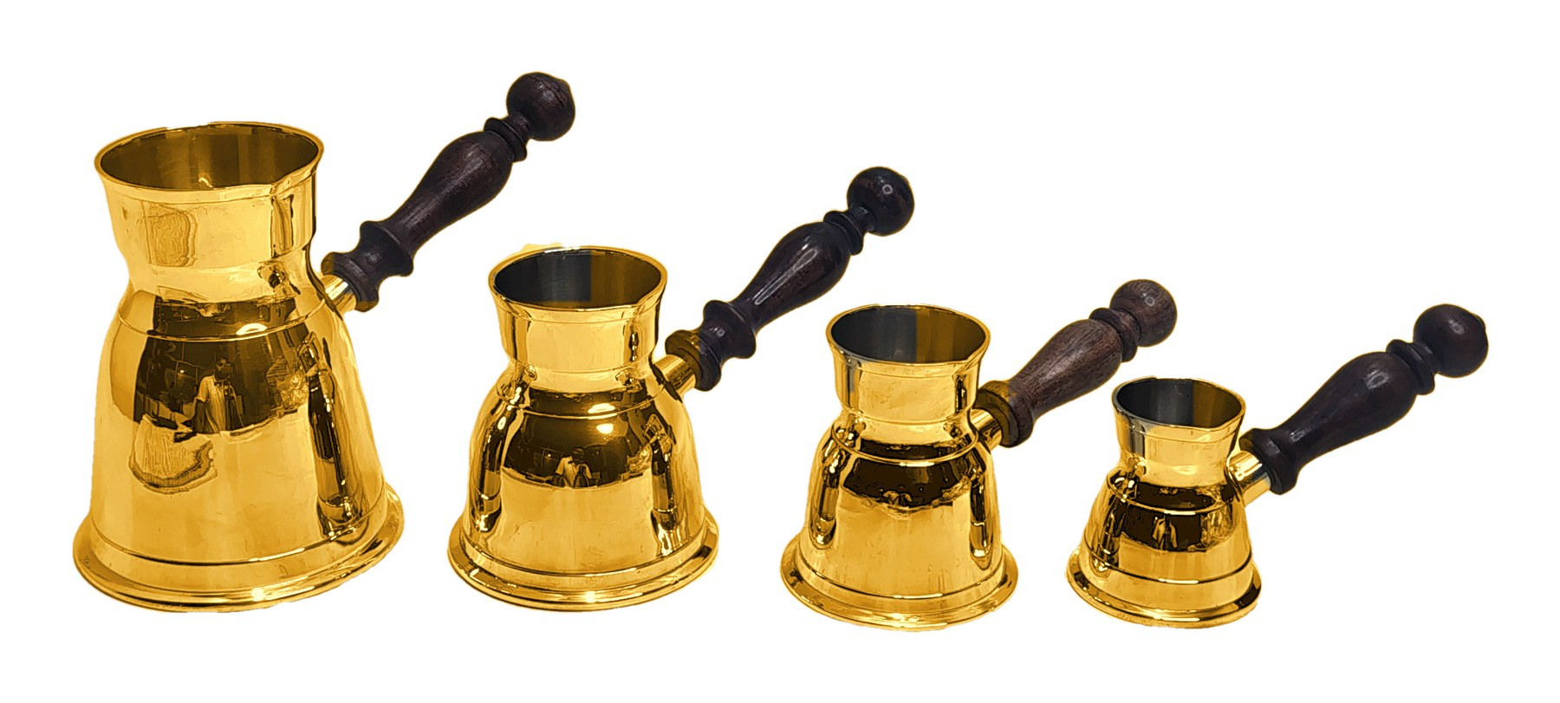
Product 26
PRODUCT 26 OF 30
Notes:
Source photo: IMG_20261003_185126851_HDR.jpg

Slide 28
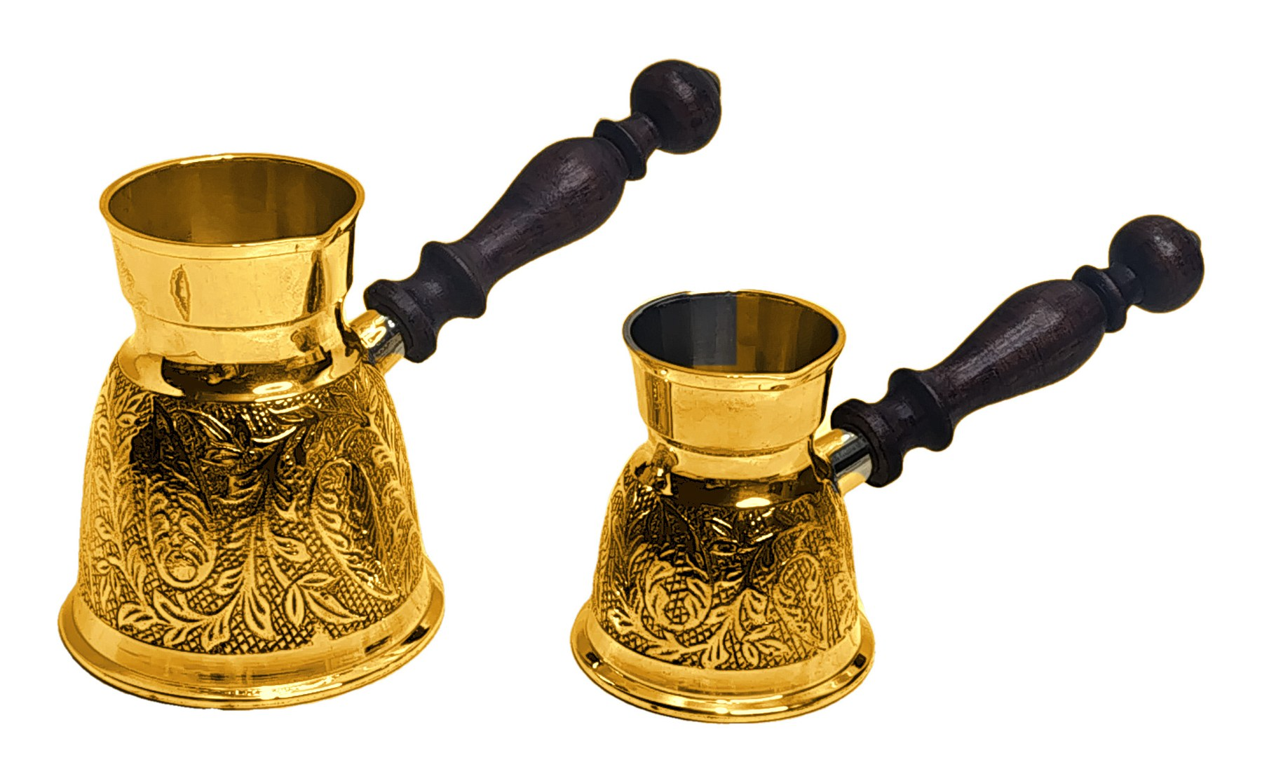
Product 27
PRODUCT 27 OF 30
Notes:
Source photo: IMG_20261003_185506789_HDR.jpg

Slide 29
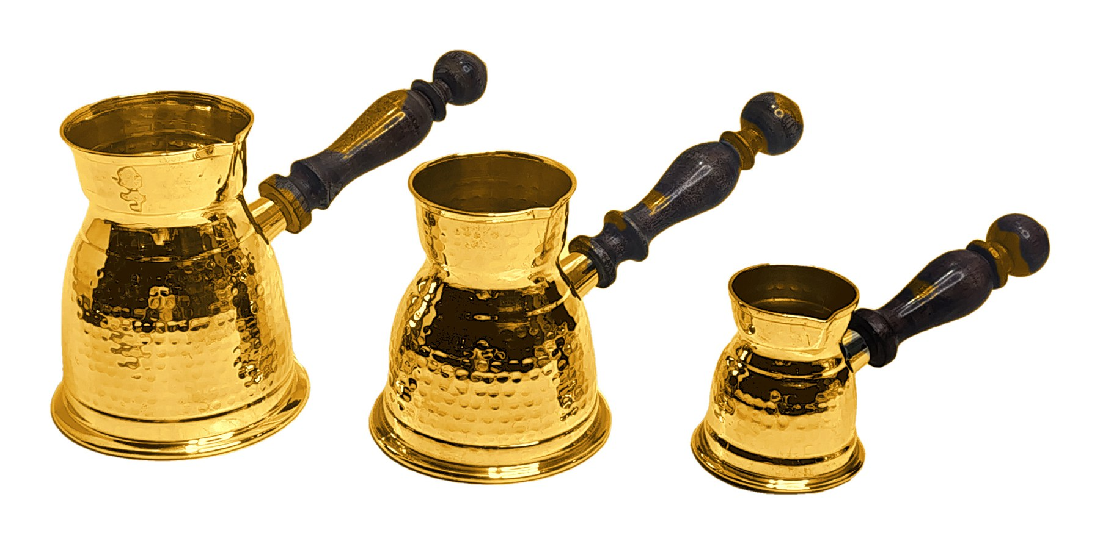
Product 28
PRODUCT 28 OF 30
Notes:
Source photo: IMG_20261003_185922587_HDR.jpg

Slide 30
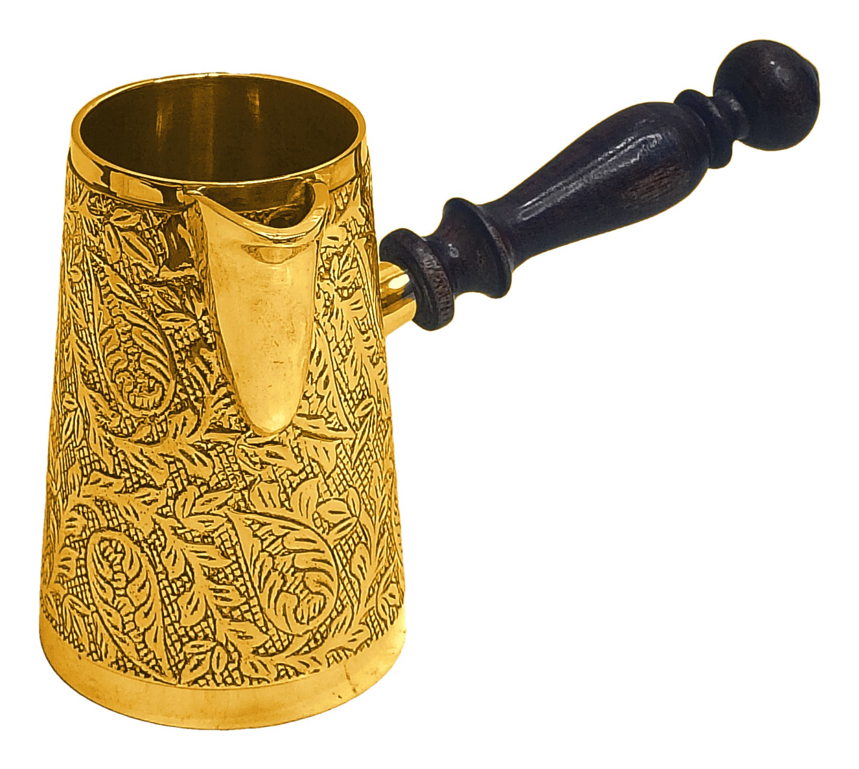
Product 29
PRODUCT 29 OF 30
Notes:
Source photo: IMG_20261003_190236652_HDR.jpg

Slide 31
Product 30
PRODUCT 30 OF 30
Notes:
Source photo: IMG_20261003_190451992_HDR.jpg

