Slide 1
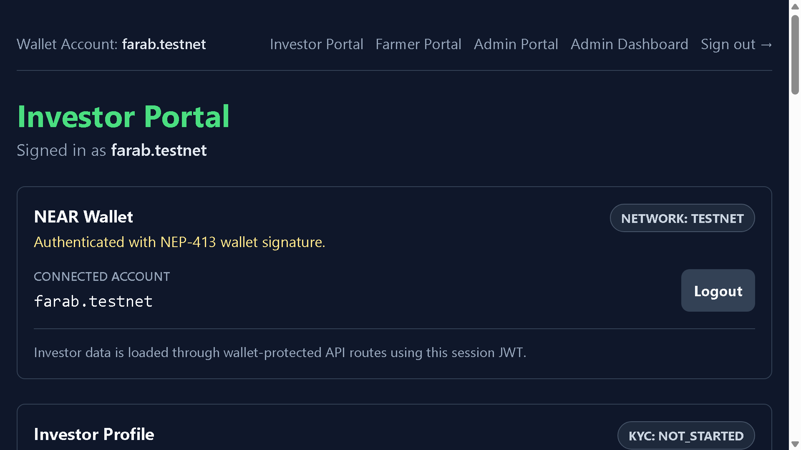
AgriPartners
AgriPartners Investor Deck
Transparent agricultural investment workflows for pilot-scale livestock projects
Alpha v1 | Investor, farmer, admin, and NEAR Testnet flows
Investor portal overview
$100,000
$163,650
$82,000
64%
63.3%
Total Pilot Funding
Expected Returns
Returned
Fidlot ROI
Hissar Projected ROI

Slide 2
AgriPartners
02
Agricultural Capital Is Still Hard to Review and Trust
Farmers need working capital before revenue arrives. Investors need structured terms, reporting discipline, and repayment visibility.
Fragmented Evidence
Weak Monitoring
Trust Gap
Deals often rely on offline documents and relationship-based updates.
Operational progress and cycle status are difficult to compare across projects.
Cross-border capital needs clear economics and repayment proof before scaling.
Farm operators
Structured deal
External capital
AgriPartners Alpha v1

Slide 3
AgriPartners
03
Real-Economy Yield in a Recurring Agriculture Market
AgriPartners is designed for regional and international investors seeking transparent access to agricultural opportunities in Central Asia.
Recurring Demand
Comparable Deals
Regional Bridge
Livestock, breeding, crops, greenhouses, poultry, and food supply chains need repeat capital cycles.
Standardized project profiles make agricultural opportunities easier to review.
The platform is designed for disciplined cross-border pilot validation.
Farm operators
Structured deal
External capital
AgriPartners Alpha v1

Slide 4
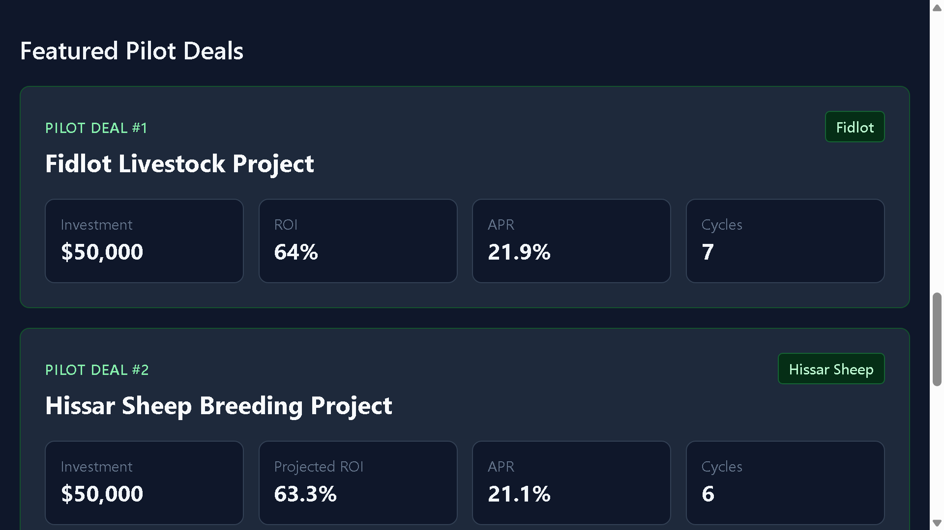
AgriPartners
04
Structured Agricultural Investment Workflows
AgriPartners connects investors and agricultural operators through project profiles, reporting, return tracking, and blockchain-supported validation.
01
02
03
04
05
Create deal
Review economics
Execute cycles
Report progress
Track returns
From review to reporting and return tracking in one controlled workflow.
Featured pilot deals
AgriPartners Alpha v1

Slide 5
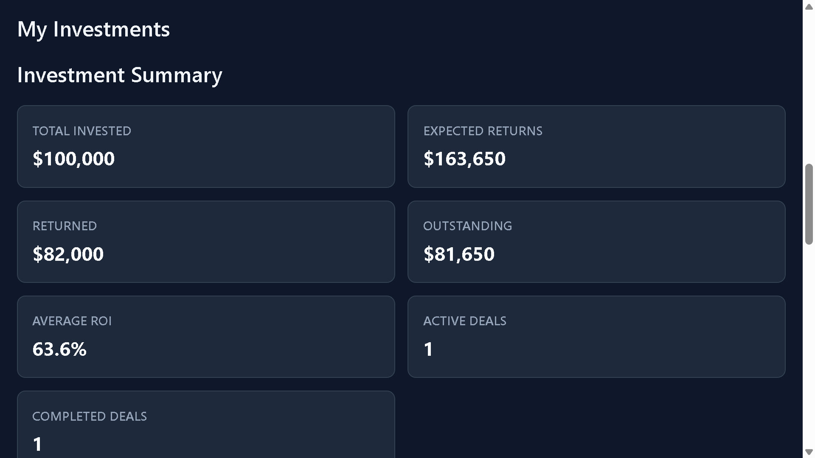
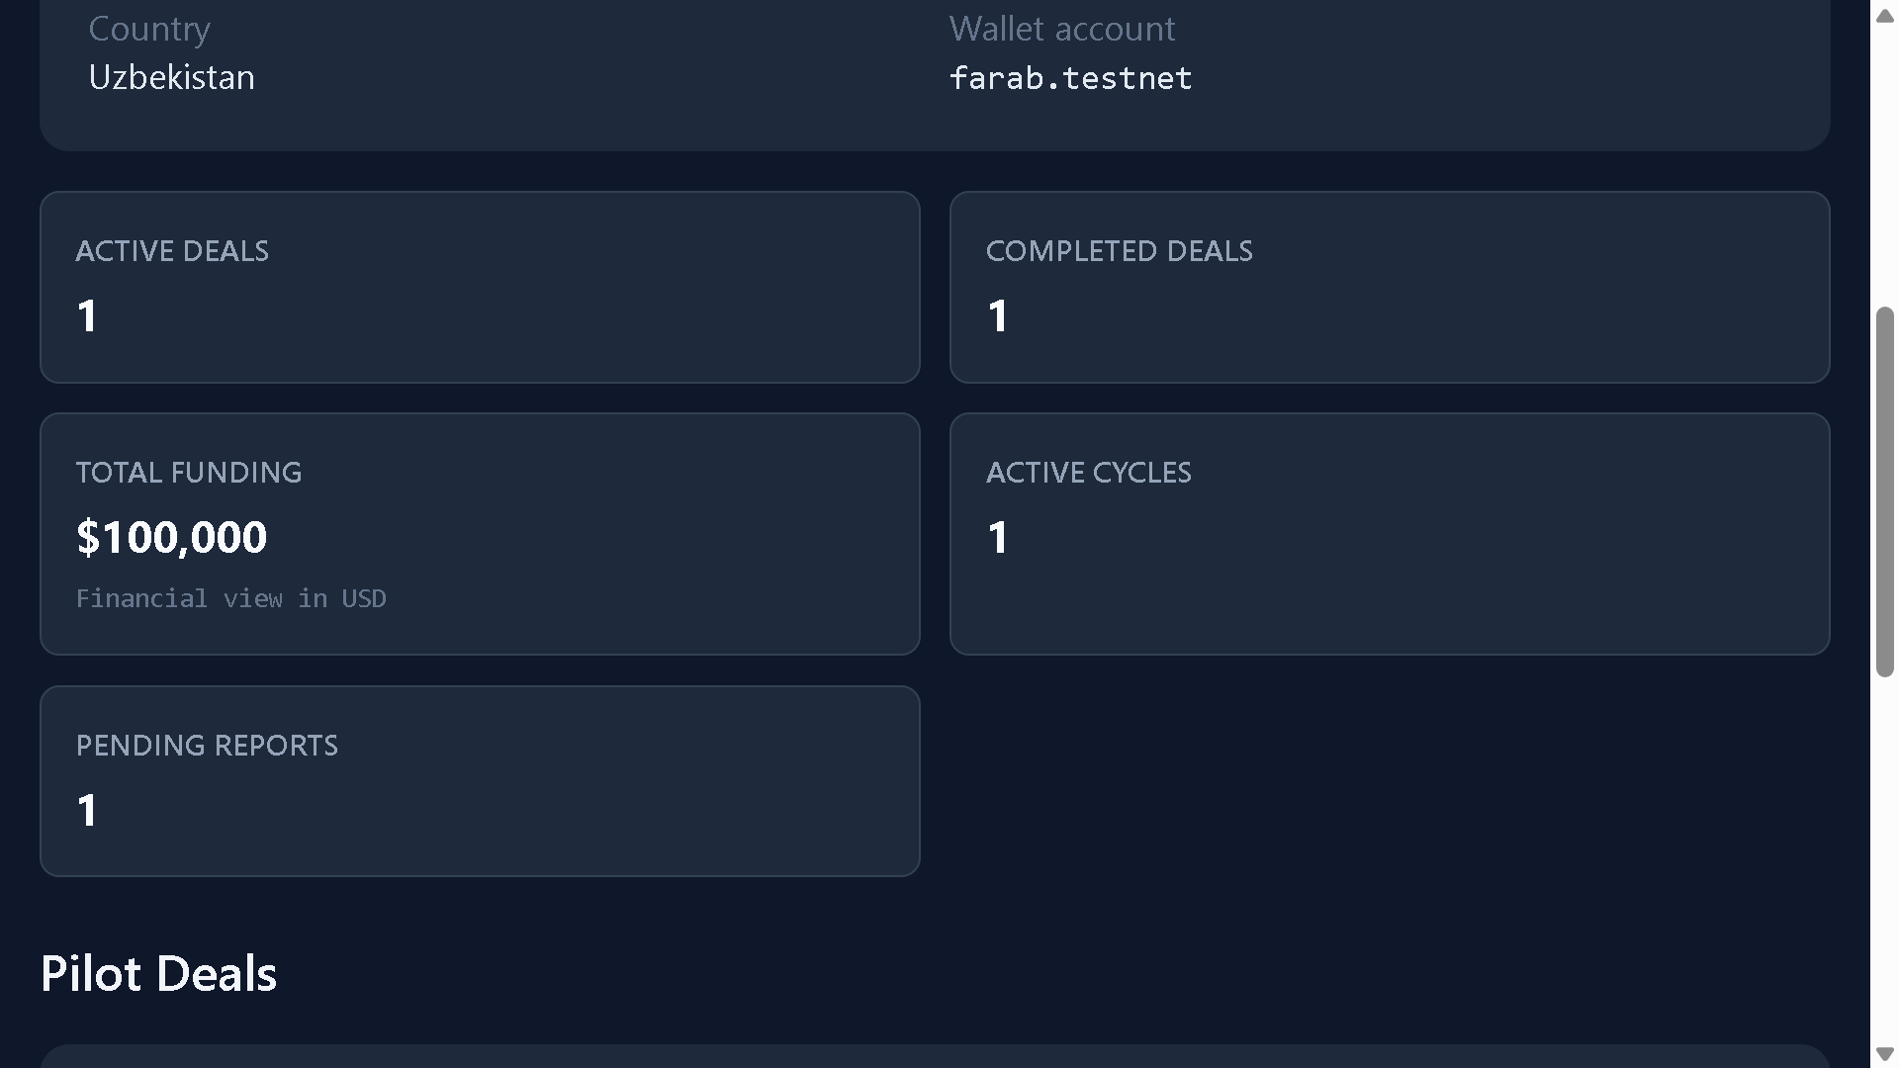
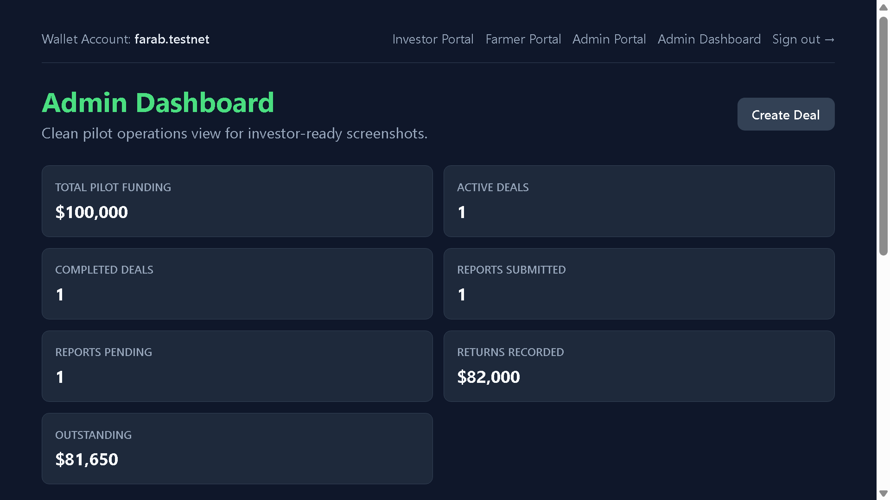
AgriPartners
05
One Platform, Three Operating Views
The same project lifecycle is translated into investor clarity, farmer execution context, and administrator control.
Investor Portal
Farmer Portal
Admin Dashboard
Portfolio metrics, pilot deals, ROI, expected returns, returned capital
Funding confirmation, cycle progress, active and completed deal status
Deal monitoring, reporting oversight, repayment status, event history
AgriPartners Alpha v1

Slide 6
AgriPartners
06
Investor Dashboard and Return Visibility
Investors can review funding, expected returns, returned capital, outstanding amounts, active deals, completed deals, and ROI in one workflow.
$100,000
Total Pilot Funding
$163,650
Expected Returns
$82,000
Returned
Completed projects show ROI
Investment summary
Active projects show projected ROI
Portfolio metrics stay visible above individual deals
AgriPartners Alpha v1

Slide 7
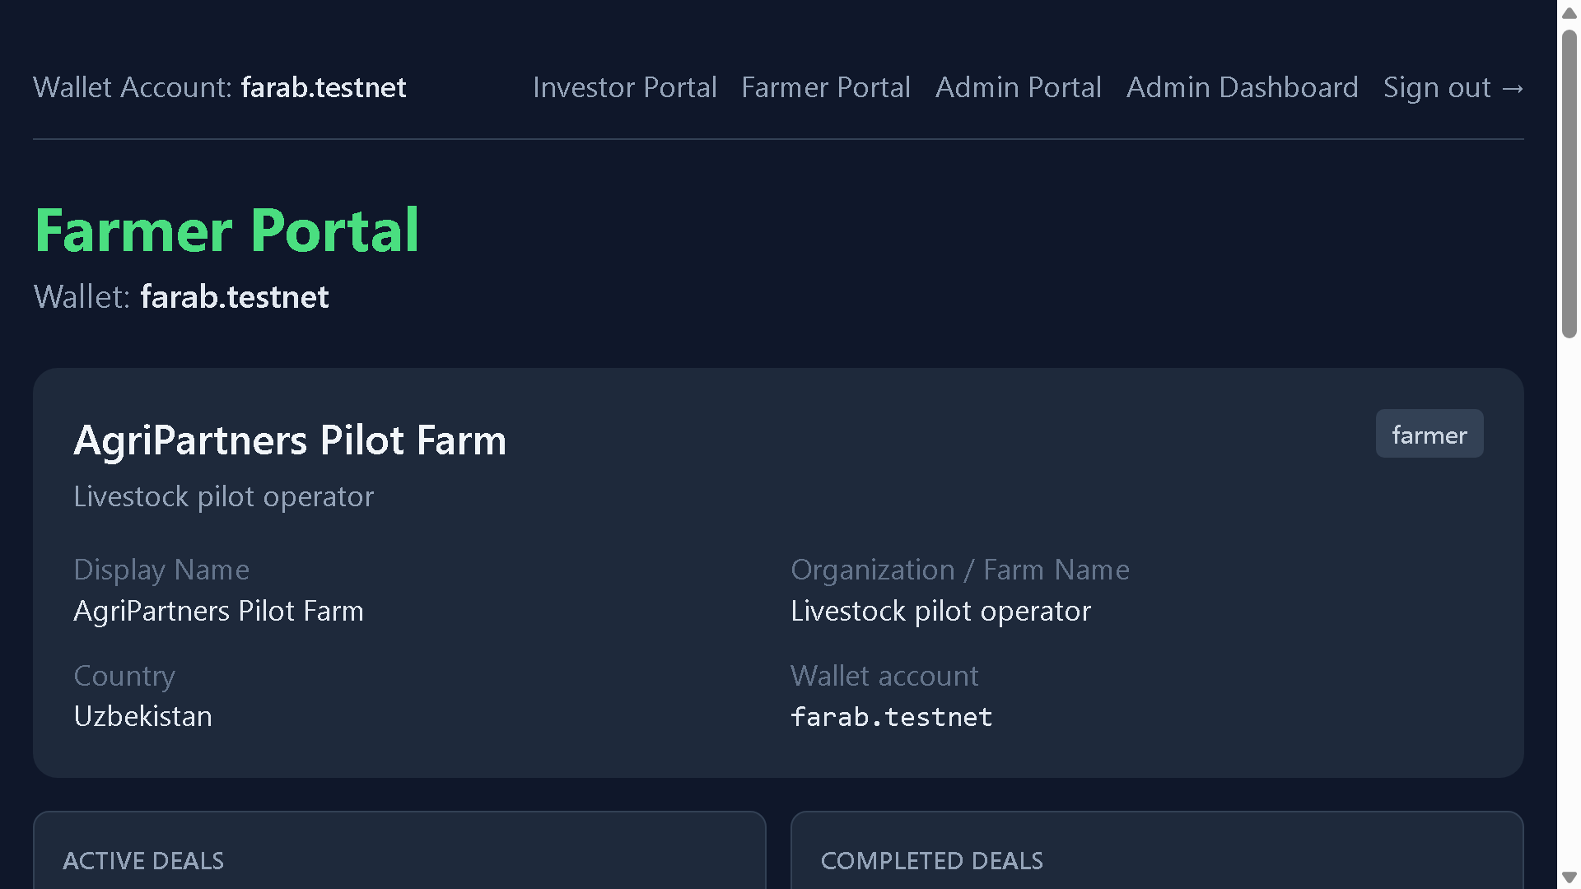
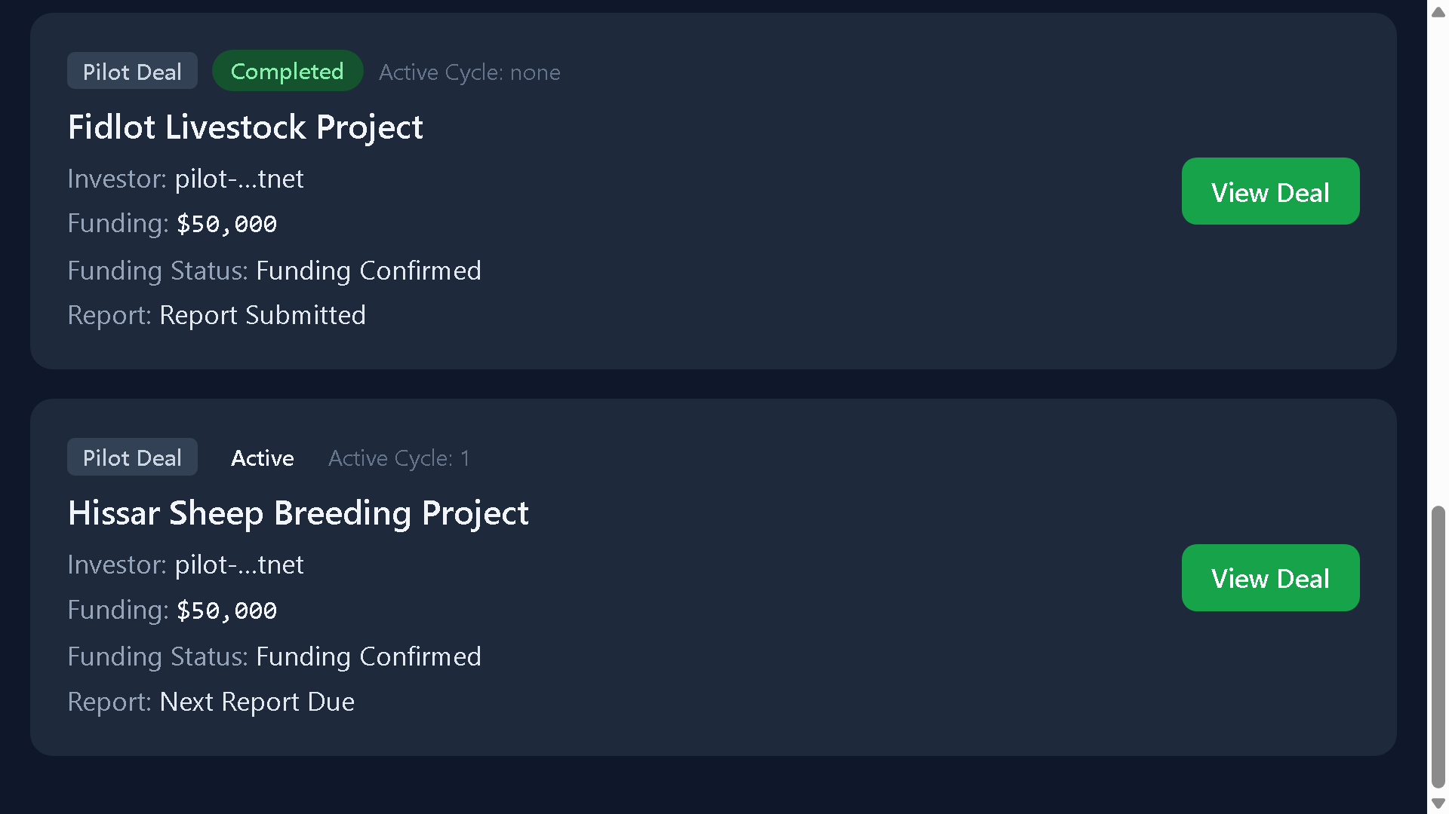
AgriPartners
07
Farmer Operations and Reporting
Farmers see funding confirmation, cycle progress, active and completed deals, and report status in business-readable language.
Profile
Metrics
Deals
Funding confirmed
Cycles executed
Report submitted
Returns tracked
AgriPartners Alpha v1

Slide 8
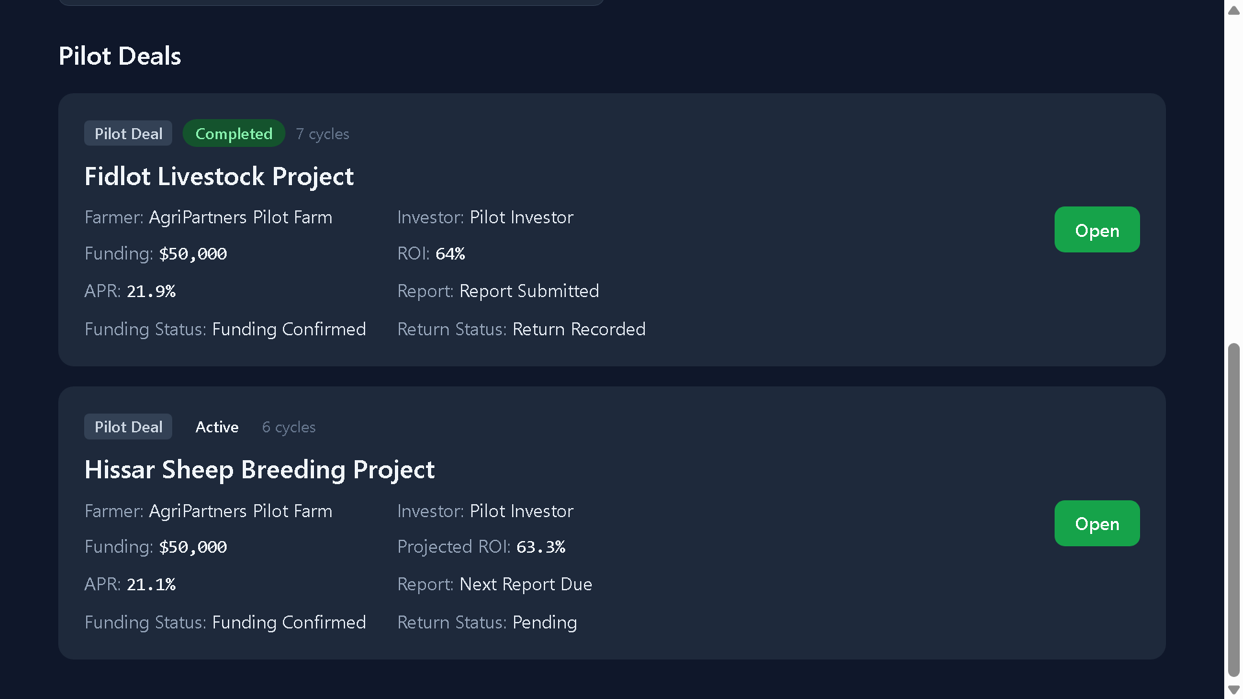
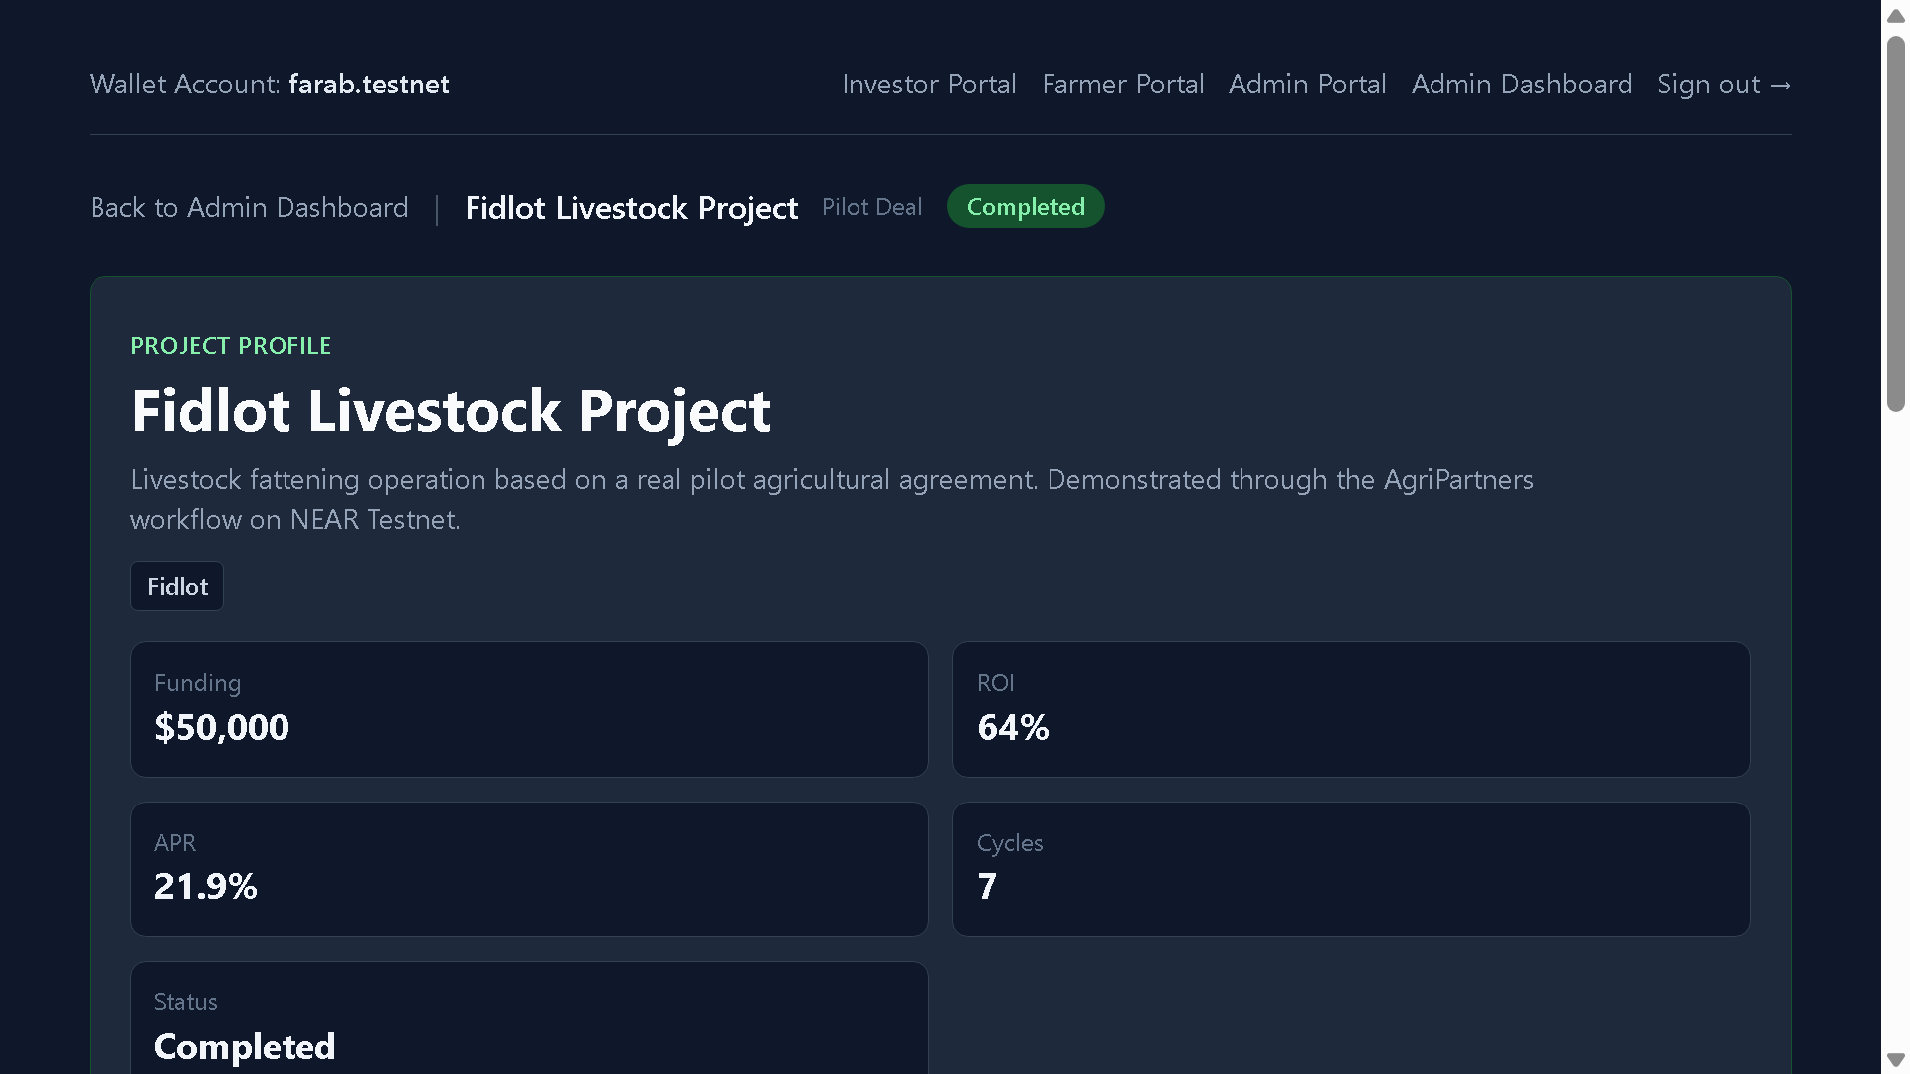
AgriPartners
08
Operational Control for Pilot Deals
Admins monitor funding, deal status, farmer reporting, repayment status, and event history across the pilot portfolio.
Pilot deals
Admin dashboard
Project profile
AgriPartners Alpha v1

Slide 9
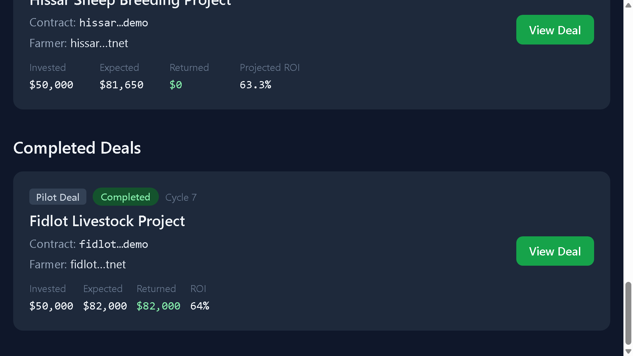
AgriPartners
09
Fidlot Livestock Project
Completed livestock fattening pilot with clear economics, cycle history, reporting, and realized return visibility.
$50,000
Investment
64%
ROI
21.9%
APR
7
Cycles
$82,000
Completed Fidlot deal
Returned
AgriPartners Alpha v1

Slide 10
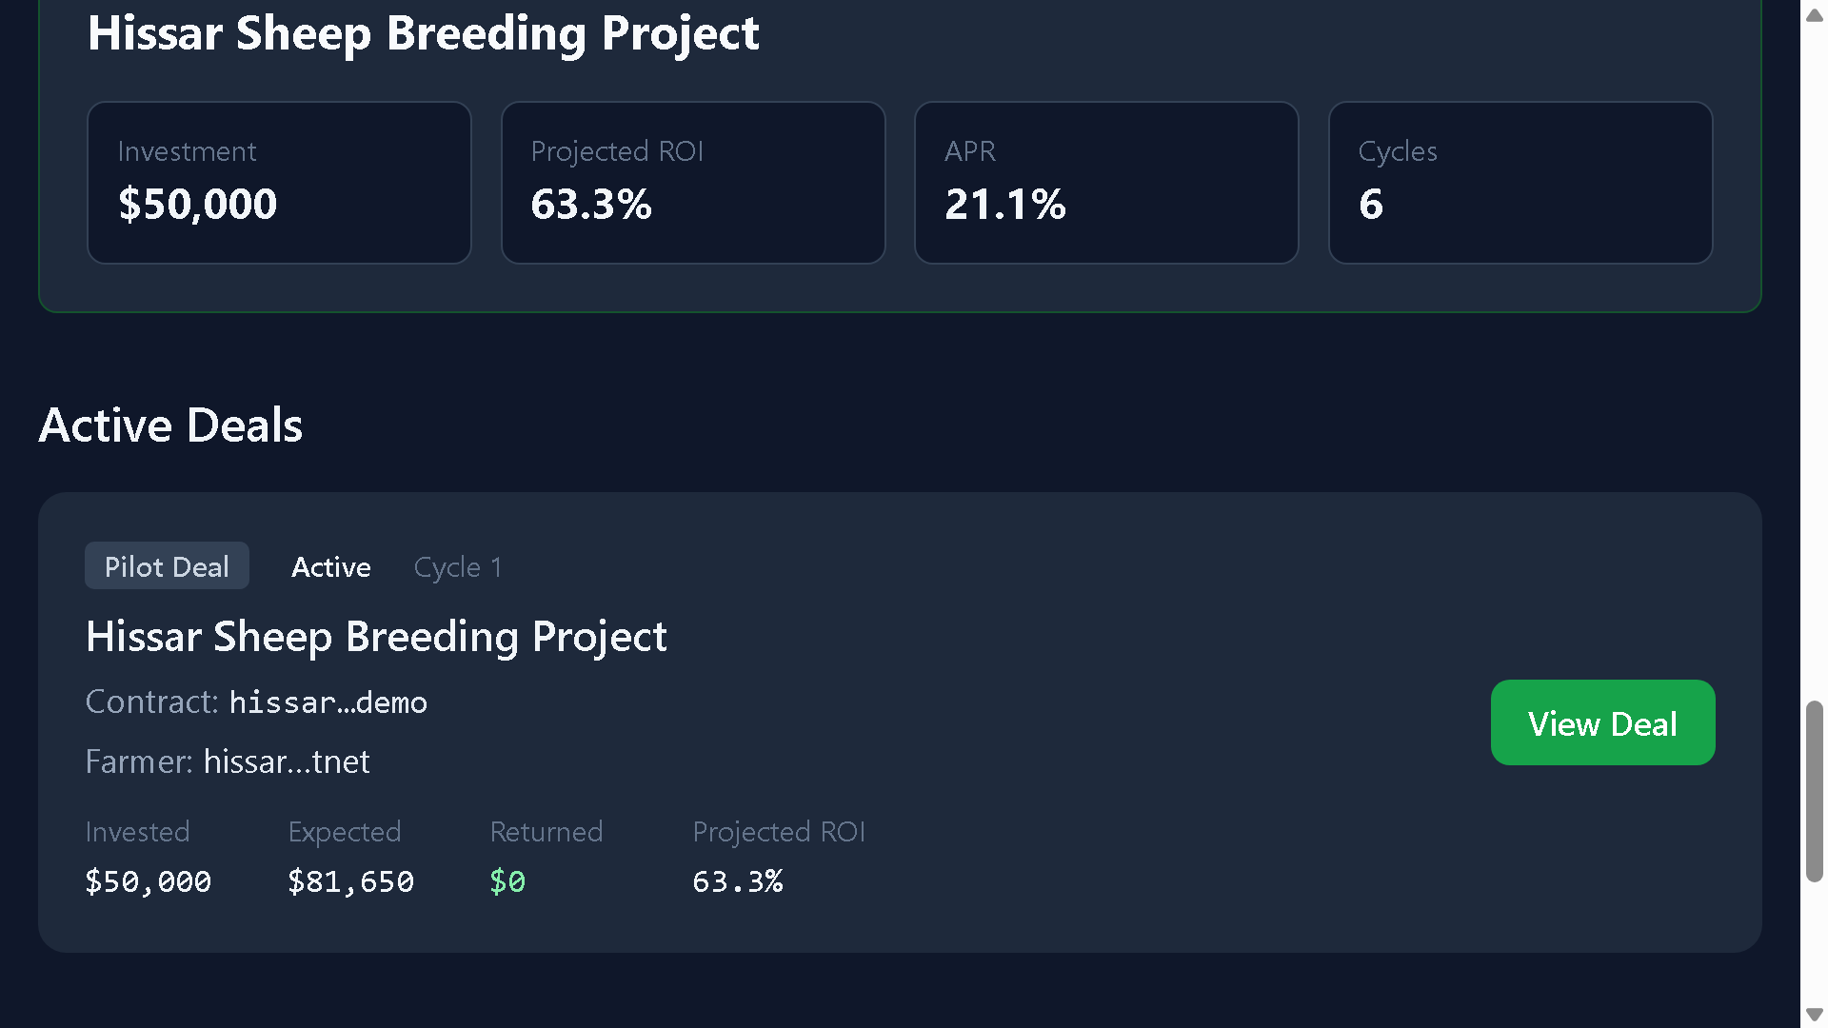
AgriPartners
10
Hissar Sheep Breeding Project
Active sheep breeding pilot showing repeatability of the same investment lifecycle across a second agricultural model.
$50,000
Investment
63.3%
Projected ROI
21.1%
APR
6
Cycles
$81,650
Active Hissar deal
Outstanding Expected Returns
AgriPartners Alpha v1

Slide 11
AgriPartners
11
Workflow Validation on NEAR Testnet
NEAR Testnet supports wallet-authenticated access, contract-aware lifecycle flows, event references, and future settlement readiness.
01
02
03
04
05
Wallet access
Contract-aware actions
Event references
Audit trail
Settlement readiness
Blockchain remains trust infrastructure behind an investor-friendly interface.
Wallet-authenticated interface
AgriPartners Alpha v1

Slide 12
AgriPartners
12
Investment Lifecycle
AgriPartners packages agricultural projects into a reviewable, monitored, and repeatable investment workflow.
01
02
03
04
05
06
07
Project intake
Investor review
Funding
Farm execution
Reporting
Return tracking
Admin review
$100,000
$163,650
$82,000
64%
63.3%
Total Pilot Funding
Expected Returns
Returned
Fidlot ROI
Hissar Projected ROI
AgriPartners Alpha v1

Slide 13
AgriPartners
13
Revenue Lines Around Verified Agricultural Deals
The business model starts with pilot validation, then monetizes around successful returns, reporting, and partner distribution.
Platform fee
Structuring fee
Success-linked fee on verified investment returns.
Deal setup for approved agricultural projects.
Investor tools
Partner programs
Reporting and portfolio management workflows.
Regional operators, funds, and ecosystem sponsors.
AgriPartners Alpha v1

Slide 14
AgriPartners
14
Alpha v1 Is Ready for External Demonstrations
The current product demonstrates two pilots, role-specific portals, return tracking, admin oversight, and NEAR Testnet validation.
Investor Dashboard MVP
Featured Fidlot and Hissar pilot deals
Farmer reporting and Admin oversight
NEAR Testnet workflow validation
$100,000
$163,650
$82,000
Fidlot and Hissar pilot deals
Total Pilot Funding
Expected Returns
Returned
AgriPartners Alpha v1

Slide 15
AgriPartners
15
From Alpha Demo to Pilot Investment Package
Next milestones focus on investor feedback, pilot validation, risk documentation, security review, and controlled expansion.
01
02
03
04
05
06
07
Demo assets
Investor feedback
Pilot validation
Risk/legal readiness
Security review
Mainnet planning
Controlled expansion
$100,000
$163,650
$82,000
64%
63.3%
Total Pilot Funding
Expected Returns
Returned
Fidlot ROI
Hissar Projected ROI
AgriPartners Alpha v1

Slide 16
AgriPartners
16
Strategic Capital and Pilot Validation Partners
AgriPartners is seeking strategic support to move from Alpha v1 demonstration into a credible pilot investment package.
Strategic investors
Pilot capital partners
Agriculture, emerging-market, and infrastructure-stage expertise.
Structured validation for Fidlot and Hissar economics.
Accelerators
Ecosystem support
Fundraising discipline, market access, and investor packaging.
NEAR review, introductions, regional partners, legal guidance.
AgriPartners Alpha v1

Slide 17
AgriPartners
17
Team & Contact
Founder-led execution with a practical first product, concrete pilots, and investor-readable workflows.
Farhod Muhamadiev
Professional next step
FM
Founder, AgriPartners
Schedule a walkthrough of the investor, farmer, admin, and NEAR Testnet flows; then review pilot economics, risk assumptions, and partner fit.
Founder-led execution with a practical first product, concrete pilots, and investor-readable workflows.
Investor
Farmer
Admin
NEAR Testnet
$100,000
$163,650
$82,000
64%
63.3%
Total Pilot Funding
Expected Returns
Returned
Fidlot ROI
Hissar Projected ROI
AgriPartners Alpha v1

