Slide 1
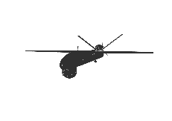
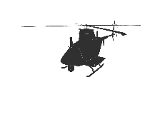
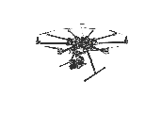
.
.
.
.
.
.
.
.
.
.
.
.
.
.
.
Q
Q
Q
.
.
.
.
.
.
.
.
.
.
.
.
.
.
.
(a) Structure of Deep-Q-Network for Centralized Planning with Standard MMDP.
(b) Structure of Deep-Q-Network for Centralized Planning with Factorized MMDP
(c) Structure of Deep-Q-Network for Decentralized Planning with Factorized MMDP

Slide 2
.
.
.
.
.
.
.
.
.
.
.
.
.
.
.
Q
Q
Q
.
.
.
.
.
.
.
.
.
.
.
.
.
.
.
(a) Structure of Deep-Q-Network for centralized planning with standard MMDP.
(b) Structure of Deep-Q-Network for centralized planning with factorized MMDP.
(c) Structure of Deep-Q-Network for decentralized planning with imperfect layers due to limited communication.

Slide 3
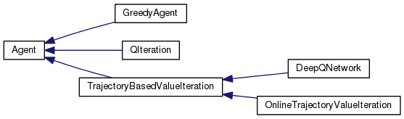

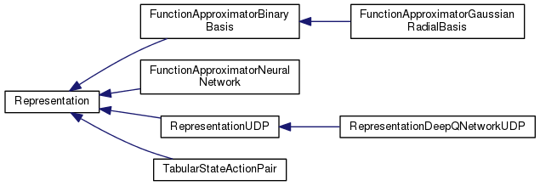

Slide 4
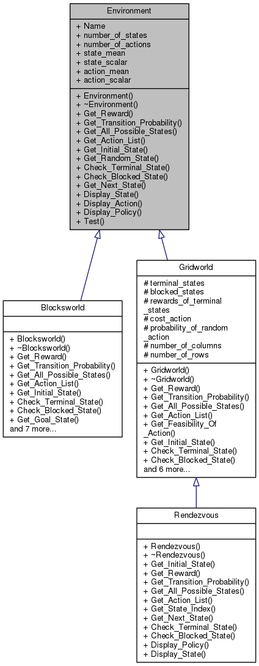
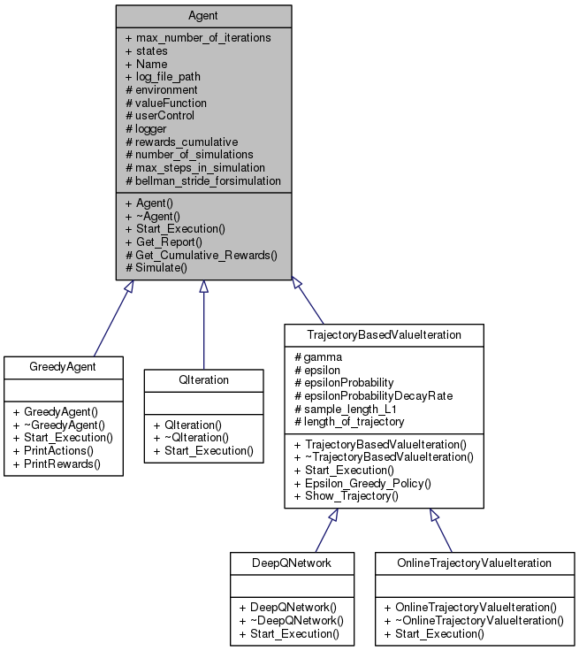
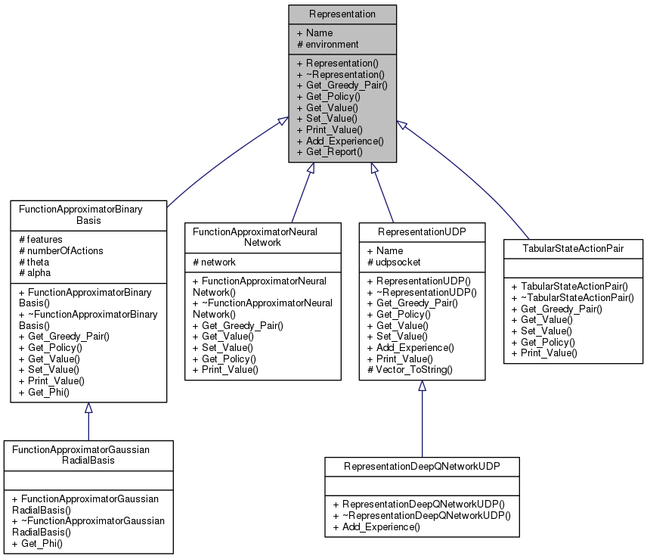

Slide 5
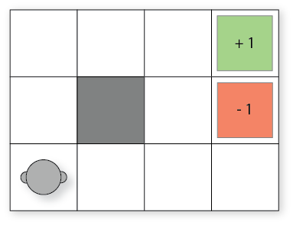
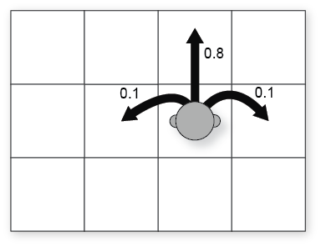
+1
-1

Slide 6
+1
-1

Slide 7
4
1
2
3
4
5
3
1
Random
Initial State
2
5
5
4
3
2
Goal State
1

Slide 9
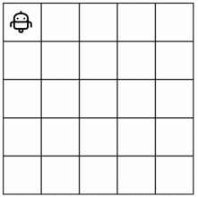
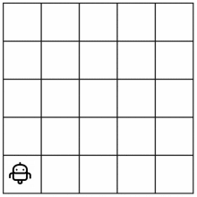
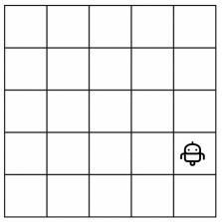




Convolution
Layer
Fully Connected
Layer
$$π_{1}$$
$$π_{2}$$
...
...
$$π_{n}$$
$$5 x 5 x n (Tensor)$$

