Slide 1
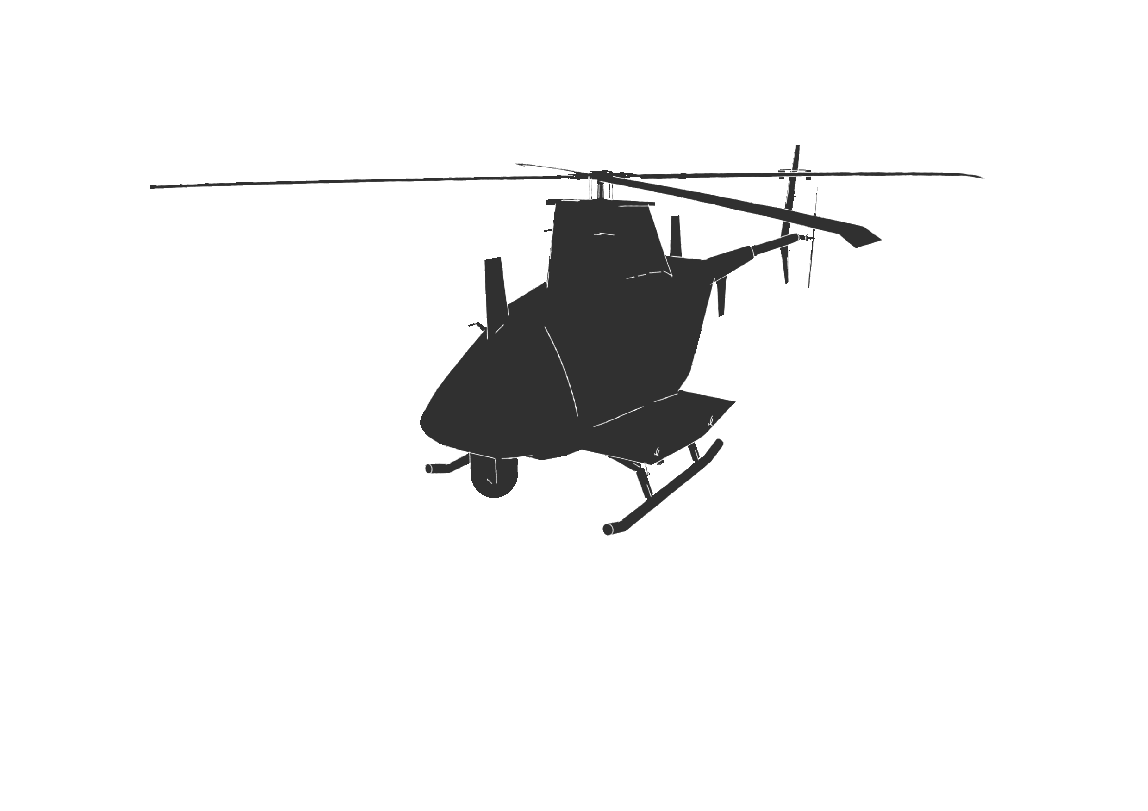
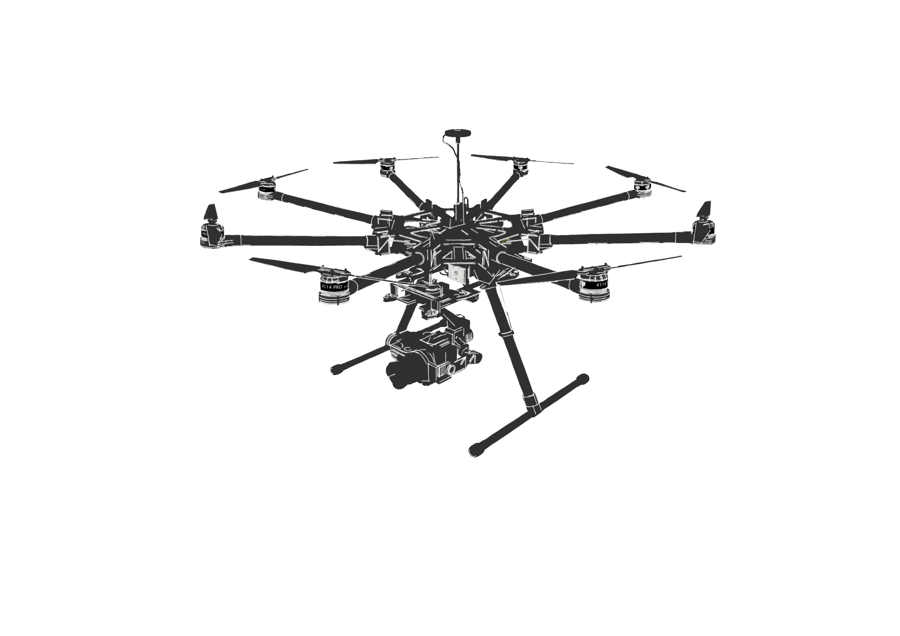
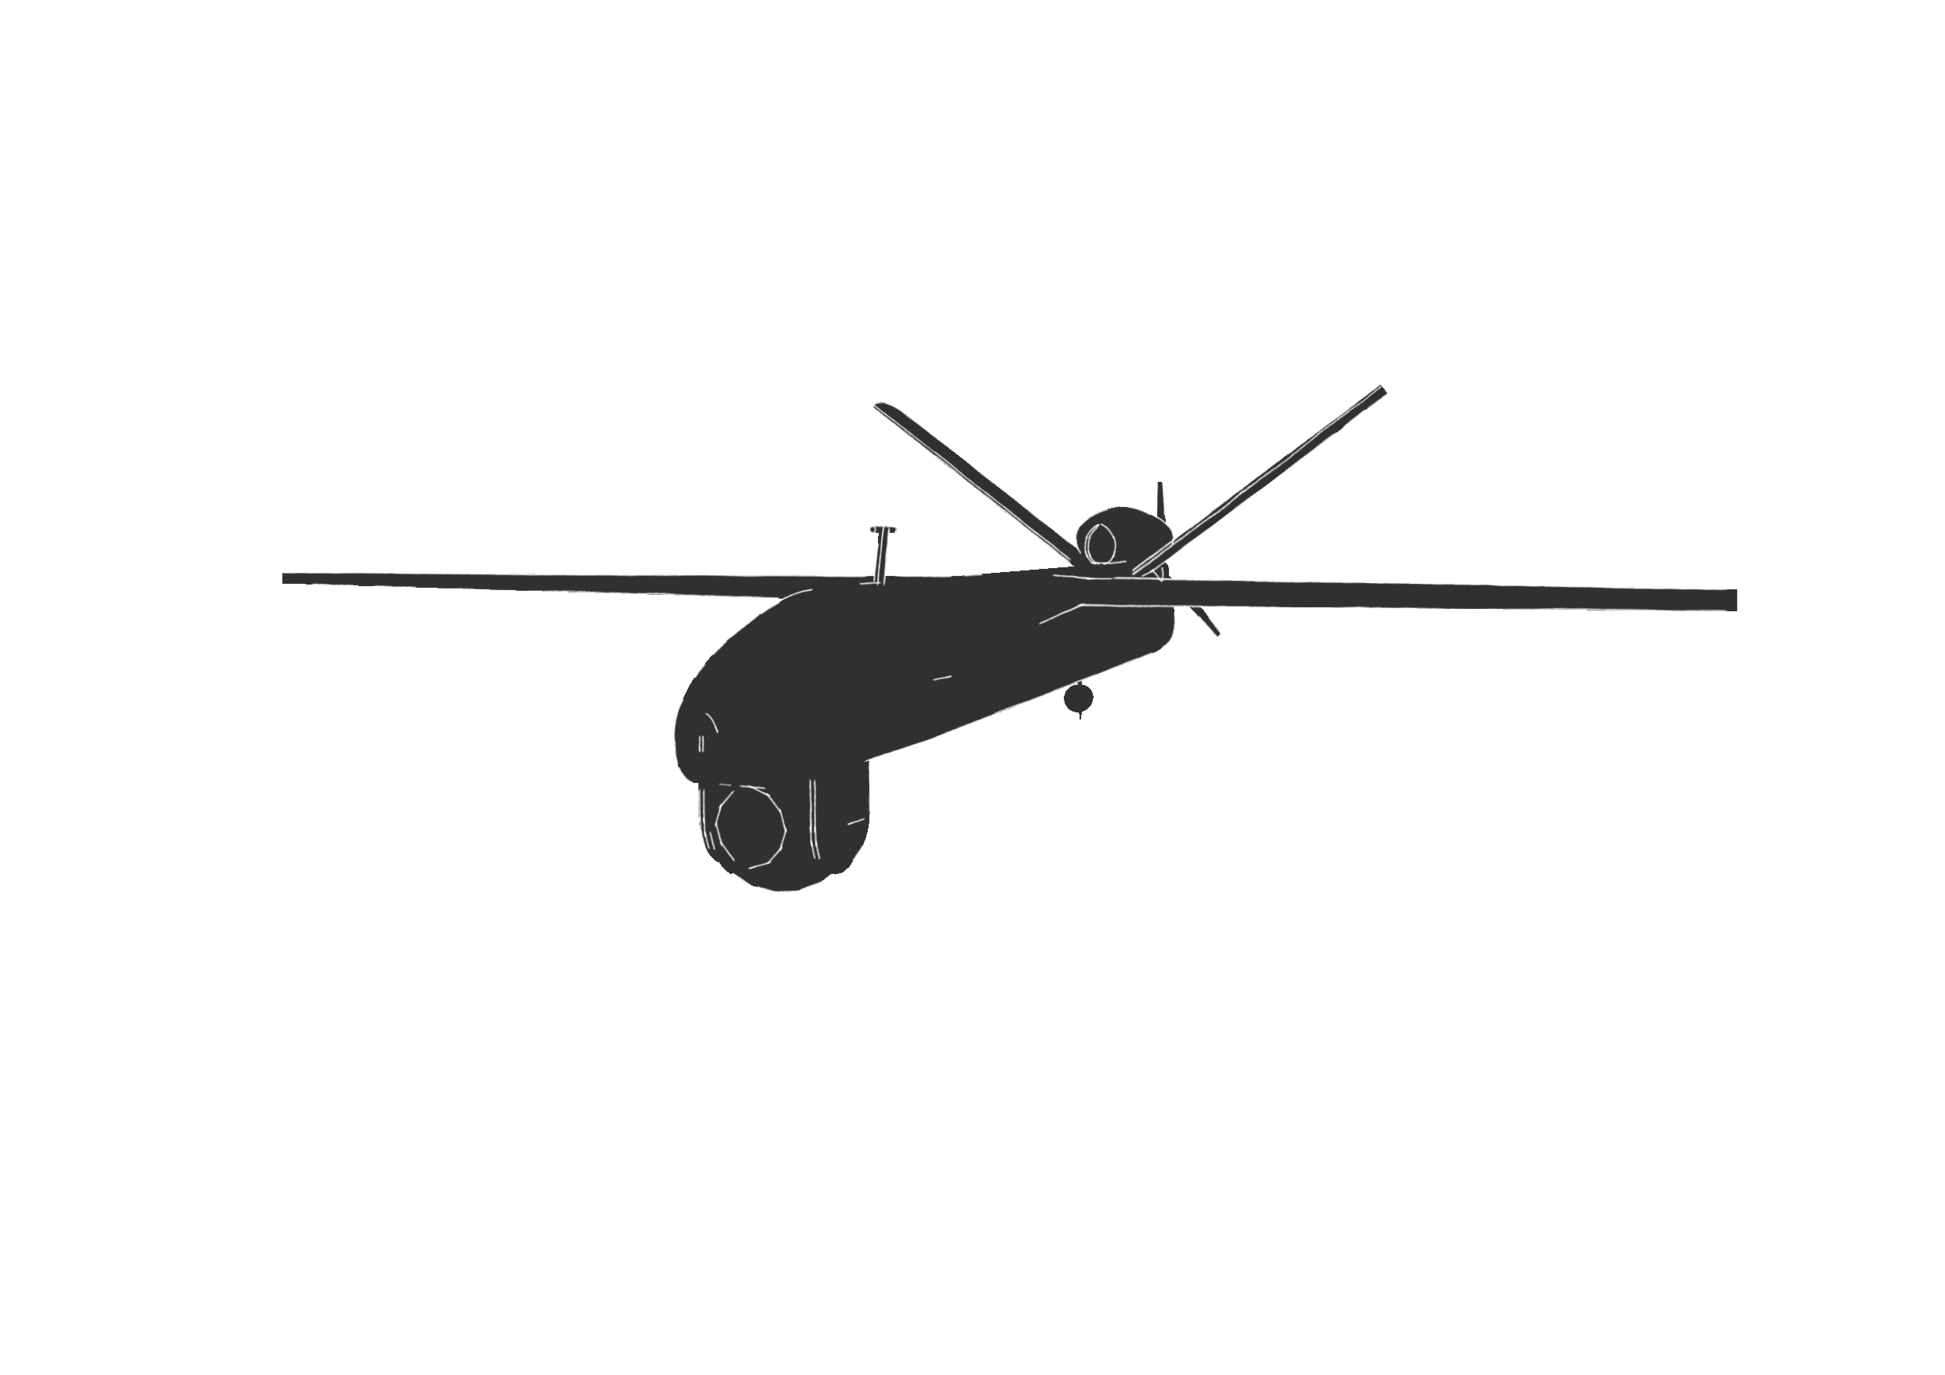
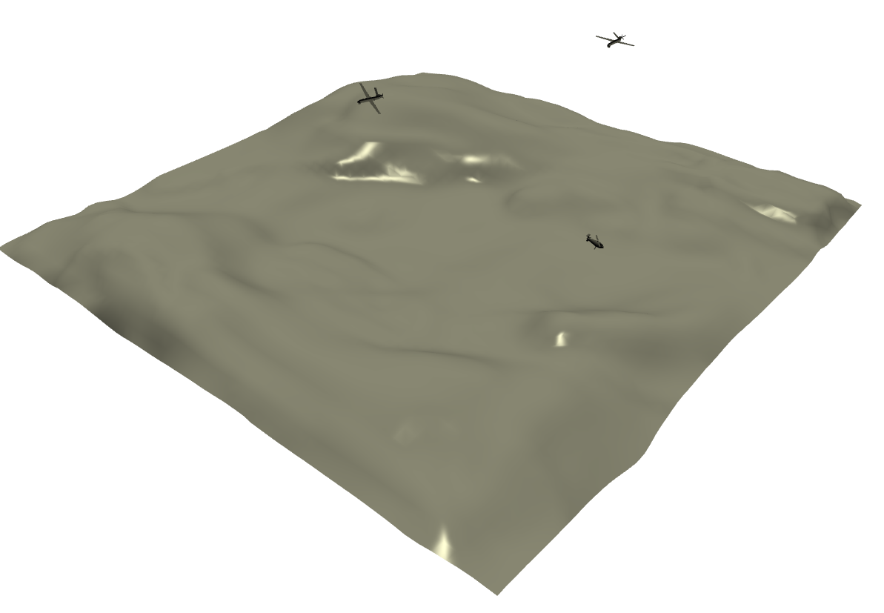
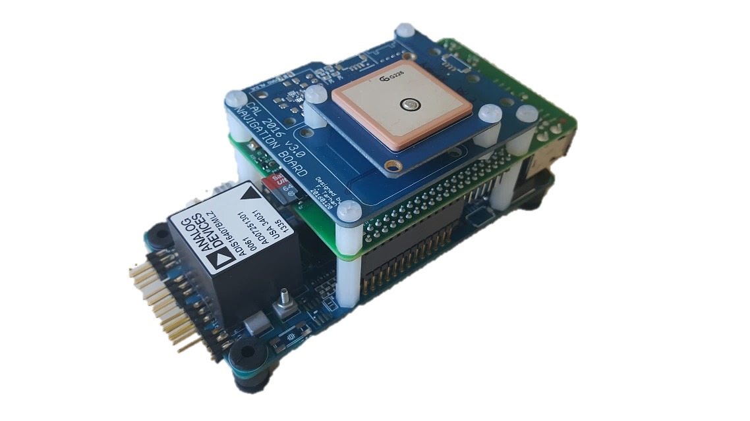
6 DOF Dynamic Model Manager
3D Simulation
Fixed-Wing
Dynamics
Helicopter
Dynamics
Multi-Copter
Dynamics
. . .
Actions
States
Decision
Maker
States
.
.
.
.
.
.
. . .
Embedded
Agent #1
Embedded
Agent #2
Embedded
Agent #n

Slide 2
6 DOF Dynamic Model Manager (DMM)
3D Real-Time
UAV Simulator
Fixed-Wing
Dynamics
Helicopter
Dynamics
Multi-Copter
Dynamics
. . .
Controls
States
Centralized
Decision
Maker (CDM)
States
Centralized Planning Bus (CPB)
Low-Level Control Bus
(LLCB)
. . .
Embedded
Agent #1
Embedded
Agent #2
Embedded
Agent #n

