Slide 1
Physics and Numerical Calculations
Rhett Allain
http://bit.ly/python-physics

Slide 2
Introduction
Why should we use numerical calculations in physics?
What kind of science is computational science?
It’s not just python - paper-based, spreadsheets, java, scratch, C++, Mathematica
History of VPython https://matterandinteractions.wordpress.com/2016/04/27/a-time-line-for-vpython-development/

Slide 3
Let’s get started
Maybe you’ve never made a program before - that’s ok.
Maybe you already programmed Hal 9000 - that’s ok.
I will assume no background experience

Slide 4
A physics problem
A cart is on a track at x = 0 m, at t = 0 s.
The cart is moving with an x-velocity of 0.45 m/s.
Where is the cart at t = 1.5 seconds?

Slide 5



Use the definition of average velocity
at t = 1.5, the cart is at 0.675 m

Slide 6

Making a numerical model
Instead of moving the cart for 1.5 seconds, let’s do 15 moves of 0.1 seconds.
For any 0.1 second time interval, I could calculate the new position
Position Update Formula

Slide 7
First Program
Go to http://bit.ly/python-physics
Go to first example program (constant velocity)
You need to sign in with a google account

Slide 8
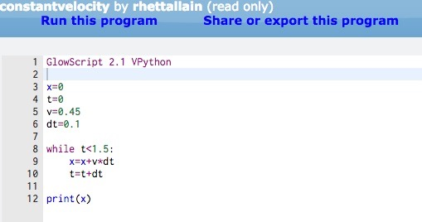
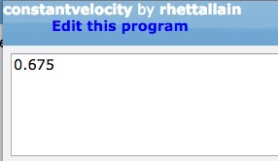
*No Units!

Slide 9
Your Turn
Open the program and run it.
Where will the cart be at 2.2 seconds?
What if the cart has a velocity of 0.62 m/s?
What if the cart starts at - 0.5 m?

Slide 10
Accelerating cart
A cart starts at x = 0 m, and t = 0 m, with a velocity of 0.45 m/s.
The cart has an acceleration of 0.2 m/s².
Where is the cart after 1.5 seconds?

Slide 11


Solution
at t = 1.5 s, the cart will be at 0.9 meters

Slide 12


Break it into small steps
What if I again break it into steps of 0.1 seconds?
What if I still use the position update formula?
Use the velocity update formula.
What if I use final velocity instead of avg?

Slide 13
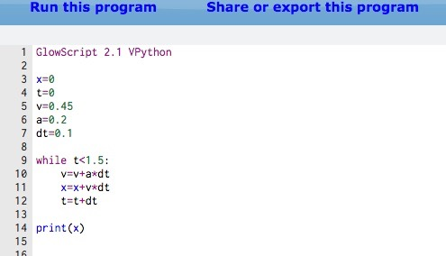
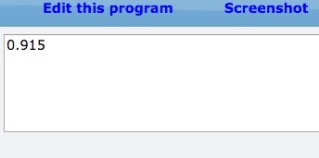

Slide 14
Your Turn
What happens if you change the time step to 0.2 seconds?
What happens if you change the time step to 0.01 seconds?
What if the acceleration is -0.01 m/s²?
If the acceleration is -0.02 m/s², how long would it take to stop? Where would it stop?

Slide 15
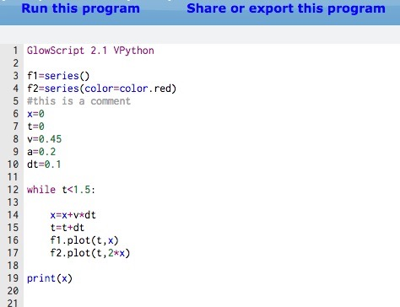
Graphs

Slide 16
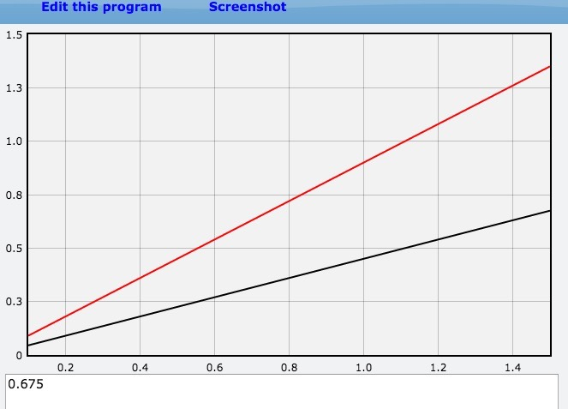

Slide 17
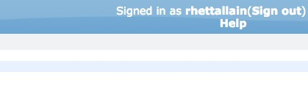
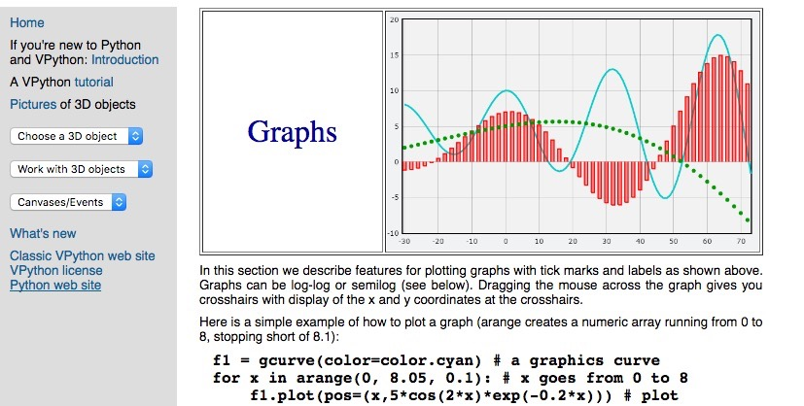
Getting Help

Slide 18
Your Turn
Make a plot of position vs. time for the accelerating cart in the previous problem.
Make a plot of velocity vs. time for the accelerating cart.
Cart A starts at x = 0.5 m, with v = 0.45 m/s. Cart B starts at x = 0 with v = 0 m/s and a = 0.2 m/s². When do they meet?

Slide 19
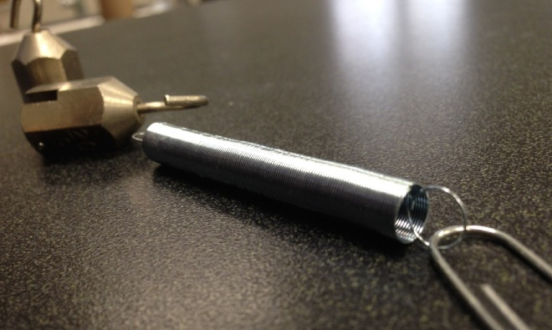
Springs

Slide 20
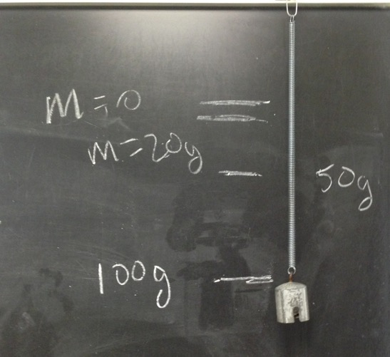
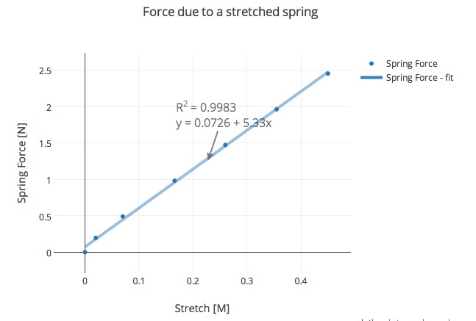

Stretching a Spring
k = 5.33 N/m

Slide 21
Oscillating a Spring
Mass = 200 grams
T = 1.2 seconds

Slide 22







Dealing with Force
Newton’s Second Law
Momentum Principle

Slide 23
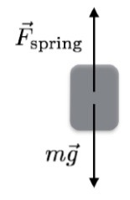




Forces on a mass
y
x
in the y-direction:
y = 0 at bottom of unstretched spring

Slide 24
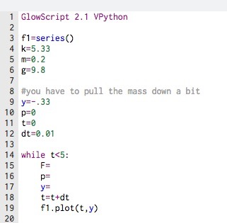
Your Turn

Slide 25
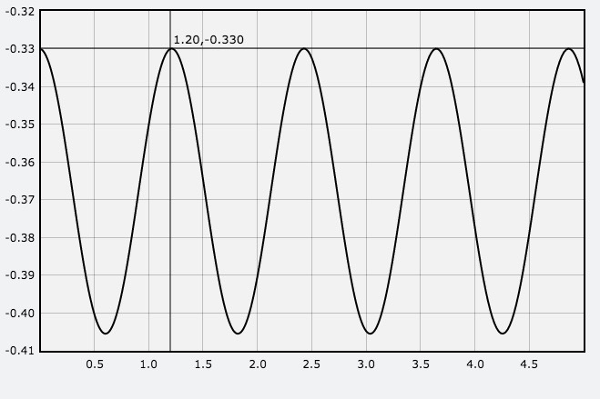
T = 1.2 seconds

Slide 26
Other Things to Try
What happens if you change the time interval to 0.1?
What about 0.001s?
Does period depend on amplitude?
Give it an initial velocity.
Change the mass to 0.4 kg. What should happen?
Change order of calculations (do y, then p, then F)

Slide 27
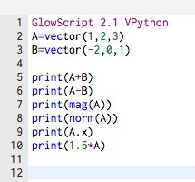
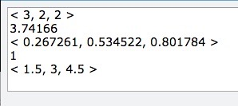
Vectors

Slide 28
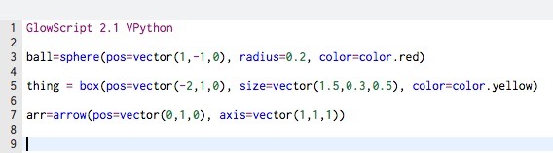
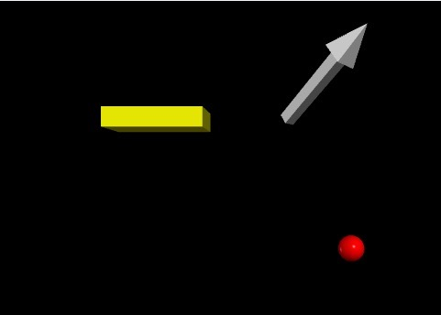
Visual in VPython

Slide 29
3D Notes
Many different objects
right-click drag to rotate (ctrl-click drag)
scroll to zoom (alt-click drag)
Can still print
Can still make a graph
change lighting, camera, texture, background….

Slide 30
Your Turn
Put a ball at vector(-2,-1,0) and a ball at (3,0,0) - both with a radius of 0.3
Create an arrow that goes from one ball to the other ball.
Make something cool.

Slide 31
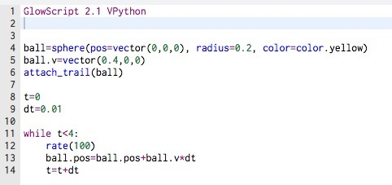
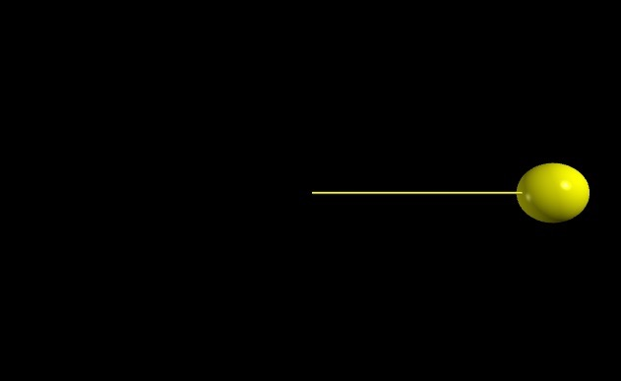

Moving in 3D

Slide 32
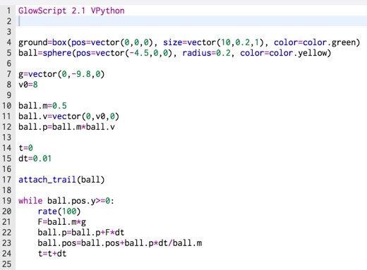
Projectile Motion

Slide 33
Your Turn
Launch the ball with the same speed at a 30 degree angle. Find the horizontal distance traveled. (hint: cos(theta), sin(theta) - in radians)
Make a plot of position vs. time (for x and y)
Make a plot of y-velocity vs. time.
Change the launch angle.
Change the starting height
Is 45 degrees the largest range?

Slide 34

Air Resistance
Suppose we want to model a ball with air resistance
density about 1.2 kg/m³
A = cross sectional area
C = 0.47 for a ball
note: v² would be mag(ball.p/ball.m)**2

Slide 35
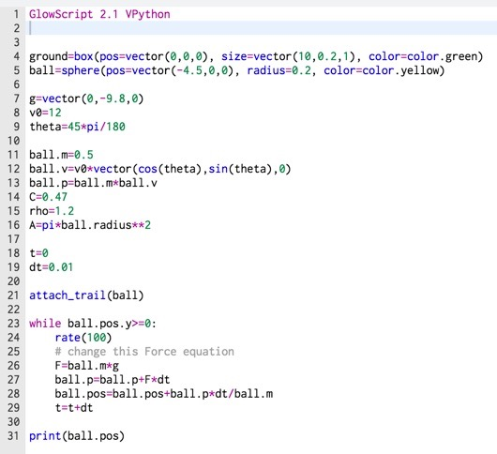

Slide 36
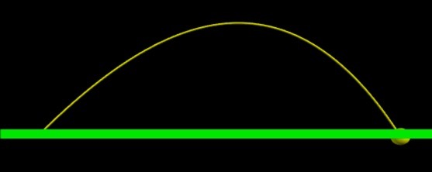

Output
final position

Slide 37
Your Turn
Finish the air resistance program
What happens if you change the speed, angle or mass?
What is the angle that gives the maximum range? Is it 45 degrees?
Add a second projectile with no air resistance

Slide 38




Gravity
B
A

Slide 39
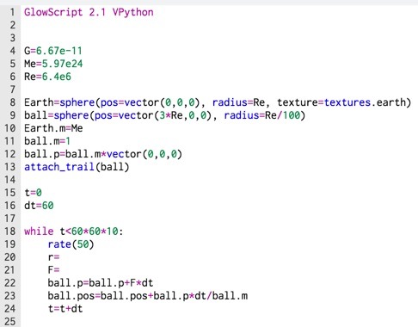

Slide 40
Your Turn
Calculate r, Calculate F
Pick an initial velocity (momentum)
What if you change the orbit?
Should the Earth move?
Plot the kinetic, potential, and total energy
Plot kinetic energy as a function of position

Slide 41
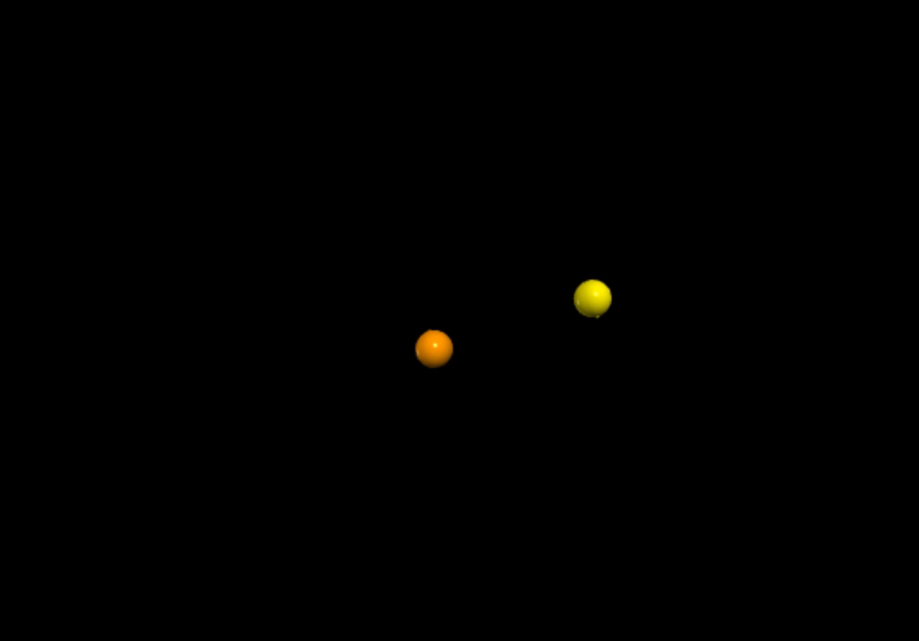
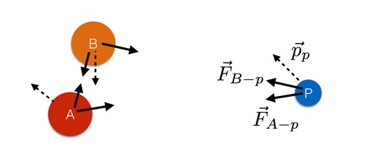
Three-Body Problem

Slide 42
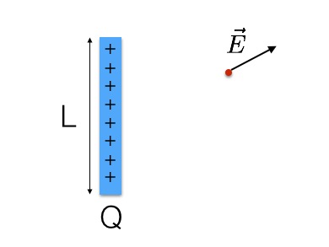
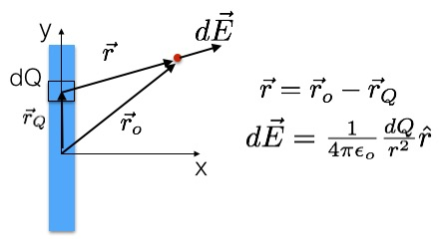
Electric Fields
http://www.wired.com/2014/09/numerical-calculation-electric-field-due-charge-distribution/

Slide 43
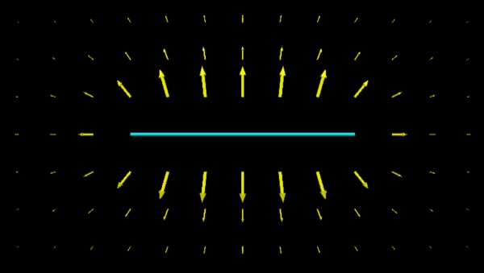
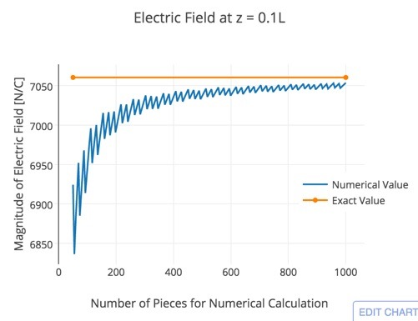
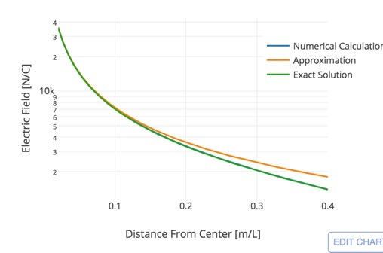

Slide 44

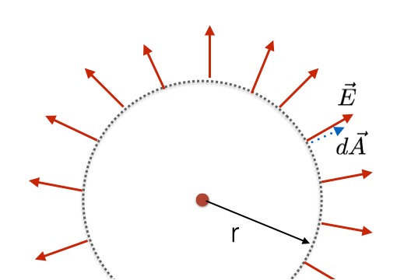
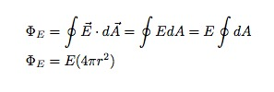

Gauss’ Law
http://www.glowscript.org/#/user/rhettallain/folder/phys222/program/gausslawexample/edit

Slide 45
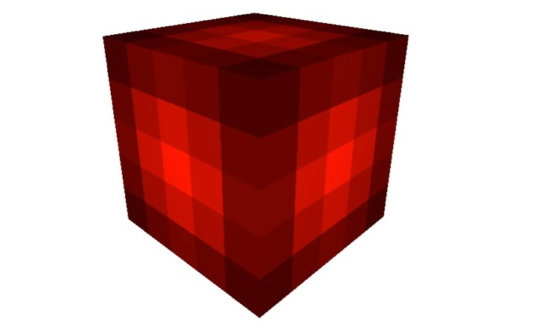
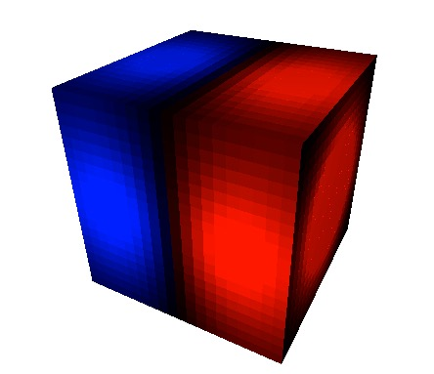
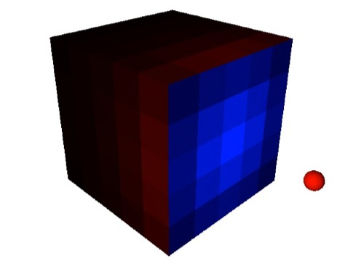

Slide 46
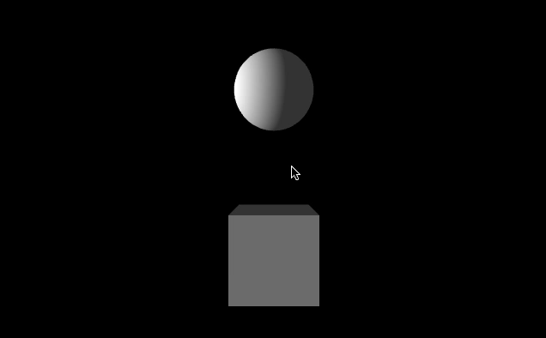
What would the moon look like as a cube?
http://www.glowscript.org/#/user/rhettallain/folder/blog_posts/program/cubemoon1

Slide 47
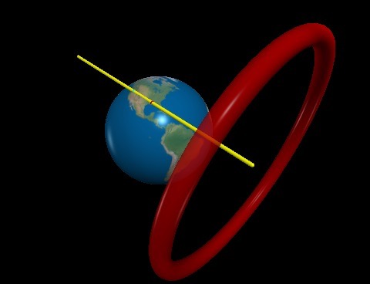
LIGO

Slide 48

Numerical Pi
http://www.glowscript.org/#/user/rhettallain/folder/blog_posts/program/numericalpi/edit

Slide 49
Discussion
Can this work in a physics class?
What’s the difference between VPython, Glowscript, and trinket.io?
How do you asses student understanding?
Sloppy Code

Slide 50
Benefits
Numerical calculation are part of real science
Programming leads to more discussion of physics
Better understanding of vectors. More vector equations

Slide 51
Links
quantum mechanics http://www.wired.com/2016/03/can-solve-quantum-mechanics-classic-particle-box-problem-code/
trinket - non physics examples http://www.wired.com/2015/05/running-python-browser-awesome-think/
what kind of science is computational science? http://www.wired.com/2014/01/what-kind-of-science-is-computational-science/

Slide 52
Common Student Problems
Typos
Vector-scalar problems
“I’m not a programmer”

Slide 53
How do you grade numerical calculations?
Outside class assignment
Students make a numerical calculation
Screencast a video (less than 5 min)
Max points for a problem that can’t be solved analytically

