Slide 1


Social Buzz

Slide 2


Today's agenda
Project recap
Problem
The Analytics Team
Process
Insights
Summary

Slide 3


Social Buzz - Scaling for Growth
Objective: Accelerate growth and prepare for IPO.
Engagement Focus:
Audit: Assess the current big data practices.
Recommendations: Provide a roadmap for a successful IPO.
Analysis: Identify the top 5 content categories based on aggregate popularity.
Project Recap

Slide 4




Problem
Managing Scalable Content in a Massive User Base
Challenge: Over 100,000 new posts daily.
Scale: Tens of millions of posts and hundreds of millions of users.
Core Question: How to leverage this massive content volume for growth and insights?

Slide 5




Andrew Fleming
Chief Technology Architect
Analytics Team
Marcus Rompton
Senior Principal
Fara Fatima
Data Analyst

Slide 6

Process
1
Data Understanding
2
Data Cleaning
3
Data Modelling
4
Data Analysis
5
Uncover Insights

Slide 7

INSIGHTS
1897
Animal Most Favorite Category
MAY
Month with Most number of post
16
Unique Categories

Slide 8
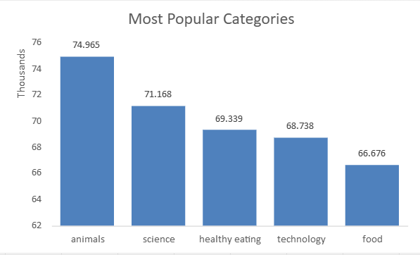

Slide 9
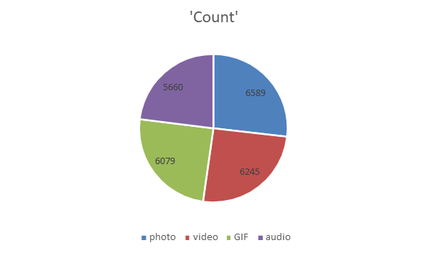

Slide 10
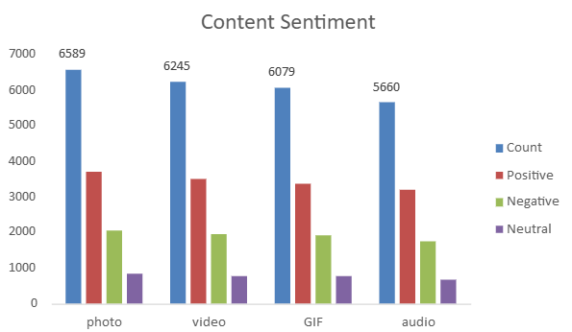

Slide 11

There are a total of 16 distinct content categories.
4 type of content – photo, video, Gif and Audio.
Out of which people prefer photo and video.
May month has the highest number of posts.
Analysis & Insights
Analysis:
"Animals" and “Science" are the top content categories, highlighting a preference for real-life and factual content.
Insight:
Food-related themes dominate, with Healthy Eating ranking highest.
This insight can guide future campaigns, especially in collaboration with healthy eating brands to enhance user engagement.
Next Steps:
While the ad-hoc analysis provides valuable insights, scaling this analysis for real-time business intelligence is crucial for continuous growth and user engagement.
SUMMARY

Slide 12

Thank you!
ANY QUESTIONS?

