Slide 1


EnergyOps Smart Submeter Billing and Monitoring Platform
Onsite Interview Project Presentation (Lead SaaS Developer)
Tech stack: React + ASP.NET Core (.NET 6) + EF Core + SQLite

Slide 2
Agenda
Problem and goals
Solution overview
Architecture and data model
Billing engine and spike detection
Dashboard analytics and UI workflow
Demo plan and next steps

Slide 3
Problem
Multi-unit buildings need accurate, unit-level energy tracking
Manual spreadsheets introduce errors and disputes
No real-time visibility into top consumers or abnormal usage
Billing workflows need repeatability and auditability

Slide 4
Goals
Deliver
Deliver an end-to-end SaaS-style workflow: ingest readings → compute bills → show analytics
Design
Design clean REST APIs and a relational data model
Keep
Keep business rules explainable (billing and spike detection)
Build
Build a responsive, interactive dashboard UI

Slide 5

Solution Overview
Property and Unit management
Rate plan assignment (rate per kWh + fixed fee)
Reading simulation (IoT-style telemetry)
Monthly billing generation with rate snapshots
Dashboard: KPIs, charts, top consumer, spike alerts, invoice drill-down

Slide 6
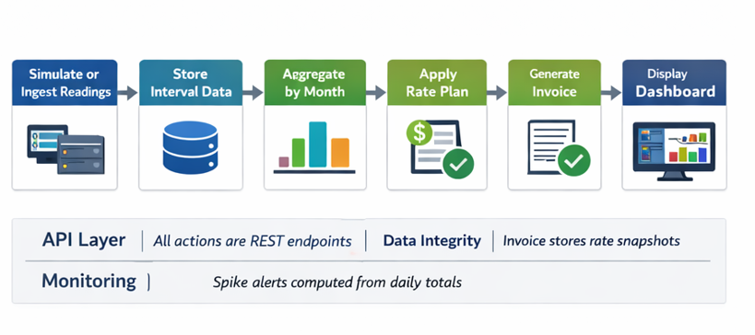
System Architecture
React SPA (Vite)
Dashboard UI
Frontend is decoupled: fetches data via REST APIs
Backend handles aggregation, billing logic, and spike detection
Database stores normalized entities and time-series readings
ASP.NET Core Web API
Billing + Analytics
EF Core + SQLite
Relational Storage

Slide 7
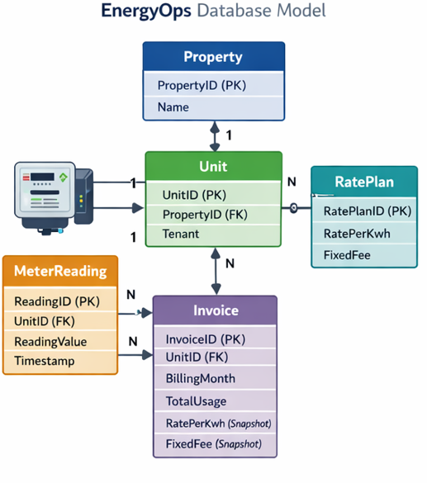
Data Model (Entities)
Property: building metadata
Unit: tenant metadata + links to Property and RatePlan
RatePlan: pricing rules (ratePerKwh, fixedFee)
MeterReading: time-series usage per unit with timestamp
Invoice: monthly bill per unit with snapshot pricing

Slide 8
API Design (REST)
Properties: GET /api/Properties, POST /api/Properties
Units: GET /api/Properties/{propertyId}/units, POST /api/Properties/{propertyId}/units
RatePlans: GET /api/RatePlans, POST /api/RatePlans, PUT /api/units/{unitId}/rateplan
Readings: POST /api/Readings, POST /api/Readings/simulate
Billing: POST /api/Billing/generate, GET /api/Billing/unit/{unitId}?month=YYYY-MM
Dashboard: GET /api/Dashboard/property/{propertyId}?month=YYYY-MM

Slide 9
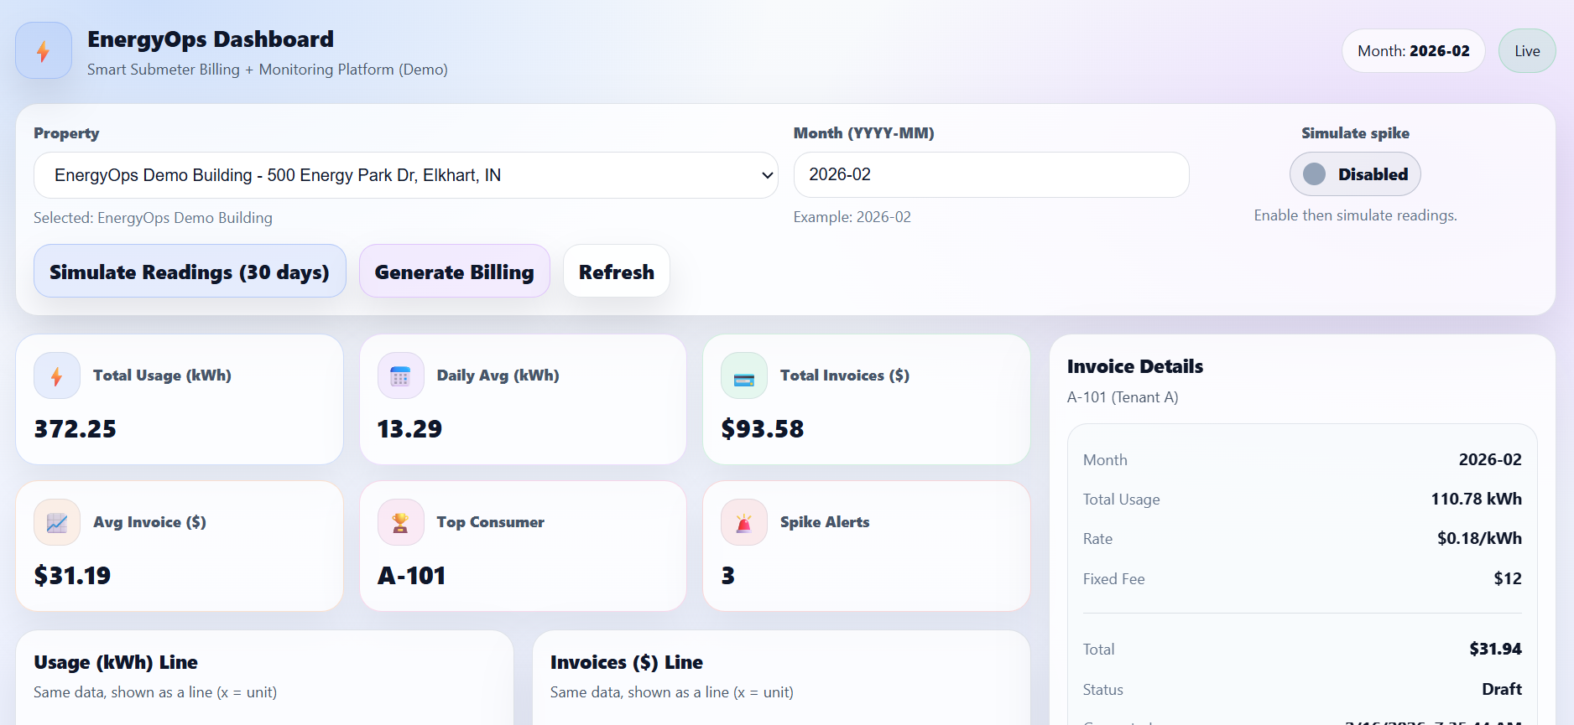
DASHBOARD

Slide 10
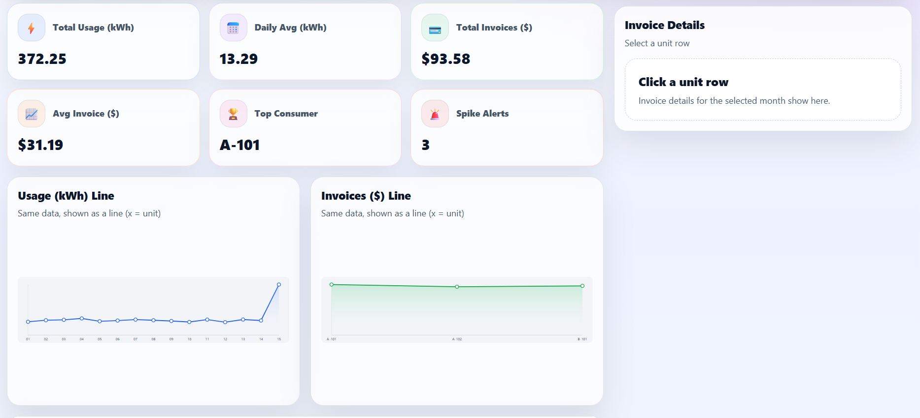
DASHBOARD

Slide 11
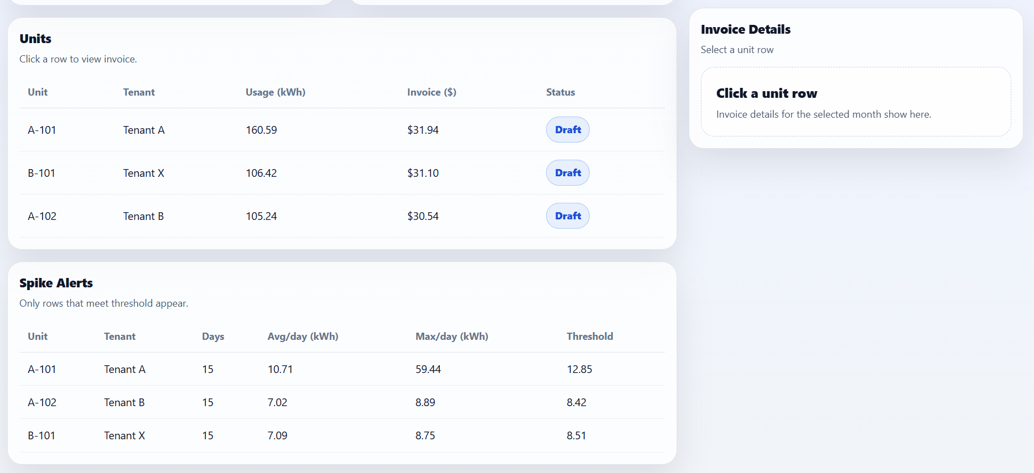
DASHBOARD

Slide 12
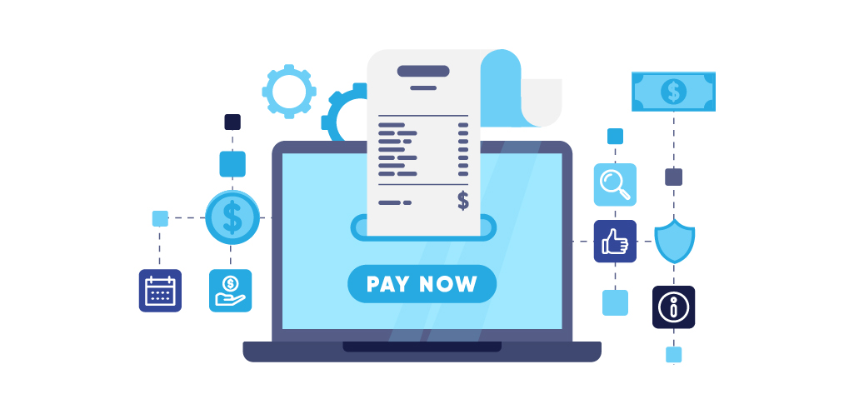
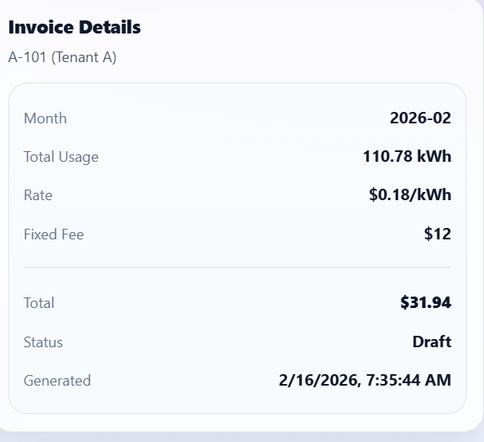
Billing Engine
Monthly window = [start of month, start of next month)
TotalUsageKwh = sum of readings in month (per unit)
TotalAmount = (TotalUsageKwh × RatePerKwhSnapshot) + FixedFeeSnapshot
Snapshot pricing supports auditability and future price changes
Designed to be re-runnable: generate or update per unit-month

Slide 13
Simulation Engine (Demo Telemetry)
Generates time-series readings for each unit
4 readings per day (every 6 hours) to mimic IoT intervals
Baseline usage randomized to show realistic variation
Optional spike mode injects an abnormal day for alert demo
In production: replace simulation with submeter gateway ingestion

Slide 14
Dashboard KPIs (Aggregated Server-side)
KPIs are computed dynamically from database data
01
Charts display per-unit comparisons and trends
02
Unit row click opens invoice breakdown panel
03
Total Usage (kWh)
Daily Avg (kWh)
Total Invoices ($)
Top Consumer
Sum of readings
Total / days
Sum of invoices
Highest usage

Slide 15
Visual Analytics (Example)

Slide 16
Spike Detection
Group readings by unit and day to compute daily totals
Compute AvgDailyKwh and MaxDailyKwh per unit
Flag spike when MaxDailyKwh exceeds threshold
Spike if: MaxDaily ≥ AvgDaily × 1.2 OR MaxDaily ≥ AvgDaily + 10 kWh

Slide 17
Live Demo Flow
1) Create property and units (or use seeded demo)
2) Create a rate plan and assign it to units
3) Simulate 30 days of readings (optional spike)
4) Generate billing for the month
5) Open dashboard: KPIs + charts + top consumer
6) Click a unit row to show invoice breakdown

Slide 18

Key Engineering Decisions
Server-side aggregation keeps UI simple and performance predictable
Invoice snapshot pricing supports audit and change control
Clean REST routes and normalized relational model
Simulation engine enables repeatable testing of billing and alerts
Designed for upgrade path: SQL Server, background jobs, auth, exports

Slide 19

Next Steps for Production
Database: migrate to SQL Server and add indexes (UnitId, Timestamp)
Billing: background job scheduling, idempotent monthly runs
Security: authentication and role-based access, secure secrets
Ops: logging, monitoring, and configuration per environment
Product: PDF/CSV exports, email delivery, tenant portal

Slide 20
Closing
EnergyOps demonstrates end-to-end SaaS thinking: APIs, data model, billing logic, analytics UI
01
Energy domain alignment: submetering, usage visibility, billing accuracy
02
Happy to walk through code, tradeoffs, and how I would productionize it
03

Slide 21

Thank You

