Slide 1

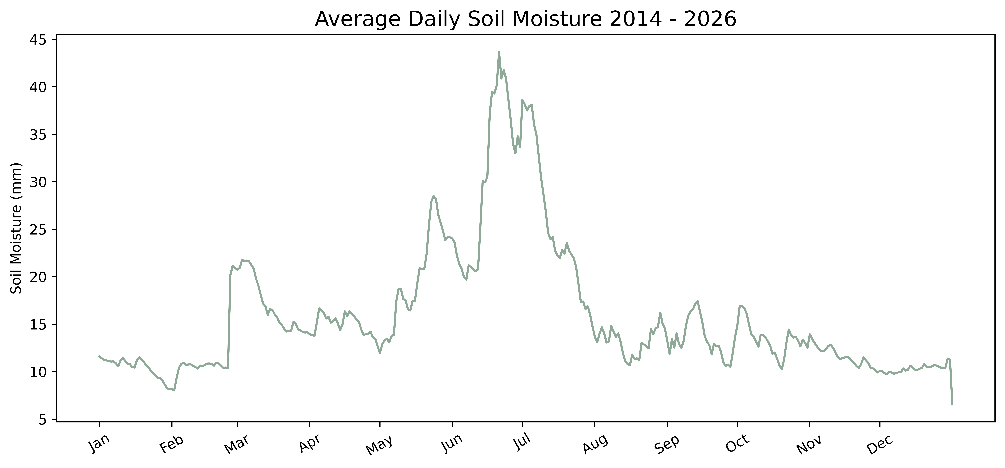
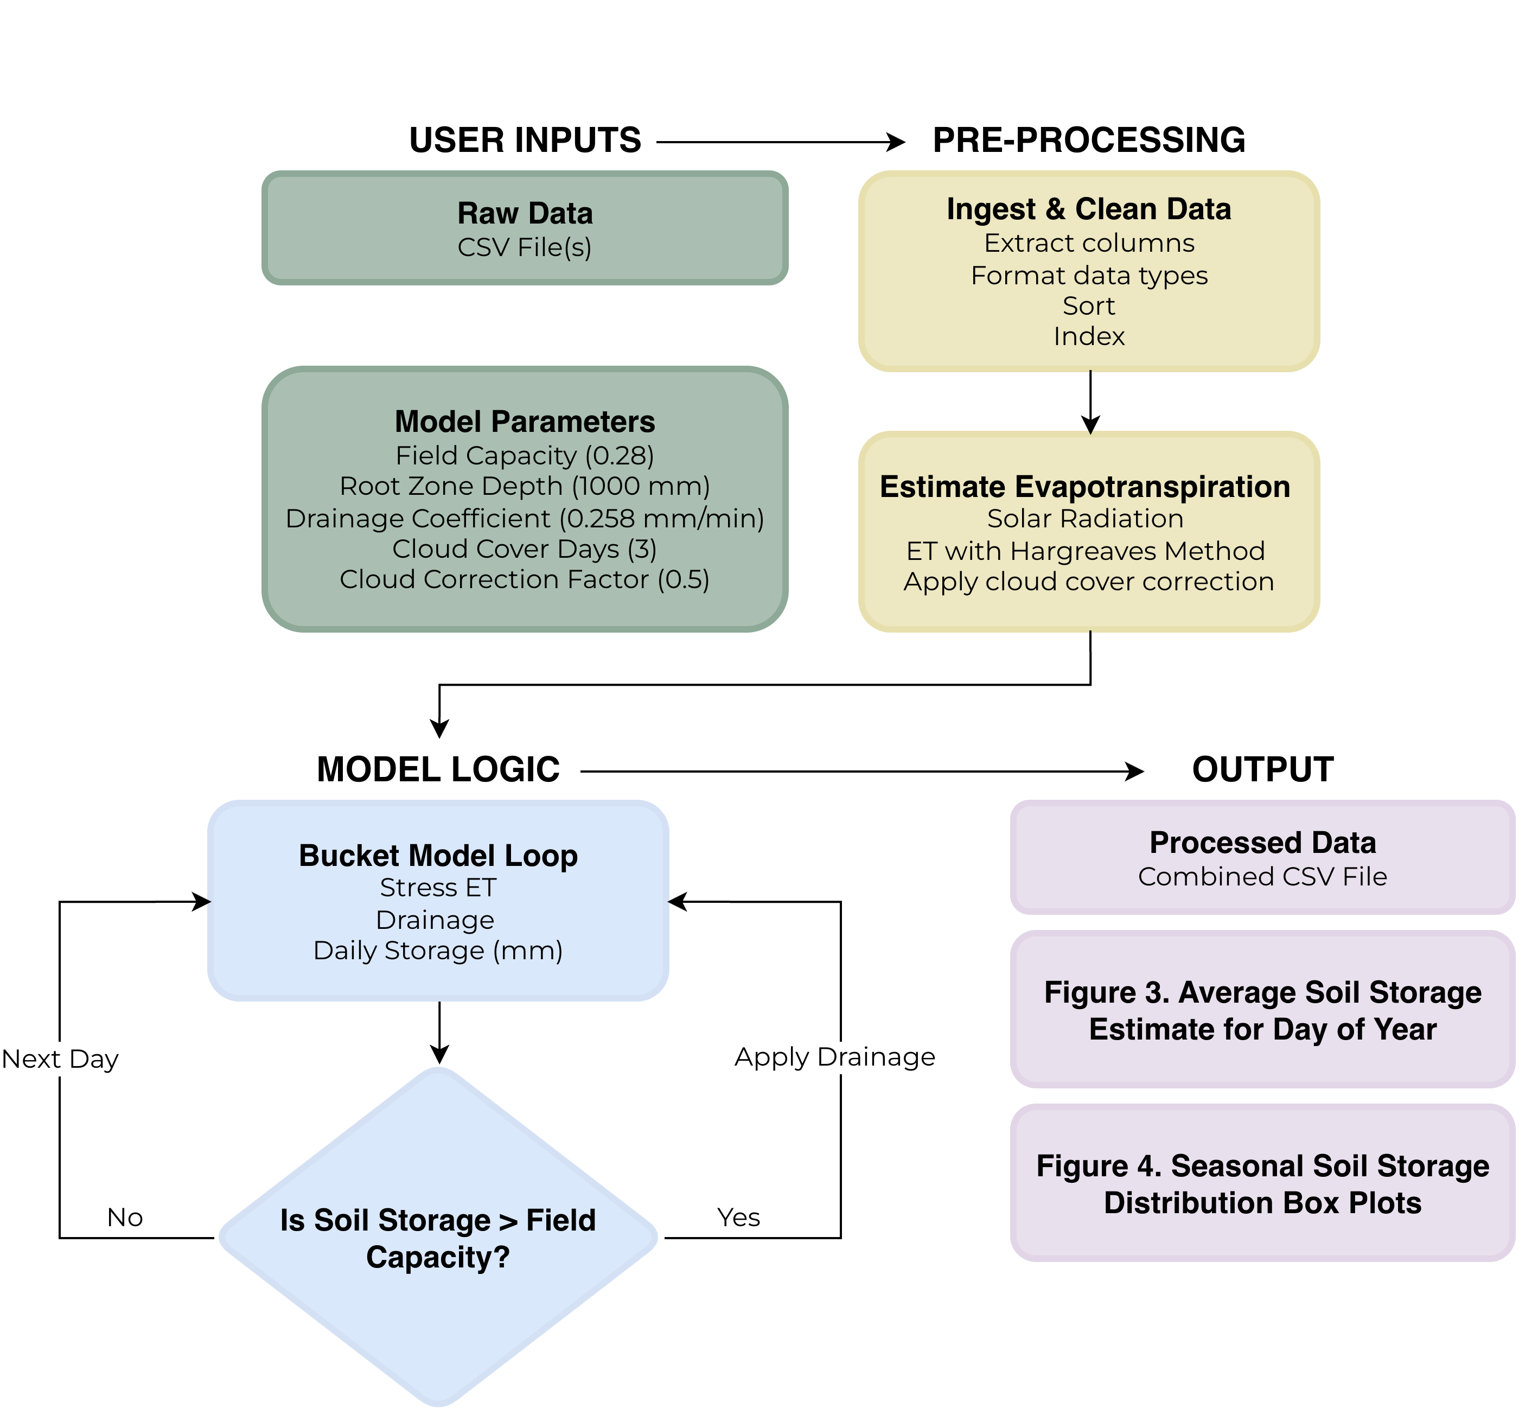
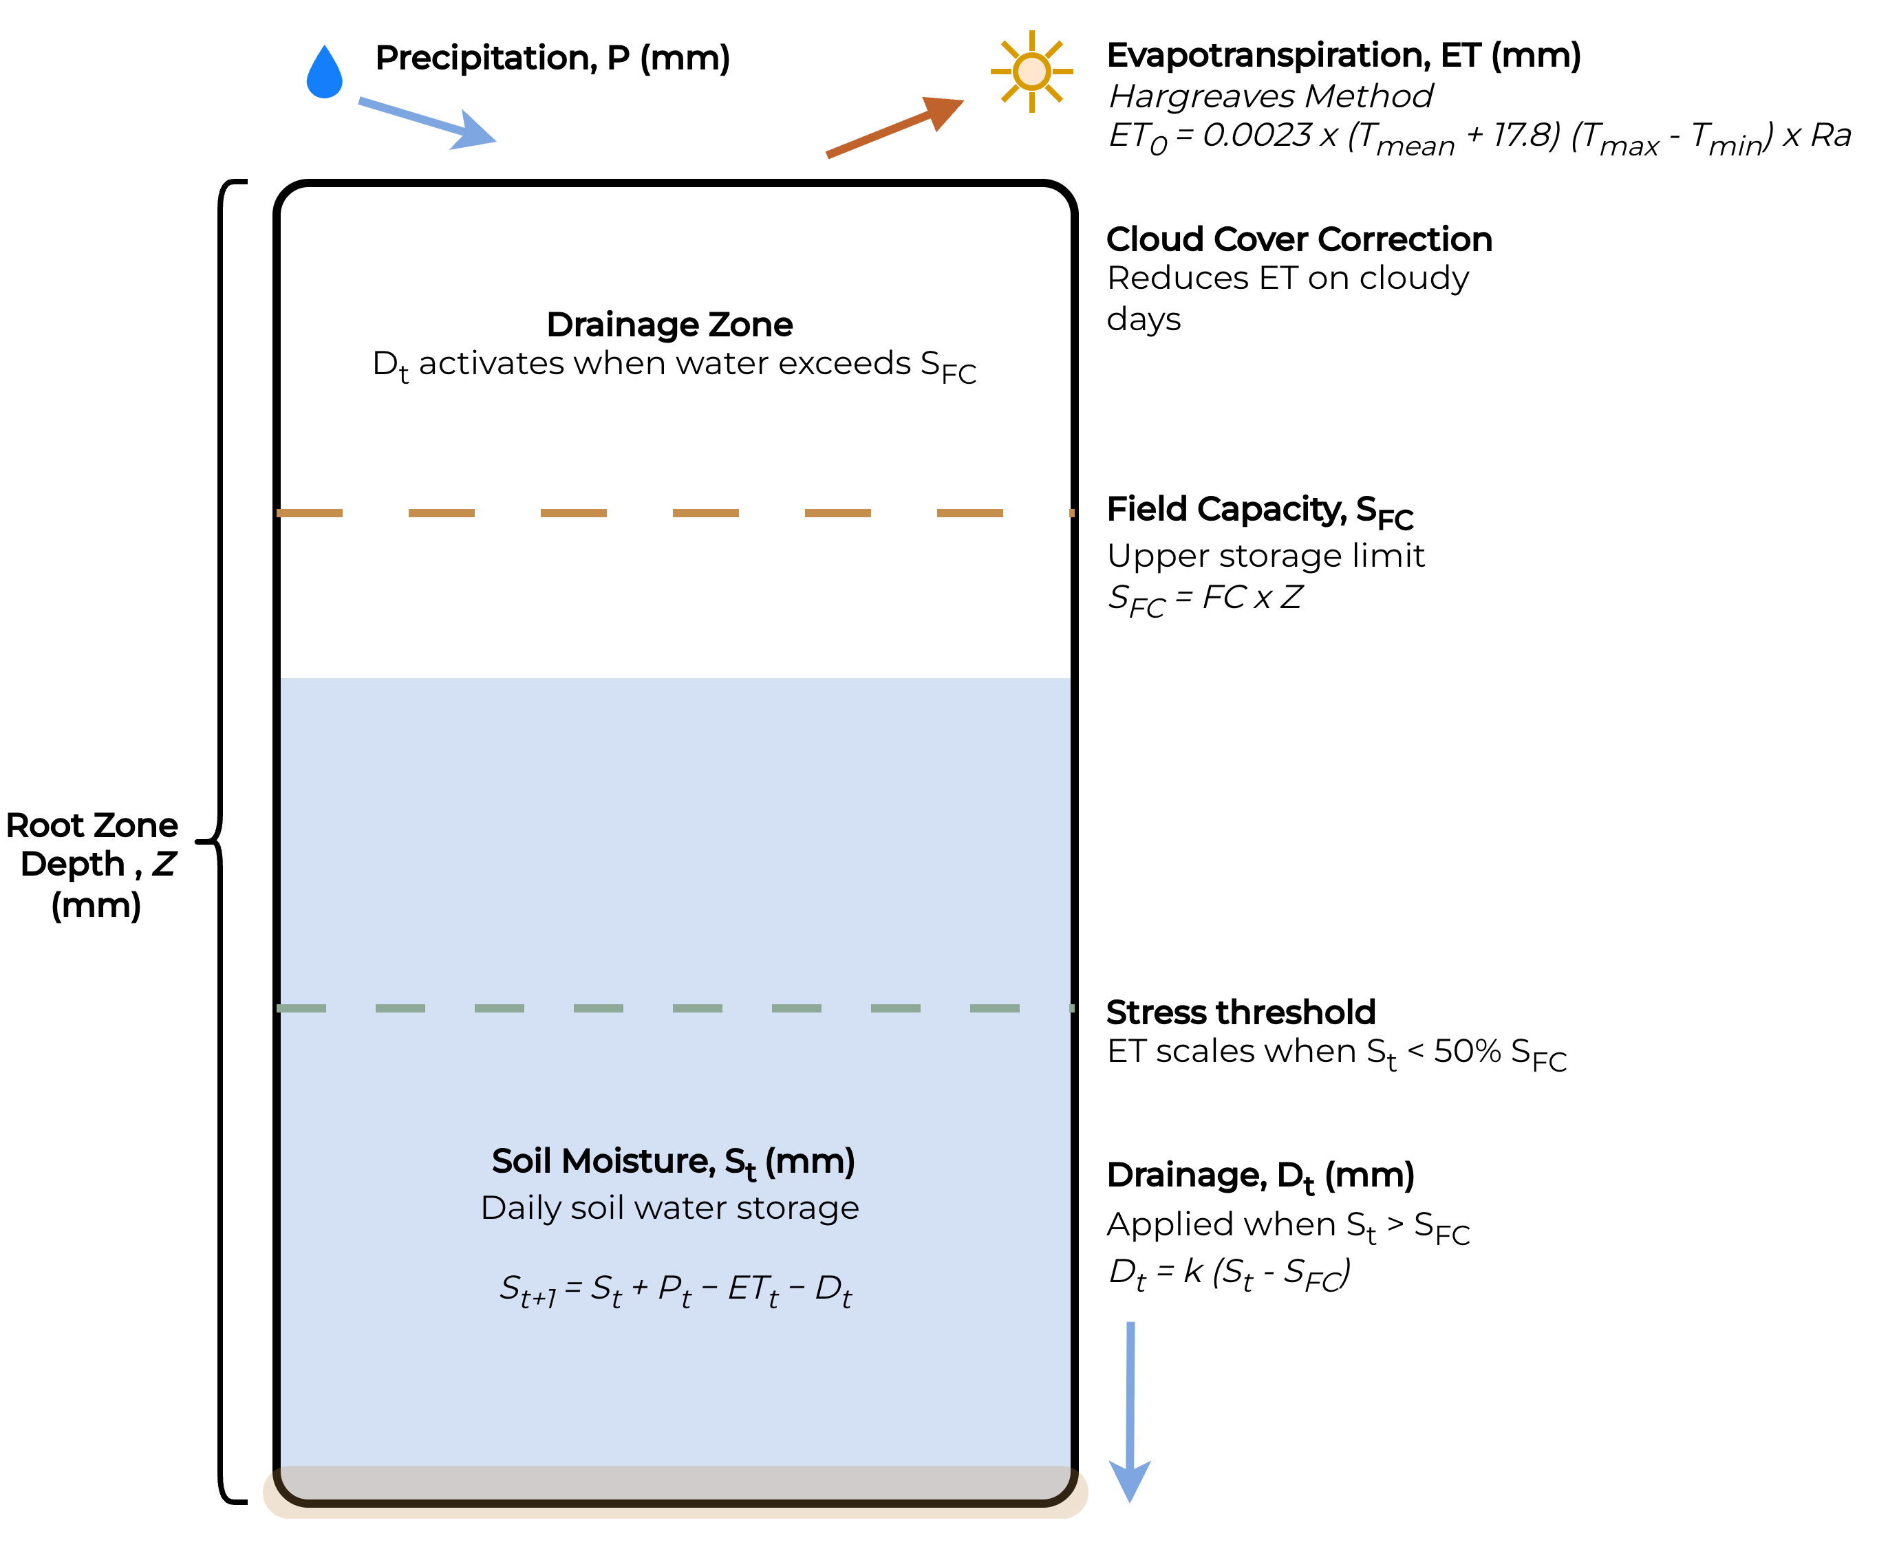
Modeling Daily Soil Moisture in Lethbridge, AB: A Water Balance Approach
Farah Sadoon, GEOG 6550: Environmental Modeling
Geography, Environment & Geomatics
BACKGROUND
ASSUMPTIONS
Soil moisture regulates land-climate interactions by controlling evapotranspiration, energy cycles, and water availability for vegetation. Shifts in soil moisture under warming conditions have led to notable changes in land cover and growing capabilities¹.
In Canada, the Prairie ecoregion provides important ecosystem services and contributes substantially to the national economy through agricultural production². Altered soil moisture dynamics pose a threat to the many benefits provided by this region and need to be further investigated to understand how best to mitigate the effects³. Direct measurement of soil properties can be costly and resource intensive; however, model-based approaches offer an alternative by using existing weather station data to represent hydrological processes⁴.
The model presented here uses meteorological data from the Lethbridge, AB weather station⁵ to simulate daily soil moisture over a 12-year period (2014 – 2026).
Soil properties are uniform and static – field capacity, drainage coefficient, and root zone depth are constant
Precipitation falls as rain – snowmelt is not modeled
Root zone depth is fixed – seasonal variation is not represented
Cloud cover correction is uniform – the same reduction factor applies to all cloudy periods
No lateral flow or surface runoff – all water is either lost to evapotranspiration, drains vertically, or remains in storage
Figure 3. Average daily soil moisture (mm) by day of year (2014 – 2026). Values represent mean soil moisture for each calendar day, averaged across all years, revealing seasonal patterns.
MODELING PROCESS
APPROACH
Figure 4. Seasonal distribution of mean soil moisture (mm) (2014 – 2026). Box plots show the distribution of annual seasonal averages. Each value corresponds to the mean soil moisture for a given season within a year. Seasonal differences and interannual variability are reflected in the spread and outliers.
STRENGTHS & LIMITATIONS
The model provides an interpretable approach to simulating soil moisture using meteorological data while capturing key water balance processes. The soil moisture stress function improves realism by reducing evapotranspiration under low water availability, and the model reproduces reasonable seasonal patterns. However, simplifying assumptions, such as uniform soil properties, fixed root zone depth, and a constant cloud correction, limit accuracy. The exclusion of snow dynamics and lateral flow or runoff further constrains realism.
Figure 2. Workflow diagram of the daily soil moisture model. All major steps including data ingestion, calculations and the main model logic used to simulate daily water storage are shown.
OUTPUT
The model produces a CSV file containing daily calculations of solar radiation, evapotranspiration, drainage estimates, and total soil moisture for the period covered by the input data. The model also reports the average soil moisture value for each day of the year (Figure 3), and the seasonal distribution of soil moisture values (Figure 4).
REFERENCES
Seneviratne et al. (2010). Earth-Science Reviews
Chipanshi et al. (2021). Intl. Journal of Climatology
Hanesiak et al. (2011). Atmosphere-Ocean
CORDIS. (2020). Impact of soil moisture on climate change projections
Government of Alberta. (2026). Acis.alberta.ca
Rodriguez-Iturbe et al. (1999). Proc. R. Soc. Lond. A
Figure 1. Conceptual diagram of the daily water balance bucket model based on Rodriguez-Iturbe et al.⁶ Precipitation enters the root zone storage, which is depleted by evapotranspiration, estimated using the Hargreaves method and adjusted for cloud cover. Drainage is applied when storage exceeds field capacity. The stress threshold represents the minimum storage level before ET₀ is scaled down to reflect reduced plant water availability.
ACKNOWLEDGEMENTS
Thanks to the course instructor, Dr. John Lindsay, for his support and guidance on this project.

