Slide 1
FINAL PROJECT JCDS01 BKS TELECOM COMPANY CUSTOMER CHURN PREDICTION
ALFARAH JOHANTIKA

Slide 2
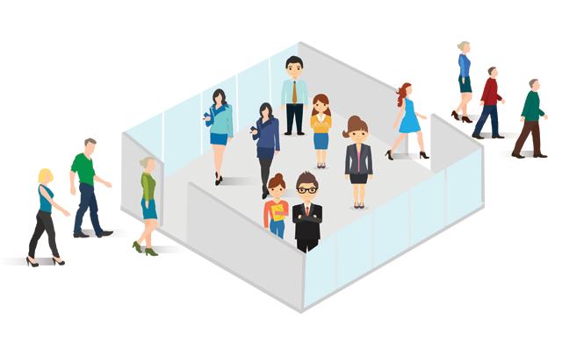
Background Issue
Customer attrition or also known as customer churn or turnover is the loss of customers from company.
This is one of the most cases in business life, especially in service companies. As they don’t want to lose the customer anymore, they will use customer attrition analysis and the rates as one of their key business metrics because the cost of retaining an existing customer is far less than acquiring a new one.

Slide 3
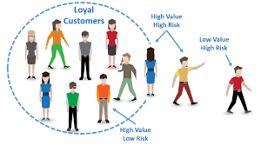
Project Purpose
This project aims to predict customer churn by assessing their propensity of risk to churn. The model generates small prioritized list of potential defectors and it will be focused to the set of the customer base who are most vulnerable to churn.
The Benefits?
Saving more cost
Keep in touch with customers
Improving after-sales service
… etc

Slide 4
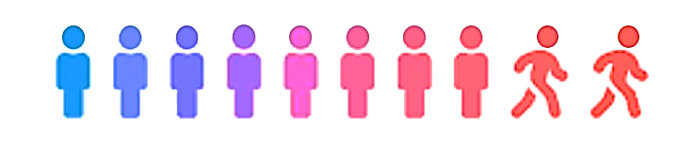
Data Information
Source : Telco Customer Churn (Kaggle)
Link : https://www.kaggle.com/blastchar/telco-customer-churn
Total Sample : 7043
Columns : 21
Features : ['customerID', 'gender', 'SeniorCitizen', 'Partner', 'Dependents', 'tenure', 'PhoneService', 'MultipleLines', 'InternetService', 'OnlineSecurity', 'OnlineBackup', 'DeviceProtection', 'TechSupport', 'StreamingTV', 'StreamingMovies', 'Contract', 'PaperlessBilling', 'PaymentMethod', 'MonthlyCharges', 'TotalCharges', 'Churn']

Slide 5
Feature Description
customerID : Customer ID
gender : Gender
SeniorCitizen : Whether the customer is a senior citizen or not
Partner : Whether the customer has a partner or not
Dependents : Whether the customer has dependents or not
tenure : Number of months the customer has stayed with the company
PhoneService : Whether the customer has a phone service or not
MultipleLines : Whether the customer has multiple lines or not
InternetService : Customer’s internet service provides (DSL, Fiber Optic, No)
OnlineSecurity : Whether the customer has online security or not
OnlineBackup : Whether the customer has online backup or not
DeviceProtection : Whether the customer has device protection or not
TechSupport : Whether the customer has tech support or not
StreamingTV : Whether the customer has streaming TV or not
StreamingMovies : Whether the customer has streaming movies or not
Contract : Type of contract (Month to Month, 1 year, 2 year)
PaperlessBilling : Whether the customer has paperless billing or not
PaumentMethod : Customer’s payment method (Bank transfer, CC, Electronic check, and Mailed check)
MonthlyCharges : Number of customer’s monthly bill
TotalCharges : Number of customer’s total bill
Churn : Whether the customer churn or not

Slide 6
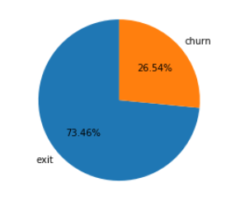
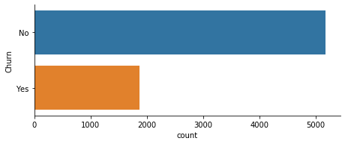
Current Customer Condition
Before starting the predict, we have to know the customer condition from the current data. By checking the total of ‘Churn’, we can see that the initial target that we have in the data is unbalanced target
Notes:
In Slide Show mode, click the arrow to enter the PowerPoint Getting Started Center.

Slide 7
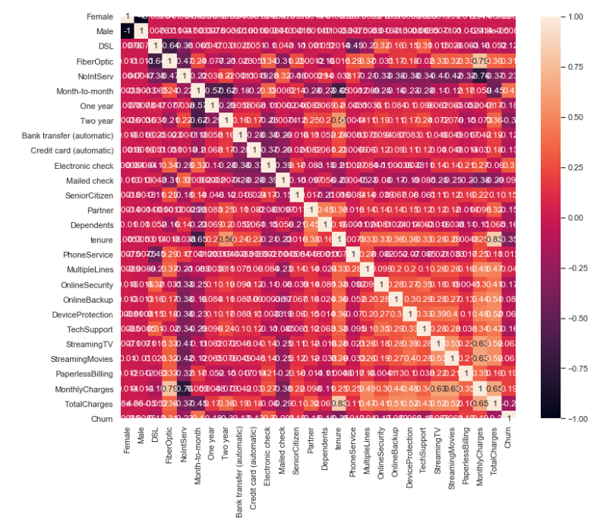
Best Correlation Features
Features that have big correlation with churn customer:
Month-to-Month [Contract] (40.45%)
Tenure (35.40%)
Fiber Optic [InternetServices] (30.74%)
Two year [Contract] (30.15%)
Electronic check [PaymentMethod] (30.15%)
Notes:
In Slide Show mode, click the arrow to enter the PowerPoint Getting Started Center.

Slide 8
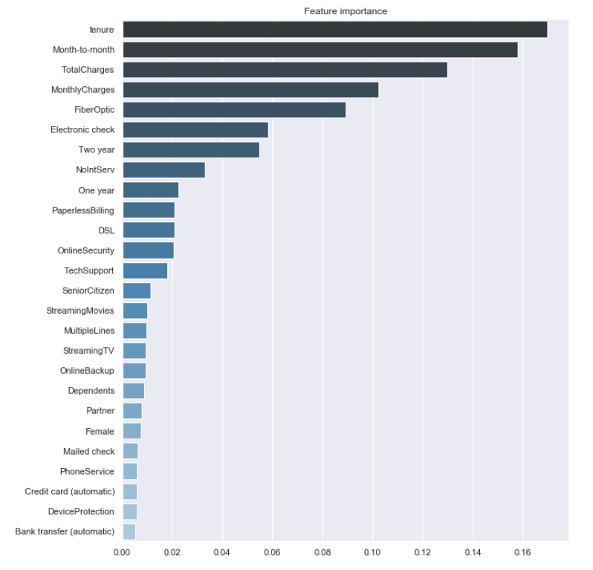
Initial Feature Importance
Top 5 Feature Importance:
Tenure
Month-to-Month [Contract]
Total Charges
Monthly Charges
Fiber Optic [InternetServices]
Notes:
In Slide Show mode, click the arrow to enter the PowerPoint Getting Started Center.

Slide 9

Machine Learning Models
For predict churn customer, I am using classification method. Here are 4 models of classification method that I used:
Logistic Regression
K-Nearest Neighbour
Decision Tree
Random Forest
For optimizing the result, I am using hyperparameter tuning by creating function to get a better score when building the model. Since we have unbalanced data, thus, I consider to use SMOTE and Random Oversampling as well beside using non-SMOTE data when training the model to compare the best result.

Slide 10
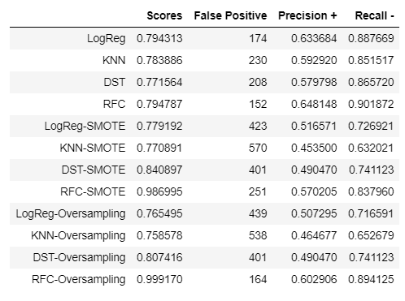
Decision Best Models
If the company would like to doing promotion, they have to more focuse to FP (False Positive) since it has the lowest score means that this is the best score than others. We don't want to lose the opportunity to get the customer who keep to stay when giving the promotion.
As we focuse on FP, then we will focus on Precision (+) and Recall (-) which both metrics have FP as one of the contributing factors.
I choose Logistic Regression (Logreg) as the best estimator than other models as Logreg have the highest AUC score (0.84) even on non-SMOTE, SMOTE, or oversampling. Although, from the scoring, the RFC-Oversampling is the highest, but I think the data is too oversampled since the score is 0.99, almost 1.

Slide 11
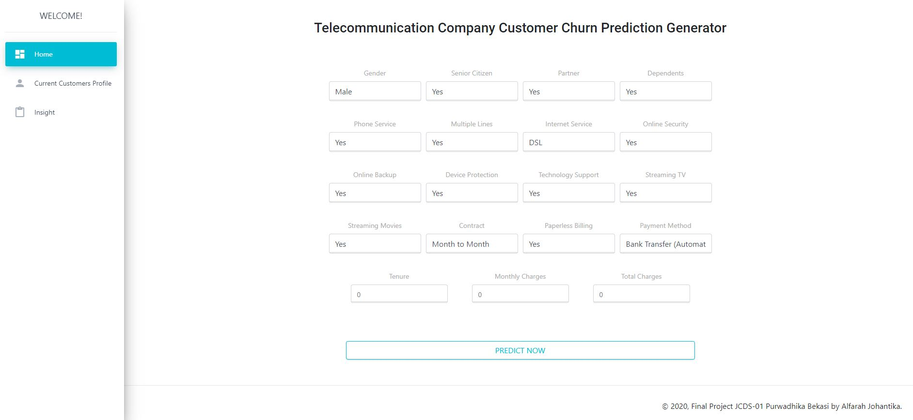
WebApp Interface - Homepage

Slide 12
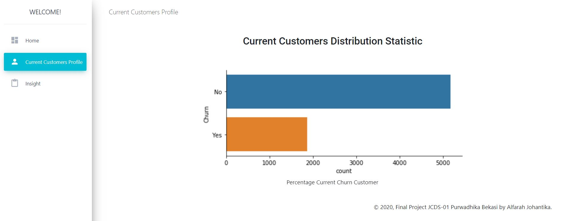
WebApp Interface – Current Costumers Profile

Slide 13
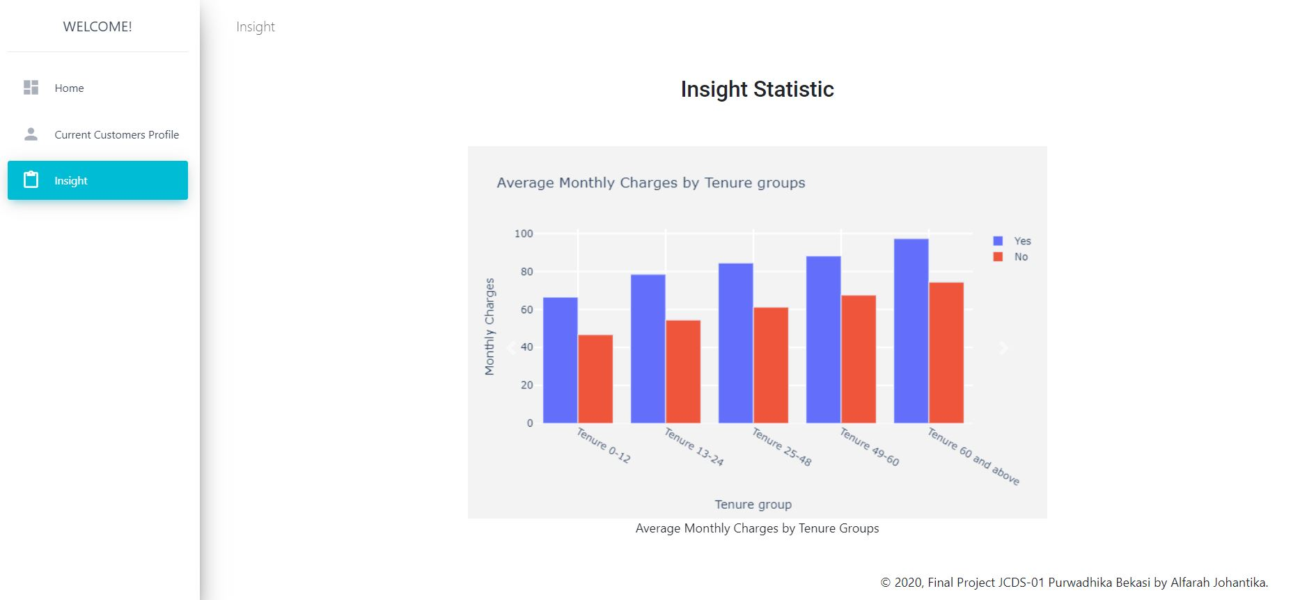
WebApp Interface – Insight Statistic

Slide 14
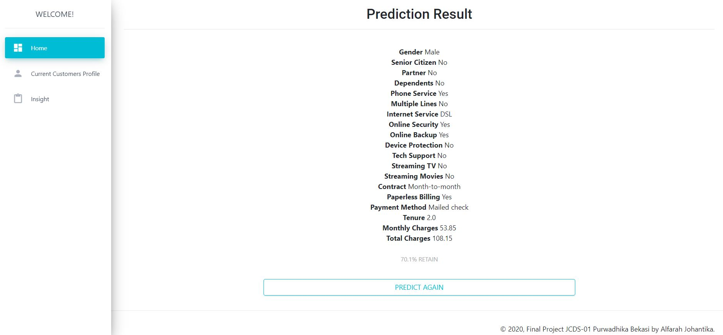
WebApp Interface – Result (Retain)

Slide 15
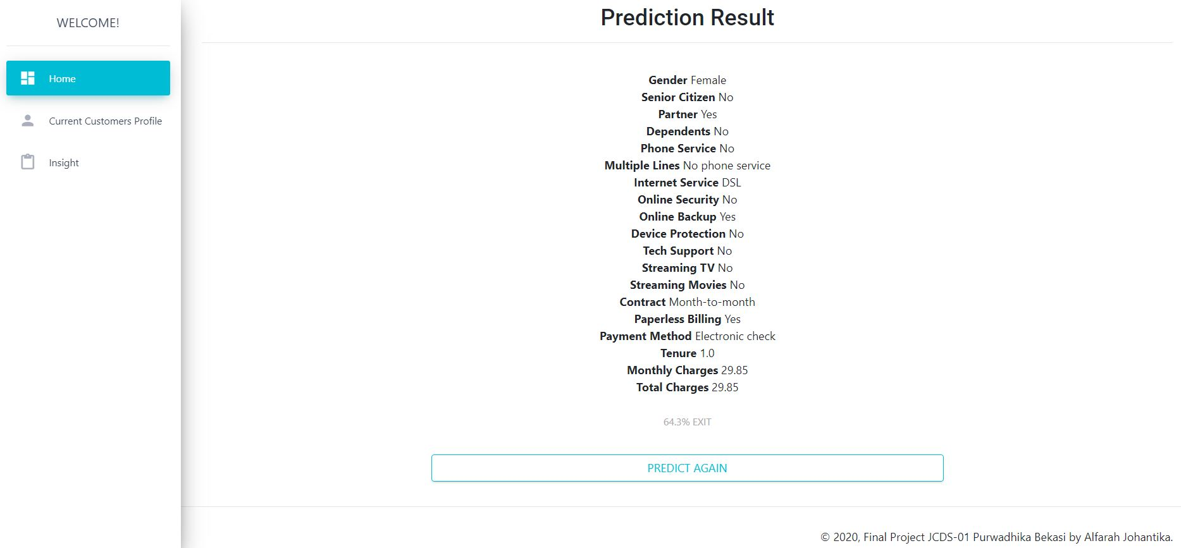
WebApp Interface – Result (Exit)

