Slide 1
Loop
Module 01
Data Science Developer

Slide 2
While Loop
angka = 1;
while(angka <= 10):
print(angka);
angka += 1;

Slide 3
For Loop and List
listItem = list(range(1,11,2));
print(listItem);
for item in range(1,11,2):
print(item);

Slide 4
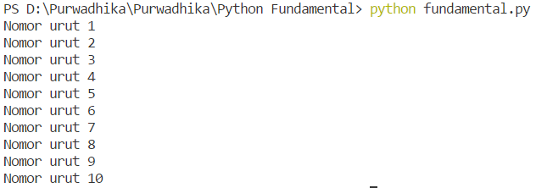
Solve It!

Slide 5
Solved!
y = 'Nomor urut ';
for item in range(1,11) :
print(y + str(item));

Slide 6
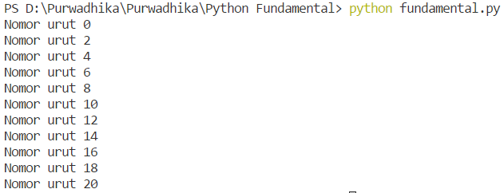
Solve It!

Slide 7
Solved!
y = 'Nomor urut ';
for item in range(0,21,2) :
print(y + str(item));

Slide 8
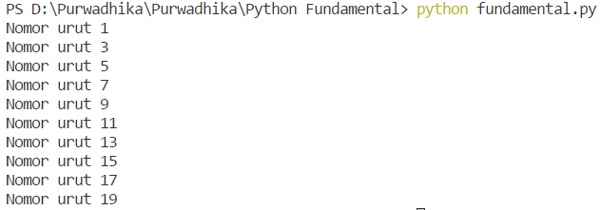
Solve It!

Slide 9
Solved!
y = 'Nomor urut ';
for item in range(1,21,2) :
print(y + str(item));

Slide 10
For Loop Drawing
z='';
for item in range(0,5):
z += ' * '
print(z);

Slide 11

For Loop Drawing
z='';
for item in range(0,5):
z += ' * \n'
print(z);

Slide 12
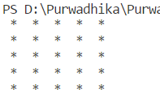
Solve It!

Slide 13
Solved!
z='';
for item in range(5):
for item1 in range(5):
z += ' * ‘
z += '\n'
print(z);

Slide 14
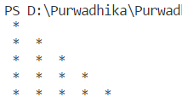
Solve It!

Slide 15
Solved!
z='';
for item in range(5):
for item1 in range(0, item+1):
z += ' * ‘
z += '\n'
print(z);

Slide 16
Solve It! #1

Slide 17
Solve It! #2

Slide 18
Solve It! #3

Slide 19
Solve It! #4

Slide 20
Solve It! #5

