Slide 1
Algorithms
Module 01
Data Science Developer

Slide 2
FizzBuzz
Fizz Buzz is an algorithm function that will log out to the console every number from 1 to “num”.
For each number, if the number is divisible by 3, it’ll log out the word “Fizz” instead of that number.
Next, if the number is divisible by 5, it’ll log out the word “Buzz” instead of that number.
And finally, if a number is divisible by both 3 and 5, we want to logout the word “FizzBuzz” instead of that number.
Beside is the result of fizzBuzz(20)

Slide 3
FizzBuzz
def fizzBuzz(num) :
for i in range(1,num+1) :
if (i % 15 == 0) :
print('FizzBuzz’);
elif (i % 3 == 0) :
print('Fizz’);
elif (i % 5 == 0) :
print('Buzz’);
else :
print(i);
fizzBuzz(20);

Slide 4
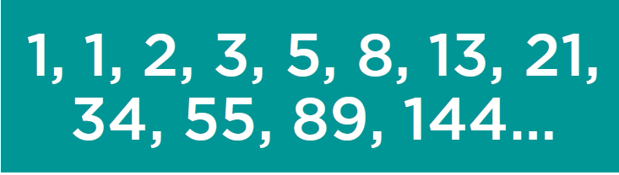
Fibonacci
Fibonacci sequence characterized by the fact that every number after the first two is the sum of the two preceding ones:
input= fibo(6) then output= 8

Slide 5
Fibonacci
def fibo(urut) :
listData = [1,1];
for i in range(2,urut):
listData.append(listData[i-2] + listData[i-1]);
return listData[urut-1];
print(fibo(8));

Slide 6
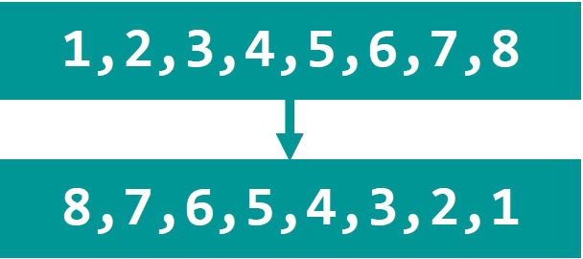
Reverse List In Place
This algorithm function will take in a list as a parameter, then it’ll reverse that list and return us the reversed list.
reverseList([1,2,3,4,5,6,7,8])

Slide 7
Reverse List In Place
import math;
def reverseList(theList) :
for i in range(0, math.floor(len(theList)/2)) :
tempList = theList[i];
theList[i] = theList[len(theList) - 1 - i];
theList[len(theList) - 1 - i] = tempList;
return theList;
print(reverseList([1,2,3,4,5,6,7,8]));

Slide 8
Bubble Sort
x = [6000, 34, 203, 3, 746, 200, 984, 198, 764, 9, 1]
def bubbleSort(list) :
for i in range(len(list), 0, -1) :
for j in range(0,i-1) :
if (list[j] > list[j + 1]) :
temp = list[j];
list[j] = list[j + 1];
list[j + 1] = temp;
return list;
print(bubbleSort(x));

Slide 9

Mean, Median & Mode
Mean is the average value of a dataset.
Median is the middle number of a dataset.
Mode is the most frequent number of a dataset.
Mean = 3 | Median = 2 | Mode = 2

Slide 10
Mean
x = [ 1,2,3,2,5,2,7,2 ]
def getMean(list) :
sum = 0;
for item in list :
sum += item;
mean = sum / len(list);
return mean;
print(getMean(x));

Slide 11
Median
x = [ 1,2,3,2,5,2,7,2 ]
def getMedian(list) :
list.sort();
median = 0;
if (len(list) % 2 != 0) :
median = list[floor(len(list) / 2)];
else :
mid1 = list[(int(len(list) / 2)) - 1];
mid2 = list[int(len(list) / 2)];
median = (mid1 + mid2) / 2;
return median;
print(getMedian(x));

Slide 12
Mode
x = [ 1,2,3,2,5,2,7,2 ]
def getMode(list) :
countList = [];
# create countList
for num in list :
check = False;
for list1 in countList :
if(list1[0] == num) :
list1[1] += 1;
check = True;
if(check == False) :
countList.append([num, 0]);
# create list of mode/s
maxFrequency = 0;
modes = [];
for list1 in countList :
if (list1[1] > maxFrequency) :
modes = [list1[0]];
maxFrequency = list1[1];
elif (list1[1] == maxFrequency) :
modes.append(list1[0]);
# if every value appears same amount of times
if (len(modes) == len(countList)) :
modes = [];
return modes;
print(getMode(x));

