Slide 1

Café Robot Scenarios Failed and final successful one Farah Aymen 194233

Slide 2
Failed Scenarios
We will explore four failed scenarios that the robot might fall into them.

Slide 3
Scenario one
The robot Spills the coffee.

Slide 4
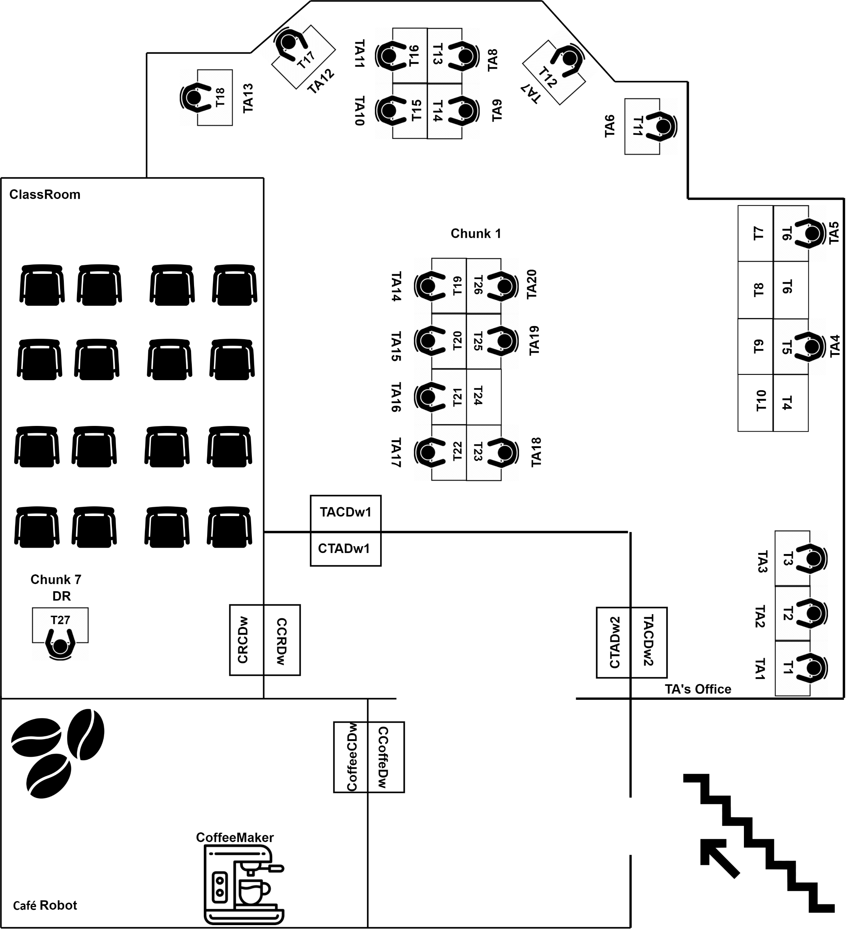



Slide 5
Scenario Two
The robot hits a wall and fails.

Slide 7
Scenario Three
The robot find an unexpected obstacle that prevents him for fulfilling its goal.

Slide 9
Scenario Four
The robot goes through an error and deliver the wrong coffee to the wrong person.

Slide 10


Slide 11
Final Scenario
The robot successfully goes through its sequence of actions, correctly executes the A* algorithm and fulfil the orders.

Slide 12
- Robot Checks list of orders:
Orders = [[blackCoffee,TA3],[latte, TA6]]
- Robot goes to make the coffee
- Robot Picks coffee, so it get added to the list of what it is carrying:
Carrying = [[blackCoffee, TA3], [latte, TA6]]
- Robot executes the algorithm

Slide 13
- Robot performs operation to move to doorway
- Robot performs operation to open the door
- Robot performs operation to move through doorway
- Robot performs operation to close the door
- After calculating the shortest path, the robot will deliver to TA3 then to TA6, and the shortest path is to take doorway 2.

Slide 14
- Robot performs operation to move to doorway
- Robot performs operation to open the door
- Robot performs operation to move through doorway
- Robot performs operation to close the door

Slide 15
- The algorithm will pick TA 3 first to deliver since it is the shortest path.
- The robot will map TA 3 to table 3. So, it will head for table 3 to deliver the coffee.
- Robot delivers coffee to TA 3.
- Robot removes the order from the list of orders and removes it from the list of what it’s carrying.
- Robot looks for the next nearest order to fulfil.

Slide 16
- The algorithm will pick TA 6 to deliver since it is the shortest path.
- The robot will map TA 6 to table 11. So, it will head for Table 11 to deliver the coffee.
- Robot delivers coffee to TA 11.
- Robot removes the order from the list of orders and removes it from the list of what it’s carrying.
- Robot looks for the next nearest order to fulfil.

Slide 17
- The algorithm will find that the orders list is now empty, so it will fulfill its final goal which is heading back to the coffee place.
- The algorithm will find the shortest path which will lead the robot to doorway 2.
- Robot performs operation to move to the door
- Robot performs operation to open the door.
- Robot performs operation to move through door.

Slide 18
- Robot Performs operation to close the door.
- The robot moves to doorway of the coffee place.
- Robot performs operation to open the door.
- Robot performs operation to go through doorway
- Robot performs operation to close the door.
- Robot arrives at the coffee maker.

