Slide 1
DECENTRALIZED SESSION NEGOTIATION WITH BCOIN
C4YT 2018
Notes:
build tooling that empowers developers everyone
platform / protocol agnostic

Slide 2
GETTING CONNECTED IS ½ THE BATTLE
@dsnprotocol
Notes:
decentralized services should use decentralized infrastructures (ipfs, blockchain, etc)
traditional session negotiations schemes rely on centralized coordinators (STUN etc)
decentralized apps need a way to connect their users p2p without depending on centralized

Slide 3
What?
Why?
@dsnprotocol
Notes:
What?
we implemented a decentralized session negotiation service as a bcoin plugin, bcoin-dsnp
extends bitcoin protocol to facilitate user-to-user interactions
Why?
direct human interaction is central to these networks valuable
make it easy for devs to incorporate direct user-to-user interaction in their applications
buzzwords:
dns for p2p connections
telephony for dapps

Slide 4
DSNP
Decentralized Session Negotiation Protocol
https://github.com/Patrickdlg/bDsnp
An Open Source DSNP Plugin for Bcoin
@dsnprotocol
Notes:
check out our open source bcoin plugin
dsnp is more of a spec than protocol; hope to inspire

Slide 5

Piggyback Protocol
DSNP piggybacks on existing protocols (Bitcoin, Cosmos, Ethereum, etc)
DSNP nodes earn rewards and reputation by connecting DSNP clients
DSNP is session protocol agnostic (from raw TCP to WebRTC)
DSNP is an experiment in 2nd layer mechanism / incentive design
@dsnprotocol
Notes:
define a new message type (packet in bcoin)
incentivized session negotiations

Slide 6
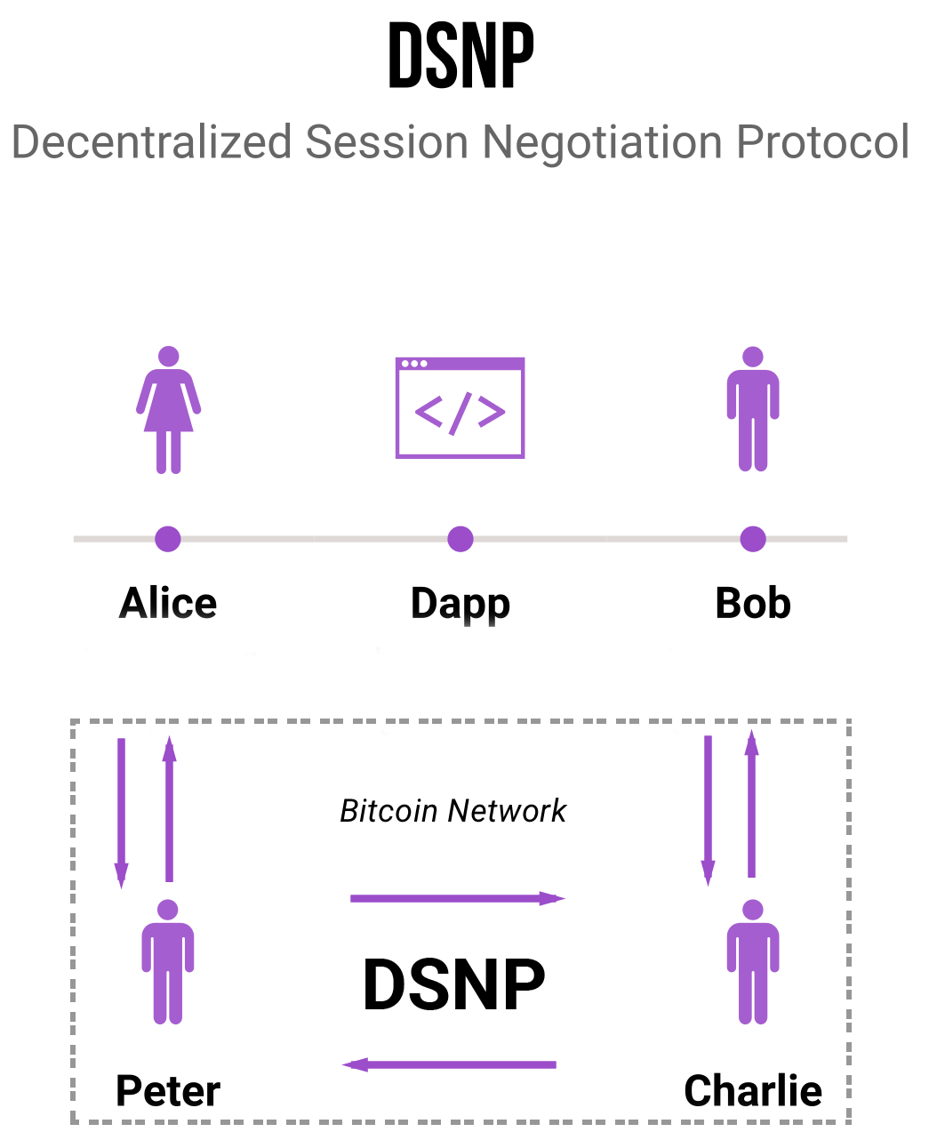
@dsnprotocol
Notes:
alice wants to talk to bob
bob has registered with charlie
public node peter broadcasts alices

Slide 7
+
bcoin
DSNP
First working implementation of DSNP powered by the Bitcoin network
Implemented as a bcoin plugin
Facilitates WebRTC PeerConnections ie browser-to-browser communication
Reward payout functionality not yet implemented for Bitcoin we’ll use Lightning
Fully tested
@dsnprotocol

Slide 8
DEMO
@dsnprotocol

Slide 9
WHAT’S NEXT?
Implement ICE / TURN server functionality for bDSNP
Integrate DSNP as service on Cosmos that interacts with the Cosmos Hub
Bitcoin Core implementation of DSNP
Off-chain reward payments with Lightning
DSNP on Ethereum as a TCR (Token Curated Registry)
R&D on implementing DSNP in an Ethereum Plasma Chain
DSNP will power peer discovery and session negotiation in browser based blockchain applications
Collect / pay to call
@dsnprotocol

Slide 10
Learn More
https://hub.docker.com/r/fcm4ypt/bdsnp
https://github.com/Patrickdlg/bDsnp
https://twitter.com/dsnprotocol
@dsnprotocol

