Slide 1
Modeling Housing Data
Using Predicted Sales Price to Maximize Financial Opportunities
for Home Buyers
Farah Malik
Project 2
June 2023

Slide 2

Problem Statement
Background
Housing prices have increased almost 50%¹ over the last decade and are projected to continue their rise. Therefore, it is more important than ever for current homeowners and future home-buyers to understand how to get the best return on their housing investment on their path to building wealth.
Objective
The objective of this project is to advise home buyers and current homeowners on the key features most associated with home sale price that they should prioritize when searching for a new home or when remodeling their existing properties to maximize future potential financial opportunities.
Analysis Method
Using a comprehensive linear regression model and in-depth exploration and analysis of housing data, this outline will provide valuable guidance to this audience.
Cleaning and Exploratory Data Analysis
Data Manipulation and Feature Engineering
Model Building and Testing
https://www.cnbc.com/select/how-much-will-a-home-in-the-us-cost-by-2030/

Slide 3
Methodology and Analysis
Data Acquisition
Ames, Iowa Housing Dataset
Comprehensive record of over 2,000 residential properties in Ames, Iowa, sold between 2006-2010
Includes features related to the physical attributes of properties, as well as aspects such as location, quality, and condition.
Predictive Model
Linear regression modeling using robust techniques to predict housing sales prices based on a series of features
Multiple iterations of features tested, and various methods of used to test the ability of the model to predict values on unseen data (e.g., regularization, cross-validation).
Final model metrics:
R² = 0.84
RMSE = 23,357 → ~3.5x smaller than if we had not used any of our features (i.e., compared to a baseline model)

Slide 4
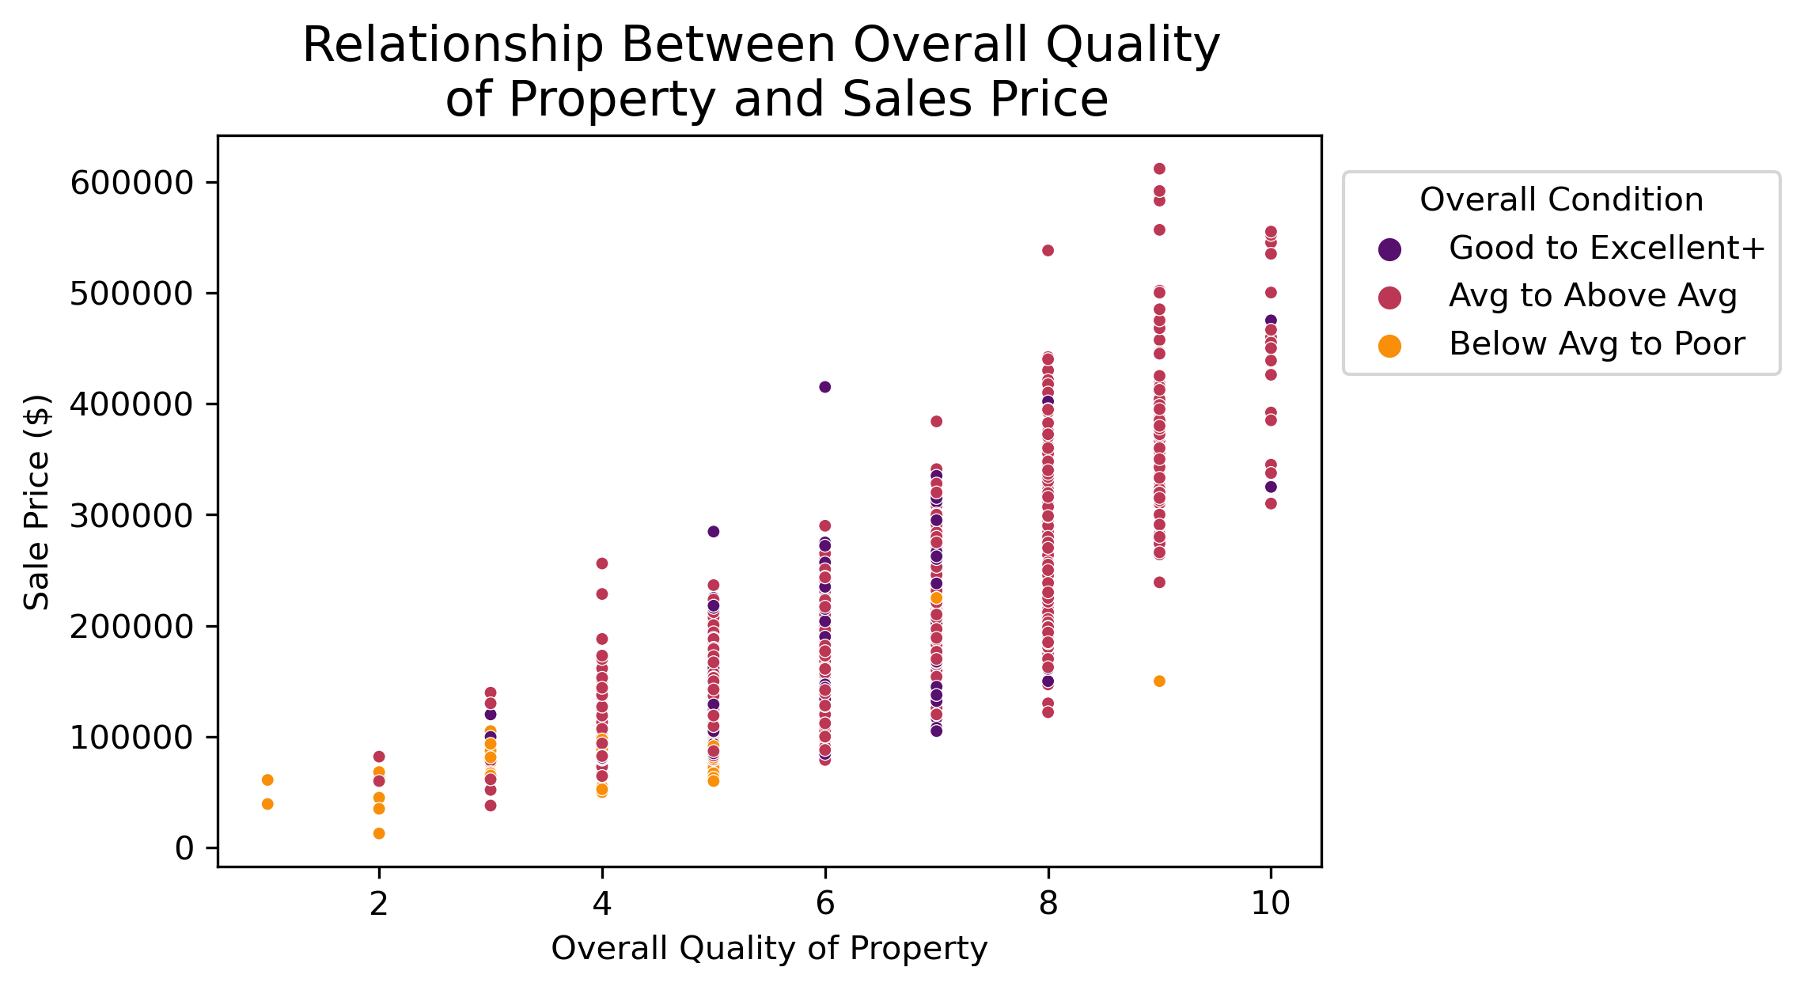
Overall Quality Score and Relationship with Condition
INSIGHT 1
For every one-point increase in the overall quality score of the property, sales price was predicted to increase by 10%, holding all else constant.
Overall Quality
Holistic Evaluation
Focuses on factors such as materials used, finish, and design^{1,2}
Overall Condition
Overall maintenance, repair, and livability^{1,2}
General state of house
Quality > Condition
https://jse.amstat.org/v19n3/decock/DataDocumentation.txt
https://nan-amc.com/what-determines-the-quality-condition-of-your-property/

Slide 5
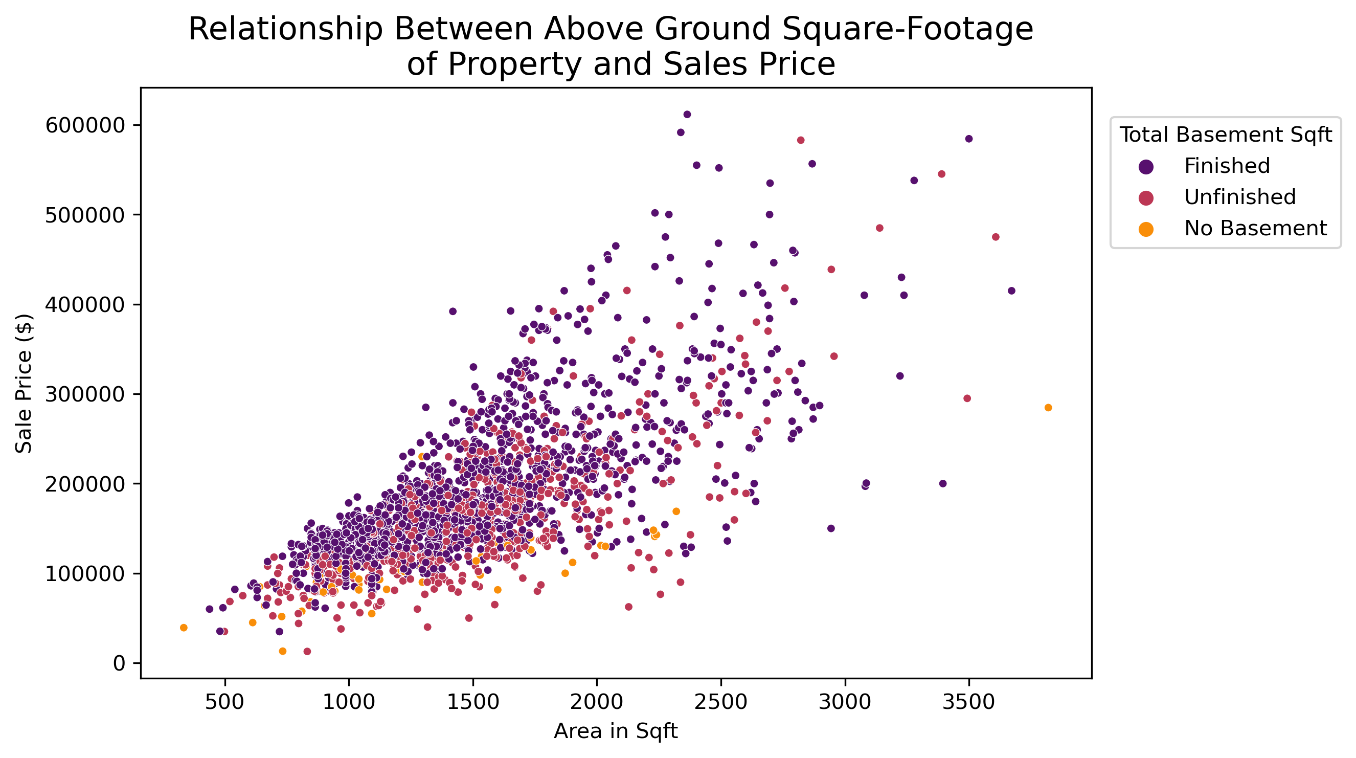
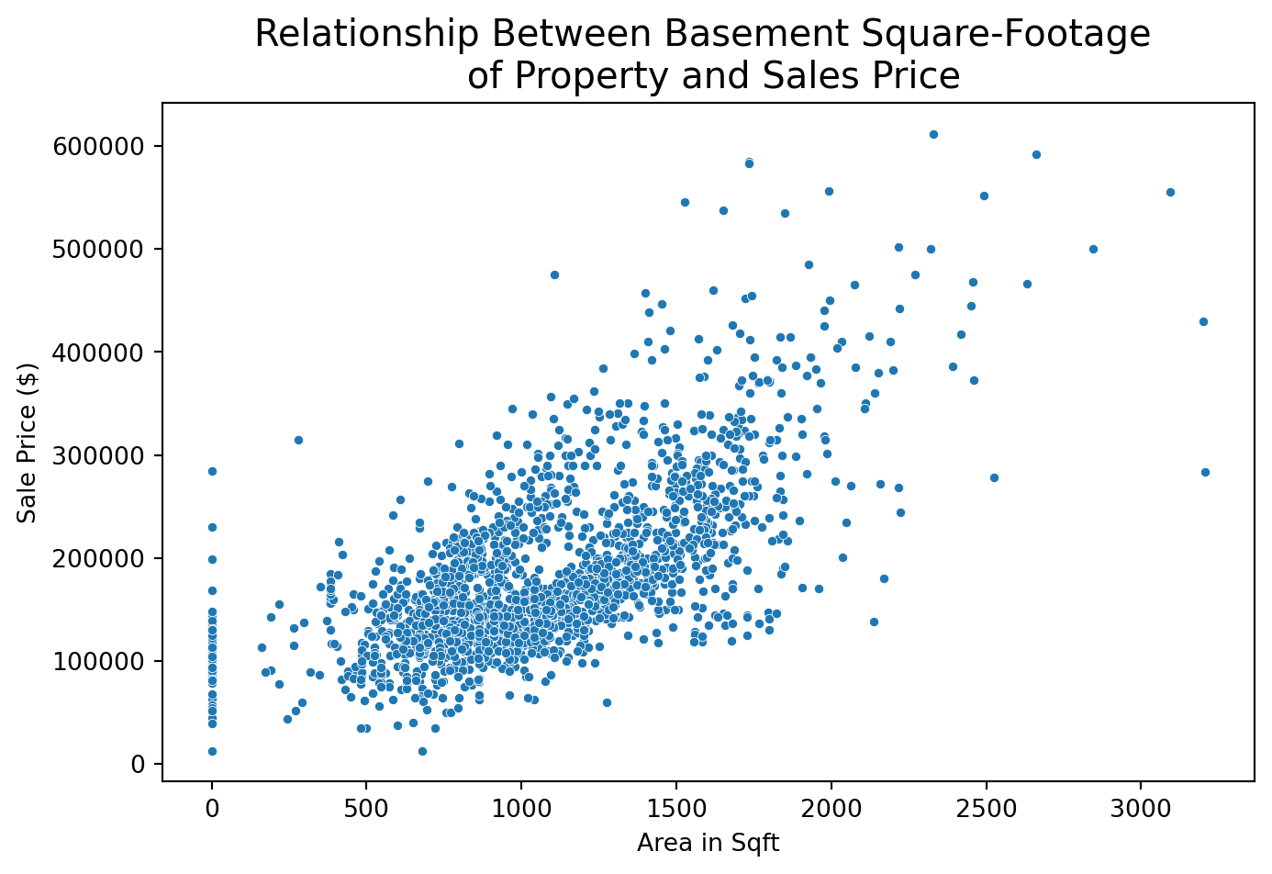
House Size and Basement
INSIGHT 2
As may be anticipated, larger houses were associated with higher sales prices. In most residential areas, more square-footage is desirable for comfort, growing families, and quality of life evaluation.
For every square-foot increase in above ground area, the predicted sales price increased by 13.5%, holding all other variables in our model constant. For basements, the increase was 6%.

Slide 6
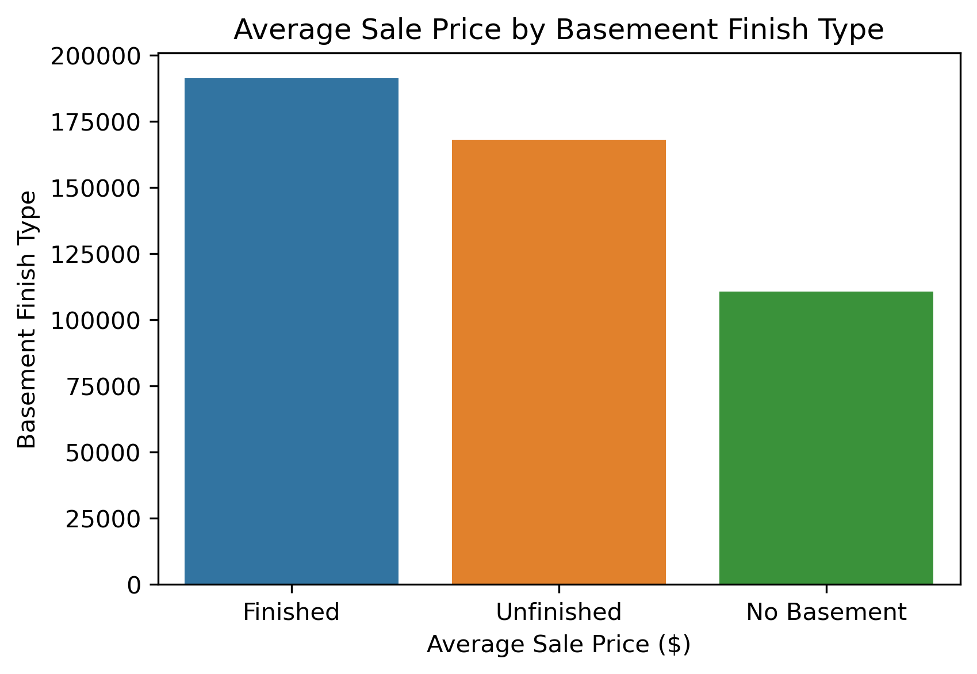
House Size and Basement
INSIGHT 2
As may be anticipated, larger houses were associated with higher sales prices. In most residential areas, more square-footage is desirable for comfort, growing families, and quality of life evaluation.
Having a basement, even if unfinished seemed advantageous over having no basement at all. There are not many houses built this way, which limited our model’s performance in gauging in this relationship – but the data above is decent indication.

Slide 7
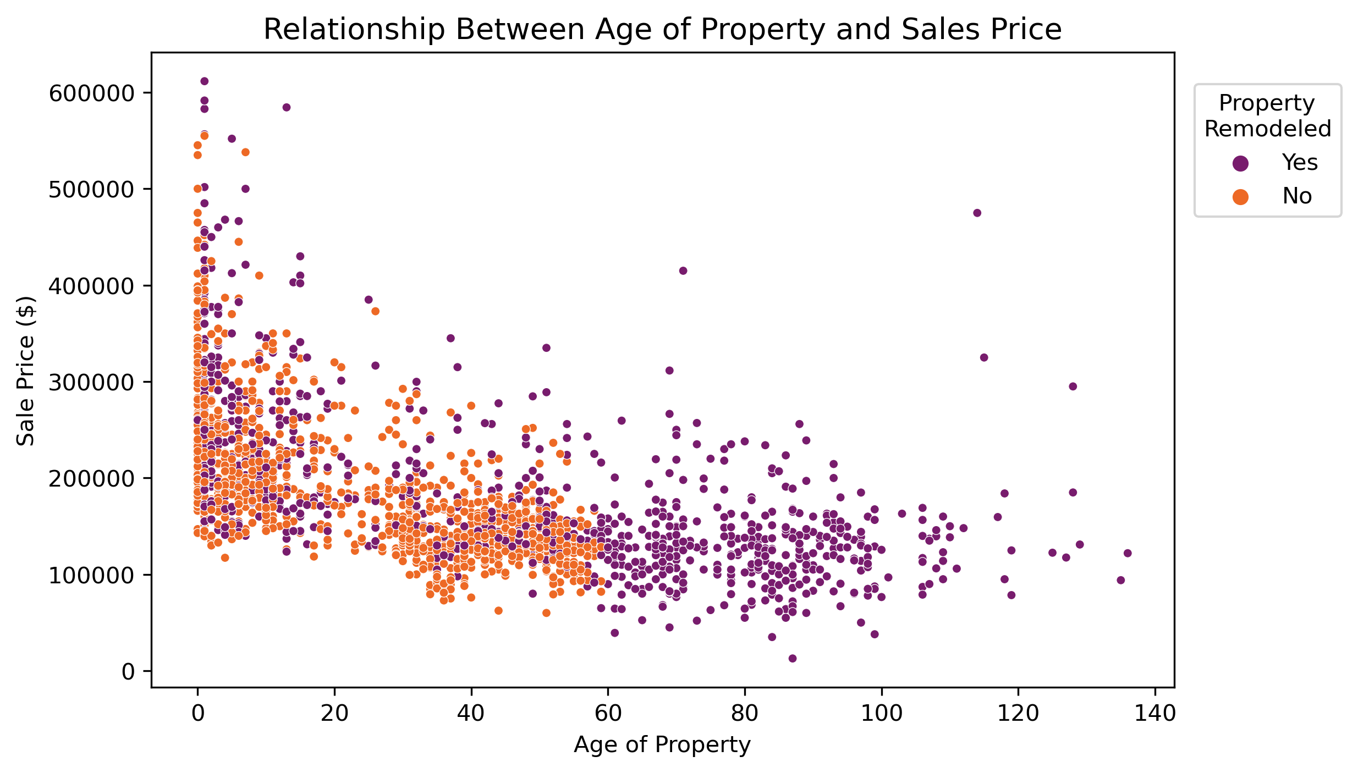
Age of Home Based on Year Built
INSIGHT 3
Newer houses are favorable to older ones when it comes to pricing and potential resale value. Our model found that for every year a property increases in age, the predict sales price decreased by 13%.*
This graph shows the negative correlation between age and sale price, but one can also see that older homes are more likely to be remodeled, but more recent remodeling have the higher sales prices.
*Holding all other variable constant

Slide 8
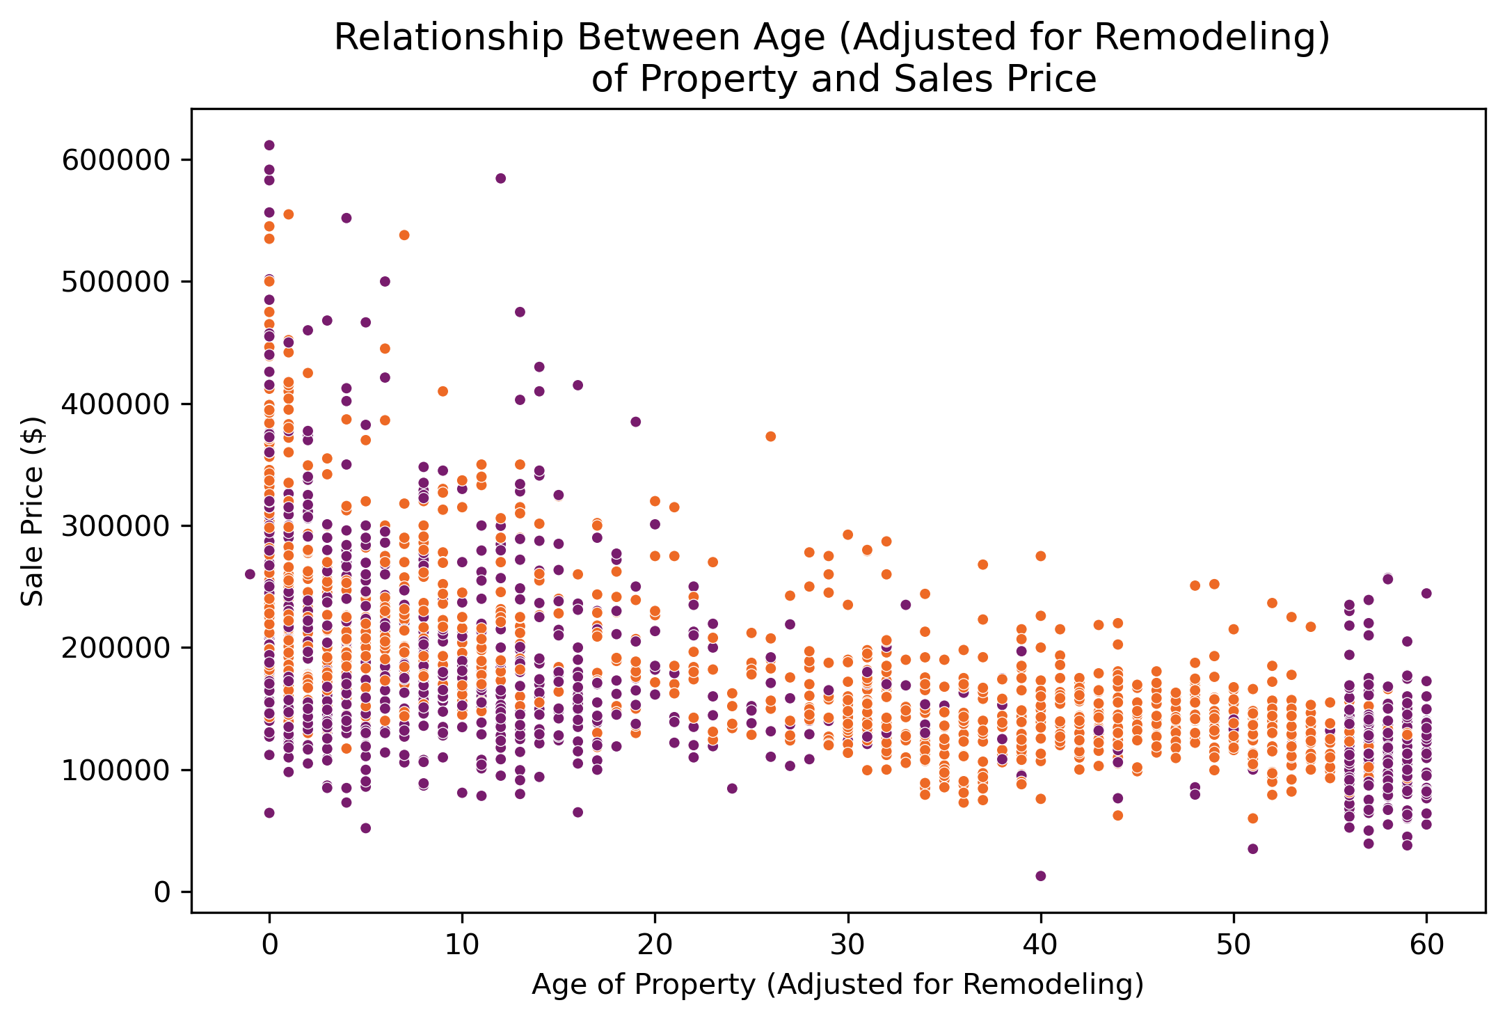
Age of Home Based on Year Remodeled
INSIGHT 3
Remodeling is an option for current homeowners, especially those with older houses which have no been remodeled within the last ~20 years. For buyers looking at remodeled homes, it will be advantageous to only consider homes where the remodeling was recent.
For every year more recent that the remodeling is (i.e., the more recently it has taken place), the predict sales price is expected to increase by 5%.*
Each year that goes by since the remodeling, the predicted sales price decreases, but not to the same degree as seen with age (13%).
*Holding all other variable constant

Slide 9
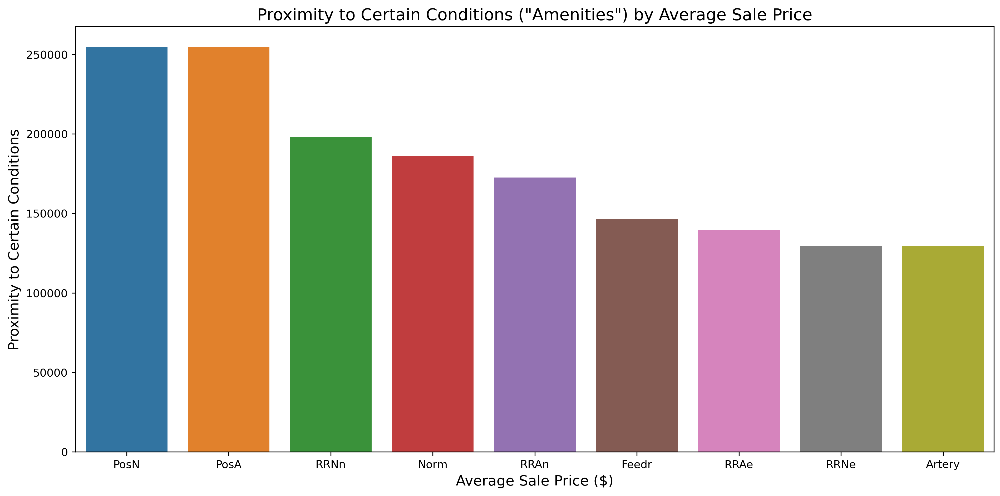
Proximity to Certain Conditions
Insight 4
Our model showed modest predictions in sales price increase depending on the property's proximity to certain conditions. Living in proximity to a positive offsite feature, such as a park or greenbelt, was predicted to show a 3% increase* in sale price. Avoid being near busy arterial streets and railroads.
Railroads
*Holding all other variable constant
Positive offsite feature

Slide 10
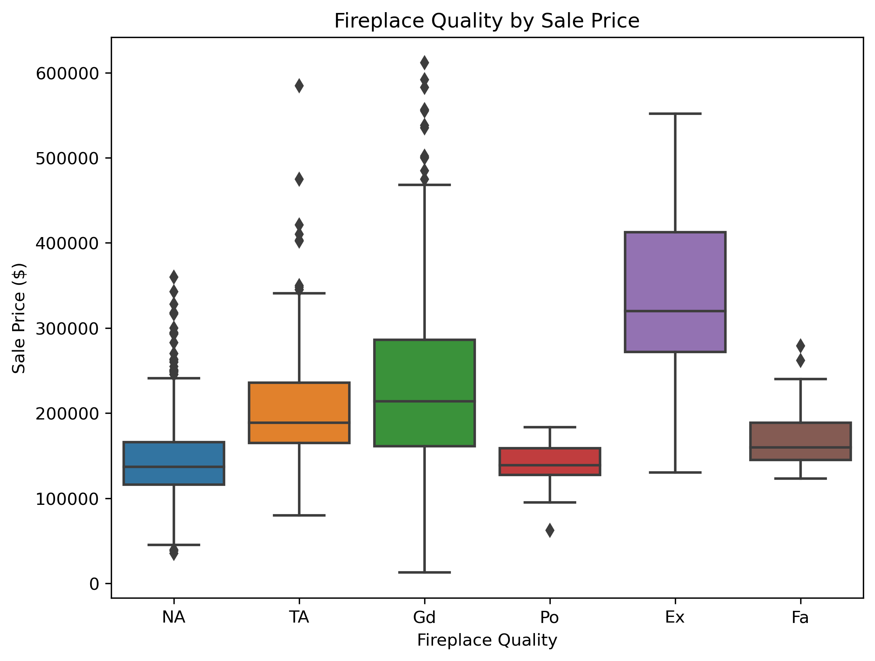
High-Quality Features: Fireplace
Insight 5
Some features in homes must be high-quality in order to maximize sale prices.
For every one unit increase in the number of fireplaces in a property, predicted sale price is expected to increase by 3%.*
However, high-quality fireplaces are much more likely to see this return on investment. Poor quality fireplaces had similar sales prices to properties with no fireplaces.
*Holding all other variable constant

Slide 11
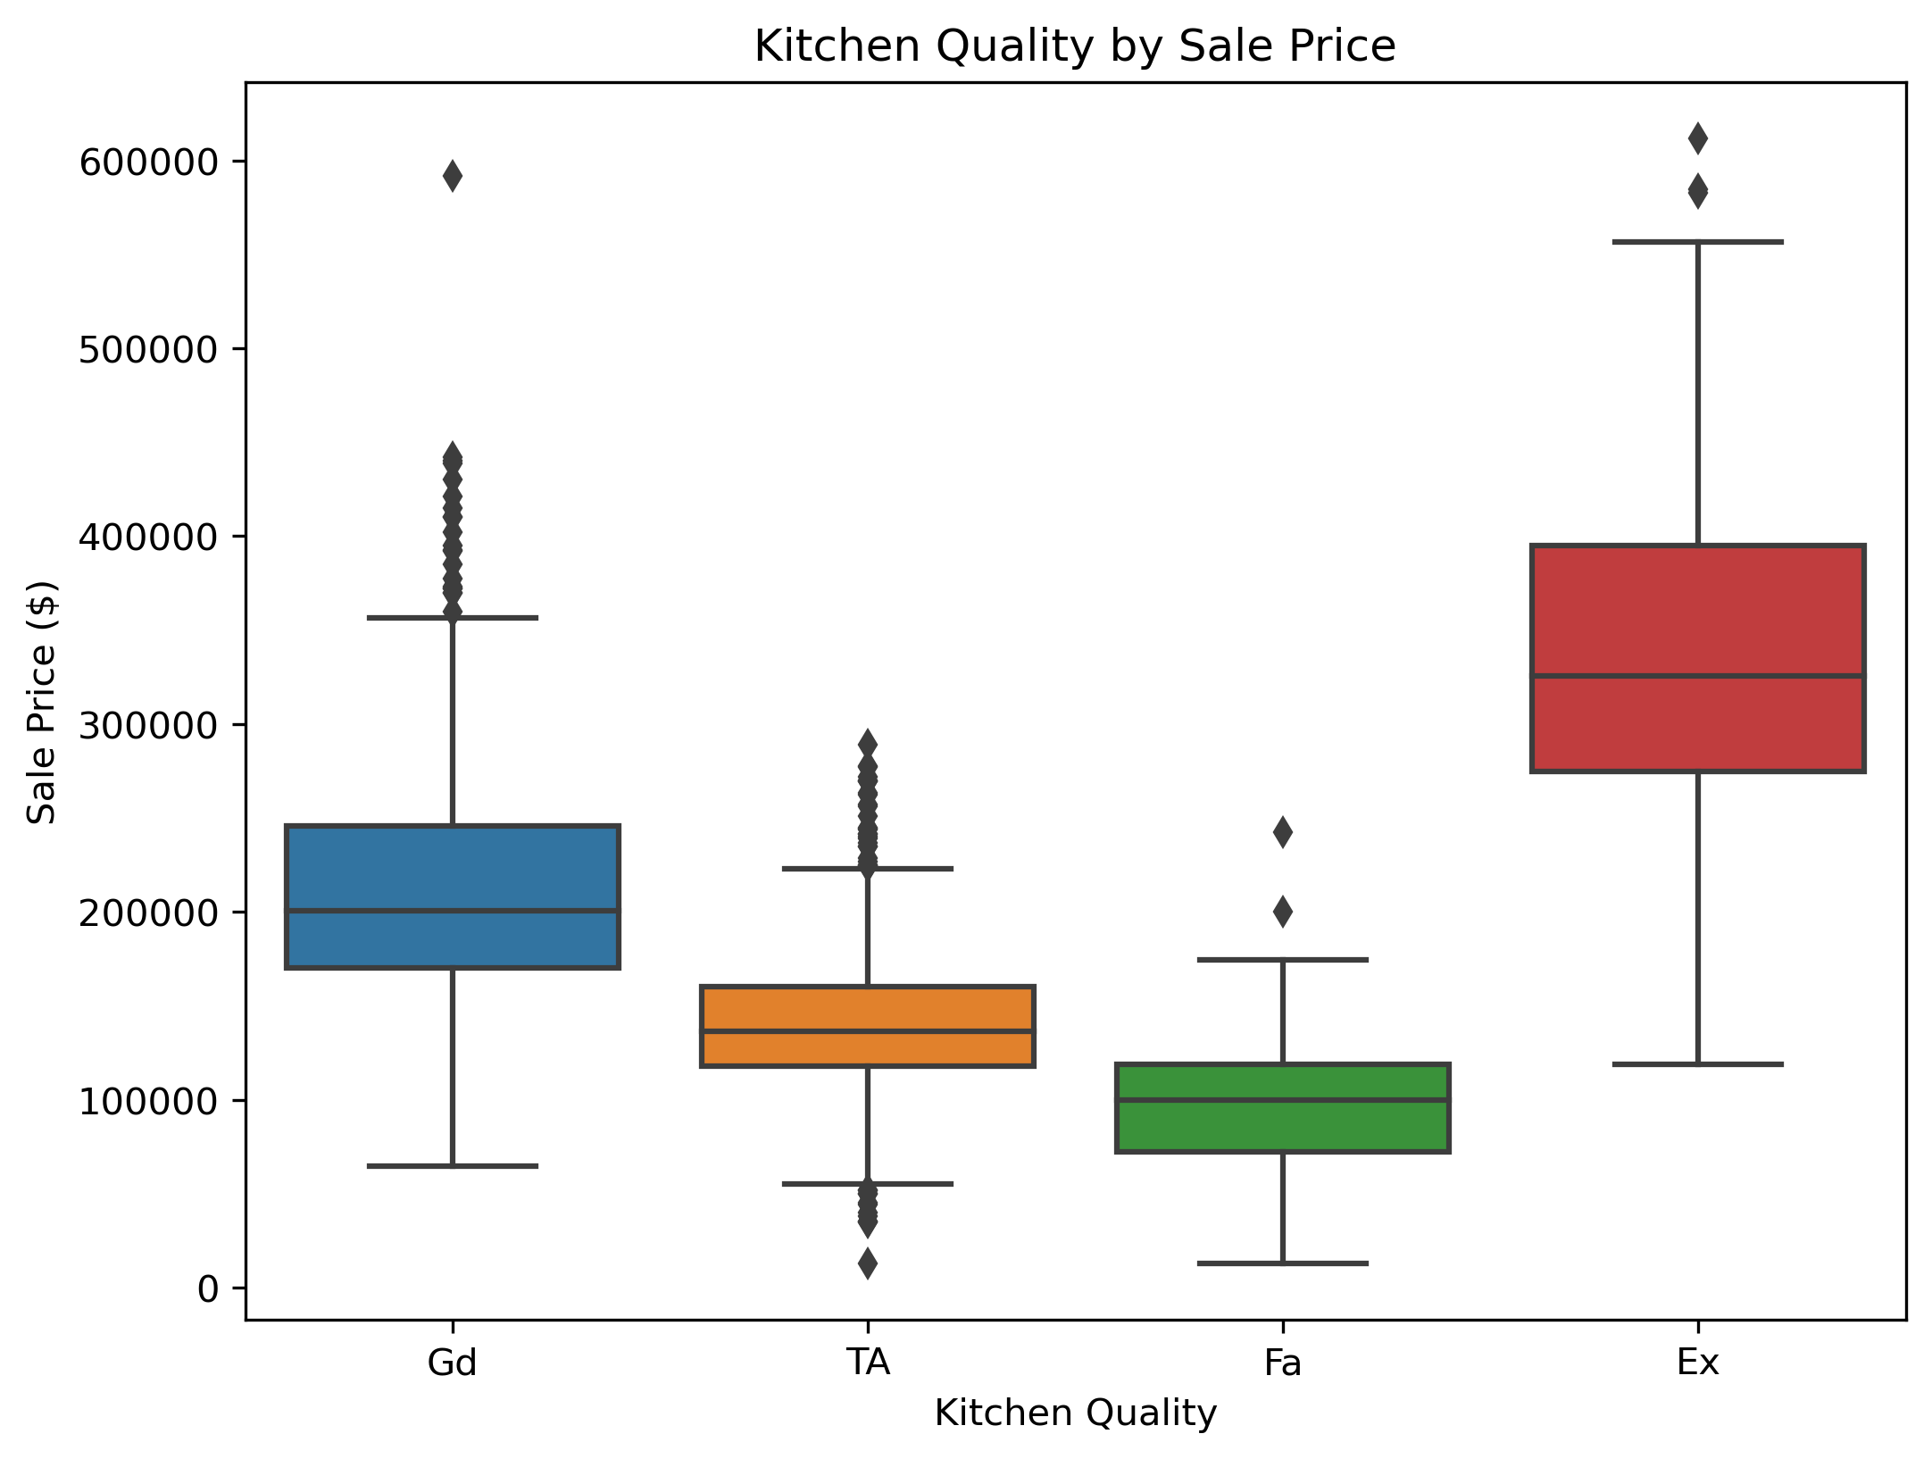
High-Quality Features: Kitchen
Insight 6
Holding all other variables constant, having an average, fair, or even good quality kitchen, rather than an excellent one, decreased predicted sale prices by 3-6%.
Consider upgrading your kitchen if it not already modern, as you can expect to see a return on investment of up to 80% after one year.¹
https://cabinetfloor.com/kitchen-remodeling-return-investment/

Slide 12
Summary of Recommendations and Key Takeaways
Recommendations
Our model gave us various insights on key features that will help home-buyers and homeowners find or improve a property that will create financial opportunities for them in the future, or be a stable, long-term investment for them.
Recommendation | Focus On… | Action
 | Quality > Condition | Review Materials, Finishes, Design (especially for Garage and house exteriors)
 | Ample Square Footage & W/ Basement | Search sale price per square foot and maximize the size as much as possible
 | Newer or Remodeled Houses | Research to assure older houses were remodeled within the last 20 years
 | Positive Offsite Features | Compare lots and give preference to safe accessibility to nearby features, avoid lots with adjacent arterial streets
 | Only High-Quality Fireplaces an Excellent Kitchens | Avoid houses with old or non-remodeled kitchens and amenities. Upgrade your kitchen before selling
1
2
3
4
5

Slide 13
Questions?

