Slide 1
Natural Language Processing and Classification
Using Subreddit Communities to Optimize Engagement with Consumers
Farah Malik
Project 3
June 2023

Slide 2



Problem Statement
Background
Participation in winter sports has been rising over the last decade, with a 26% increase in the active number of snowboarders and skiers.¹ It is only projected to increase, with high consumer values on outdoor activity, experiences, and health. For the first time, the interest in snowboarding has outpaced that of skiing.²
Client and Issue
Objective
Methodology & Analysis
Burton Snowboards, Inc. is a leader in the winter sports space, but is facing increasing competition in a niche market and among evolving consumer interests and demands.
It is critical that Burton finds way to expand its customer based and establish consumer loyalty.
The objective of this project is to develop a classification model that predicts the source of a Reddit post based on its text.
With this, we will identify opportunities for Burton that will enhance its market share, generate financial opportunities, and optimize products and marketing.
Acquire data via Python Reddit API Wrapper (PRAW)
Conduct exploratory data analysis, cleaning, data transformation via Vectorizing
Build and test various classification models
Evaluate with accuracy report
Pull Data
via PRAW
Cleaning
and EDA
Model Tuning & Testing
https://kenver.com/blogs/news/state-snow-sports/
https://www.factmr.com/report/229/snowboard-equipment-market

Slide 3

Pre-Processing and Transformation
Methodology and analysis
Baseline Model
RegexpTokenizer
My first board. Ready for the upcoming season!!
Tokenize
my
first
board
ready
Skiers: 51.2%
Snowboarders: 48.8%
for
the
upcoming
season
Text Transformation – CountVectorizer and TfidfVectorizer
Board Brand
Burton
Burton
Avalanche
K2
Avalanche
Burton | Avalanche | K2
1 | 0 | 0
1 | 0 | 0
0 | 1 | 0
1 | 0 | 1
0 | 1 | 0

Slide 4
Modeling, Tuning, and Testing
Methodology and analysis
Logistic Regression
Rationale: Binary classification, large amount of data for sufficient performance, interpretability
Hyperparameters Tested: C, penalty
Precision Outcome: 91.33%
Multinomial Naïve Bayes
Rationale: Many discrete features (e.g., word counts for text classification), performance with textual data, computational efficiency and scalability
Hyperparameters Tested: Alpha
Precision Outcome: 87.94%
Support Vector Machine
Rationale: High performance for text classification task, ability to handle non-linear relationships, versatility in kernel choices
Hyperparameters Tested: C, kernel, degree
Precision Outcome: 91.95%

Slide 5
Modeling, Tuning, and Testing (Cont’d)
Methodology and analysis
Random Forest
Rationale: Reduce overfitting, performance with textual data, capture of feature importances to aid interpretability
Hyperparameters Tested: N_estimators, max_depth
Precision Outcome: Accuracy not high enough, did not continue to calculating precision
Extra Trees
Rationale: Reduce overfitting, extra randomness to further reduce variance, performance with textual data, capture of feature importances, computational efficiency
Hyperparameters Tested: N_estimators, max_depth
Precision Outcome: Accuracy not high enough, did not continue to calculating precision
Ensembling
Rationale: Wisdom of the Crowds, improving accuracy by reducing individual model bias, increase robustness by removing outliers and noise,
Hyperparameters Tested: All that were tested during individual model runs
Precision Outcome: Accuracy not high enough, did not continue to calculating precision

Slide 6
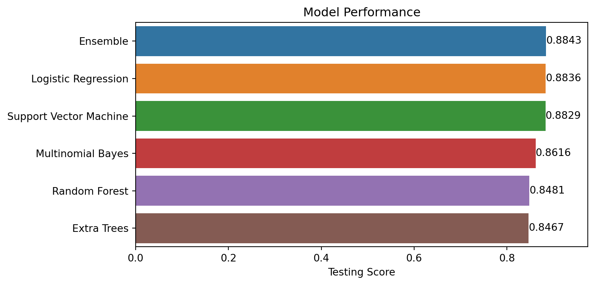
Modeling Accuracy and Final Model Selection
Methodology and analysis
Each model outperformed the baseline significantly, but each model performed similarly in terms of accuracy.
Logistic Regression using TfidfVectorizer transformation was selected to be the final model. While the accuracy was similar to the SVM, we choose the logistic regression for its simplicity, interpretability, and computational efficiency.

Slide 7
Modeling Accuracy and Final Model Selection
Methodology and analysis
Each model outperformed the baseline significantly, but each model performed similarly in terms of accuracy.
Final Model
Logistic Regression using TfidfVectorizer transformation was selected to be the final model. While the accuracy was similar to the SVM, we choose the logistic regression for its simplicity, interpretability, and computational efficiency.

Slide 8
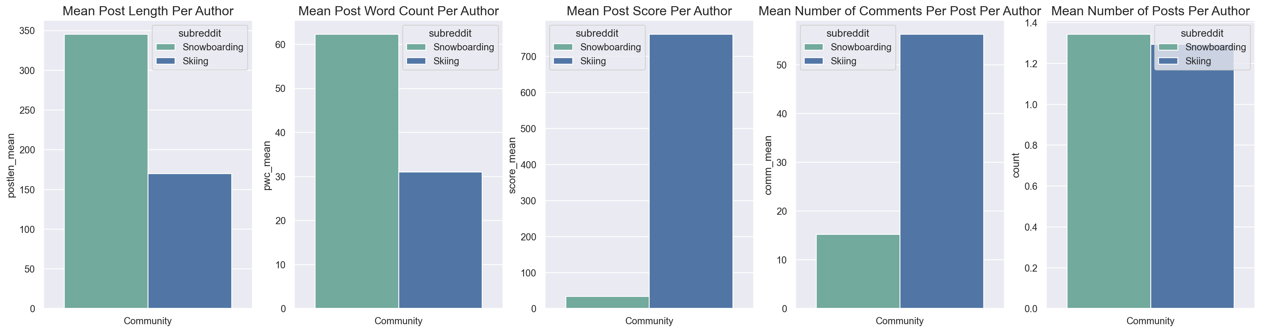
Determining How to Use Our Model: Leverage EDA
INSIGHT 1
To understand how our model can be leveraged to help Burton Snowboards, we must leverage insights from our exploratory data analysis.
Both groups had a very similar number of average posts per author. Snowboarders engaged by posting longer messages on average and upvoting fewer messages, whereas skiers engaged by upvoting more messages and commenting more with each post.

Slide 9


Determining How to Use Our Model: Leverage EDA (Cont’d)
INSIGHT 2
Community Engagement
Snowboarders
Skiers
Top words among the snowboarding community had more to do with gear, performance, technique, or the experience in or during the activity.
Top words among the skiing community aligned more with the experience around the activity, such as the best place to go, the best time of year, the best passes to get.
boot
binding
Burton
trip
Palisade Tahoe/ Lake Tahoe
season
jump
edge
Jackson Hole, Park City, Winter Park
best resort
Epic pass / Season Pass / Ikon Pass
toe
gear
day
Vail resort
gear
heel
turn

Slide 10
Summary of Recommendations
Recommendations
Using the insights gained on the subreddit communities, we can now put our model to use in the most effective way possible.
Outreach to Snowboarding Members …
Implement digital transformation efforts to increase E-commerce and direct-to-consumer business by doing the following:
Recommendation | Area | Action
 | Marketing | Advertise promotional offers and exclusive discounts to the snowboard community for gear and accessories.
 | Partnerships | Partner with professionals and snowboard schools to package lessons and rentals/equipment if bought through Burton.
 | Content Creation | Create and deliver targeted content (video tutorials, blog articles, social media posts) on technical tips and tutorials.
1
2
3

Slide 11
Summary of Recommendations
Recommendations
Using the insights gained on the subreddit communities, we can now put our model to use in the most effective way possible.
Outreach to Skiing Members …
Expand the market share of skiers by advertising Burton’s high-performance apparel and appealing to the community’s interest in trip-planning.
Recommendation | Area | Action
 | Partnerships | Partner with ski resorts and travel agencies to create exclusive packages that include discounted apparel from Burton. Use these partnerships to expand Burton’s global reputation
 | Website Promotion | Promote skiing section of Burton's website by directing skiers to special/exclusive apparel and accessory offers
 | Travel / Destination Guides | Develop guides highlighting the best ski resorts or locations for winter activity. Showcase the utility and advantages of Burton products as essential gear.
1
2
3

Slide 12
Questions?

Slide 13
Appendix

Slide 14
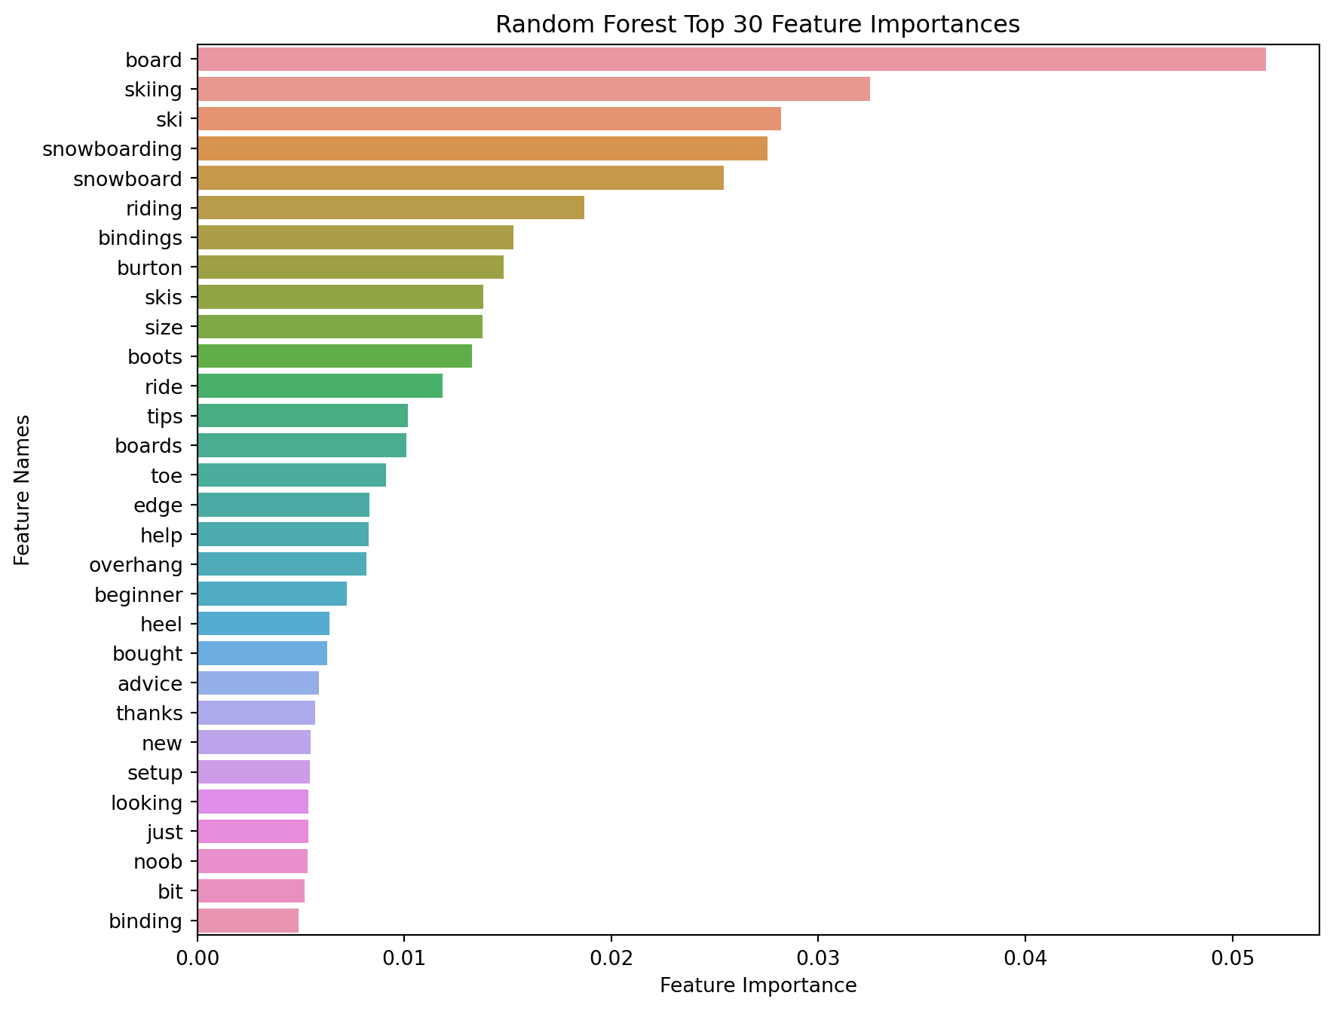
Appendix

Slide 15
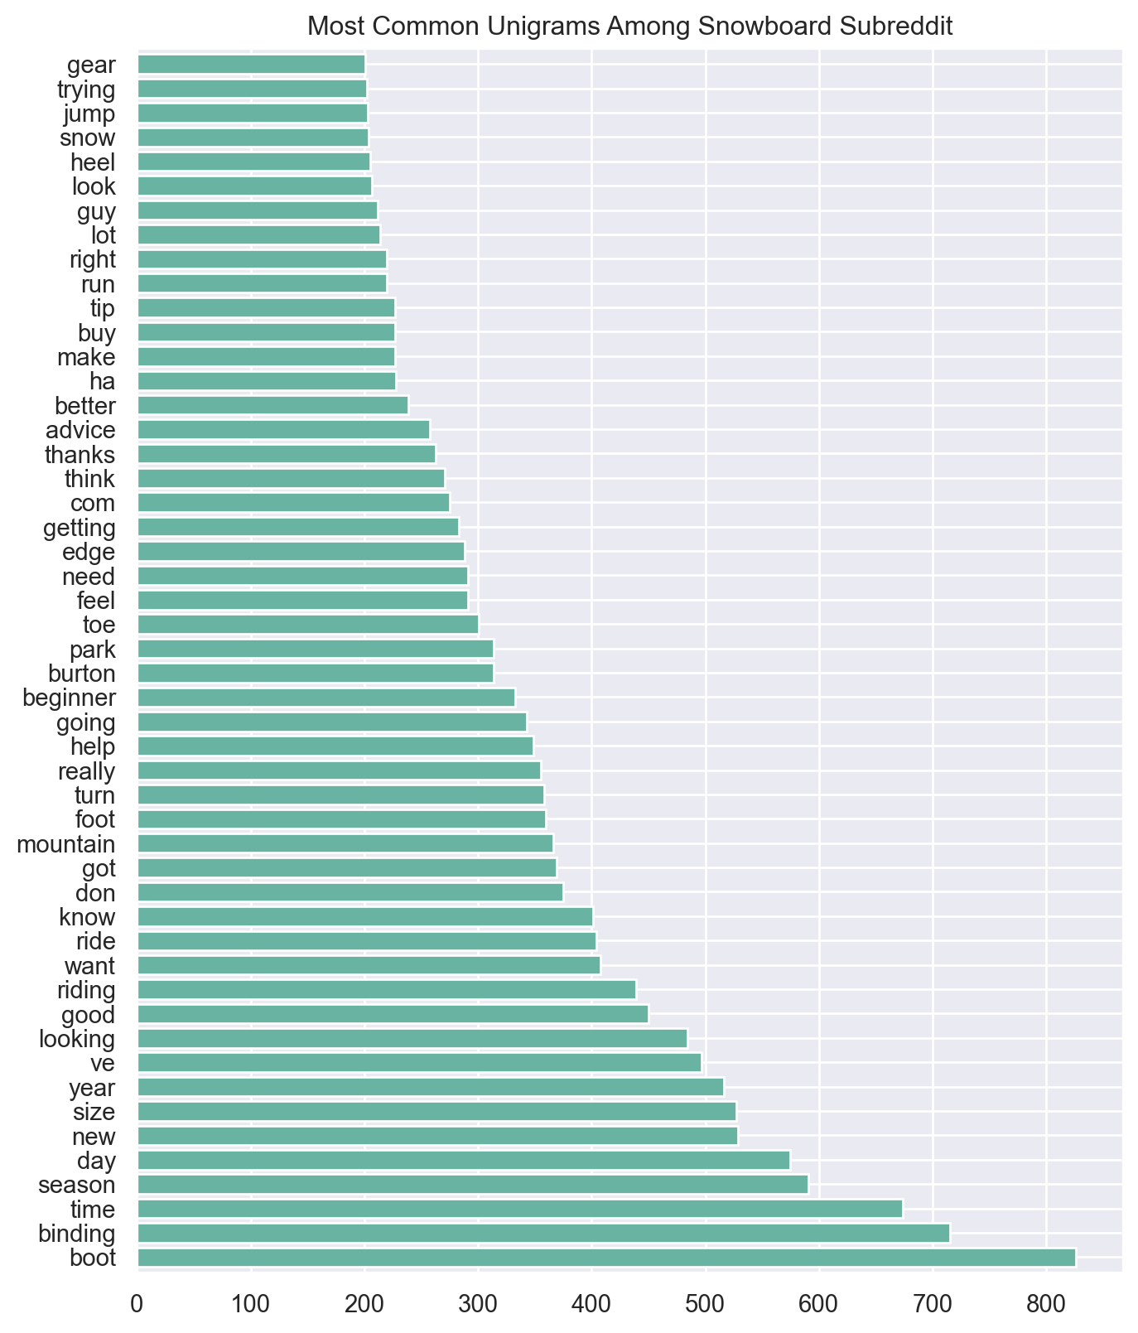
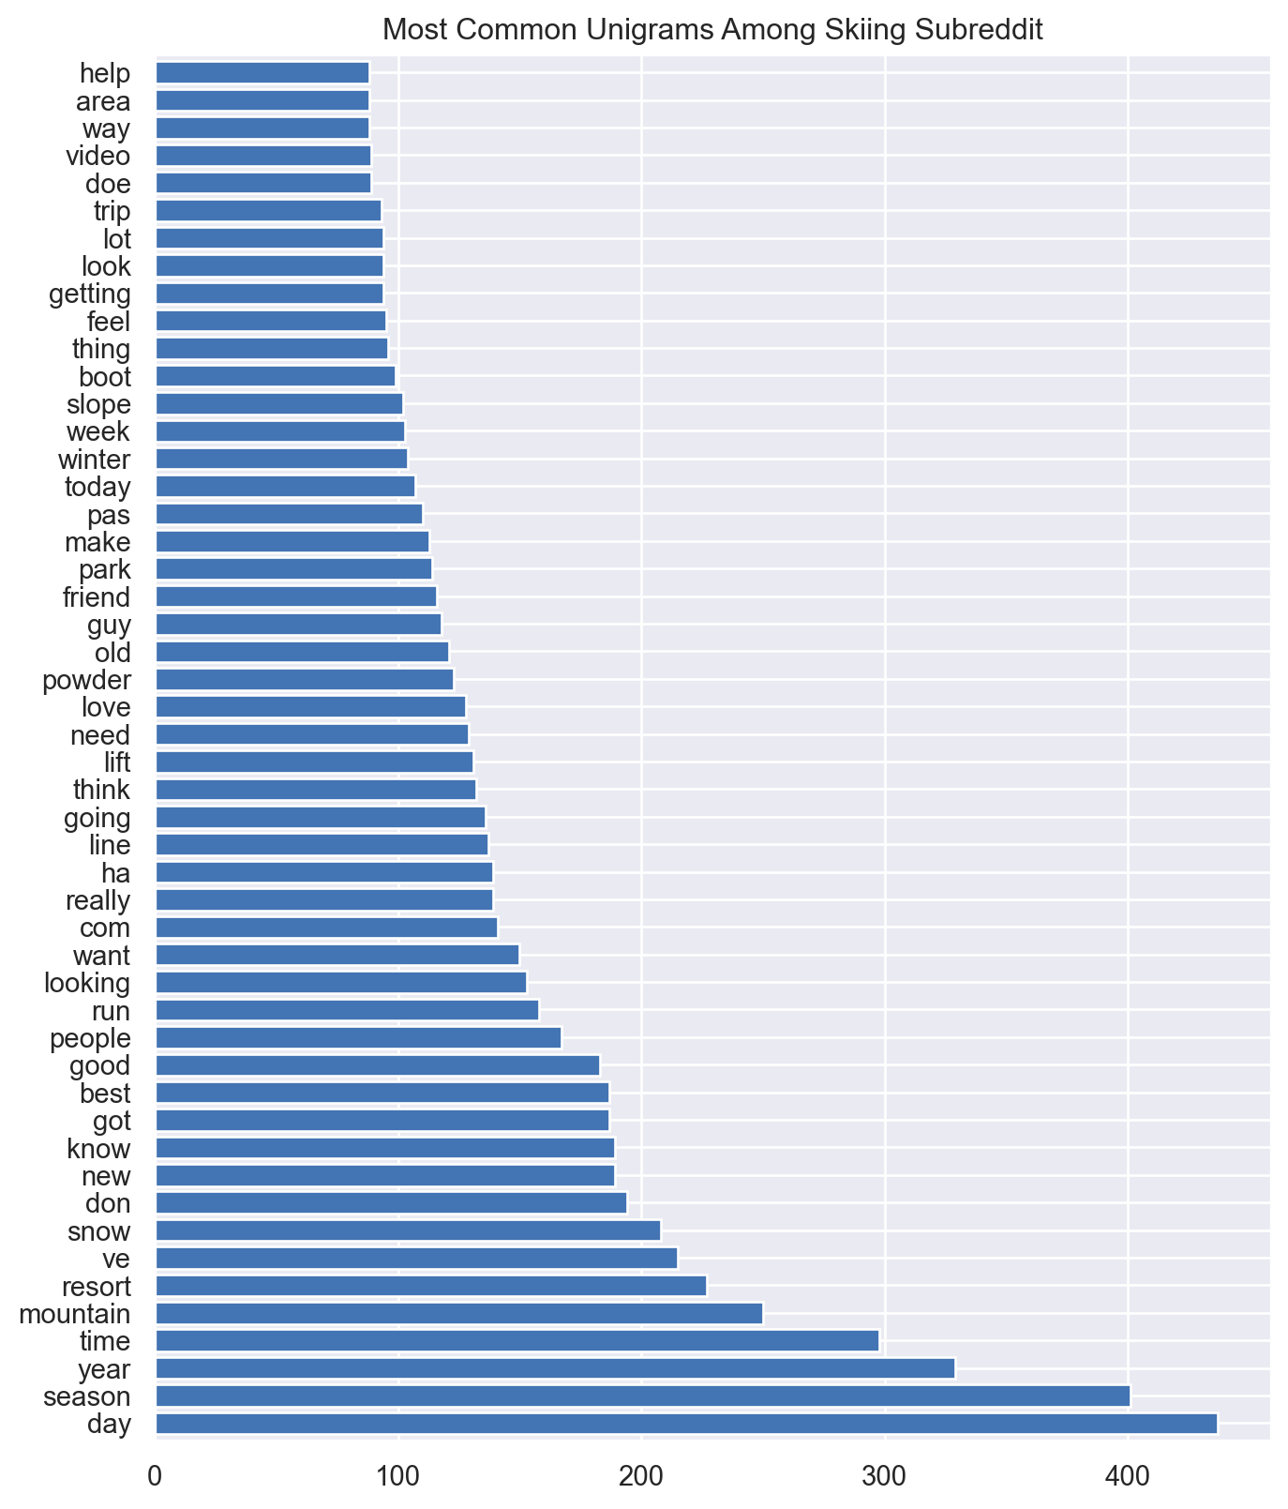

Slide 16
