Slide 1
Hot Dog or Not Hot Dog? DSI 508 HAckathon
Bob Adams, Farah Malik, Bryan Ortiz, Jennafer Schweyen, Andrew Seefeldt
July 5, 2023

Slide 2
Background
Objective
To develop a neural network model that can classify images as either "hotdogs" or “not hotdogs“ with high accuracy.
Purpose
By distinguishing between hotdogs and other objects, our model can aid in various applications such as food recommenders, dietary apps, and image-based search engines.

Slide 3
Analysis and Methodology
Step 1
Step 2
Step 3
Step 4
Data Ingestion
Data Preprocessing (Resize, Rescale)
CNN Building (layers, nodes, regularization..)
CNN Testing

Slide 4
Results
50%
74%
Baseline
CNN MOdel

Slide 5
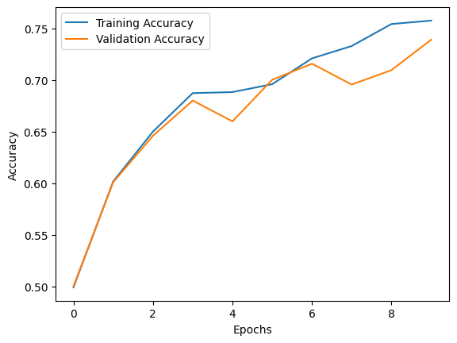
RESULTS – Our Model
74%
CNN Model
1 input layer,
3 Conv2D hidden layers
RELU activation
MaxPooling
10% - 50% Dropout
1 Flattened Dense output layer
Sigmoid activation
10 Epochs used for fitting
Neptune
It’s the fourth-largest planet in the Solar System

Slide 6
Recommendations
Continue model iteration, including data augmentation (Flip, Rotate, Scale are included)
01
02
Instantiate our model in a hosted streamlit app (Upload in progress!)
03
Leverage our model to help identify whether these pictures are, indeed, of hot dogs.

Slide 7
Questions?

