Slide 1

INTEL IMAGE CLASSIFICATION (CNN - KERAS)

Slide 2
TEAM
FARAH MOATAZ 2021170393
MAYA MOHAMED 2021170439
MAZEN MOSTAFA 2021170438
MAZEN RAAFAT 2021170436
MAYER SOLIMAN 2021170441
BISHOY SEDRA 2021170130

Slide 3
INTRODUCTION
With the increasing demand for automated image recognition in areas like urban planning and environmental monitoring,
this project aims to leverage deep learning techniques to analyze and classify diverse images accurately.

Slide 4
DATASET DESCRIPTION & PREPROCESSING
INTEL IMAGE CLASSIFICATION
The Intel Image Classification project tackles the challenge of categorizing outdoor scenes into six distinct classes: mountains, streets, glaciers, buildings, seas, and forests.
The Intel Image Classification dataset provides a well-curated collection of over 14,000 labeled images, enabling robust training and testing of models.

Slide 5
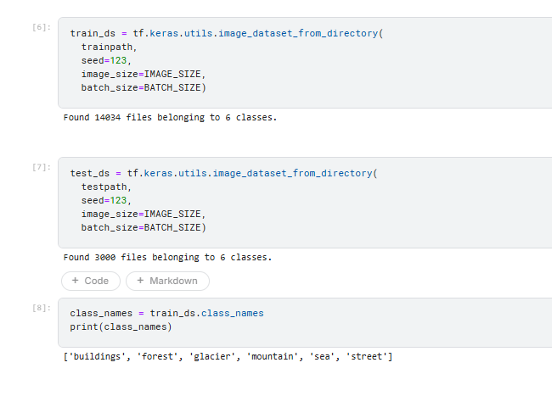
ABOUT THE DATASET

Slide 6
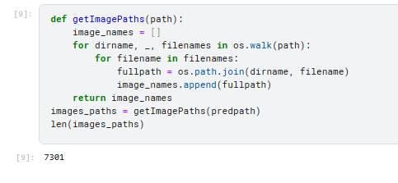
LOADING THE DATASET

Slide 7
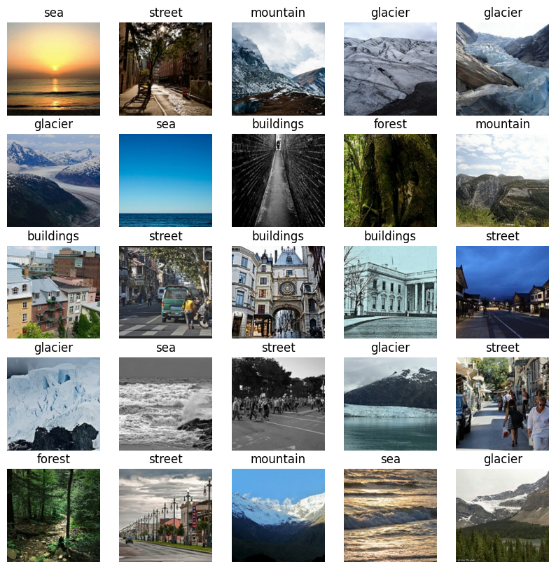

EXAMPLES FROM THE TRAIN DATA

Slide 8
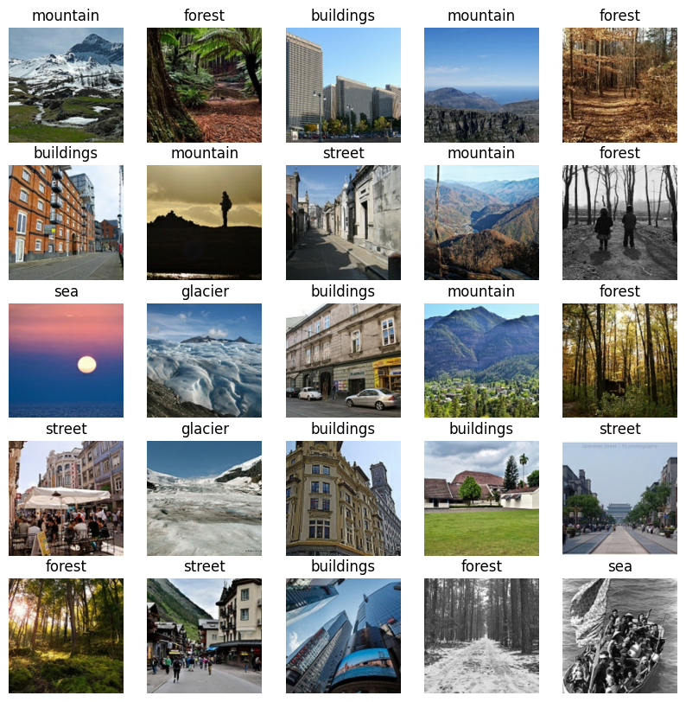
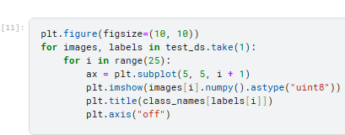
EXAMPLES FROM THE TEST DATA

Slide 9
MODEL CREATION
We can build an easy model composed of different layers such as:
Conv2D: (32 filters of size 3 by 3) The features will be "extracted" from the image.
MaxPooling2D: The images get half sized.
Flatten: Transforms the format of the images from a 2d-array to a 1d-array .
Relu : given a value x, returns max(x, 0).
Softmax: 6 neurons, probability that the image belongs to one of the classes.

Slide 10
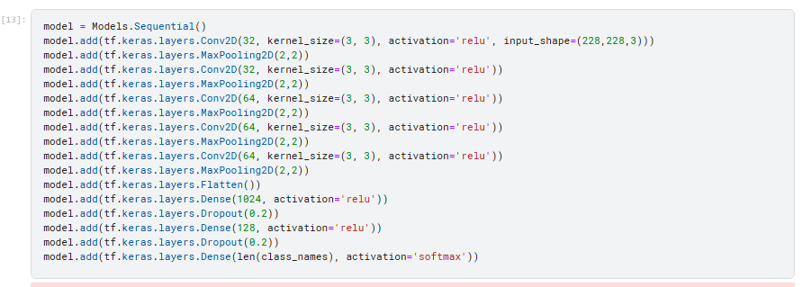
MODEL CREATION

Slide 11
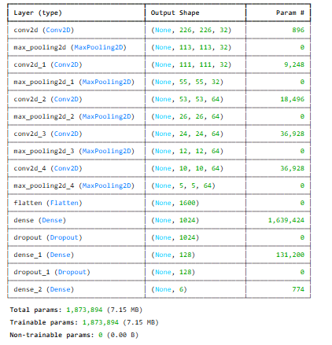
MODEL SUMMARY

Slide 12
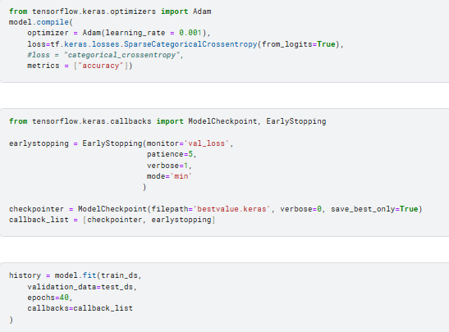
MODEL COMPILE AND EARLY STOPPING

Slide 13
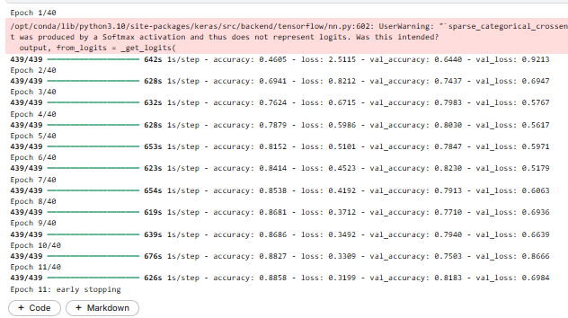
EPOCHS

Slide 14
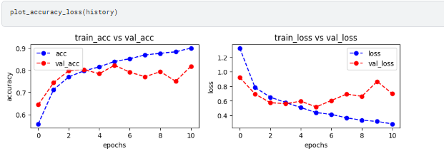
EVALUATE THE MODEL

Slide 15
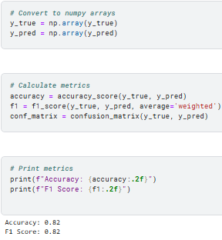
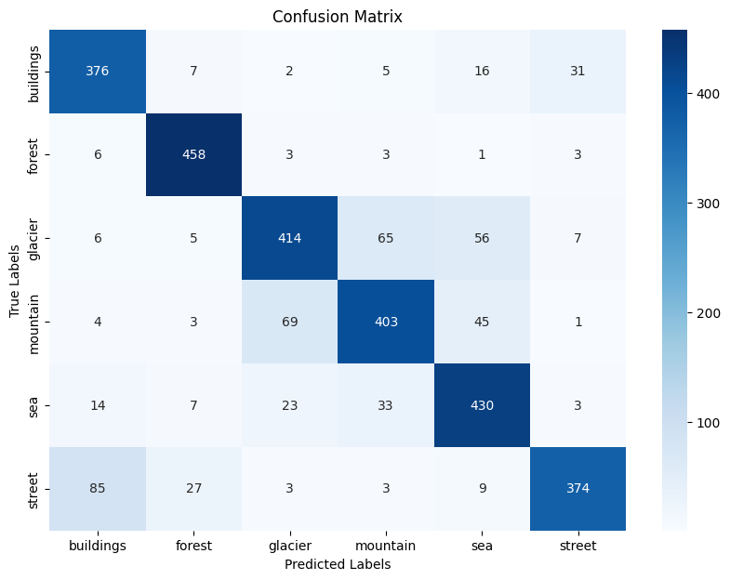
EVALUATE THE MODEL

Slide 16
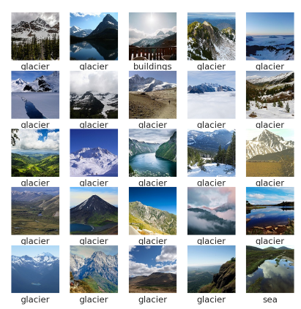
WHY ONLY 82% ACCURACY
SOME OF THE IMAGES MISSCLASSIFIED

Slide 17
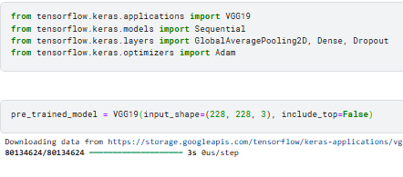
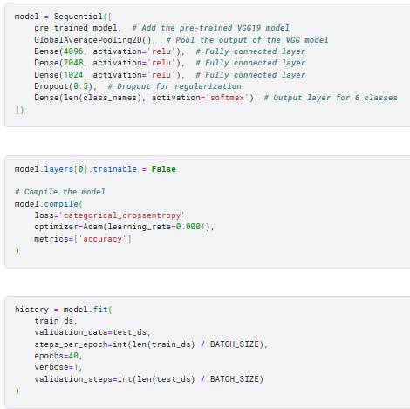
PRE-TRAINED MODEL

Slide 18
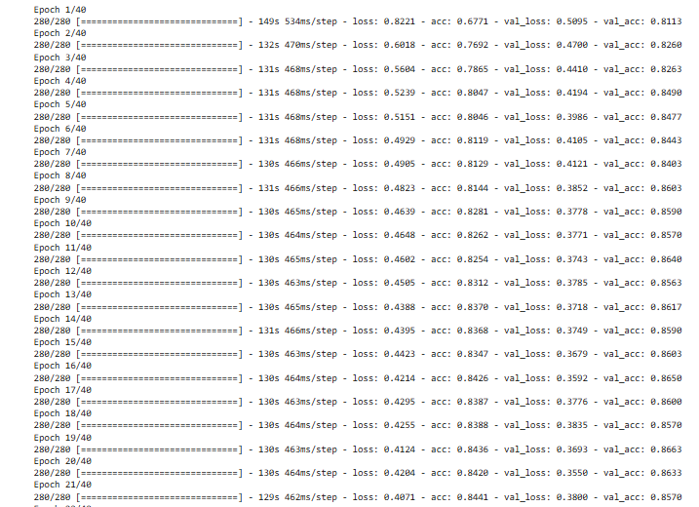
EPOCHS

Slide 19
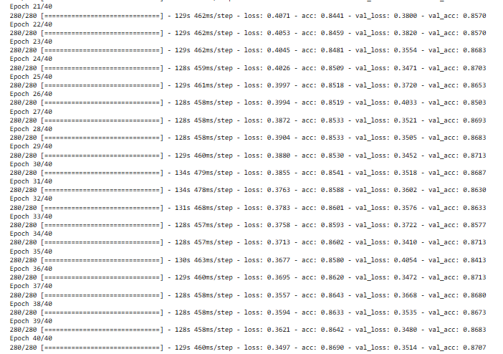
EPOCHS

Slide 20

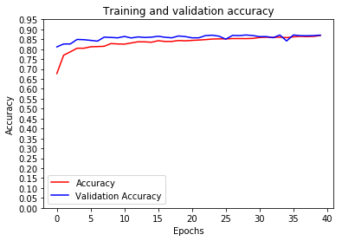
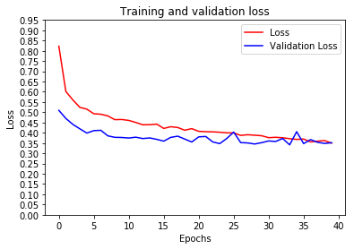
ACCURACY : 86%
EVALUATION

Slide 21
THANK YOU

