Slide 1
Opening a Café in Toronto
Farah Alshaar
Nov 11, 2019

Slide 2
Introduction
In the following presentation we will discuss the opportunities available to open a café in Toronto area.
Cafés have always been number one choice to entrepreneurs who would like to enter the business work; since
coffee being a popular seller always.
Location required usually smaller than restaurants
Café tend to expand and become chain, example: Tim Horton’s.

Slide 3
Target Audience
New entrepreneurs
Local business owners
Already existing café owners who are looking to expand
Government looking to improve area to provide more services to resident

Slide 4
Data
The data will be used in order to obtain such information will be
From Wikipedia
Toronto Postal Code List
Population, size and other demographical information for the city
Geographical coordinates of Toronto neighborhood
Using the data above we are trying to see how many café in relation to the above information.

Slide 5
Data Cleaning
The data will go under cleaning and merging to obtain the required information using the following:
Python
K-means clustering
Foursquare API
Data Frame [Panda]

Slide 6
Data Cleaning
The files pulled from the various sources had to go under couple of changes for example:
unassigned borough were excluded
Combines multiple neighborhoods that fall under one postal code into one entry
Unassigned neighborhoods to be assigned borough value
We have combined data from postal code and geographical information of the neighborhood to be able to locate them on the map
*Please refer to the Jupiter file to see the data and the new data frames created (Week 1-3)

Slide 7
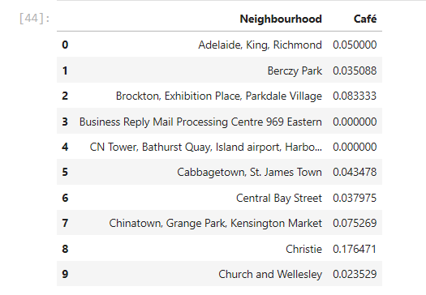
Data Analysis
Using the data obtained the following table displays Cafés in various locations around Toronto area

Slide 8
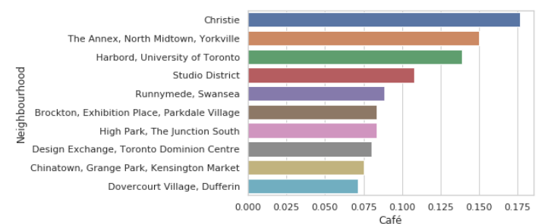
Data Analysis
The following table show the different area where least cafés are open
Dufferin No café
Christie (Financial district in Toronto) has most cafes

Slide 9
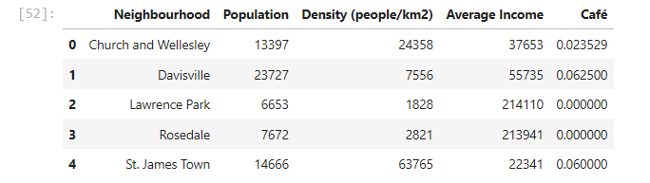
Data Analysis
The following data shows different neighborhoods in Toronto with their income, population, and density information in relative to cafés
We noticed Lawrence Park and Rosedale has not cafés list which their population is relatively high

Slide 10
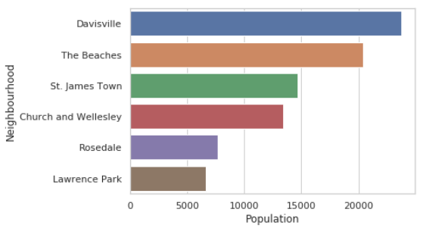
Data Analysis
The following table shows different neighborhood and population information to help us in our analysis.

Slide 11
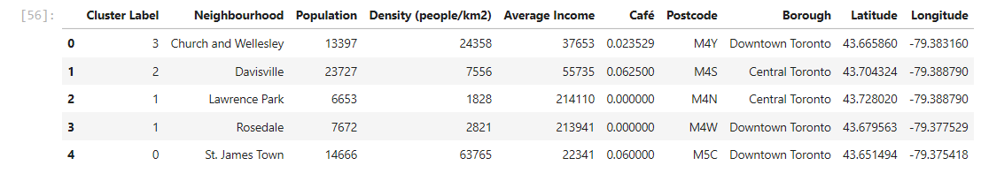
Data Modeling
Using K-Cluster technique it help us identify neighborhoods in relative to their population, density and location details in relationship to café presents

Slide 12
Conclusion
From the above we conclude that:
Cluster 4 [The beaches] has most population and no café currently open has it would be the optimal location for new business to open there. Knowing that the ‘The Beaches’ is very popular area between young crowd where they gather, and many concerts and events usually are held in the summer
Cluster 2 [Lawrence Park and Rosedale] would be the second optimal locations to open a café due to their population and income information and now café currently are there.

