Slide 1
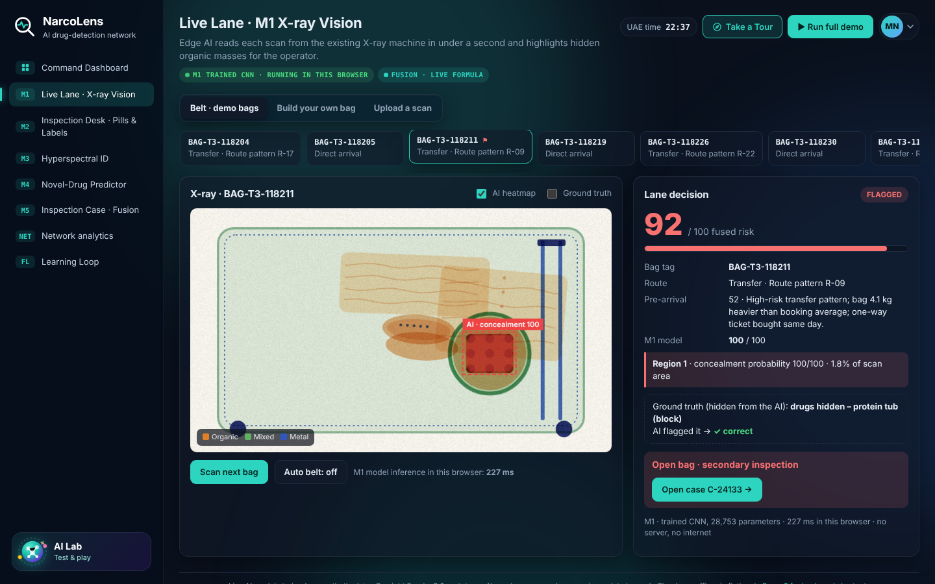
NarcoLens
PRESIGHT EUREKA 3.0 · DEFENSE & POLICING
AI-Assisted Substance Screening for Police and Airport Customs
Existing scanners
Officer decides
Evidence-ready
Prototype: M1 flags a block hidden inside a protein tub (simulated scan)
Farah Shaik · Riazat Rasool
Technology readiness: TRL 3, a proof of concept built and measured on synthetic data
Notes:
NarcoLens is an AI-assisted substance screening and evidence workflow for police and airport customs.
It proposes one intelligence layer across the scanners and inspection desks that customs already operate. For every bag or parcel it opens a single case, and five modules add evidence to it: X-ray vision, tablet and label checks, hyperspectral identification, a predictor of emerging variants, and an explainable risk score. The officer makes the decision, and every action is recorded for laboratory referral.
The idea sits in the Defense and Policing theme. The prototype you can open runs on simulated data, and we place it at Technology Readiness Level 3: a proof of concept, with real-data validation as the next step.
The presenters are Farah Shaik and Riazat Rasool.

Slide 2
Every suspicious substance demands a fast, defensible decision
502
406 kg
2.3 million
seizures by Dubai Customs, January to May 2026
of controlled substances intercepted
narcotic tablets intercepted
The current situation
The remaining gap
The operational consequence
The UAE already deploys advanced inspection systems, AI-driven risk analysis and K9 units. These figures show the volume of findings that officers must assess.
After a flag, officers still rely on operator interpretation of X-ray images and on laboratory confirmation to identify the substance. Evidence is recorded across separate systems.
Decisions made under this uncertainty can delay legitimate travellers and parcels, or leave the basis for a seizure harder to defend.
Source: Dubai Customs figures via Emirates News Agency (WAM), June 2026; also reported by Gulf News and Khaleej Times.
Notes:
Every suspicious substance demands a fast, defensible decision.
The UAE already has strong foundations: advanced inspection systems, AI-driven risk analysis and K9 units. Dubai Customs reported 502 seizures, 406 kilograms of controlled substances and more than 2.3 million tablets between January and May 2026. We read those figures as the volume of findings that officers must assess, not as a sign that existing systems fail.
What remains is the moment after a flag. Officers still rely on operator interpretation of X-ray images and on laboratory confirmation to identify the substance, and the evidence sits across separate systems. Under that uncertainty, a decision can delay a legitimate traveller, or leave the basis for a seizure harder to defend.
Source: Dubai Customs figures through the Emirates News Agency, June 2026.

Slide 3




Four gaps remain after an item is flagged
Image interpretation
Substance identity
Concealments are found by operators reading dense X-ray images. In the public sources we reviewed, we found no published system that flags narcotics automatically in UAE customs scans.
Naming a substance depends on laboratory confirmation, so decisions at the inspection desk are made under uncertainty.
Emerging variants
Evidence records
New synthetic variants are designed to fall outside detection libraries, so recognition can trail the first seizure.
Findings, photos and decisions sit in separate systems, which makes the basis of a decision harder to reconstruct.
Why now: edge computers and hyperspectral cameras are increasingly available, scan data is already digital, and the UAE is investing in sovereign AI. What is missing is the software layer that connects them into one decision.
Notes:
Four gaps remain once an item is flagged.
First, image interpretation. Operators read dense X-ray images by eye. In the public sources we reviewed, we did not find a published system that flags narcotics automatically in UAE customs scans. That is not proof that none exists, and we make no claim about systems we cannot see.
Second, substance identity. Naming a substance depends on laboratory confirmation, so the decision at the desk is made under uncertainty.
Third, emerging variants. New synthetic variants are designed to fall outside detection libraries.
Fourth, evidence. Findings, photos and decisions are held in separate systems.
Why now: edge computers and hyperspectral cameras are increasingly available, scan data is already digital, and the UAE is investing in sovereign AI. What is missing is the software layer that joins them.

Slide 4




One intelligence layer across existing customs scanners
Delivered as software: an edge computer beside each scanner and a hyperspectral camera at the inspection desk
M1 · X-ray vision
M2 · Tablet and label checks
M3 · Hyperspectral ID
Flags concealed organic masses and shows where the model found them.
Verifies tablet imprints and aims to read Arabic and English labels against a registry.
Assesses the substance through its packaging and separates mixtures.
M4 · Variant predictor
M5 · Explainable risk fusion
Officer decision and evidence record
Aims to add emerging synthetic variants to the library before their first seizure.
Combines the evidence into one score that shows each module's contribution.
The officer decides. Every action is logged for laboratory referral.
Federated learning aims to let each site learn from laboratory-confirmed seizures without sharing raw images.
Notes:
NarcoLens adds one intelligence layer across the scanners customs already operate, from first scan to laboratory referral.
It is delivered as software on an edge computer beside each scanner, with a hyperspectral camera at the desk. For each bag or parcel it opens one case, and the modules add evidence to it.
M1 flags concealed organic masses on the X-ray image. M2 verifies tablet imprints and aims to read Arabic and English labels. M3 assesses the substance through its packaging. M4 aims to add emerging synthetic variants to the library before their first seizure. M5 combines everything into one score that shows each module's contribution.
The officer decides, and every action is logged for laboratory referral. Federated learning aims to let each site learn from confirmed seizures without sharing raw images.

Slide 5
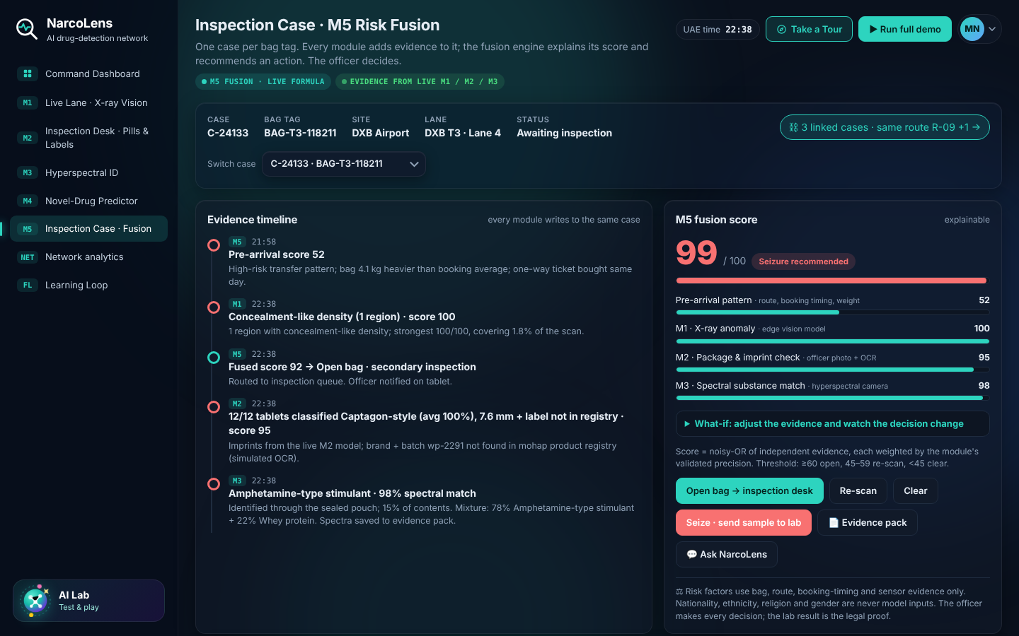
One bag, from first scan to laboratory referral
1
Before arrival
Route and booking patterns give a starting score. No nationality or ethnicity is used.
2
At the scanner
M1 flags a dense organic mass and highlights where.
3
Routing
M5 fuses the evidence and sends the bag to secondary inspection.
4
At the desk
M2 checks the label and tablet imprints from the officer's photo.
5
Hyperspectral scan
Prototype: one case collects evidence from every module (simulated data)
M3 assesses the substance through the sealed packaging.
Cargo and postal parcels follow the same flow. The air waybill or parcel barcode becomes the case identifier.
6
Decision and referral
The officer decides. The case is recorded for laboratory referral.
Notes:
Follow one bag.
Before it arrives, route and booking patterns give it a starting score. Nationality and ethnicity are never used.
On the belt, the X-ray scanner image goes to the edge box. M1 flags a dense organic mass and highlights where it found it. M5 fuses that with the starting score and routes the bag to secondary inspection.
At the desk, the officer photographs the contents. M2 checks the label and the tablet imprints. The sealed pouch goes under the hyperspectral camera, and M3 assesses the substance through the packaging.
The officer decides, and the whole path is recorded in one case for laboratory referral. Cargo and postal parcels follow the same flow, with the air waybill or barcode as the case identifier. This is a simulated demonstration.

Slide 6
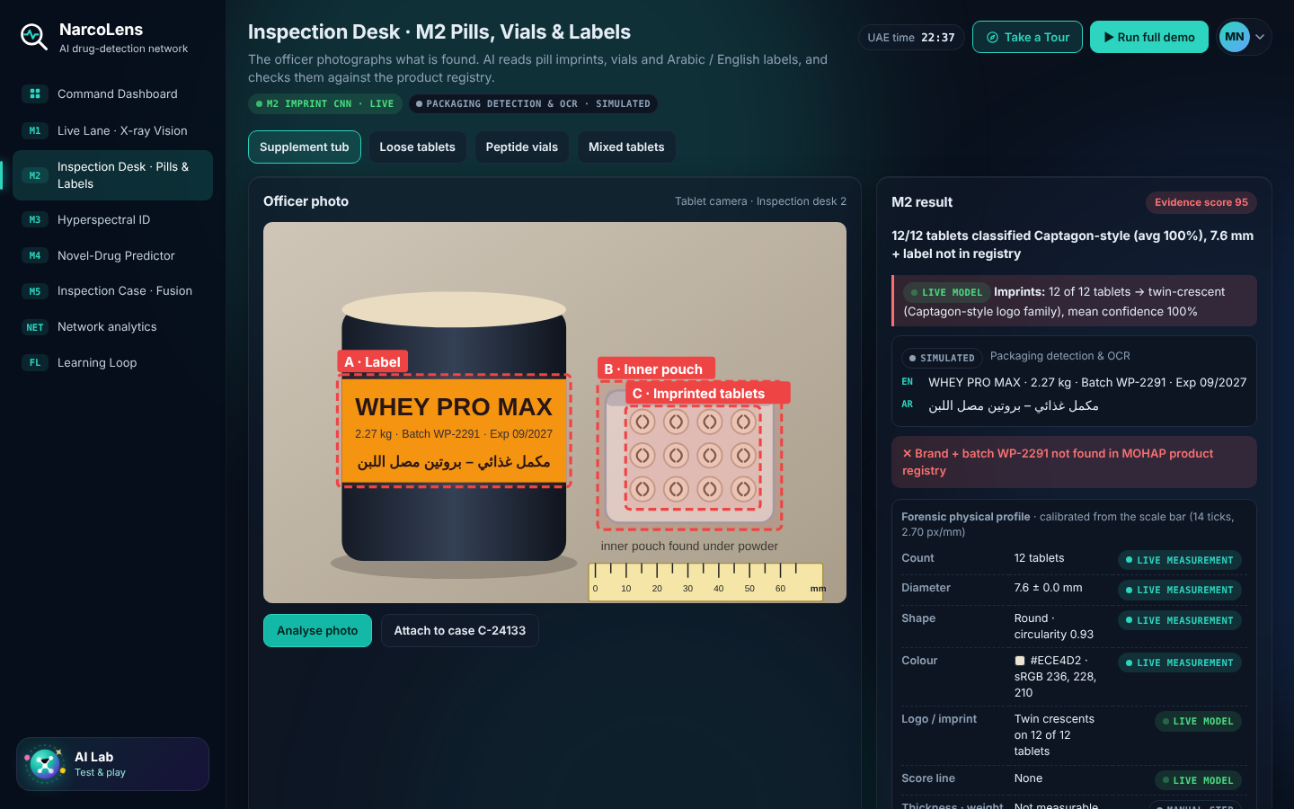
Seeing what is hidden: X-ray and tablet checks
M1 · X-ray vision
M2 · Tablet and label checks
A convolutional segmentation network (28.7k parameters) marks where concealed organic material sits. On held-out synthetic data it flagged 311 of 311 concealment bags, with 1.7% false alarms on clean bags.
A convolutional classifier (88.1k parameters) verifies imprints, and a physical profile is measured from the millimetre scale. It reached 99.8% accuracy on 1,200 synthetic images. Label reading is simulated.
Notes:
These two modules are real trained neural networks that run live in the browser prototype.
M1 is a convolutional segmentation network with about 28,700 parameters. It takes a dual-energy scan and marks where concealed organic material sits, which becomes the heatmap the operator sees. On held-out synthetic data it flagged all 311 concealment bags, with 1.7% false alarms on clean bags.
M2 is a convolutional classifier with about 88,100 parameters. It verifies tablet imprints, and the prototype also measures a physical profile against the millimetre scale. It reached 99.8% accuracy on 1,200 synthetic images. The label reading is simulated in the prototype.
All of this is synthetic data. The numbers show the method works. They are not estimates of field performance.

Slide 7
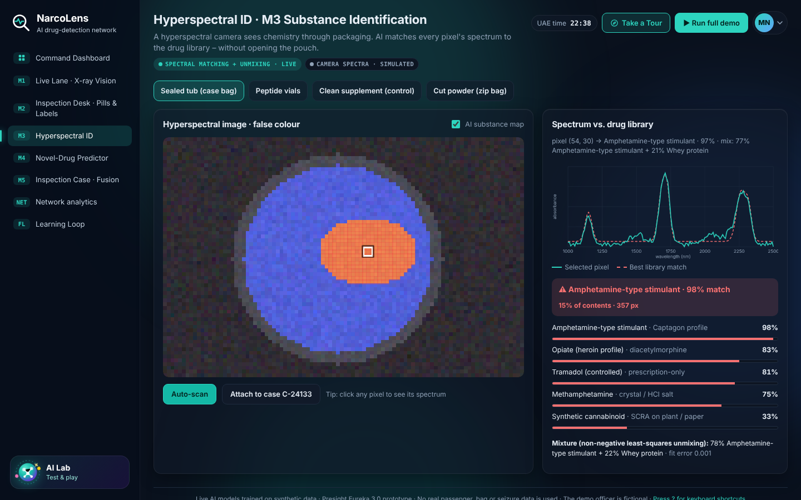
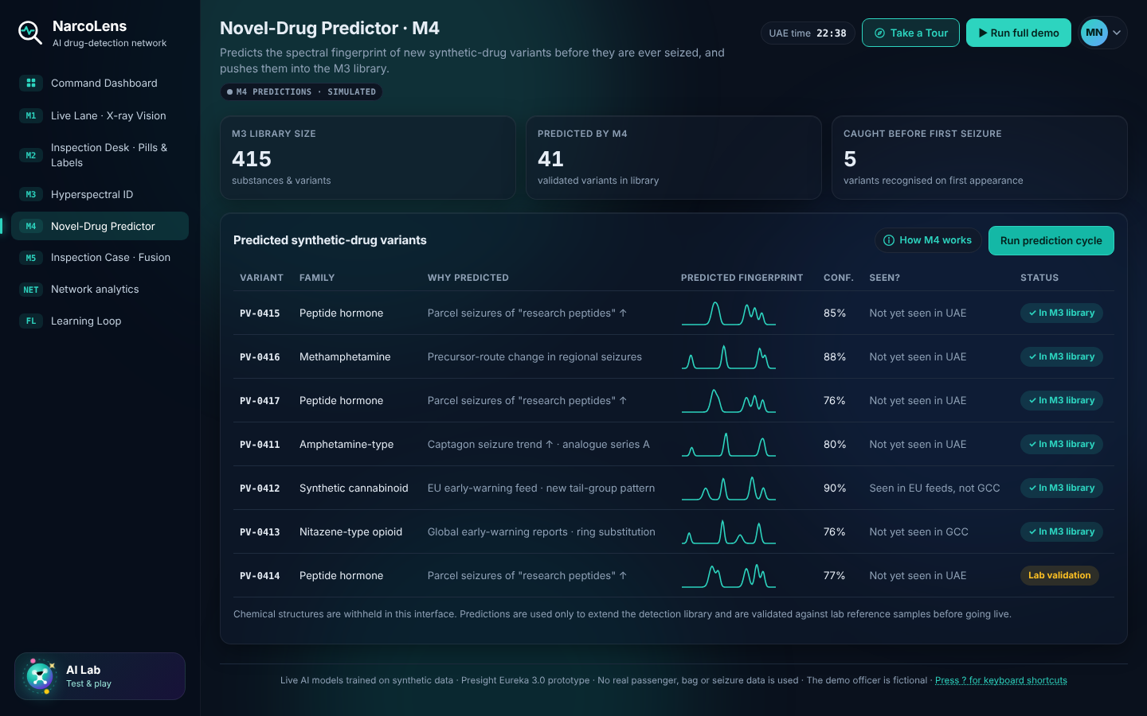
Seeing chemistry: identify, then anticipate
M3 · Hyperspectral identification
M4 · Variant predictor
Each pixel's infrared spectrum is matched to a drug library by correlation, and mixtures are separated by non-negative least squares. The prototype library uses synthetic profiles.
Proposes a graph neural network that predicts the spectral signature of emerging synthetic variants for review by forensic chemists. This cycle is simulated in the prototype.
Notes:
M3 and M4 address the chemistry.
M3 uses a hyperspectral camera to assess what a substance is without opening the package. Each pixel's infrared spectrum is matched to a library by correlation, and mixtures are separated by non-negative least squares, so a cut powder shows its components. These are algorithms, not trained networks, which makes each match easy to inspect. The prototype library uses synthetic spectral profiles.
M4 proposes a graph neural network that predicts the spectral signature of an emerging synthetic variant from the chemistry of its family. Forensic chemists would review each prediction before it is added to every M3 library, so that a variant can be recognised before its first seizure. In the prototype this cycle is simulated, and we claim no predictive accuracy.

Slide 8



Explainable by design, accountable by default
Explanation by default
A heatmap shows where the model looked, and the score shows each module's share.
The officer decides
NarcoLens flags, assesses and records. Seizures need supervisor approval.
Fair inputs
No nationality or ethnicity data is used.
Auditable record
Every action is logged in an evidence pack with a chain of custody.
Fusion model: S = 1 − ∏ (1 − wᵢ pᵢ), a weighted noisy-OR over the available evidence. The weights are design parameters and have not yet been calibrated on real outcomes.
Notes:
Officers and courts need to know why an item was flagged.
Every flag comes with a heatmap that shows where the model looked, and the fused score shows how much each module contributed. Nothing is a black box.
The officer decides. NarcoLens flags, assesses and records, and a seizure needs supervisor approval. No nationality or ethnicity data is used as an input.
Every action goes into an evidence pack with a chain of custody that can be printed for laboratory referral.
The fusion is a weighted noisy-OR over the available evidence. The weights in the prototype are design parameters, and we state plainly that they have not been calibrated on real outcomes. That calibration is part of the pilot.

Slide 9
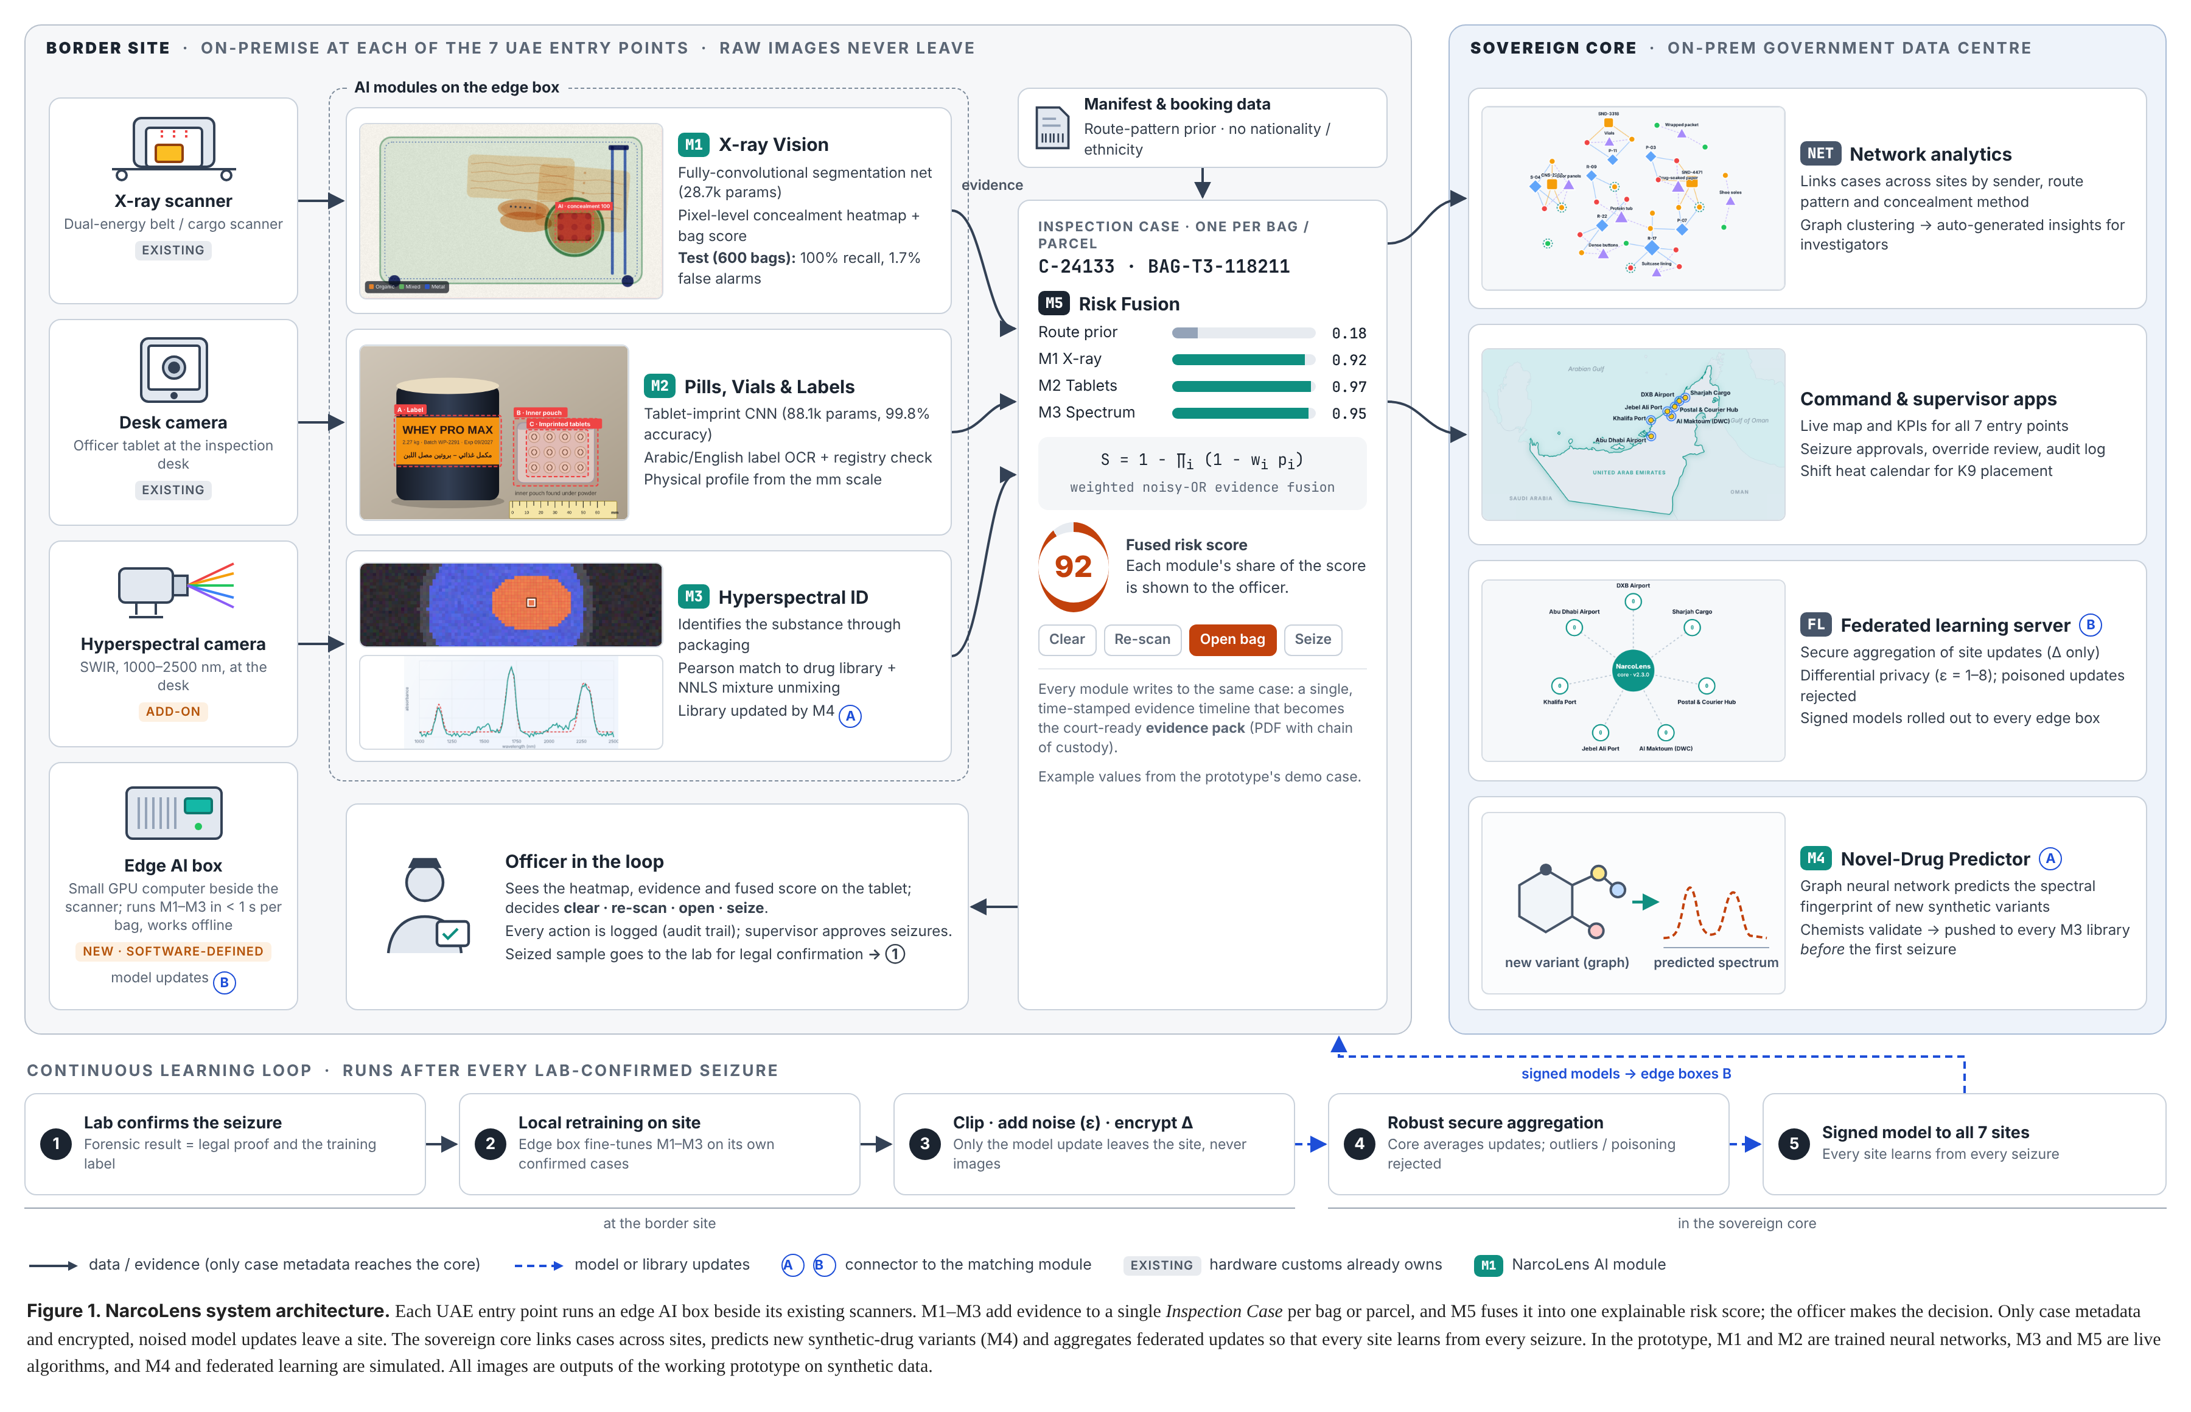



Architecture: border sites feed a sovereign core
At each site
An edge computer runs M1 to M3 beside the scanner. Raw images stay on site.
In the sovereign core
Network analytics, command and supervisor apps, federated aggregation and the variant predictor.
What leaves a site
Only case metadata and protected model updates.
Notes:
This is the proposed architecture.
On the left is the border site. The existing X-ray scanner, the desk camera and a hyperspectral camera feed an edge computer that runs M1 to M3. Raw images stay on site. The officer sees the heatmap, the evidence and the fused score on a tablet.
On the right is the sovereign core in a government data centre. It hosts network analytics that link cases across sites, the command and supervisor applications, the federated-learning server and the variant predictor.
Only case metadata and protected model updates leave a site. At the bottom is the learning loop that runs after every laboratory-confirmed seizure. All images in the figure are outputs of the working prototype on synthetic data.

Slide 10
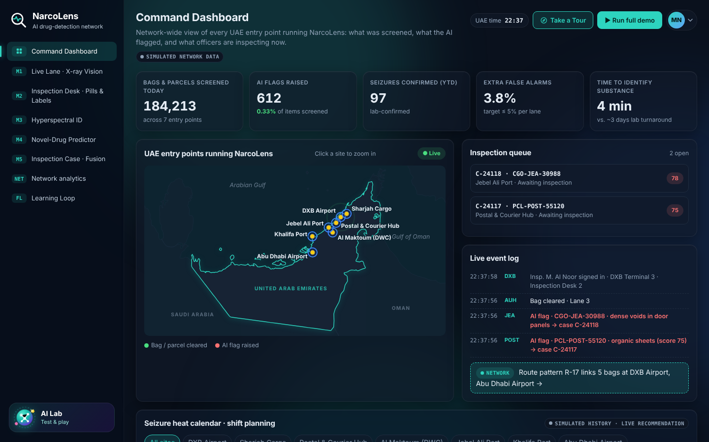
Working prototype: what is live and what is simulated
Part | Technology | Status
M1 X-ray vision | Segmentation network | Trained, live
M2 imprint check | Convolutional classifier | Trained, live
M2 label reading | Text recognition | Simulated
M3 hyperspectral | Spectral matching, unmixing | Live algorithm
M4 variant predictor | Graph neural network | Simulated
M5 risk fusion | Weighted noisy-OR | Live algorithm
Network analytics | Graph clustering | Live, simulated cases
Federated learning | Secure aggregation, privacy | Simulated
Command dashboard (simulated network data)
Runs offline in a browser. All data is synthetic or simulated, and the officer personas are fictional. Every screen states what is live and what is simulated.
Notes:
We want to be exact about what is real in the prototype.
The X-ray model and the tablet imprint classifier are trained neural networks that run live in the browser. The hyperspectral matching and the fusion are live algorithms. Network analytics run live on simulated cases.
The label reading, the variant predictor and federated learning are simulated, and the prototype says so on screen.
It runs offline from a zip file, with sign-in details in the instructions. All data is synthetic or simulated, and the officer personas are fictional. Judges can use Take a Tour for a guided walk-through.

Slide 11
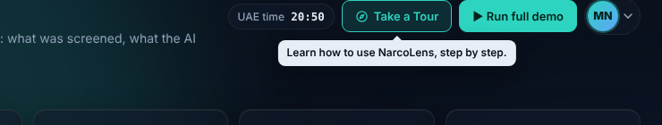
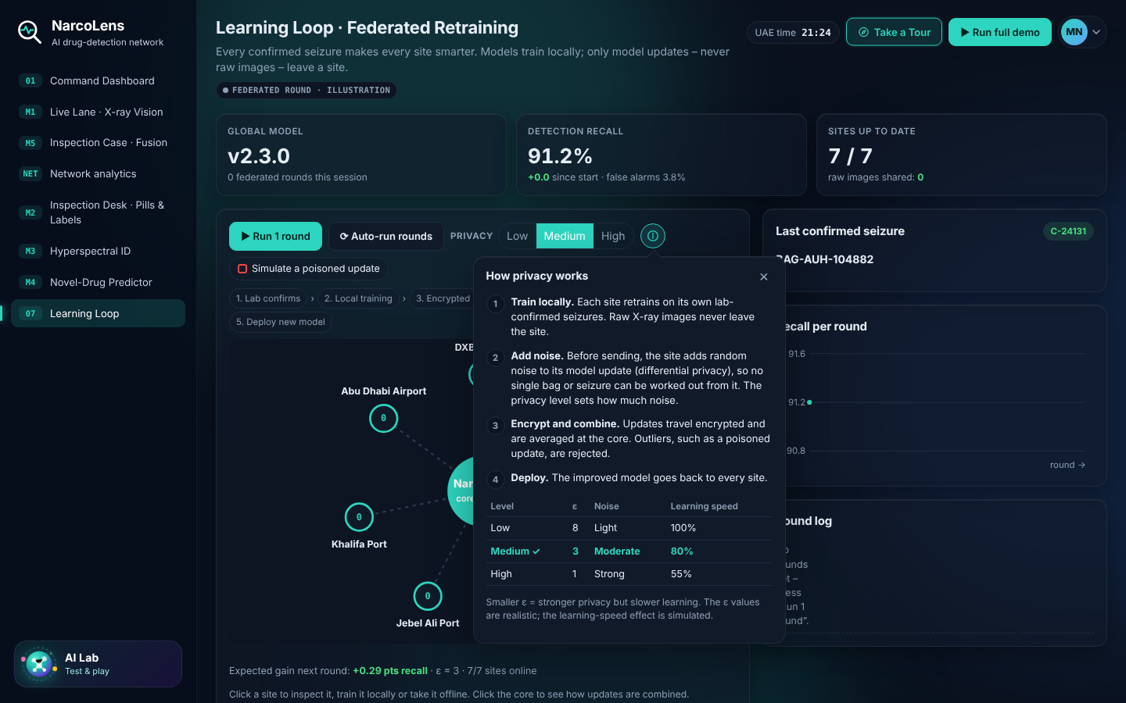
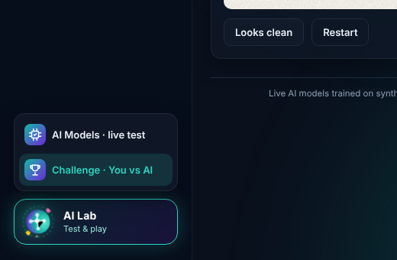
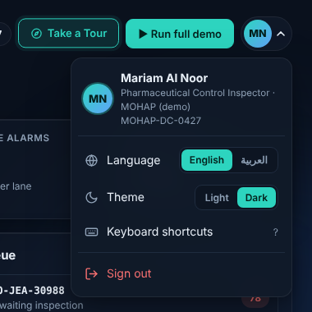
Try it in five minutes
Take a Tour: a five-step guided walk-through
Learning Loop: an interactive federated-learning simulator
Press Run full demo to follow one bag end to end
Build your own bag, hide drugs and scan it with the live model
Draw a tablet imprint and see the classifier respond
AI Lab: live model test and a challenge against the AI
User menu: language (English or Arabic) and theme
Notes:
The prototype is built to be tested, not just watched.
Take Tour at the top right gives a five-step guided walk-through. Run full demo plays one bag end to end in about a minute.
The AI Lab, at the bottom left of the menu, holds a live test of the two trained models and a challenge in which you click where you think drugs are hidden and compare yourself with the AI. In the Live Lane you can build your own bag, hide drugs anywhere and scan it. In the Inspection Desk you can draw a tablet imprint.
The user menu switches the whole interface to Arabic with right-to-left layout and toggles the theme. The Learning Loop is an interactive federated-learning simulator with a privacy slider and an explanation of what Low, Medium and High mean.

Slide 12
Measured on synthetic data; real-data validation planned
Model | Test set | Metric | Result
M1 X-ray | 600 held-out bags | Bag recall | 100% (311/311)
 |  | False alarms, clean bags | 1.7%
 |  | Pixel IoU | 0.916
M2 imprint | 1,200 tablet images | Four-class accuracy | 99.8%
Path to validation
TRL 3 today
Proof of concept on synthetic data
Shadow-mode trial
How to read these numbers
Runs beside current inspections on real scans without making decisions
Real concealment scans were not available, so the models learned from synthetic images with exact pixel-level labels.
The test sets are synthetic too. They show that the method works. They do not estimate accuracy on real scans.
TRL 4 and beyond
Recall at an agreed false-alarm rate, by scanner vendor; fusion weights calibrated on real outcomes
Notes:
These are the measured results, with their scope stated.
On 600 held-out synthetic bags, 311 of them carrying a concealment, the X-ray model flagged all 311, with 1.7% false alarms on clean bags and a pixel overlap of 0.92. On 1,200 held-out synthetic tablet images, the classifier reached 99.8% accuracy.
Real concealment scans were not available for this prototype, so we built the data ourselves, with exact pixel-level labels. That let us measure the method rigorously. It does not tell you how the models perform on real scans, and we do not claim it does.
That is why we place the work at Technology Readiness Level 3. The proposed next step is a shadow-mode trial in which NarcoLens runs beside current inspections on real scans without making any decision. Customs would hold the data. We would then measure recall at an agreed false-alarm rate, performance by scanner vendor, and calibrate the fusion weights on real outcomes.

Slide 13
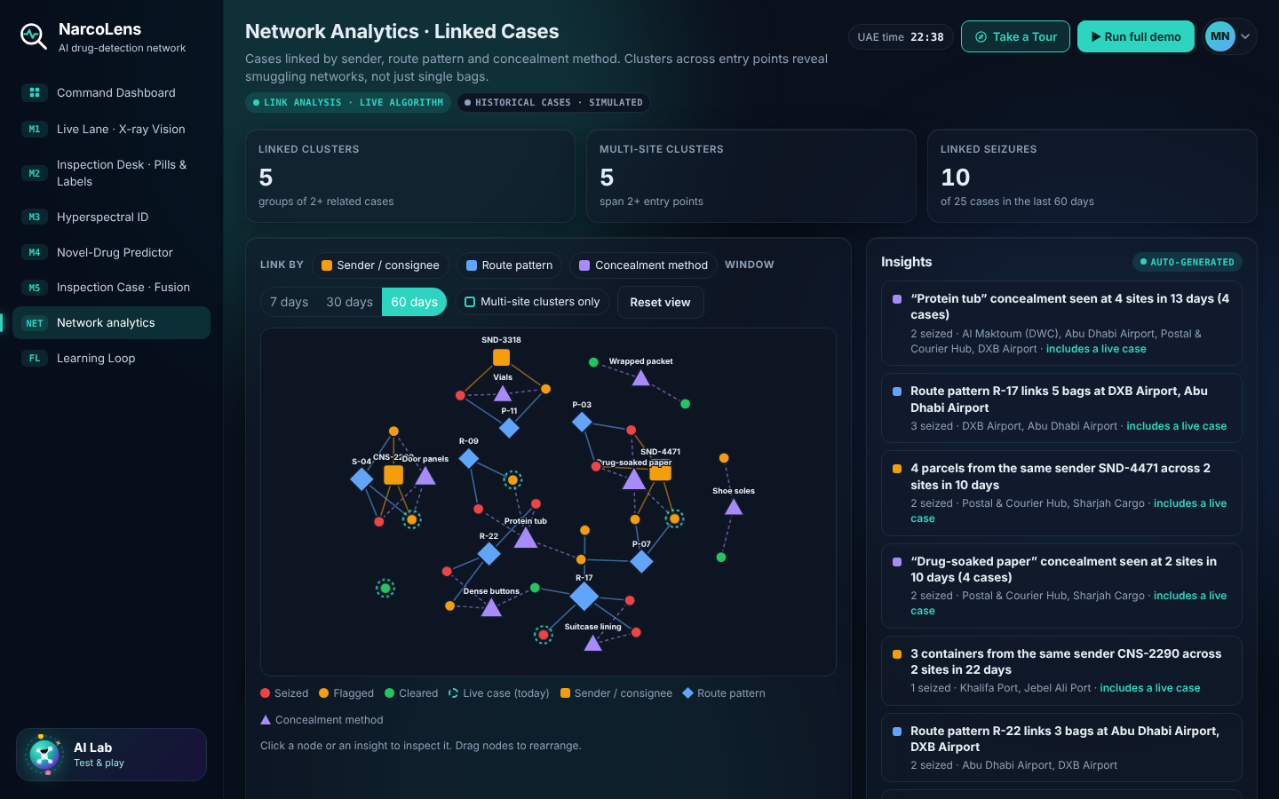
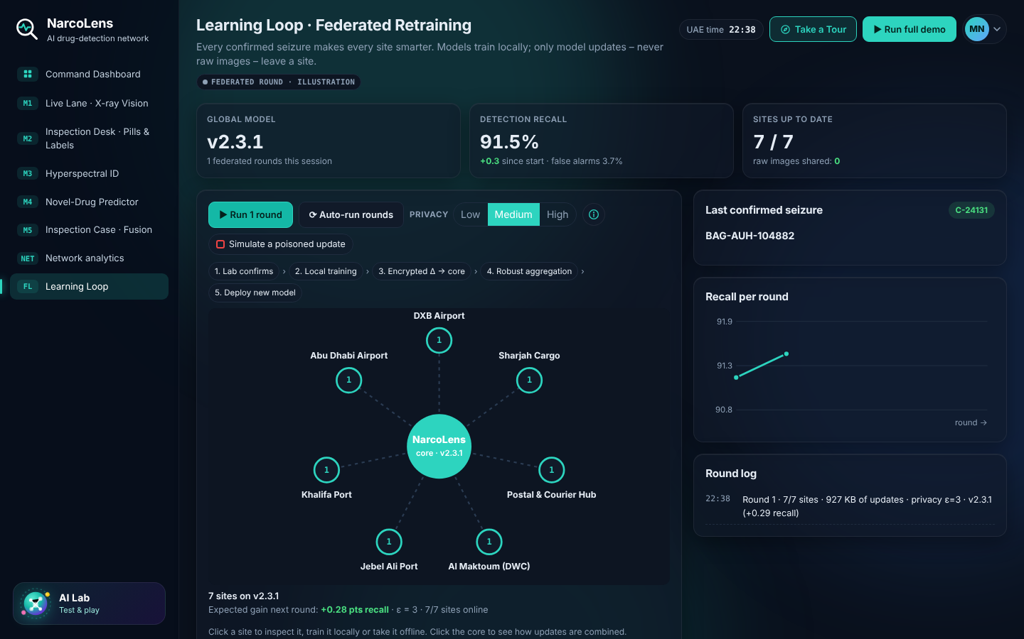
Linking cases and learning across sites
Network analytics
Federated learning
Cases are linked by shared sender, route pattern and concealment method. Clusters become insights for investigators, such as parcels from one sender across two sites.
Aims to let each site learn from laboratory-confirmed seizures. Only protected model updates leave a site, and a poisoned update can be rejected. A privacy slider trades learning speed for protection.
Notes:
Two capabilities turn separate sites into a network.
Network analytics links cases by shared sender, route pattern and concealment method. In the prototype, on simulated cases, it can show parcels from the same sender across two sites, so investigators see a pattern that no single site would notice.
Federated learning aims to let each site learn from laboratory-confirmed seizures. Each site retrains locally, adds noise to its update and encrypts it. The core aggregates updates and rejects outliers such as a poisoned update. Raw images never leave a site.
The privacy setting, Low, Medium or High, controls how much noise is added. More privacy means slower learning. The epsilon values are typical settings, and the learning-speed effect is a simulation parameter.

Slide 14



Intended impact, stated as hypotheses for the pilot
Fewer unnecessary searches
Faster assessment
Stronger records
Shared learning
Evidence-led flags could reduce manual searches of legitimate travellers and parcels.
Identifying a flagged item at the desk, before laboratory results, could shorten the time to a decision.
One case record could make the basis of each decision easier to review and refer.
Every confirmed seizure could improve detection at every site.
These are hypotheses to test in a shadow-mode pilot. They are not measured results. A proposed acceptance criterion is a false-alarm rate of no more than 5% per lane.
Who benefits
Value for Presight
Beyond narcotics
Customs inspectors and X-ray operators
Police anti-narcotics teams and supervisors
Laboratory analysts and investigators
Travellers, through fewer manual searches
A sovereign product for UAE border security
Network leads across entry points
A path to GCC customs agencies
Weapons and explosives
Counterfeit goods and wildlife trafficking
Undeclared currency and gold
Notes:
We state the impact as hypotheses, because claims about speed and impact should rest on measured results, and those come from the pilot.
We hypothesise fewer unnecessary searches of legitimate travellers and parcels, faster assessment of a flagged item at the desk, a stronger and more reviewable record for laboratory referral, and shared learning across sites. A proposed acceptance criterion for the pilot is a false-alarm rate of no more than five percent per lane.
The beneficiaries are customs inspectors and operators, police anti-narcotics teams and supervisors, laboratory analysts and investigators, and travellers who face fewer manual searches.
For Presight it is a sovereign product for UAE border security with a path to GCC customs agencies. The same platform, one case with many detectors, could extend to weapons, counterfeit goods and undeclared currency.

Slide 15
Roadmap: shadow-mode pilot to UAE-wide rollout
M0
M3
M6
M9
M12
M15
M18
Discovery and data agreement
Data MoU
M1 X-ray, shadow mode
One lane
M2 inspection desk app
Months 5–7
M3 hyperspectral and M4
One vendor camera
M5 fusion and federated rollout
Airport, port, post
UAE-wide scale-up
Month 15+
Proposed go-live gate: targets agreed with customs, met in shadow mode
Team at peak of about 12: computer vision, spectroscopy ML, data and MLOps engineering, full-stack, a product lead with a customs expert, and a responsible-AI and legal lead
Notes:
We propose delivery in six phases over roughly 15 to 18 months, with M1 first because it can add value on scanners that are already installed.
Phase one is discovery workshops and a data-sharing agreement with customs. Phase two runs the X-ray module in shadow mode on one lane, so it sees every bag but changes no decision. Phase three adds the inspection desk app. Phase four integrates one hyperspectral camera and the variant predictor with chemist review. Phase five adds risk fusion for cargo and postal and the federated rollout across an airport, a seaport and the postal hub. Phase six scales across the UAE.
There is no live use until shadow mode meets recall and false-alarm targets agreed with customs. The team at peak is about twelve people across vision, spectroscopy, data, MLOps, product and responsible AI.

Slide 16



Risks we have designed for
Risk | How NarcoLens handles it
Little labelled real X-ray data | Pretraining, threat-image projection and active learning from officer feedback; real-data validation in the pilot
False alarms slow the queues | Shadow mode first; per-lane thresholds; officers see the highest-risk items
Closed scanner formats | The DICOS security-imaging standard; early partnership with one or two scanner vendors
Profiling and bias | No nationality or ethnicity inputs; regular bias audits; full audit log
Evidence in court | AI flags only; laboratory confirmation stays the legal proof; heatmaps and chain of custody
Why Presight
Sovereign, on-premise AI for UAE government is core business
Big-data analytics for public safety and investigations
In-house talent in computer vision, Arabic NLP and MLOps
Notes:
These are the main risks and how the design handles them.
Data scarcity is the first. Real labelled X-ray data of narcotics is limited, so we would pretrain, synthesise concealments in clean scans, and learn from officer feedback, and the pilot is where real-data validation happens.
False alarms can slow queues and erode trust, so we start in shadow mode and tune thresholds per lane. Closed scanner formats are addressed through the DICOS standard and early partnership with scanner vendors.
On profiling and bias, nationality and ethnicity are excluded as inputs, with regular bias audits and a full audit log. In court, NarcoLens only flags. Laboratory confirmation stays the legal proof.
Why Presight: sovereign, on-premise AI for government is our core business, we already work on analytics for public safety and investigations, and we have in-house vision, Arabic language and MLOps talent.

Slide 17
The team and the ask
Team
Our ask
Farah Shaik
1
An ELT sponsor
to champion NarcoLens with UAE border agencies
Riazat Rasool
2
An introduction to customs
and border authorities, to agree a data-sharing arrangement for historical scans
Presight Eureka 3.0 · Defense & Policing
3
A shadow-mode pilot
on one lane, running beside current inspections with no effect on passengers
One confirmed seizure should make every UAE border smarter.
Notes:
The team is Farah Shaik and Riazat Rasool.
Our ask is small and concrete.
First, an ELT sponsor to champion NarcoLens with UAE border agencies and position it within Presight's public-safety work.
Second, an introduction to customs and the border authorities, to agree a data-sharing arrangement for historical scans and laboratory outcomes. Real data is the single biggest step toward validation.
Third, a shadow-mode pilot on one lane. NarcoLens would run beside current inspections without changing any decision, so there is no effect on passengers while we measure it against officers' real outcomes.
If the pilot meets the agreed targets, the path is clear: add the desk and hyperspectral modules, then scale across the UAE. Today a seizure teaches one officer. With NarcoLens, one confirmed seizure should make every UAE border smarter.

