Slide 1
UCSC:4357 Embedded Firmware Essential Final Project
Ken Tanpairoj
Jianmin Huang

Slide 2
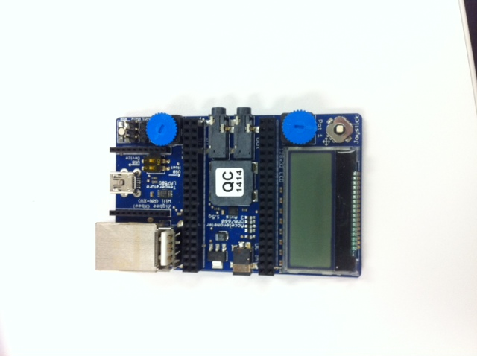
Equipment/tools needed
Mbed application board for LPC1768
Complier
Available libraries from Mbed developer site

Slide 3
Detailed Features
Codes will keep a loop counter in main
Every 3 counts, display and LED lights will change according to loop counts
Loop 0-3: Display shows “Hello Final Project”
Loop 4-6: LEDs move from left to right
Loop 6-9: LEDS will flash
Loop 10-12: LEDs move from right to left
Loop 13-15: LEDs will skip around
Loop 16-18: 2 LEDS will flash at the same time
Loop 19: Display will show moving Santa Clause and a Christmas tree
Loop counter goes back to 3

Slide 4
Key Features and Capability
1. Display words
2. Display animation with cartoon char.
3. Different patterns of LED flashing by controlling the 4 LED lights on the mBed board, and by programmable timer.
4. Replay of the features

Slide 5
Codes (partial)

Slide 6
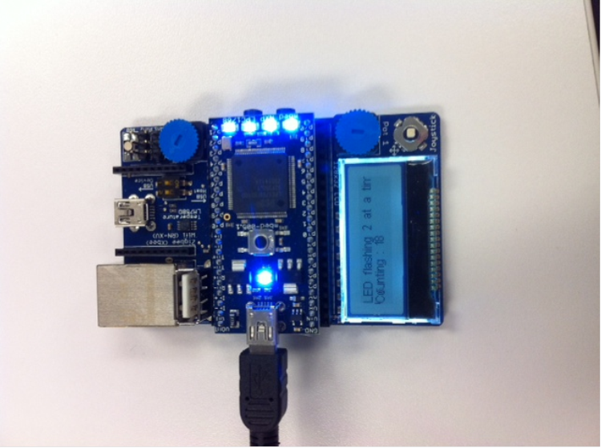
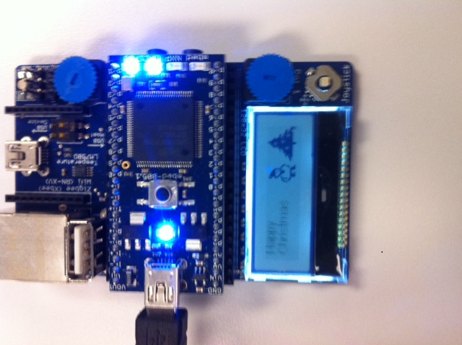
Demo

