Slide 1
Automated Image Quality Assessment in Medical Images
By: Faranak Dayyani & Sarina Taki

Slide 2
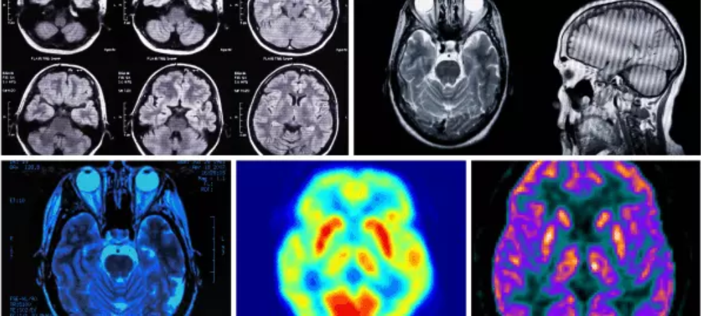
Introduction:
Image Quality Assessment
Important in image processing
Helps with design decisions [1]
Three metrics:
Noisy-ness (N) → amount of noise
Common source: motion artifacts
Contrast (C) → Resolution
Edge Quality (E) → Fuzzy or sharp
Image quality represents the level of accuracy in imaging systems [1]
Dataset: Lung CT scans & Brain MRIs
[11]: https://openmedscience.com/radiology-radiography/

Slide 3
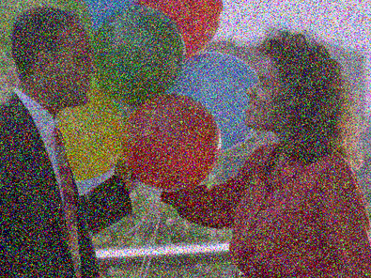

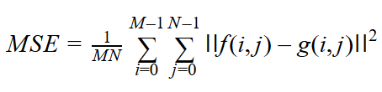
Noisy-ness:
Definition: “Random variation of brightness or color information” [2]
Multiple methods
Chosen method: Peak signal-to-noise ratio (PSNR)
Unit : dB (decibel scale)
RMS equation [3][4]:
[12]: https://people.sc.fsu.edu/~jburkardt/c_src/image_denoise/image_denoise.html

Slide 4
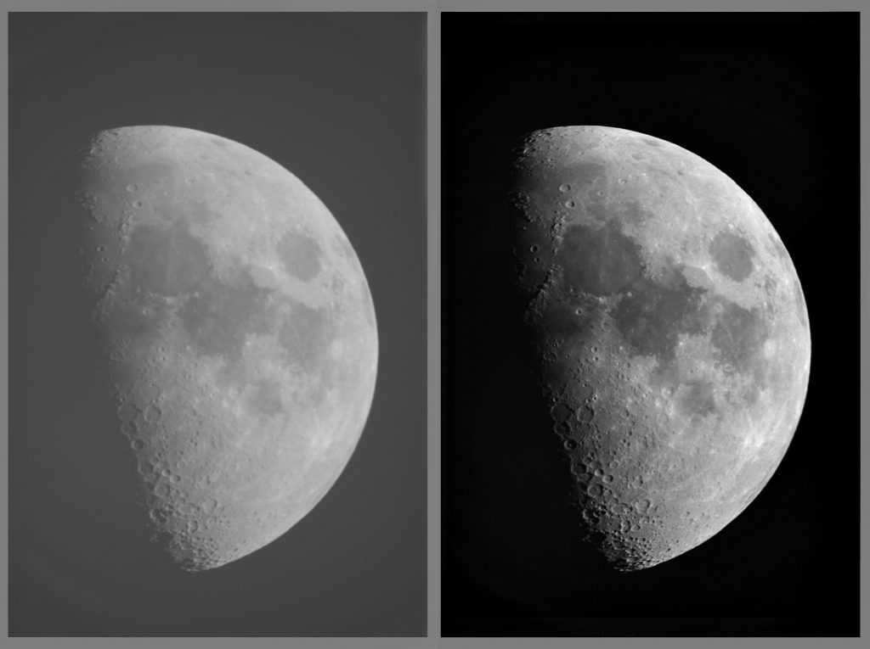

Contrast:
Well-known metric
Several methods [5]: similar results
Weber
Michelson
RMS (Root-mean-square)
Advantage:
Simple
Easy to understand
RMS: statistical measure
Helps to identify patterns
Equation [6]:
[13]: http://www.ianmorison.com/everything-about-refractors-ii-why-do-they-give-the-highest-contrast-images/

Slide 5
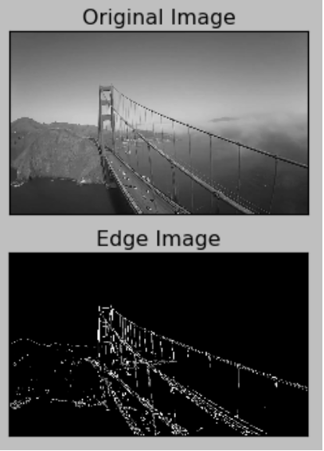
Edge Quality:
Determine performance of edge detectors [7]
Various methods: MSE & SSIM [7]
Both successful
MSE → already used for measuring noisy-ness
SSIM → too complex to implement
Method chosen: FM algorithm [8]
Measures image sharpness
7 steps
Involves computing FT of input image
[14]: https://www.bogotobogo.com/python/OpenCV_Python/python_opencv3_Image_Canny_Edge_Detection.php

Slide 6

Methods:
To measure image metrics by using three methods
PSNR measurement: noise-ness of the image [3].
RMS measurement: contrast of the image [10].
FM algorithm: Edge quality of the image [8].
[15]: https://doist.com/blog/personal-productivity-methods/

Slide 7
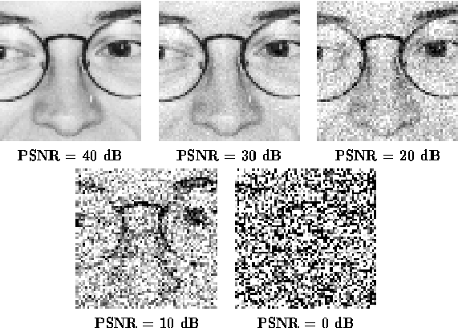
Methods(Noise-ness):
PSNR method was used:
Convert the image type to double.
Filtered it by a Non-local mean filter.
Convert both input and filtered images to 8-bit signed integer.
Calculate MSE [3].
Calculate PSNR [3].
[16]:https://www.researchgate.net/figure/Illustration-of-the-PSNR-measure_fig6_268807675

Slide 8
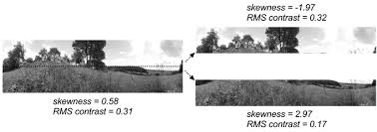
Methods(Contrast):
RMS method was used:
Convert the image type to double
Change the intensity range to [0 255] (Only for Lung CT)
Eliminate the zero pixels (Only for Lung CT)
Normalize the image
Calculate RMS [10].
[17]:https://uu.diva-portal.org/smash/get/diva2:1133556/FULLTEXT01.pdf

Slide 9
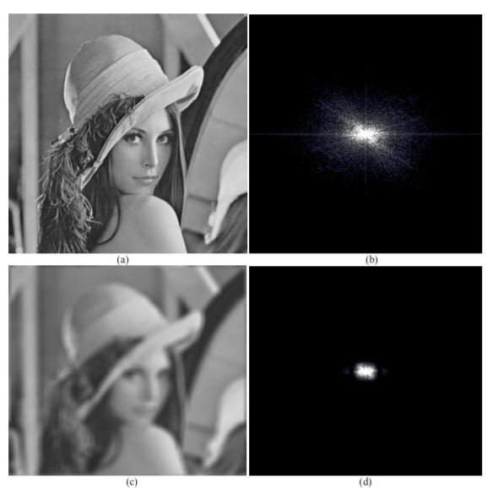
Methods(Edge Quality):
FM algorithm was used [8]:
Convert the image type to double
Normalize the image
Compute frequency spectrum
Shift frequency spectrum to the center
Compute magnitude frequency
Compute maximum value of the magnitude frequency
Compute threshold
Compute number of pixels with intensity greater than the threshold
Compute image sharpness
[18]:https://www.sciencedirect.com/science/article/pii/S1877705813016007

Slide 10
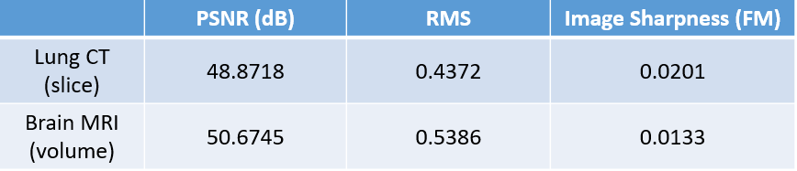
Results:
This table shows the values of PSNR, RMS and image sharpness for both Lung CT slice and Brain MRI volume images:

Slide 11
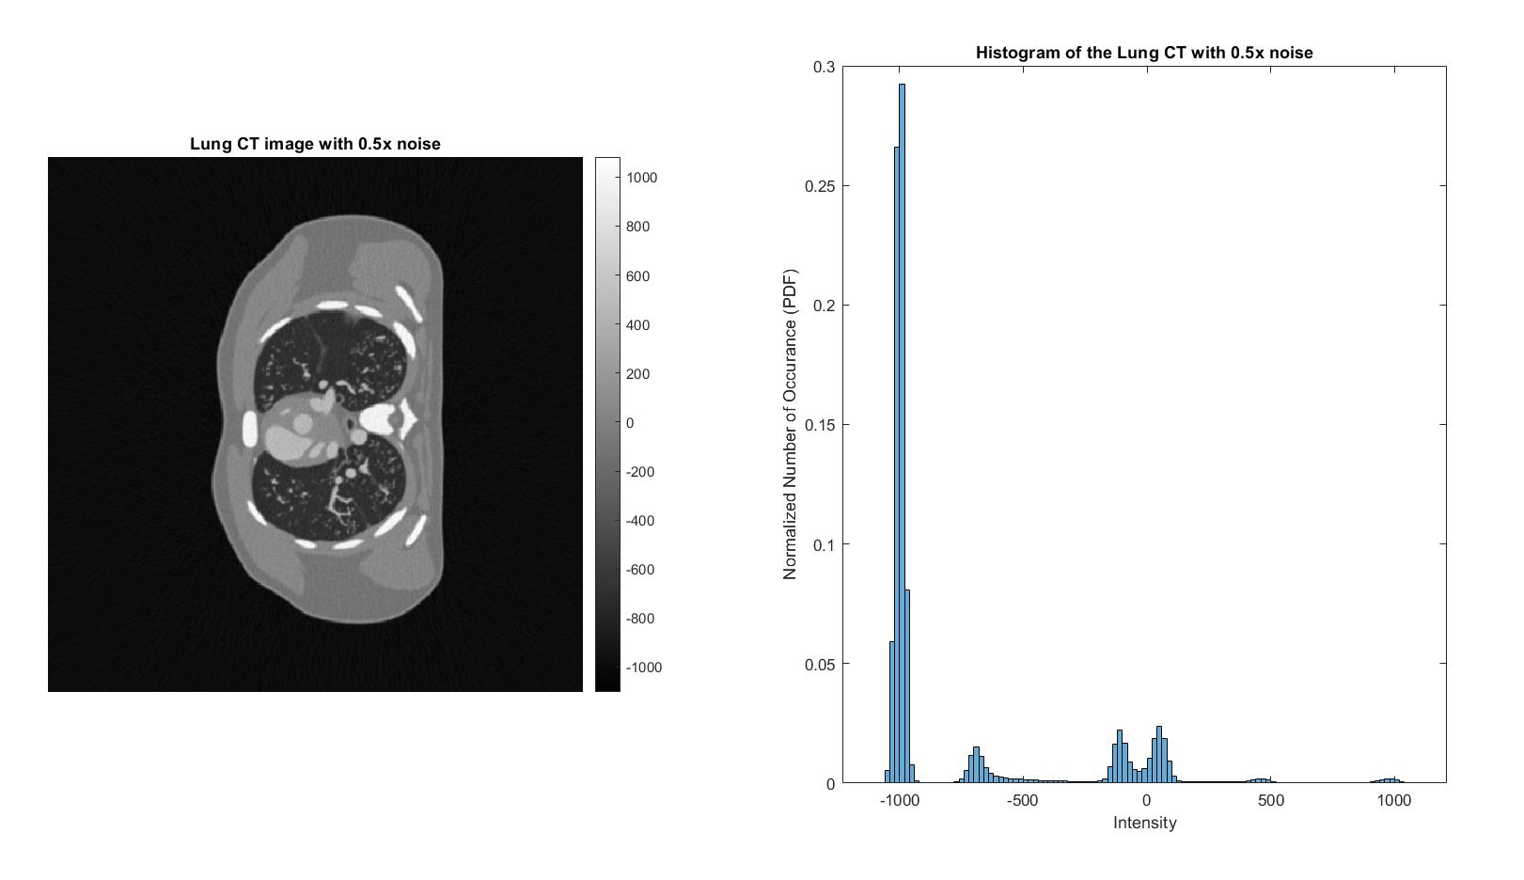
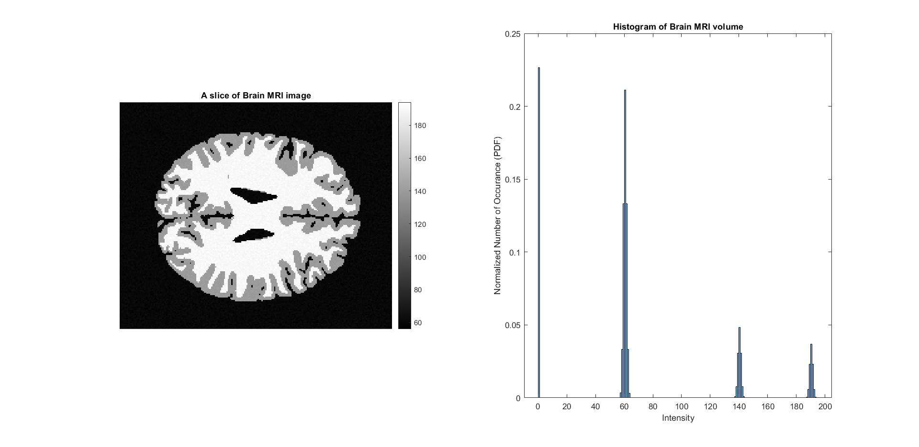
Results(PSNR):
The image and histogram of a Lung CT slice with 0.5x noise for noise measurement
The image and histogram of a Brain MRI volume for noise measurement

Slide 12
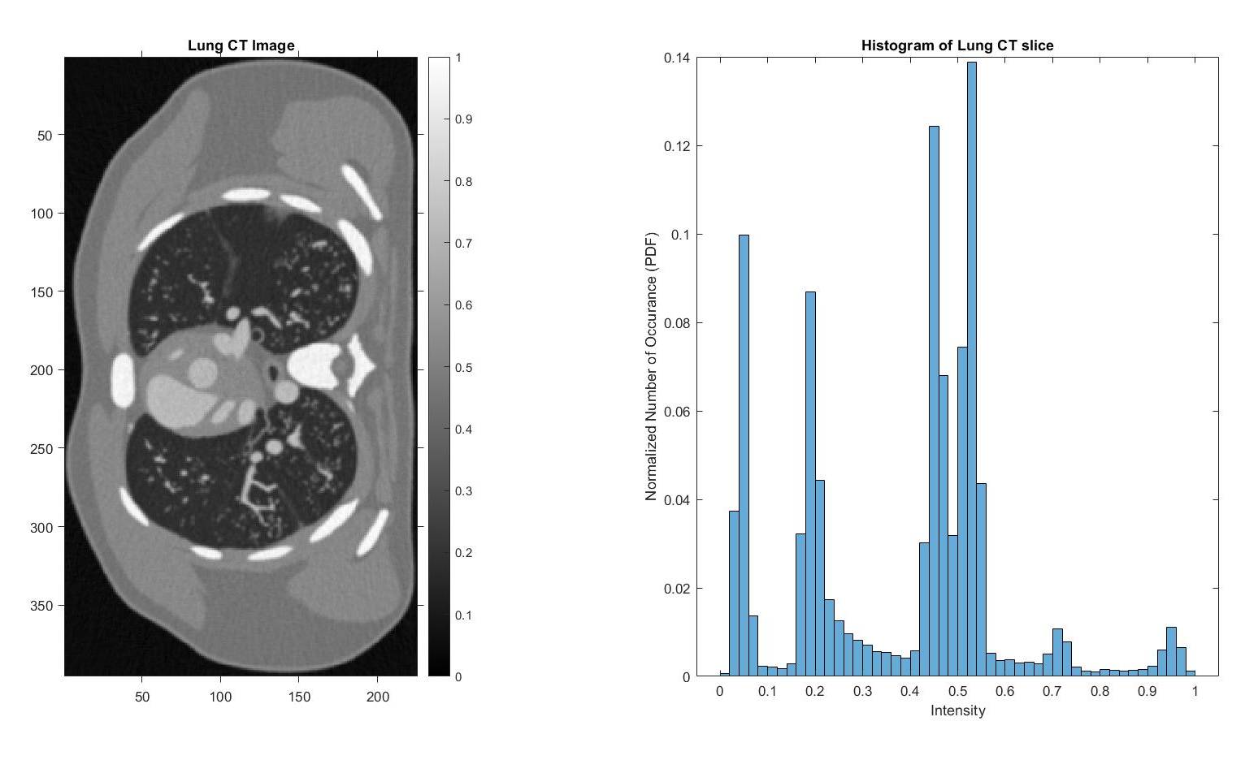
Results(RMS):
The image and histogram of a Lung CT slice with 0.5x noise for contrast measurement
The image and histogram of a Brain MRI volume for contrast measurement

Slide 13
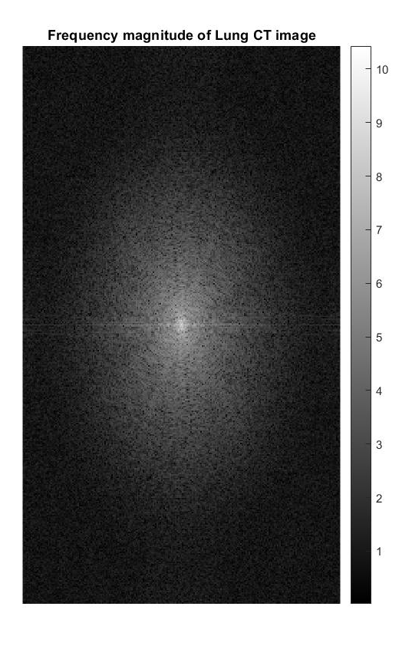
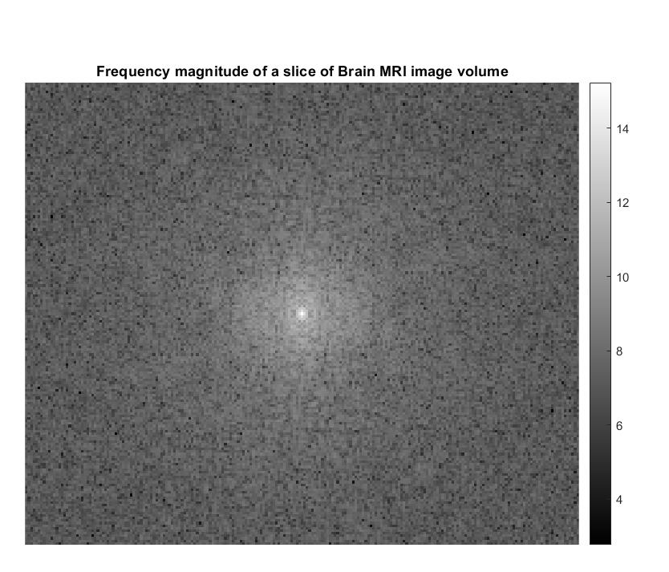
Results(FM algorithm):
The image and histogram of a Brain MRI volume for edge quality measurement
The image and histogram of a Lung CT slice with 0.5x noise for edge quality measurement

Slide 14
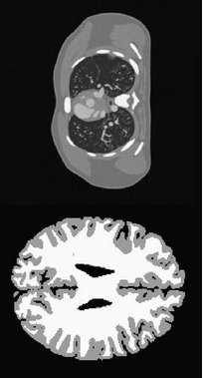
Discussion:
Dataset: 1 slice of a lung CT scan, volume of a brain MRI
Lung CT slice:
PSNR: 48.8718 → not noisy (in the 30 - 50 dB range)
RMS: 0.4372 → low contrast, more dark regions (below 0.46291)
FM: 0.0201 → strong edge quality ( > 0.014922)
Brain MRI volume:
PSNR: 50.6745 → noisy (outside the 30 - 50 dB range)
RMS: 0.5386 → high contrast (in the 0.46291 - 0.5537 range)
FM: 0.0133 → weak edge quality ( < 0.014922)
Noisiness and edge quality are directly correlated
Brain MRI is both noisy and has a weak edge quality, lung CT is the opposite

Slide 15
Conclusion:
The purpose of this experiment is to measure the image quality based on three image quality metrics: image noisy-ness, contrast of the image and edge quality of the image.
PSNR was used to justify the noise quality of the image by computing the maximum signal to noise ratio [3].
RMS was used to justify the contrast quality of the image by identifying certain patterns in the image [5].
FM was used to justify the edge quality of the image by finding the total number of pixels with certain intensity in the non-shifted frequency spectrum of the image [8].

Slide 16

The End.
Thank You
[19]:http://fallontrendpoint.blogspot.com/2006/05/who-really-owns-smiley.html

Slide 17
References:
[1]BME 872 Biomedical Image Analysis, “Project: Automated Image Quality Assessment in Medical Images”, Ryerson University, Toronto, ON, rep., Winter 2020.
[2]A. Swain, “Noise in Digital Image Processing”, 24-Nov-2019. [Online]. Available: https://medium.com/image-vision/noise-in-digital-image-processing-55357c9fab71
[3]National Instruments, “Peak Signal-to-Noise Ratio as an Image Quality Metric”, 5-Mar-2019. [Online]. Available: https://www.ni.com/en-ca/innovations/white-papers/11/peak-signal-to-noise-ratio-as-an-image-quality-metric.html
[4]A. Robinson, “How to Calculate PSNR”, 2-Mar-2019. [Online]. Available: https://sciencing.com/how-to-calculate-psnr-12751768.html
[5]A. Shaus, S. F. Golovin, B. Sober, E. Turkel, & E. Piasetzky, (2017). “Potential Contrast – A New Image Quality Measure”, Image Quality and System Performance XIV, 14, 52–58, 2017. [Online]. Available: https://pdfs.semanticscholar.org/e3f2/e337d4470545398cc6753a54c21debf9c37b.pdf
[6]R. Gholipour-Peyvandi, S.Z. Islami-Rad, R. Heshmati, S. Zaferanlouie, & M. Ghannadi-Maragheh, “Influence of gamma emitter source intensity against energy on the image RMS contrast”. The Egyptian Journal of Radiology and Nuclear Medicine, 42(0378-603X), 425–431. 2011. doi: https://doi.org/10.1016/j.ejrnm.2011.10.003
[7]D. Sadykova, & A. P. James, “Quality Assessment Metrics for Edge Detection and Edge-aware Filtering: A Tutorial Review”, 1-Jan-2018. [Online]. Available: https://arxiv.org/pdf/1801.00454.pdf
[8]D. Kanjar, & V. Masilamani, “Image Sharpness Measure for Blurred Images in Frequency Domain”. Procedia Engineering, 64(18777058), 149–158. 2013. doi: 10.1016/j.proeng.2013.09.086
[9]S. Saladi, N. Amutha Prabha, “Analysis of denoising filters on MRI brain images”. Int. J. Imaging Syst. Technol. 27: 201– 208. 17-Aug-2017 https://doi-org.ezproxy.lib.ryerson.ca/10.1002/ima.22225
[10]D. G. Pelli, & P. Bex, “Measuring contrast sensitivity”. Vision Research, 90(0042-6989), 10–14. 213. doi: https://doi.org/10.1016/j.visres.2013.04.015

