Slide 1
R1: Read real-time 1st repetition, Consonants in symmetric VCV 1/3

Slide 2
aapaa

Slide 3
oopoo

Slide 4
eepee

Slide 5
aataa

Slide 6
ootoo

Slide 7
eetee

Slide 8
aakaa

Slide 9
ookoo

Slide 10
eekee

Slide 11
aabaa

Slide 12
ooboo

Slide 13
eebee

Slide 14
aadaa

Slide 15
oodoo

Slide 16
eedee

Slide 17
aagaa

Slide 18
oogoo

Slide 19
eegee

Slide 20
R2. Consonants in symmetric VCV 2/3

Slide 21
aathaa

Slide 22
oothoo

Slide 23
eethee

Slide 24
aasaa

Slide 25
oosoo

Slide 26
eesee

Slide 27
aashaa

Slide 28
ooshoo

Slide 29
eeshee

Slide 30
aamaa

Slide 31
oomoo

Slide 32
eemee

Slide 33
aanaa

Slide 34
oonoo

Slide 35
eenee

Slide 36
aalaa

Slide 37
ooloo

Slide 38
eelee

Slide 39
R3: Consonants in symmetric VCV 3/3

Slide 40
aafaa

Slide 41
oofoo

Slide 42
eefee

Slide 43
aavaa

Slide 44
oovoo

Slide 45
eevee

Slide 46
aaraa

Slide 47
ooroo

Slide 48
eeree

Slide 49
aahaa

Slide 50
oohoo

Slide 51
eehee

Slide 52
aawaa

Slide 53
oowoo

Slide 54
eewee

Slide 55
aayaa

Slide 56
ooyoo

Slide 57
eeyee

Slide 58
R4: Vowels in bVt

Slide 59
beat

Slide 60
bit

Slide 61
bait

Slide 62
bet

Slide 63
bat

Slide 64
pot

Slide 65
but

Slide 66
bought

Slide 67
boat

Slide 68
boot

Slide 69
put

Slide 70
bite

Slide 71
butte

Slide 72
bird

Slide 73
Boyd

Slide 74
abbot

Slide 75
R5: Sentences 1/1

Slide 76
She had your dark suit in greasy wash water all year.

Slide 77
Don’t ask me to carry an oily rag like that.

Slide 78
The girl was thirsty and drank some juice, followed by a coke.

Slide 79
Your good pants look great! However, your ripped pants look like a cheap version of a K-mart special. Is that an oil stain on them?

Slide 80
R6: Rainbow

Slide 81
When the sunlight strikes raindrops in the air, they act as a prism and form a rainbow. The rainbow is a division of white light into many beautiful colors.

Slide 82
These take the shape of a long round arch, with its path high above, and its two ends apparently beyond the horizon. There is, according to legend, a boiling pot of gold at one end.

Slide 83
People look, but no one ever finds it. When a man looks for something beyond his reach, his friends say he is looking for the pot of gold at the end of the rainbow.

Slide 84
R7: Grandfather 1/2

Slide 85
You wish to know all about my grandfather. Well, he is nearly 93 years old, yet he still thinks as swiftly as ever. He dresses himself in an old black frock coat, usually several buttons missing.

Slide 86
A long beard clings to his chin, giving those who observe him a pronounced feeling of the utmost respect. When he speaks, his voice is just a bit cracked and quivers a bit.

Slide 87
R7: Grandfather 2/2

Slide 88
Twice each day he plays skillfully and with zest upon a small organ. Except in the winter when the snow or ice prevents, he slowly takes a short walk in the open air each day.

Slide 89
We have often urged him to walk more and smoke less, but he always answers, 'Banana oil!' Grandfather likes to be modern in his language.

Slide 90
R8: North wind and the sun 1/2

Slide 91
The North Wind and the Sun were disputing which was the stronger, when a traveller came along wrapped in a warm cloak.

Slide 92
They agreed that the one who ﬁrst succeeded in making the traveller take his cloak off should be considered stronger than the other.

Slide 93
R8: North wind and the sun 2/2

Slide 94
Then the North Wind blew as hard as he could, but the more he blew the more closely did the traveller fold his cloak around him; and at last the North Wind gave up the attempt.

Slide 95
Then the Sun shone out warmly, and immediately the traveller took off his cloak. And so the North Wind was obliged to confess that the Sun was the stronger of the two.

Slide 96
R9: Gestures

Slide 97
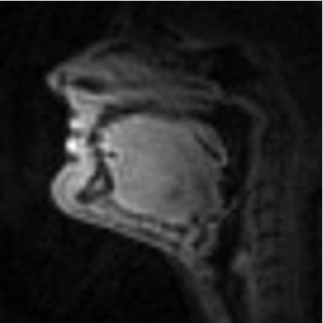
clench

Slide 98
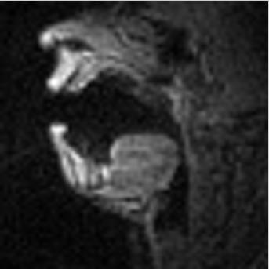
open wide & yawn

Slide 99
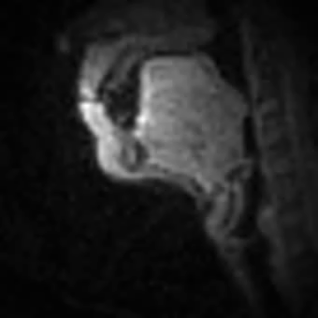
swallow

Slide 100
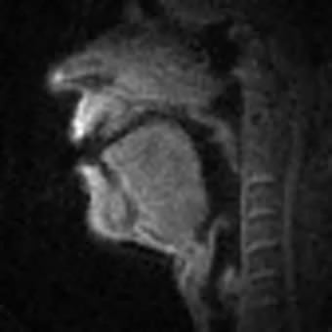
eee … aahh … uuww … eee

Slide 101

trace palate with tongue tip

Slide 102
Sing “la” at your highest note

Slide 103
Sing “la” at your lowest note

Slide 104
R10: Read real-time 2nd repetition, Consonants in symmetric VCV 1/3

Slide 105
aapaa

Slide 106
oopoo

Slide 107
eepee

Slide 108
aataa

Slide 109
ootoo

Slide 110
eetee

Slide 111
aakaa

Slide 112
ookoo

Slide 113
eekee

Slide 114
aabaa

Slide 115
ooboo

Slide 116
eebee

Slide 117
aadaa

Slide 118
oodoo

Slide 119
eedee

Slide 120
aagaa

Slide 121
oogoo

Slide 122
eegee

Slide 123
R11. Consonants in symmetric VCV 2/3

Slide 124
aathaa

Slide 125
oothoo

Slide 126
eethee

Slide 127
aasaa

Slide 128
oosoo

Slide 129
eesee

Slide 130
aashaa

Slide 131
ooshoo

Slide 132
eeshee

Slide 133
aamaa

Slide 134
oomoo

Slide 135
eemee

Slide 136
aanaa

Slide 137
oonoo

Slide 138
eenee

Slide 139
aalaa

Slide 140
ooloo

Slide 141
eelee

Slide 142
R12: Consonants in symmetric VCV 3/3

Slide 143
aafaa

Slide 144
oofoo

Slide 145
eefee

Slide 146
aavaa

Slide 147
oovoo

Slide 148
eevee

Slide 149
aaraa

Slide 150
ooroo

Slide 151
eeree

Slide 152
aahaa

Slide 153
oohoo

Slide 154
eehee

Slide 155
aawaa

Slide 156
oowoo

Slide 157
eewee

Slide 158
aayaa

Slide 159
ooyoo

Slide 160
eeyee

Slide 161
R13: Vowels in bVt

Slide 162
beat

Slide 163
bit

Slide 164
bait

Slide 165
bet

Slide 166
bat

Slide 167
pot

Slide 168
but

Slide 169
bought

Slide 170
boat

Slide 171
boot

Slide 172
put

Slide 173
bite

Slide 174
butte

Slide 175
bird

Slide 176
Boyd

Slide 177
abbot

Slide 178
R14: Sentences 1/1

Slide 179
She had your dark suit in greasy wash water all year.

Slide 180
Don’t ask me to carry an oily rag like that.

Slide 181
The girl was thirsty and drank some juice, followed by a coke.

Slide 182
Your good pants look great! However, your ripped pants look like a cheap version of a K-mart special. Is that an oil stain on them?

Slide 183
R15: Rainbow

Slide 184
When the sunlight strikes raindrops in the air, they act as a prism and form a rainbow. The rainbow is a division of white light into many beautiful colors.

Slide 185
These take the shape of a long round arch, with its path high above, and its two ends apparently beyond the horizon. There is, according to legend, a boiling pot of gold at one end.

Slide 186
People look, but no one ever finds it. When a man looks for something beyond his reach, his friends say he is looking for the pot of gold at the end of the rainbow.

Slide 187
R16: Grandfather 1/2

Slide 188
You wish to know all about my grandfather. Well, he is nearly 93 years old, yet he still thinks as swiftly as ever. He dresses himself in an old black frock coat, usually several buttons missing.

Slide 189
A long beard clings to his chin, giving those who observe him a pronounced feeling of the utmost respect. When he speaks, his voice is just a bit cracked and quivers a bit.

Slide 190
R16: Grandfather 2/2

Slide 191
Twice each day he plays skillfully and with zest upon a small organ. Except in the winter when the snow or ice prevents, he slowly takes a short walk in the open air each day.

Slide 192
We have often urged him to walk more and smoke less, but he always answers, 'Banana oil!' Grandfather likes to be modern in his language.

Slide 193
R17: North wind and the sun 1/2

Slide 194
The North Wind and the Sun were disputing which was the stronger, when a traveller came along wrapped in a warm cloak.

Slide 195
They agreed that the one who ﬁrst succeeded in making the traveller take his cloak off should be considered stronger than the other.

Slide 196
R17: North wind and the sun 2/2

Slide 197
Then the North Wind blew as hard as he could, but the more he blew the more closely did the traveller fold his cloak around him; and at last the North Wind gave up the attempt.

Slide 198
Then the Sun shone out warmly, and immediately the traveller took off his cloak. And so the North Wind was obliged to confess that the Sun was the stronger of the two.

Slide 199
R9: Gestures

Slide 200
clench

Slide 201
open wide & yawn

Slide 202
swallow

Slide 203
eee … aahh … uuww … eee

Slide 204
trace palate with tongue tip

Slide 205
Sing “la” at your highest note

Slide 206
Sing “la” at your lowest note

Slide 207
S1: Spontaneous speech, Picture 1/5

Slide 208
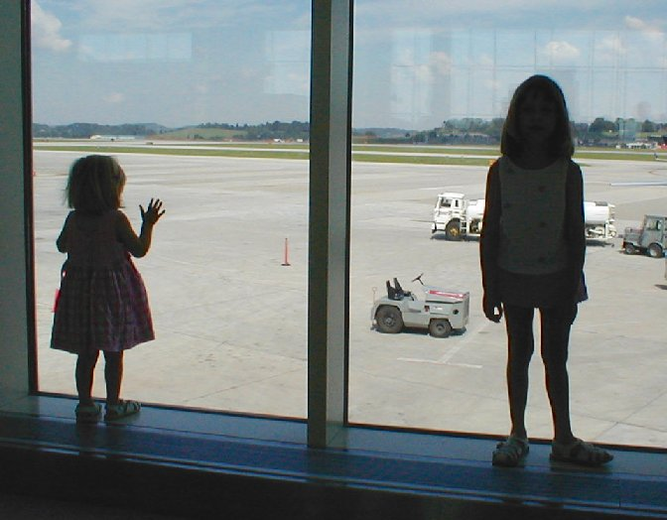

Slide 209
S2: Picture 2/5

Slide 210
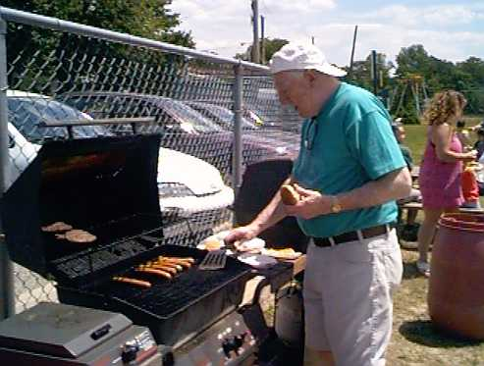

Slide 211
S3: Picture 3/5

Slide 212
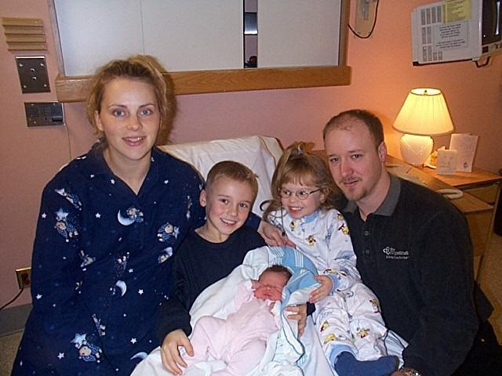

Slide 213
S4: Picture 4/5

Slide 214
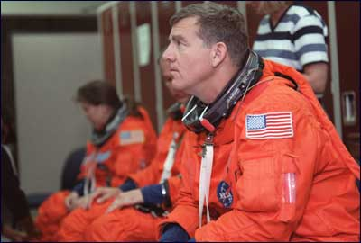

Slide 215
S5: Picture 5/5

Slide 216
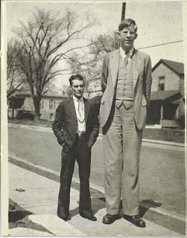

Slide 217
S6: Question 1/5

Slide 218
My favorite music

Slide 219
S7: Question 2/5

Slide 220
How do I like L.A.

Slide 221
S8: Question 3/5

Slide 222
My favorite movie

Slide 223
S9: Question 4/5

Slide 224
Best place I’ve been to

Slide 225
S10: Question 5/5

Slide 226
My favorite restaurant

Slide 227
V1: Volumetric 1st repetition

Slide 228
beet

Slide 229
bit

Slide 230
bait

Slide 231
bet

Slide 232
bat

Slide 233
pot

Slide 234
but

Slide 235
bought

Slide 236
boat

Slide 237
boot

Slide 238
put

Slide 239
bird

Slide 240
abbot

Slide 241
afa as in food

Slide 242
ava as in voice

Slide 243
atha as in thing

Slide 244
atha as in this

Slide 245
asa as in soap

Slide 246
aza as in zipper

Slide 247
asha as in shoe

Slide 248
agea as in beige

Slide 249
aha as in happy

Slide 250
ama as in rim

Slide 251
ana as in pin

Slide 252
anga as in ring

Slide 253
ala as in late

Slide 254
ara as in rope

Slide 255
Breathe normally with your mouth closed, resting.

Slide 256
Clench your teeth and hold

Slide 257
Stick your tongue out as far as you can, and hold

Slide 258
Pull back your tongue as far into the mouth as you can, and hold (like yawning)

Slide 259
Raise the tip of your tongue to the middle of your palate, and hold

Slide 260
Hold your breath

Slide 261
V2: Volumetric 2nd repetition

Slide 262
beet

Slide 263
bit

Slide 264
bait

Slide 265
bet

Slide 266
bat

Slide 267
pot

Slide 268
but

Slide 269
bought

Slide 270
boat

Slide 271
boot

Slide 272
put

Slide 273
bird

Slide 274
abbot

Slide 275
afa as in food

Slide 276
ava as in voice

Slide 277
atha as in thing

Slide 278
atha as in this

Slide 279
asa as in soap

Slide 280
aza as in zipper

Slide 281
asha as in shoe

Slide 282
agea as in beige

Slide 283
aha as in happy

Slide 284
ama as in rim

Slide 285
ana as in pin

Slide 286
anga as in ring

Slide 287
ala as in late

Slide 288
ara as in rope

Slide 289
Breathe normally with your mouth closed, resting.

Slide 290
Clench your teeth and hold

Slide 291
Stick your tongue out as far as you can, and hold

Slide 292
Pull back your tongue as far into the mouth as you can, and hold (like yawning)

Slide 293
Raise the tip of your tongue to the middle of your palate, and hold

Slide 294
Hold your breath

