Slide 1

FinalProject
CloudFormation
Configuration Management and Continuous Delivery in the Cloud
Sadek, Faras
cscie90 Cloud Computing
Harvard Extension School
prof. Zoran B. Djordjevic
Faras Sadek

Slide 2
What am I trying to achieve?
What Problem I want to attackle?
I want to automate the process of resource allocation and resource configuration in AWS Cloud.
Faras Sadek

Slide 3





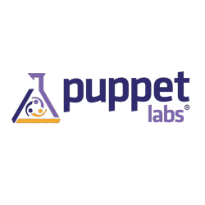
VPC Public
172.31.0.0/16
VPC Develop
172.16.0.0/16
172.31.0.0/20
CloudFormation Template
172.16.0.0/20
172.31.16.0/20
172.16.16.0/20
Peering Tunnel
Dev Instance
Developer
Faras Sadek

Slide 4



Tools
CloudFormation
Puppet
GitHub
Jenkins
Faras Sadek

Slide 5
CloudFormation
CloudFormation JSON Template is used in two cases:
Create a VPC with private and public subnets. This case is used to build my environment, by applying this template twice for the public and development VPCs.
Another CloudFormation template used to create an EC2 instance in development VPC, in the peering subnet of the development VPC, specifically in the subnet that peer the development with the public VPC.
CloudFormation
VPC Public
172.31.0.0/16
VPC Develop
172.16.0.0/16
172.31.0.0/20
172.16.0.0/20
172.31.16.0/20
172.16.16.0/20
EC2
Faras Sadek

Slide 6
Puppet
Puppet is a configuration management that i used for the automation process.
I used puppet to install and configure the required packages in the EC2 instance.
When the instance is created in the development VPC using the cloudFormation template, puppet will take over to install and configure the packages and application on the machine over the peering tunnel.
VPC Public
172.31.0.0/16
VPC Develop
172.16.0.0/16
172.31.0.0/20
CloudFormation Template
172.16.0.0/20
172.31.16.0/20
172.16.16.0/20
Peering Tunnel
Dev Instance
Faras Sadek

Slide 7
GitHub
gitHub stores two repositories:
The CloudFormation templates, e90_cfm. VPC and EC2 creation templates.
https://github.com/FarasSadek/e90_cfm.git
The puppet configuration and modules, e90_puppet.
https://github.com/FarasSadek/e90_puppet.git
Puppet repository have two branches , master and develop branches. It uses the web-hook service to trigger Jenkins if any any pushes arrives to the repository, and Jenkins is configured to do something when receiving such a trigger.
Faras Sadek

Slide 8
Jenkins
Jenkins is a continuous delivery and testing tool.
It being used in this project to test the functionality of the puppet configuration on a development system before it goes to the production.
Here is the scenarios:
DevOps user pushes new change to the development branch in puppet repository,
github will capture the change and send a post web-hooks to Jenkins,
Jenkins will create an EC2 instance in the development VPC,
the instance will be configured using puppet,
if the process succeed, Jenkins will show a success and only in this case the developer can merge the development branch to the master branch to be ready for the test.
Faras Sadek

Slide 9
The Full Picture
VPC Public
172.31.0.0/16
VPC Develop
172.16.0.0/16
172.31.0.0/20
CloudFormation
172.16.0.0/20
172.31.16.0/20
172.16.16.0/20
Peering Tunnel
Dev Instance
Developer
Faras Sadek

Slide 10
DEMO TIME

Slide 11
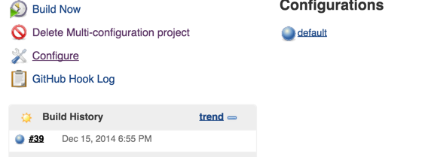
JENKINS CONFIGURATION

Slide 12
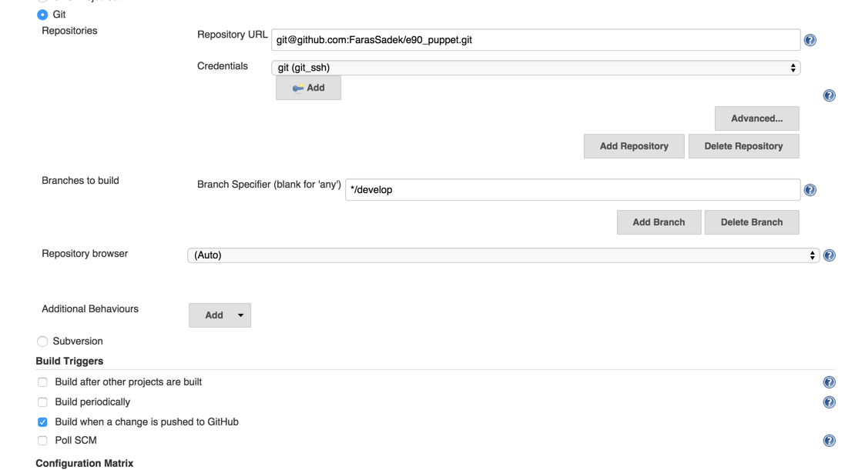
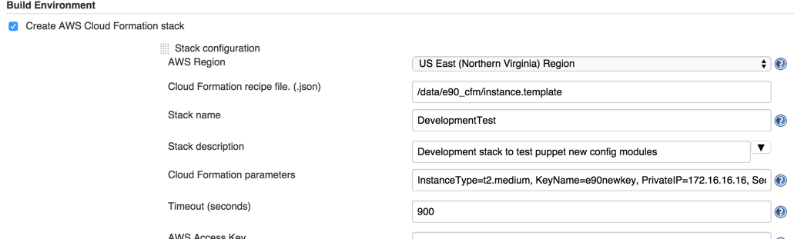

Slide 13
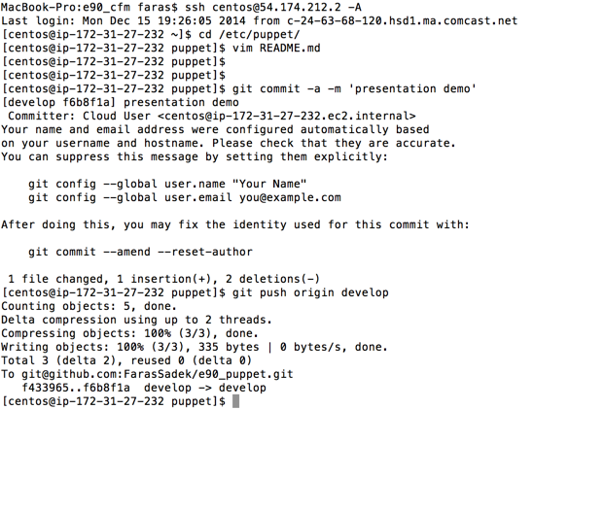
Push to the development branch of the puppet master repository.

Slide 14
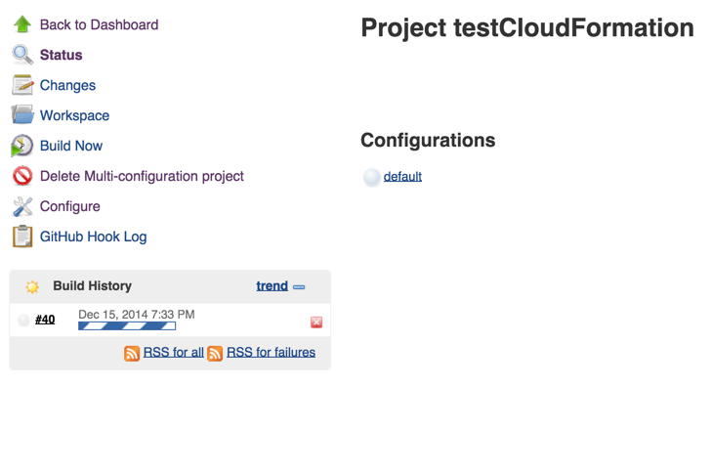
Jenkins will start New build

Slide 15
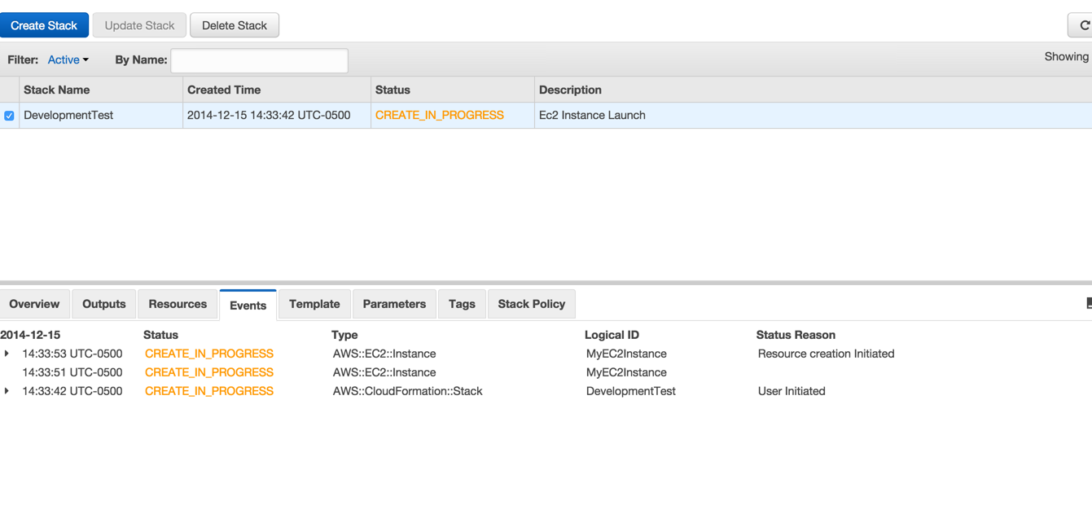
A new stack “DevelopmentTest” is on the way to be created.

Slide 16
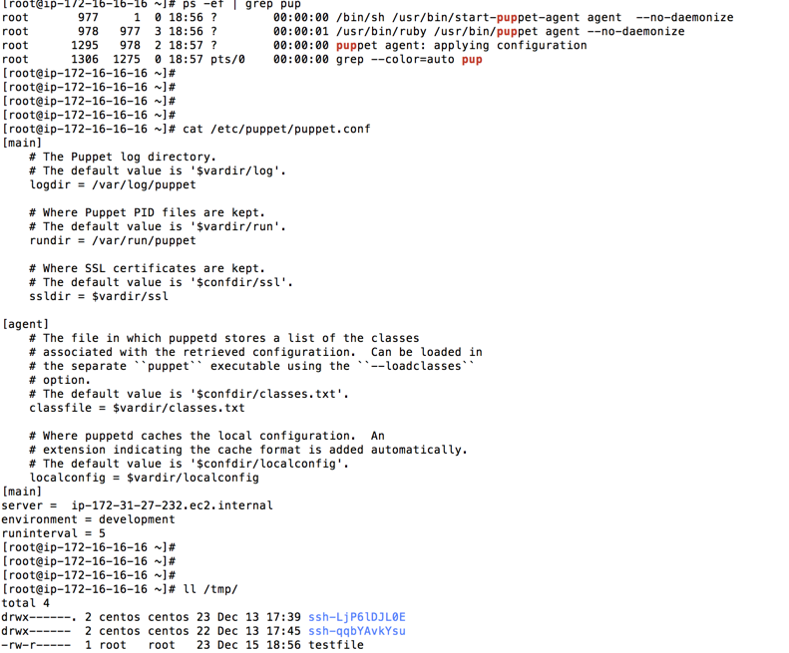
Login to the new EC2 and check if the /tmp/testfile is created.

Slide 17
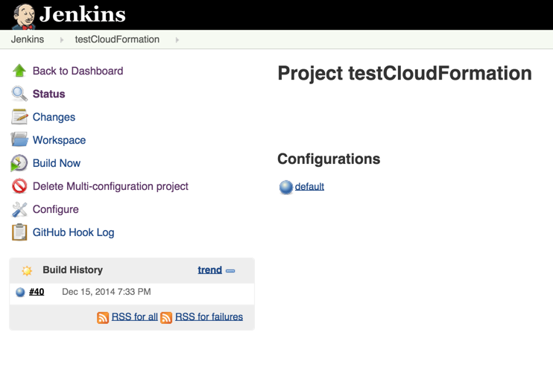
The new build succeed.

