Slide 1
Scalable Order Management system
- PRATIK RAGHAVENDRA
- GAURAV MADARKAL

Slide 2
Project goals
An application that can “handle” receiving large scale orders.
To build a simple solution which can scale easily that can used by any very small (MSME) to very large organizations
When we say “handle” we mean the following tasks
Order Categorization
Order Routing
Order updates notifier

Slide 3
Components
KUBERNETES - GKE
FLASK – REST APIS – CRUD operations for Orders, OAuth 2.0
CRON Jobs
RABBITMQ
MYSQL, MONGODB – DATABASE
REACT JS – FRONTEND
DOCKER

Slide 4
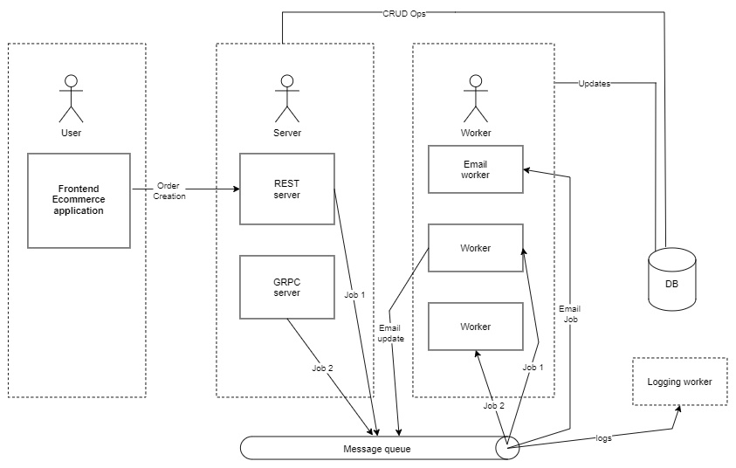
ARCHITECTURE

Slide 5
COMPONENT – BACKEND
The backend of OMS is the heart of the application, consisting of the following sub-components
REST SERVER
CATEGORIZING WORKER
ROUTING WORKER
EMAIL WORKER

Slide 6
COMPONENT – BACKEND (REST SERVER)
14 REST APIS
Maximum being the Order APIs
Important ones being, GET order/routing, GET order/driverassignment, GET orders/city, PUT order/status/update, POST /order/create
Auth APIs
Handle the admin and driver logins to the OMS dashboard

Slide 7
COMPONENT – BACKEND (WORKERS)
Routing Worker
CRON job - Receives Signal from server to start routing
Gathers all orders (Order addresses) for the following day
Creates a distance matrix for each city, applies the shortest path (Nearest neighbour) algorithm
Saves the delivery routing path for each city in database
Categorizing Worker
CRON job - Receives Signal from server to start categorizing
Categorizes the orders into city and postalCode, removes all unnecessary data and puts it to database
Email Worker
Sends an order status update emails to users whose orders have been delivered

Slide 8
COMPONENT – Messaging broker
RABBITMQ
Routing worker – Message to routing worker everyday at a specific time to start the worker
Categorizing worker –Initiates the categorizing worker everyday at specific time to start order categorization
Email worker – Sends message to email worker from the server when an order has been marked as delivered

Slide 9
COMPONENT – databases
MySQL – To store structured data such as
User data – users who use the platform including the admin and drivers
Order data – Saves which user has ordered which product on which date and the status of the order
Auth – Stores admin, driver user creds and access tokens
Warehouses, Drivers – Stores the delivery outlets and the drivers who will be deliver orders
MongoDB
Routes – Stores frontend dashboard data, For ex – Chicago has 500 orders for the day, and they have been divided into 5 different routes
Orders – Stores orderids categorized into cities and postalCode
Driver Assignment – Stores the different routes for each city and the driver assigned to each route

Slide 10
Debugging / Testing
Debugging
Basic logging of exceptions and critical results
Since the project was clearly divided into components the cases of error were reduced
Exception handling mechanism
Testing
Unit testing all major logical code to make sure it does what it is intended to do.
Python scripts to test APIs

Slide 11
Scaling
This project’s goal was to build a scalable system
The reason to use two different databases was so that the project can be scaled.
The frontend dashboard will not be able to handle huge responses
Pre-structure the data needed by FE and store it on mongodb.
The server will be containerized and hosted on Kubernetes – we can create multiple pods to ensure maximum availability
The workers are independent applications whose load does not impact the server, and the workers are run once everyday (time of day when load on the server is minimum) making them very efficient
This project can be scaled to any load, with down-side being only the amount of database storage required

Slide 12
Learnings
How to scale applications to Kubernetes?
How to make use of CRON jobs to move out the logic which need not be in the server
How to strip the server into only the necessary parts and move all the long running tasks to workers
How to make workers asynchronous, meaning, how to not make the server wait for the workers

Slide 13
DEMO

Slide 14
THANK YOU

