Slide 1
IBM University Engagement Project Submission
“Exploring the Power of Agentic AI with IBM Granite and LangFlow”

Slide 2

Project Tile – [Online Payment Fraud Detection]
Domain of Project – [ Financial Security ]
Student Name | Recent Passport Photo | Email ID | Mobile number [WhatsApp]
FARAZ AKRAM |  | farazakram2024@gmail.com | 8603778367

Slide 3
Problem Statement -
Problem Statement :
With the rapid growth of digital payments, financial fraud has become increasingly common. Users and institutions face challenges in identifying suspicious transactions in real time due to complex patterns, high transaction volume, and lack of intelligent monitoring systems.
The Objective
Build an AI-powered Fraud Detection System that analyzes transaction data and identifies suspicious activities using intelligent decision-making models.
1. Transaction Analysis
Input:
Type (TRANSFER, CASH_OUT, PAYMENT, etc.)
Amount
Sender & Receiver balances
Output:
Fraud / Safe classification
2. Intelligent Fraud Detection
Detect patterns like:
Large transaction amounts
Sudden balance drop to zero
Inconsistent balance updates
Suspicious transfer chains

Slide 4
Technology Used
Tech Stack (Mandatory)
Use any one of the following approaches:
Lang Flow + IBM watsonx.ai + Granite Models
IBM Cloud Agentic Lab with IBM Granite Models
Replicate with Lang Chain + RAG + IBM Granite Models
I used Lang Flow + IBM watsonx.ai + Granite Models

Slide 5
Proposed Solution -
The proposed solution is a multi-agent AI-powered Fraud Detection System built using LangFlow, IBM watsonx.ai, and Granite Models to detect and prevent fraudulent financial transactions in real time. The system addresses challenges in identifying suspicious payment activities, reducing financial risks, and improving trust in digital payment systems through an intelligent and modular architecture.
At its core, the solution leverages a Retrieval-Augmented Generation (RAG) pipeline combined with rule-based and machine learning techniques to analyze transaction data. Historical transaction datasets (such as PaySim or banking datasets) are embedded and stored in a vector database, enabling the system to identify patterns and detect anomalies. Granite models are used to interpret transaction behavior, classify fraud risk, and generate explainable outputs.
The system consists of four key agents:
Transaction Analysis Agent – Processes raw transaction data such as transaction type (TRANSFER, CASH_OUT, etc.), amount, and sender/receiver balances.
Fraud Detection Agent – Applies rules and machine learning models to detect suspicious patterns like unusually high transaction amounts, sudden balance drops, and zero balance after transfer.
Risk Scoring Agent – Assigns a fraud probability score and categorizes transactions into High Risk, Medium Risk, or Low Risk.
Explanation & Guardrail Agent – Generates clear, human-readable explanations for decisions and ensures all outputs are safe, compliant, and free from unsafe recommendations using IBM Granite Guardrails.

Slide 6
Langflow component Used -
Chat Input – Interface where users or systems enter transaction details, queries, or raise alerts for fraud investigation.
IBM watsonx.ai (Model Component) Role: This is the Reasoning Engine. It is configured with Project_ID, API Key, and IBM Granite models to analyze transactions and generate intelligent fraud insights.
Fraud Detection Agent (Agent Component)Role: This acts as the Decision Maker. In Lang Flow, the agent follows complex instructions, uses tools, and performs step-by-step reasoning (e.g., “If transaction amount is unusually high, then verify location and velocity”).
Chat Output – Displays AI-generated responses such as fraud risk scores, explanations, recommended actions, and alerts.
File Component – Stores and retrieves transaction history, user data, fraud patterns, and labeled datasets for analysis and model improvement.

Slide 7
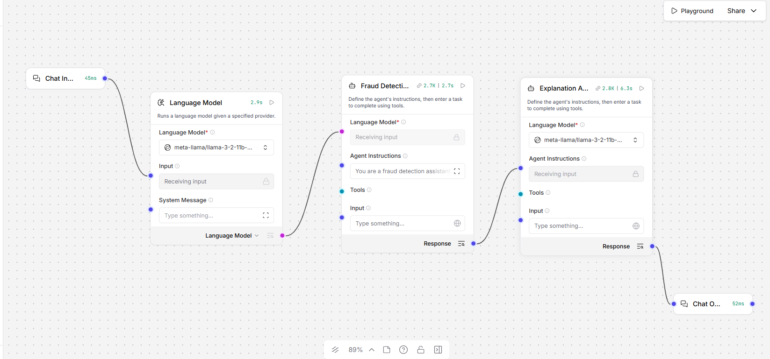
Langflow workflow -

Slide 8
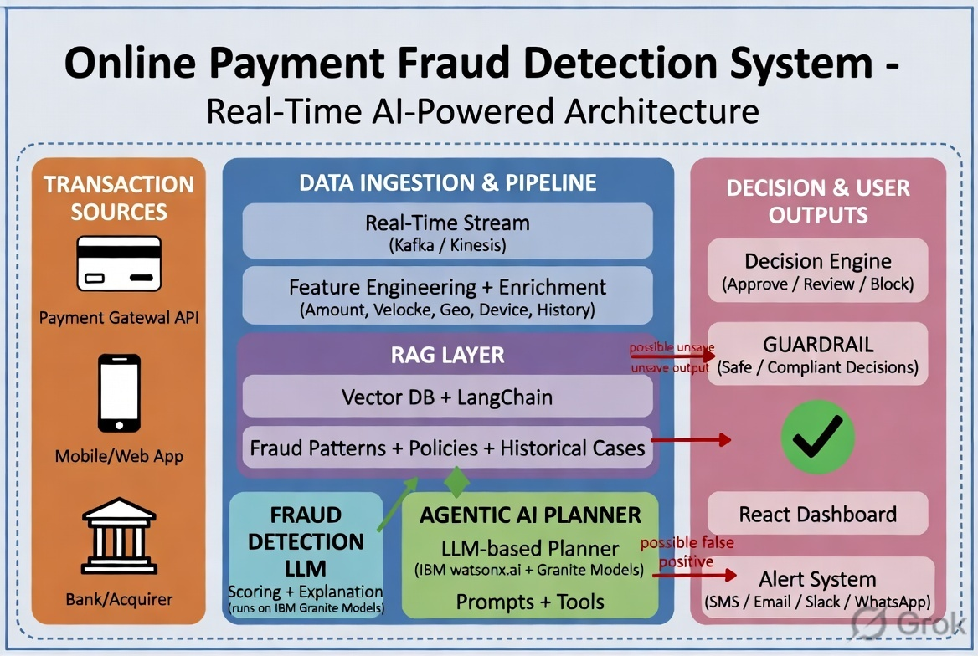
Architecture blueprint

Slide 9

Role of Agentic AI in the solution
Role of Agentic AI in Fraud Detection System
Agentic AI enables the Fraud Detection System to function as an intelligent, autonomous security system rather than a simple rule-based checker. Using IBM watsonx.ai and Granite models, it coordinates multiple specialized agents to analyze transactions and detect fraud in real time.
Each agent performs a specific role—such as processing transaction data, detecting suspicious patterns, assigning risk scores, and generating explanations—while working collaboratively. This multi-agent approach ensures faster processing, higher accuracy, and efficient fraud detection.
Agentic AI also provides context awareness, understanding transaction details like amount, type, and balance changes to identify unusual behavior. It can detect patterns such as sudden large transfers, abnormal balance drops, or inconsistent transaction flows.
Additionally, the system supports real-time adaptation, continuously improving its decisions based on new transaction data and evolving fraud patterns. Agents communicate with each other, enabling better coordination and more reliable outcomes.
Overall, Agentic AI makes the system proactive, adaptive, and intelligent, acting like a smart financial security assistant that helps prevent fraud, reduce financial losses, and enhance trust in digital payment systems.

Slide 10
Technology Used
Lang flow platform -Used for designing and orchestrating multi-agent workflows visually. It helps connect different agents (transaction analysis, fraud detection, risk scoring, explanation) in a structured pipeline.
IBM Granite Model (e.g., ibm-granite-3-2-8b)
Used for: Natural language understanding
IBM Cloud
Provides a secure and scalable infrastructure to: Deploy the fraud detection system
RAG (Retrieval-Augmented Generation)
Used to: Retrieve historical transaction patterns and fraud cases ,Combine real data with AI reasoning
Improve accuracy and trust in fraud detection
IBM watsonx.ai
Used for: Model deployment ,Generating embeddings for transaction data ,AI governance and monitoring.
Vector Database (FAISS / Chroma)
Stores: Transaction embeddings ,Fraud patterns and historical data
Enables: Fast similarity search Detection of anomalies and suspicious behavior

Slide 11
Novelty and Uniqueness
Unique Value Proposition: Fraud Detection System
The proposed Fraud Detection System stands out by combining Agentic AI, RAG, and real-time intelligence into a single powerful solution for financial security.
Multi-Agent Intelligence-Instead of a single rule-based system, multiple specialized agents collaborate to: Analyze transactions ,Detect fraud patterns
RAG-Based Accuracy-Integrates real-time data retrieval with AI reasoning:
Uses historical transaction data and fraud cases ,Reduces false positives
Context-Aware Detection-Understands transaction details such as: Amount ,Transaction type ,Balance changes
Real-Time Fraud Detection-Instantly classifies transactions as: Fraud Detected Transaction Safe Helps prevent fraud before financial damage occurs.
Multi-Modal Input – Supports text, voice, and image-based meal tracking for better usability.
Adaptive Learning System-Continuously improves using new transaction data ,Adapts to evolving fraud techniques
Scalable & Enterprise-Ready
Built on IBM watsonx.ai with Granite models, ensuring: Scalability ,Security ,AI governance.
This makes the system a smart, proactive, and adaptive financial security assistant, not just a basic fraud checker—capable of detecting fraud in real time while providing explainable and reliable insights.

Slide 12
Git Hub Link
GitHub URL – https://github.com/faraz-2023/Fraud-Detection-Data
·
·
·

Slide 13
Future Scope
Integration with Banking & Payment APIs –The system can be integrated with real-time banking APIs, payment gateways (UPI, cards, wallets), and transaction monitoring systems to collect live transaction data such as amount, location, device fingerprint, velocity, and account behavior. This integration enables the Fraud Detection Agent to make more accurate and dynamic risk assessments based on actual transaction patterns and user behavior.
2.AI-Powered Voice Assistant & Multilingual Support –
Enhancing the system with a voice-enabled assistant and support for multiple languages will improve accessibility for fraud teams and customers. Users and investigators can report suspicious transactions, receive alerts, or get explanations naturally in their preferred language, making the solution more inclusive and suitable for diverse populations, especially in regions with varied linguistic backgrounds like India.
·
·
·

Slide 14


